Slide 1
Theoretical Computer Science Christos Papadimitriou Columbia U.

Slide 2
(a Cultural Anthropology of) Theoretical Computer Science
did
Have you tried
reducing from SAT?

Slide 3
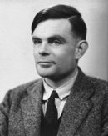
Alan M. Turing (1912 – 1954)
The “Turing machine”
(1936)
He used it to answer, in the negative, a key challenge of that time: “can math be automated?”

Slide 4
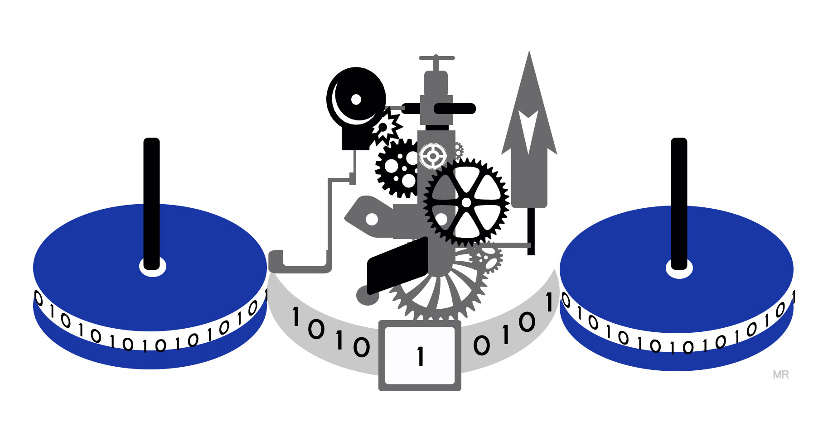
The Turing machine
Universality,
Turing-completeness

Slide 5
Alan M. Turing
He proved that there are computational problems that are unsolvable
He also studied the Mind…
…and saved the world

Slide 6
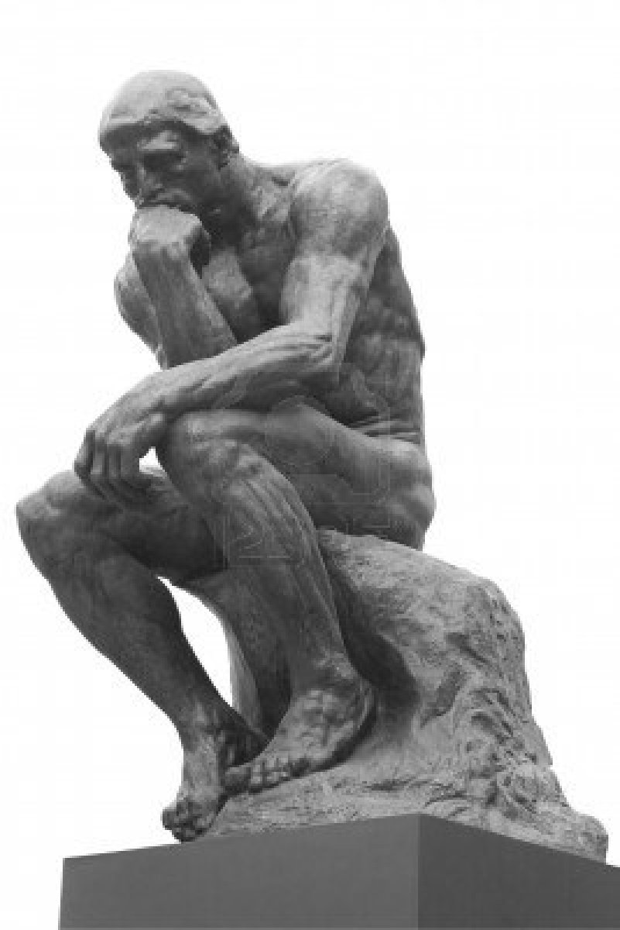
The halting problem
“will program P halt
if started on input X?”
Can you see why it is unsolvable?
CS was born
aware of its own limitations
(and with a sweet tooth
for math…)

Slide 7
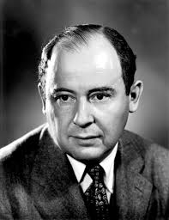
1946: Turing’s idea becomes reality
von Neumann
and the EDVAC

Slide 8
This Talk:
Computer Science 70 years later
Algorithms
Randomness
Complexity, P vs NP
Learning algorithms
CS and the sciences, incl. evolution
How might a computer scientist think about the Brain?

Slide 9
Computer Science 1946 – 2018: We’ve come a long way
Compilers Operating systems
Databases
Chips Machine learning
Graphics
Networks
Slick interfaces
Global information environment
Moore’s law
fast algorithms

Slide 10
Fast algorithms (“ what CS theorists do…”)
hides constants!
Multiplying two n by n matrices takes O(n³) operations
Can it be done faster?
yes! [Strassen 1969]: O(n^{2.81…})
half a century and a dozen consecutive
improvements later: O(n^{2.38…})
Lower bound? n² log n

Slide 11
Randomness is our friend!
To test if an integer n is a prime…
…check if it violates Fermat’s little theorem
n prime ➔ a^{n} = a (mod n) for all a < n
Algorithm: Choose a at random
repeat enough times to be sure (…)
Can also be solved deterministically in O(b⁸) steps, where b is the number of bits [AKS 2005]

Slide 12
By the way, random graphs are our friends too
Erdős – Renyi G_{n,p} model [1959]
n points, say 2000
probability p
(independent)
say .01

Slide 13
Back to primality being easy How about… factoring?
not a prime: 53809342579219227901
= ???????????? X ????????????
The best mathematicians in the world have worked on this problem for 2,500 years
The fastest known algorithm is exponential in the number of bits
Modern cryptography is based on the assumption that this problem is hard!
We also understand complexity -- and it is occasionally our friend too…

Slide 14
On the subject of Complexity: a bunch of numbers
7641, 3753, 9053, 1856, 6545, 2908, 7132, 5417, 9867, 4036, 5643, 2656, 4500, 7618
Add them:
84,764
Multiply them:
2,209,987,765,…,772,000
Partition them into
two equal parts?

Slide 15
Matching boys and girls
A perfect match, if one exists,
can be found in O(n^{2.5}) time

Slide 16
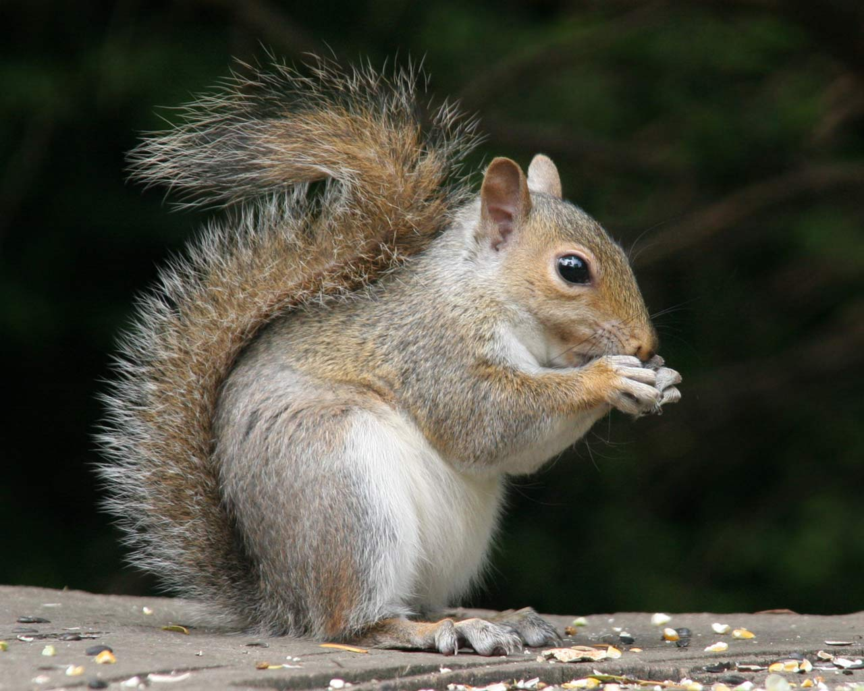
Matching boys and girls and pets?

Slide 17
The Facebook network
Am I within 6 hops
of everybody else?
easy to answer in O(n) time

Slide 18
The Facebook network
are there 60 people
who form a clique?

Slide 19
Another puzzle: the set cover problem
“Cover the whole alphabet with as few words as possible”
BOLD, ATAXIA, CAJAL, FIMBRIN, GABA, AXON, PYRAMIDAL, SEQUENT, SEIZURE, DORSAL, WERNICKE, KNOCK, LABYRINTH, GLIAL, FICK

Slide 20
An intriguing contrast…
Can be solved in polynomial time O(n), O(n³), etc.
Seem to require exponential time…
Primality
Shortest paths
The boy-girl matching problem
The minimum spanning tree problem
The set cover problem with words of length two
Factoring
The clique problem
The 3-way matching problem
The number splitting problem
The traveling salesman problem
The set cover problem

Slide 21
Not so obvious: Number splitting and matching are related!
Can you see why 3-way matching can be reduced to
number splitting?
Q: If you had an algorithm for number splitting, how would you solve 3-way matching?
A: Maybe arithmetize each boy-girl-pet triple as a sparse 0-1 vector? And then....

Slide 22
Factoring
The clique problem
The 3-way matching problem
Integer programming
The number splitting problem
The traveling salesman problem
The set cover problem
All seem to require exponential time
They are all equivalent!
NP-complete

Slide 23
Is P = NP?
NP = all problems that can be solved by exponential exhaustive search
P = those that can also be solved in polynomial time -- O(n), O(n³) etc.
NP-complete means: “the hardest problems in NP ”
Most researchers believe that P ≠ NP
That NP-complete problems are intractable

Slide 24
NP-completeness FAQ
did
Have you tried
reducing from SAT?
How many NP-complete problems are known?
How do you prove a problem NP-complete?
What was the first NP-complete problem?
And how about factoring?
What does NP-completeness mean in practice?
When will we know if P = NP?

Slide 25
Is P = NP?
How did Life start on Earth?
Is there a single equation that describes the universe?
How do our neurons and synapses give rise to our cognition and behavior?
Can exhaustive search for a solution always be avoided?

Slide 26
Soooo, Computer Science
Creator and curator of an essential technology
Fountainhead of one of the most fundamental questions in mathematics and arguably all of science
What else can it do?

Slide 27
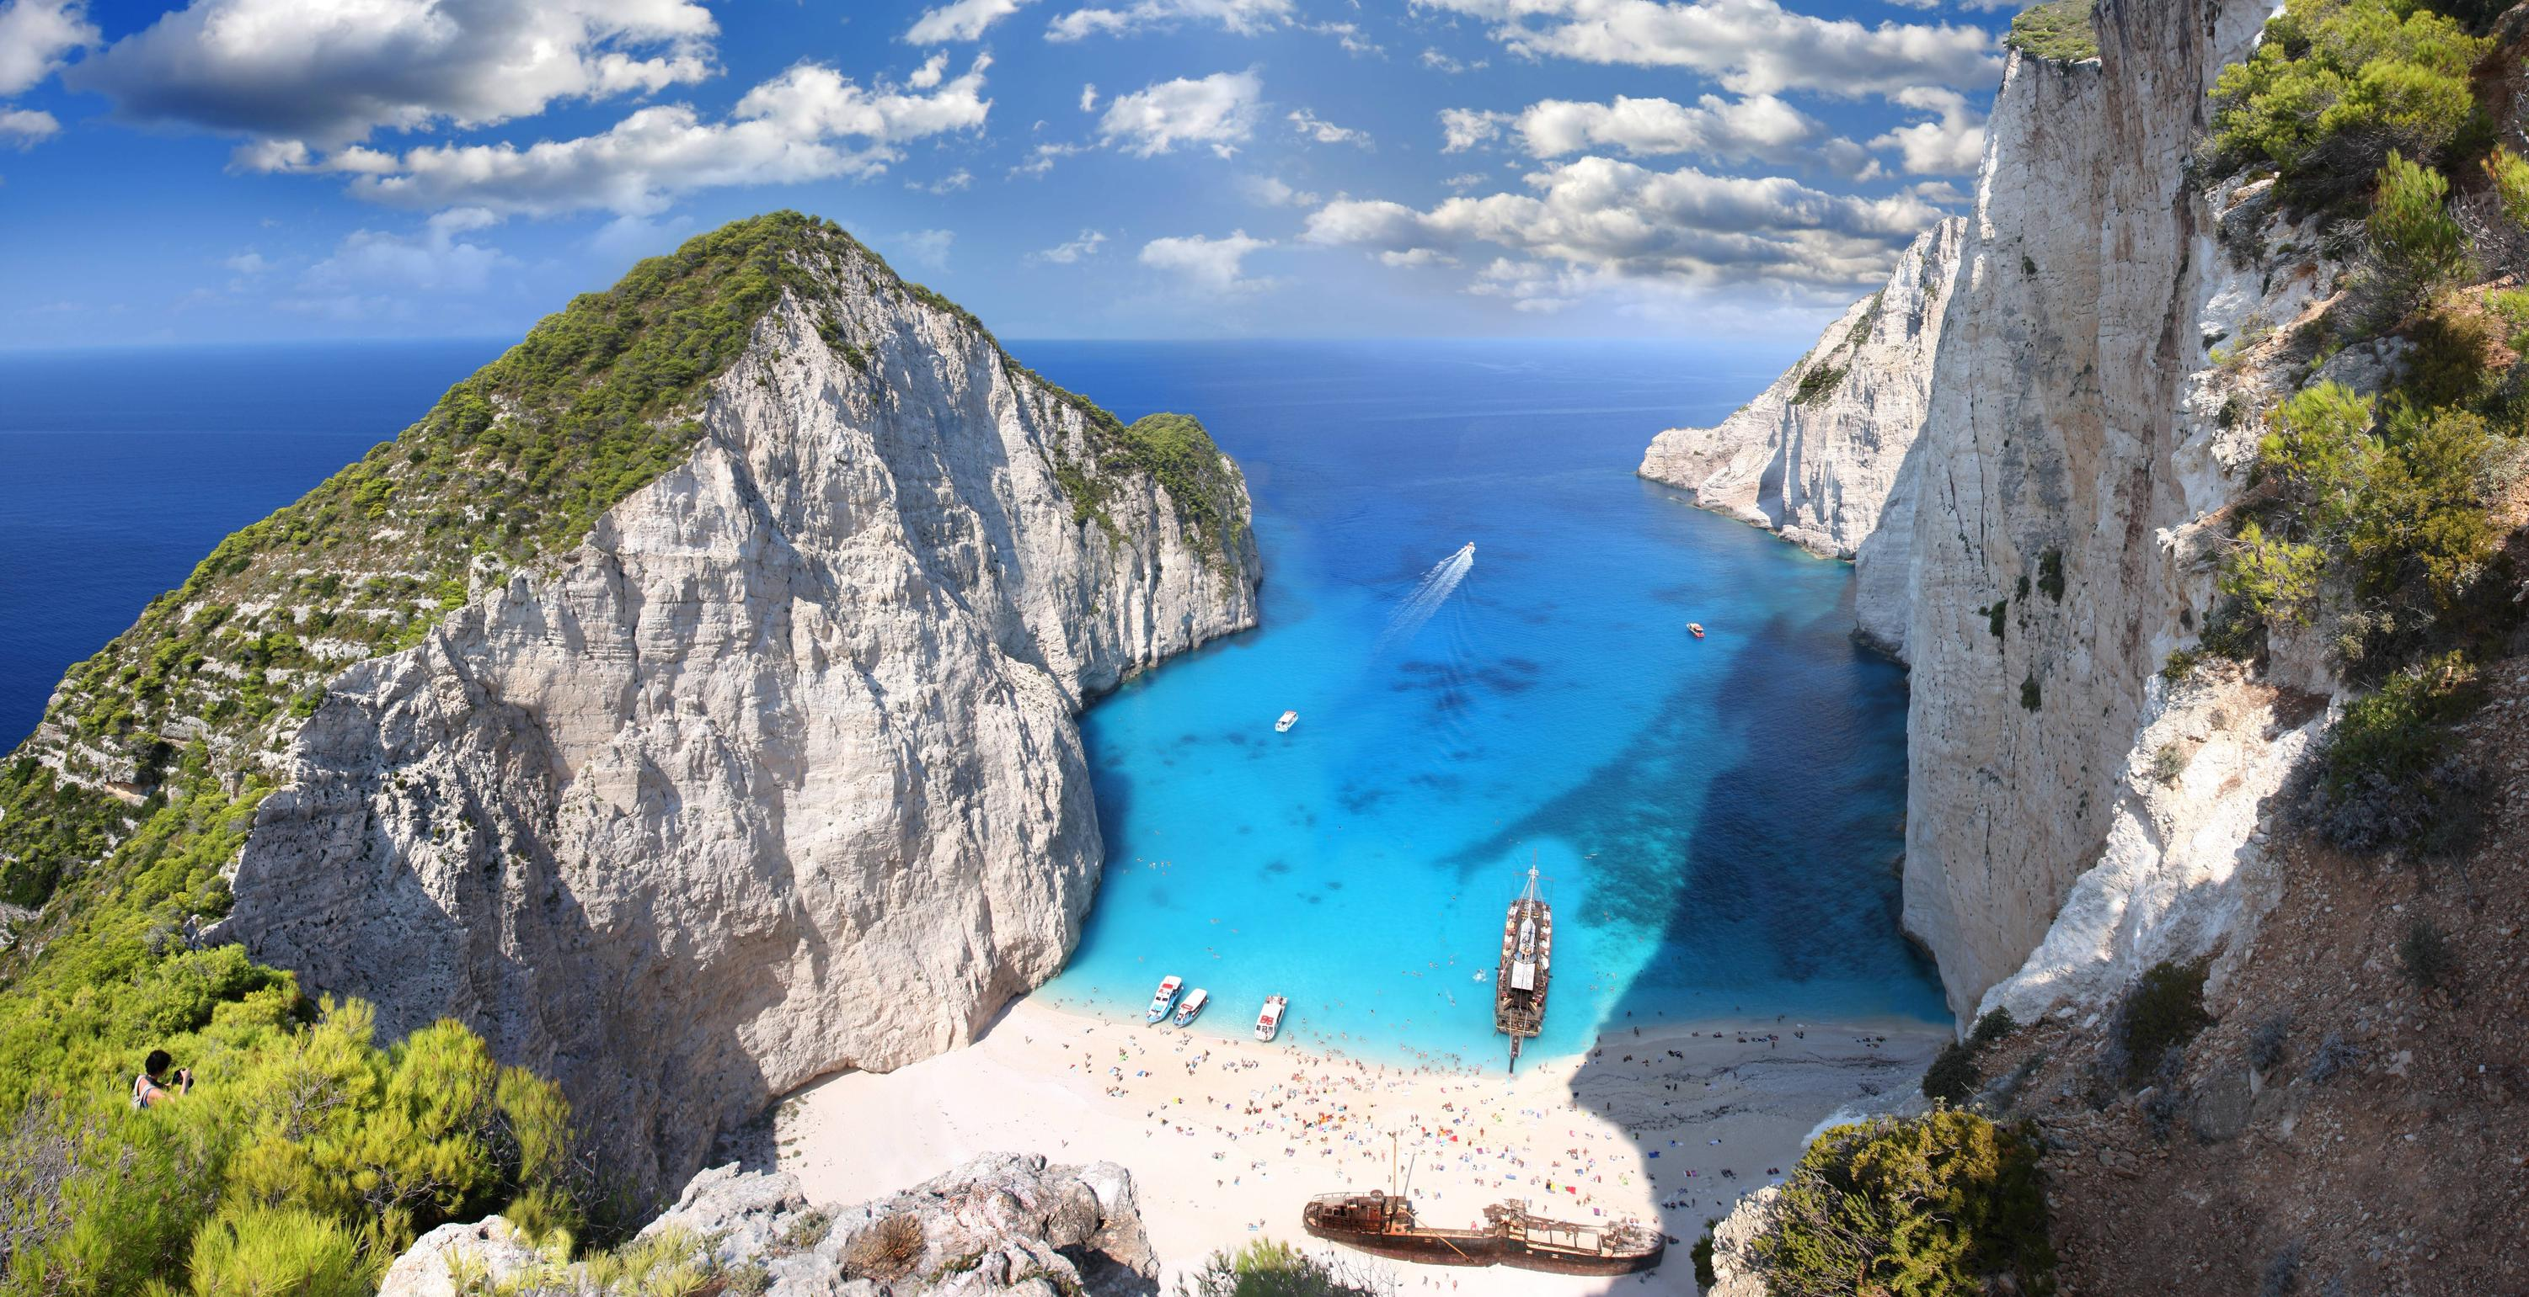
Next…
Learning algorithms
TCS and the sciences
TCS and Evolution
TCS and the Brain

Slide 28
Learning
Supervised
Unsupervised (next talk by Santosh…)
Semi-supervised
Reinforcement
…

Slide 29
Online Learning: the n experts problem

Slide 30
Online Learning: the n experts problem
+$.3 -$.1 +$.2 -.$9. -$.1. +$.7
Day 1:
Choose an expert

Slide 31
Online Learning: the n experts problem
+$.1 +$.8 -$.2 +$.3 -$.1. +$.1
Day 2:
Choose an expert

Slide 32
…and so on for T days…
NB: No distribution assumptions
In fact, we assume outcomes are adversarial
Q: Is there a “learning strategy” that gets you very close to the performance of the best expert after T days?

Slide 33
YES! The multiplicative weights algorithm
Start by giving all experts equal probabilities, p_{i}¹ = 1/n for all experts i
At each step update the probabilities by
p_{i}^{t+1} = p_{i}^{t} (1 + ε × outcome_{i})/Z^{t+1}
That is, boost a little the experts that did better at the expense of the others

Slide 34
Theorem: The multiplicative weights algorithm is guaranteed to perform in expectation within $√\log{n/T}$ of the best expert.
Also solves: convex programming, network congestion…

Slide 35
Perceptron Algorithm
A sequence of examples of the form (vector, ±)
We know that the + and the – are separated by a hyperplane
In fact, with some positive “margin” μ
Task: Find the hyperplane

Slide 36
Perceptron Algorithm (cont.)
Looking for the hyperplane $w⋅x>0$
Start with $w=0$
Repeat for each example $\left(x, ±\right):$
If mistake on $+, w←w+x$
If mistake on $−, w←w −x$
Theorem: If hyperplane exists, it will be found after at most $\frac{1}{μ^{2}}$ mistakes

Slide 37
+ + + + + + +
+ + + _ + +
+ + _ _ _ + +
+ + _ _ _ + + +
+ + _ + + +
+ + + + + + +
Trick: add new dimension $z=x^{2}+y^{2}$

Slide 38
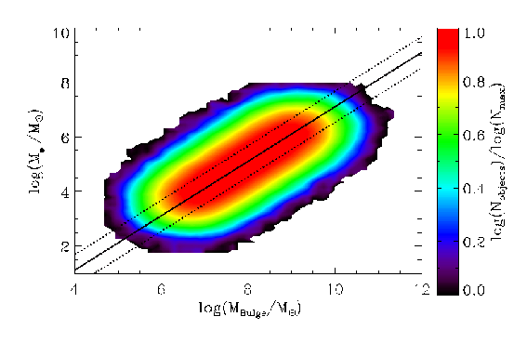
Learning a distribution
When is an apple tasty?
color
_ + _
_ + +
+ _
_ + + _
distribution D
labeled examples
f: R² {+, -}
class of “learning
hypotheses” H
diameter

Slide 39
Goal: probably approximately correct
We want to select one of the hypotheses h in H…
…such that, with probability 1 – δ,
Prob_{x ~ D} [h(x) = f(x)] > 1 - 𝜀
Realizability assumption: The data points do come from a hypothesis h in H

Slide 40
Goal: probably approximately correct (cont.)
Algorithm:
1. Draw from D a sample S of labeled points of the form (x, ±)
2. Find the hypothesis h in H that minimizes the number of misclassified points in S

Slide 41
Learning Theorems
Under the realizability assumption, [ln |H| + ln (1/ẟ)]/𝜺 samples suffice
Without realizability, we need more samples, by a factor of O(1/𝜺)
ln |H| can be replaced in the above by the VC-dimension of H

Slide 42
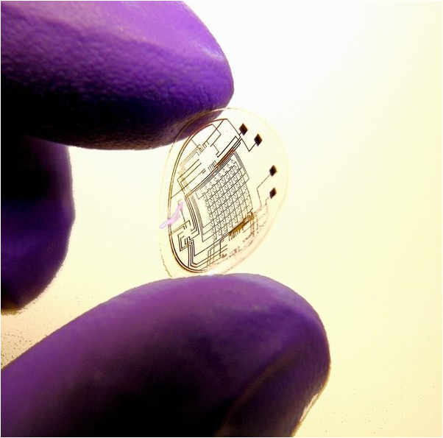
Computation as a Lens on the Sciences

Slide 43
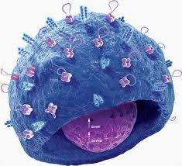
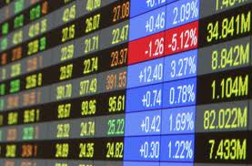
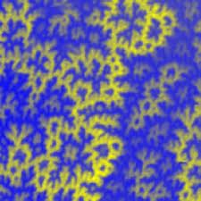
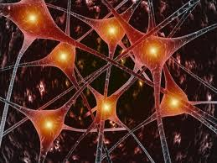
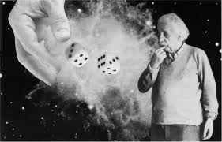
Computation is everywhere!

Slide 44
Statistical Physics and Algorithms
How does the
lake freeze?
The mystery
of phase
transitions
vs. the convergence of algorithms

Slide 45
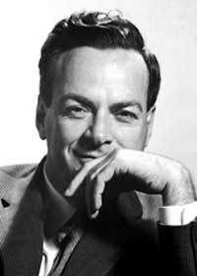
Quantum computation: Turning a question on its head
“Oh my God, how do you
simulate such a system
on a computer?”
Richard Feynman, 1983:
“But what if we built a computer
out of these things?”

Slide 46
How to factor a 1000-bit integer [Shor 1995] in ~1000 easy steps (on a quantum computer).
output
(measurement)
1000 bits
input
1000 bits
Superposition of
of 2¹⁰⁰⁰ states
maintained throughout

Slide 47
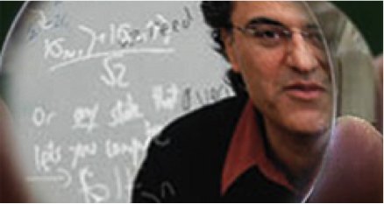
“Quantum computation is as much about testing Quantum Physics as it is about building powerful computers.”
Umesh Vazirani

Slide 48
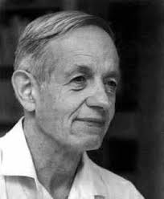
Equilibria in Economics
They exist in two-player
zero-sum games
[John von Neumann 1928]
[John Nash 1950]:
all games have one!

Slide 49
In markets too! Price equilibria (Arrow-Debreu 1954)
“The Nash equilibrium lies at the foundations of modern economic thought.”
Roger Myerson

Slide 50
Surprise!
Finding
equilibria
is an
intractable
problem!

Slide 51
And intractability means…
…the Nash equilibrium cannot be a useful prediction of the behavior of a group of people
“If your laptop can’t find it, neither can the market”
Kamal Jain

Slide 52
Evolution 150 years later: questions still unanswered
What is the role of recombination?
Why all this diversity?
Is Evolution optimizing something?

Slide 53
Evolution 150 years later, CS version
“What algorithm could have done
all this!
in a mere 10¹² steps?”

Slide 54
frequency of allele 1 at generation t
relative fitness of allele 1 in the present genetic environment
Evolution of a haploid population in the weak selection regime, gene with two alleles:
x^{t+1} = x^{t} (1 + s f₁^{t})/Z^{t+1}
The Multiplicative Weights algorithm!
Furthermore, x^{t+1} is the x that maximizes
ɸ(x) = Σ_{τ < t+1}(f₁^{τ} – f₂^{τ}) x + s⁻¹H(x)

Slide 55
Recall the questions still unanswered
What algorithm could have done
all this! in a mere 10¹² steps?
What is the role of sex?
Why all this diversity?
Is Evolution optimizing something?

Slide 56
Next: TCS
and the Brain

Slide 57
How does the Mind emerge from the Brain?

Slide 58
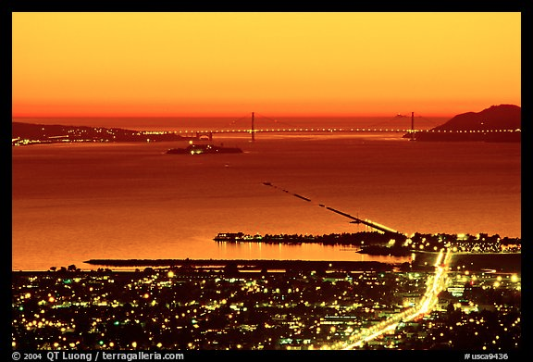
How does the Mind emerge from the Brain?

Slide 59
How does one think computationally about the Brain?

Slide 60
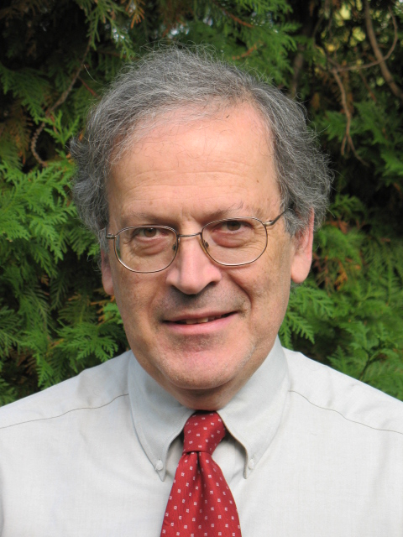
Good Question!
a computational theory
of the Brain is both possible and essential
[the way the brain works]
may be characterized by less
logical and arithmetical depth
than we are normally used to

Slide 61
David Marr (1945 – 1980)
The three-step program:
specs
hardware
algorithm

Slide 62
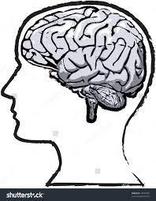
The Specs: [Ison et al. 2016]

Slide 63
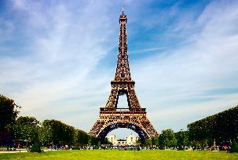

Slide 66
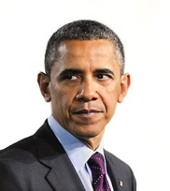

Slide 71
The Challenge:
These are the specs
What is the hardware?
What is the algorithm?

Slide 72
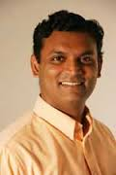
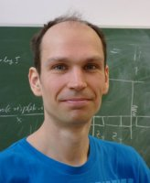
…joint work with…
Santosh Vempala
Georgia Tech
Wolfgang Maass
TU Graz
Robert Legenstein
TU Graz

Slide 73
Speculating on the Hardware
A little analysis first
They recorded from ~10² out of ~10⁷ MTL neurons in every subject
Showed ~10² pictures of familiar persons/places, with repetitions
each of ~10 neurons responded consistently to one image
Hmmmm...

Slide 74
Speculating on Hardware (cont.)
Each memory is represented by an assembly of many (perhaps ~ 10⁴ - 10⁵ ) neurons;
cf [Hebb 1949], [Buzsaki 2003, 2010]
Highly connected, therefore stable
It is somehow formed by sensory stimuli
Every time we think of this memory,
~ all these neurons fire

Slide 75
cells (or concept cells)

Slide 76
Algorithm?
How are assemblies formed?
How does association happen?
Let us formulate a conjecture

Slide 77
Assembly formation
assembly
stimulus

Slide 78
Association

Slide 79
[Pokorny et al. 2018], in submission
Simulations of a recurrent neural network model support the conjecture

Slide 80
cf: [al. et Axel, 2011] re: mouse olfaction
2

Slide 81
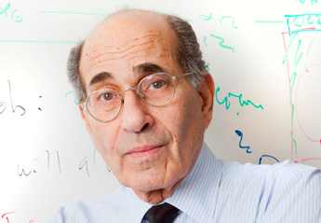
From the Discussion section of [al. et Axel]
An odorant may [cause] a small subset of … neurons [to fire].
This small fraction of ... cells would then generate sufficient recurrent excitation to recruit a larger population of neurons.
Inhibition triggered by this activity will prevent further firing
In the extreme, some cells could receive enough recurrent input to fire … without receiving [initial] input…

Slide 82
Mathematical Model
Two large sets of excitatory neurons: SC and MA
Synapses SC → MA and MA → MA form a random G_{n,p} directed graph
Discrete time
A set of SC neurons fire for a small number of steps T (the presentation of the stimulus)
At each time t, the set A_{t} of K neurons in MA that have the largest synaptic input (from SC or MA) will fire*
Hebbian Plasticity: If at time t cell i fires, and at time t + 1 cell j fires, the weight of synapse (i, j) increases by β

Slide 83
We can prove…
...the precise narrative of assembly formation in [al. et Axel]
Furthermore, after the sequence of presentations E, O, E + O, E, O, a small but non-vanishing set of cells in the E assembly will also respond to O, and vice-versa
(all with high probability…)

Slide 84
Stronger results under G_{n,p}++
[Song et al 2005]: reciprocity
and triangle completion
G_{n,p}++
p ~ 10⁻¹
G_{n,p}
p ~ 10⁻²

Slide 85
birthday
paradox

Slide 86
two questions of many
Can combinatorial completion biases such as G_{n,p}++ be a crucial part of the way the brain works?
Can a mechanism similar to the one described here be a part of the Brain circuit for building syntax trees?

Slide 87
Soooooo, Theoretical Computer Scientists
Algorithmic thinkers
Mathematicians at heart, they enjoy formulating and proving theorems
They know complexity and randomness
They like to explore interesting new areas and learn new tricks
Looking forward to interacting with you and learning from you!

Slide 88
Thank You!

Slide 89
As you set out for Ithaka hope the voyage is a long one, full of adventure, full of discovery. Laistrygonians and Cyclops, angry Poseidon—don’t be afraid of them: you’ll never find things like that on your way as long as you keep your thoughts raised high, as long as a rare excitement stirs your spirit and your body. Laistrygonians and Cyclops, wild Poseidon—you won’t encounter them unless you bring them along inside your soul, unless your soul sets them up in front of you.

Slide 90
Hope the voyage is a long one. May there be many a summer morning when, with what pleasure, what joy, you come into harbors seen for the first time; may you stop at Phoenician trading stations to buy fine things, mother of pearl and coral, amber and ebony, sensual perfume of every kind— as many sensual perfumes as you can; and may you visit many Egyptian cities to gather stores of knowledge from their scholars.

