Slide 1
Pseudorandom generators from pseudorandom multi-switching lemmas
Rocco Servedio
Columbia University
Li-Yang Tan
TTI
Simons Institute
UC Berkeley
March 2017
Notes:
Title: Two circuit lower bounds
We present two recent lower bounds on small-depth circuits.
The first lower bound deals with shallow monotone circuits of Majority gates (unweighted threshold gates). We show that for any d, a monotone depth-d circuit of Majority gates needs size 2^{n^{1/d}} to compute a particular explicit (monotone) weighted threshold function. This answers questions of Goldmann and Karpinski (1993) and Hastad (2010, 2014), and can be viewed as a step towards showing that monotone TC0 is not contained in monotone NC1.
The second lower bound gives a near-optimal size-depth tradeoff for circuits computing the “distance-k connectivity function” on graphs. Our lower bound here extends results of Beame, Impagliazzo and Pitassi (1993) and Rossman (2014) and may be viewed as giving evidence towards the optimality of Savitch’s small-space algorithm for directed s-t connectivity. This lower bound is proved via “random projections”, an extension of the classic technique of random restrictions that has recently proved useful in other contexts in circuit complexity.
Joint work with Xi Chen, Igor Oliveira, and Li-Yang Tan.

Slide 2



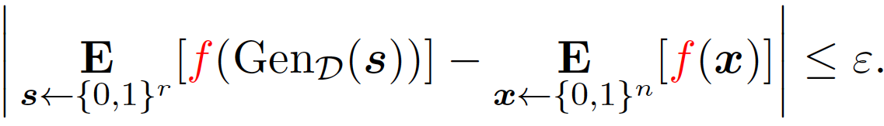
Background: Unconditional pseudorandomness
Pick your favorite circuit class C of n-variable Boolean circuits.
A PRG for C: efficient deterministic algorithm that maps uniform
r-bit strings (r<<n) to a distribution over n-bit strings that
“appears uniform random to every circuit in C”.
10100110
Circuit f in C
0 or 1
100100110110101101010100010100110
uniform r-bit seed
n-bit string
For every f in class C,

Slide 3
California dreaming
We’d love to have PRGs for class C = {all poly(n)-size circuits}.
But PRGs against C imply
circuit lower bounds against C; and, even stronger,
correlation bounds against C.
So without
proving new circuit lower bounds / correlation bounds, or
making computational hardness assumptions,
we can only hope for PRGs against circuit classes C where we have circuit lower bounds and correlation bounds.

Slide 4
Results-oriented introduction
This work:
Best possible pseudorandom generators
for “simple” types of Boolean functions
(given known circuit/correlation bounds).
. . . . . . .
….........
Sparse F₂ polynomials
Constant-depth circuits

Slide 5
Constant-depth circuits: AC⁰
….........
Complexity measured by
size M = # gates
depth d

Slide 6
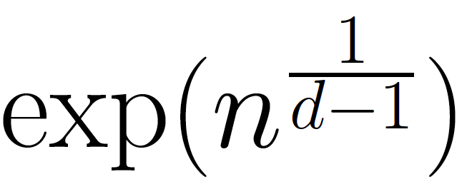

Constant-depth circuits
Strongest known circuit lower bounds for depth-d circuits: size (for e.g. the parity function)
….........
Given this state of the art for circuit lower bounds, best PRGs we can hope for would have seed length
to –fool size-M depth-d circuits.

Slide 7
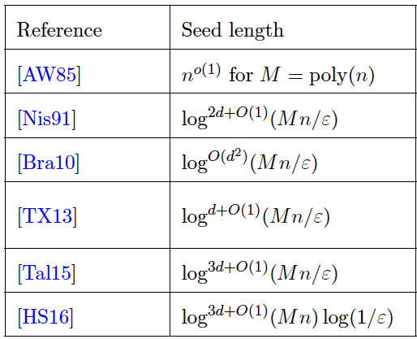
PRGS for constant-depth circuits: prior state-of-the-art
Right dependence on M
Right dependence on eps

Slide 8
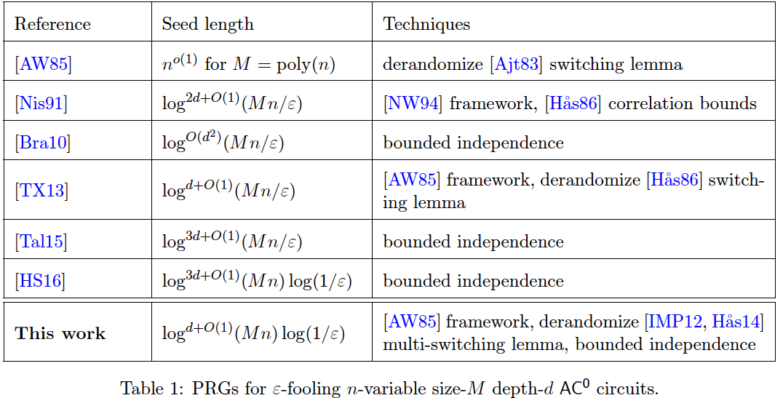
PRGS for constant-depth circuits: state-of-the-art

Slide 9
PRGS for constant-depth circuits: new state-of-the-art
Essentially matches best possible*
seed length. *given current circuit lower bounds

Slide 10
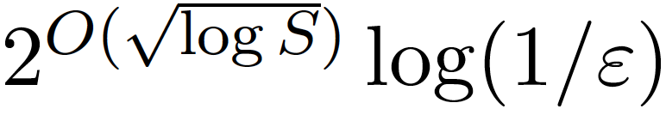
Second result: Sparse F₂ polynomials
S-sparse F₂ polynomial: a PARITY of
S many AND gates
. . . . . . .
Correlation bounds against log(n)-degree F₂ polynomials:
a longstanding unresolved challenge.
Given this obstacle, best achievable PRG would have seed length
to -fool S-sparse F₂ polynomials.

Slide 11
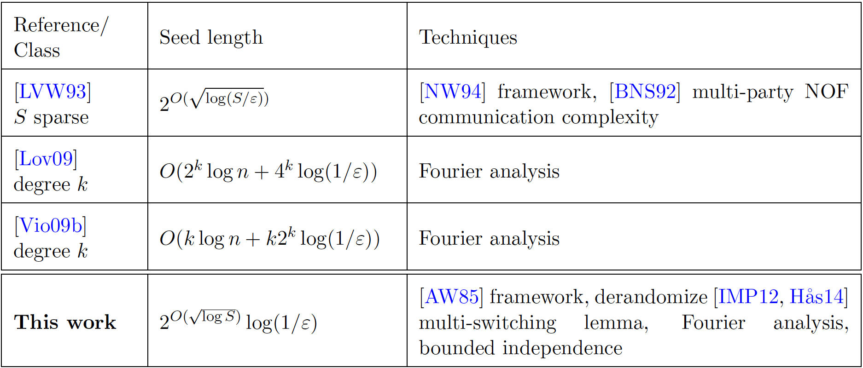
PRGS for S-sparse F₂ polynomials

Slide 12
PRGS for S-sparse F₂ polynomials:
New state-of-the-art
Matches best possible*
seed length. *given current correlation bounds

Slide 13
Techniques-oriented introduction
Main ingredient for new PRG results:
pseudorandom variants of recent multi-switching lemmas
due to [IMP12,Has14]

Slide 14

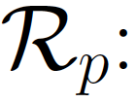
Restrictions
Restriction of function f: a mapping of input variables to 0,1,*
f(x₁ , x₂ , x₃ , x₄ , x₅ , x₆ , x₇ , x₈ , x₉ , x₁₀ , x₁₁ , x₁₂ , x₁₃ , x₁₄ , x₁₅)
. . .
. . .
. . .
f( 0 , 1 , x₃ , 0 , 0 , x₆ , x₇ , 1 , 0 , 0 , 1 , x₁₂ , 0 , x₁₄ , 1 )
Most commonly considered restrictions: truly random restrictions
0 w.p. (1-p)/2,
1 w.p. (1-p)/2,
x_{i} w.p. p
Each x_{i}

Slide 15
Switching lemmas
Under random restriction, DNFs “switch” to CNFs (and vice versa).
Most famous switching lemma:
Useful aspect of bound: for poly(n)-size CNF F, can take p=1/log(n).

Slide 16
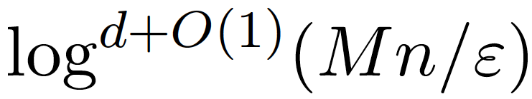
Pseudorandom switching lemmas: background
Pseudorandom restrictions: put down 0’s and 1’s, or choose locations of *s, in a randomness-efficient way.
[AW85]: first showed how pseudorandom switching lemmas → PRGs.
[TX13]: gave an optimal pseudorandom version of [H86] switching lemma (by “fooling its proof”).
Like [H86], can take p=1/log(n)
Led to -seed length PRG for AC⁰
(See also [GMRTV12], [GMR13], other works that give PRGs via PRSLs.)

Slide 17
Main techniques contribution
[TX13]: gave an optimal pseudorandom version of [H86] switching lemma (by “fooling its proof”).
We give a similar-in-spirit optimal derandomization
of a recent multi-switching lemma of [IMP12,H14]
(similarly, by “fooling its proof”).
Other ingredients for our AC⁰ PRG result:
[AW85] PRG framework, [HS16] result on bounded independence fooling AC⁰.
Other ingredients for our F₂ PRG result:
[AW85] PRG framework, [HS16], PRG of [Viola08, Lovett09] for low-degree F₂ polynomials.

Slide 18
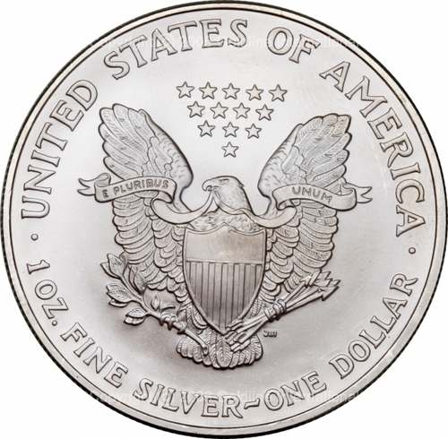
Quick sketch of other ingredient:
One stage of the iterative [AW85]-style PRG construction
Pseudorandom switching lemma:
(choice of stars)
(values of non-stars)
Cycle through all L’s in supp of pseudorandom distribution of stars
Cycle through all bitstrings y in supp of pseudorand. dist that δ-fools DTs
For each (L,y) pair, proceed to next stage. Each good (L,y) pair approximately preserves bias:
`
Fills in |L| ≈ pn coordinates, and preserves F’s bias up to O(δ).
(This is why we want to be able to take p to be large.)
Notes:
Say in words, this is not the only other ingredient; for AC0, there’s the HS16 improvement of bounded independence fooling AC0. We’ll see later how this comes in.

Slide 19
End of both introductions
Rest of talk: AC⁰.
Switching lemma and multi-switching lemma
Recall how [TX13] “fooled the proof” of [H86] switching lemma to get their pseudorandom switching lemma
Sketch of how we “fool the proof” of [H14] multi-switching lemma to get our pseudorandom multi-switching lemma
Notes:
Explicit function that requires any circuit size n^{\omega(1)}.
We don’t know how to prove 10n lower bound.
So, we look at restricted circuits.
Bound depth
Monotone circuits (for monotone functions)

Slide 20
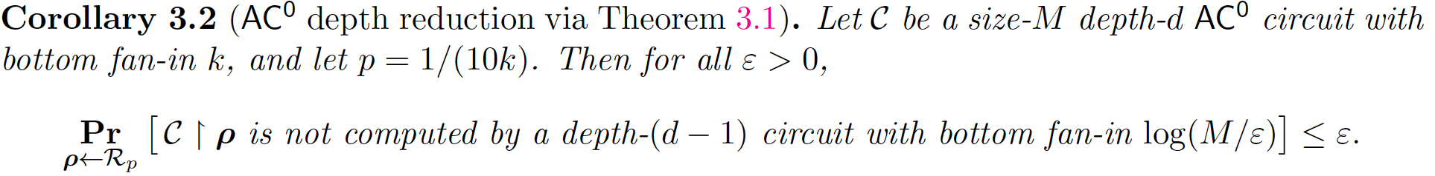
Switching lemmas and multi-switching lemmas
Recall [H86] switching lemma: analyzes a single CNF under random restriction.
Often used to analyze AC⁰ circuits:
….........
(Bottom fan-in depends on , hence so does p in later applications…)
Notes:
Explicit function that requires any circuit size n^{\omega(1)}.
We don’t know how to prove 10n lower bound.
So, we look at restricted circuits.
Bound depth
Monotone circuits (for monotone functions)

Slide 21
[H14] Multi-switching lemma: setup
[H14] multi-switching lemma: analyzes a collection of CNFs under random restriction.
Key notion: common partial decision tree.
Common l-partial DT for F₁,F₂,...,F_{m}:
T
such that
F₁ =
F₂ =
…......
F_{m} =
T
T
T
depth-l
…..................
depth-l
…..................
depth-l
…..................
Notes:
Explicit function that requires any circuit size n^{\omega(1)}.
We don’t know how to prove 10n lower bound.
So, we look at restricted circuits.
Bound depth
Monotone circuits (for monotone functions)

Slide 22
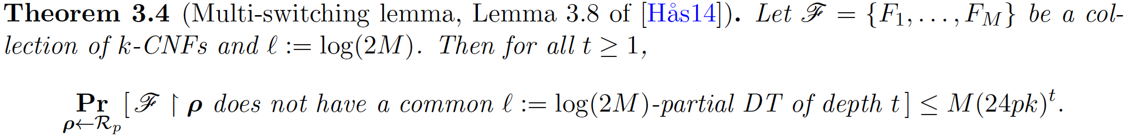
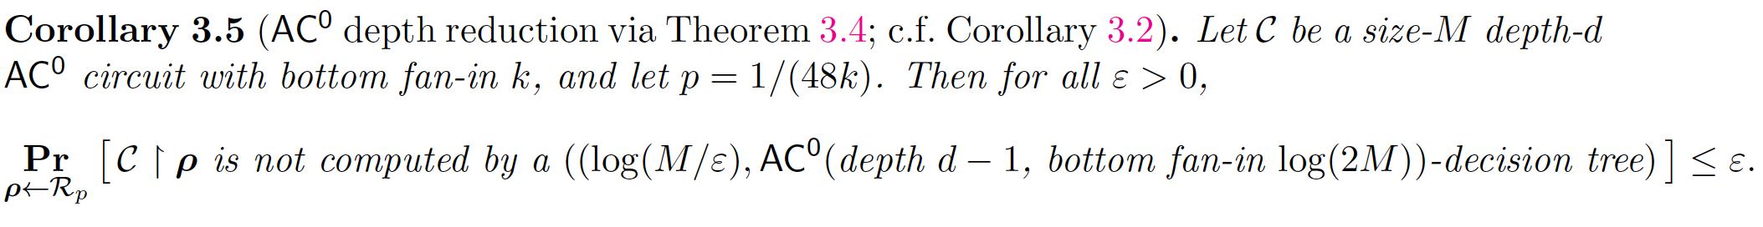

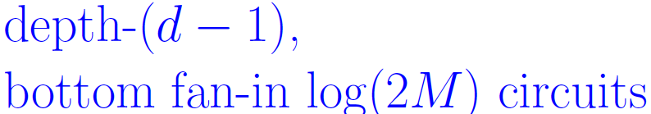
[H14] Multi-switching lemma
In context of AC⁰ circuits, this gives:
`
T
Now bottom fan-in of AC0 circuit is independent of ! So can repeat, and
take p in each stage independent of .
C₁ C₂ ...........................
Notes:
Explicit function that requires any circuit size n^{\omega(1)}.
We don’t know how to prove 10n lower bound.
So, we look at restricted circuits.
Bound depth
Monotone circuits (for monotone functions)

Slide 23
Quick recap of [TX13]
Notes:
Explicit function that requires any circuit size n^{\omega(1)}.
We don’t know how to prove 10n lower bound.
So, we look at restricted circuits.
Bound depth
Monotone circuits (for monotone functions)

Slide 24
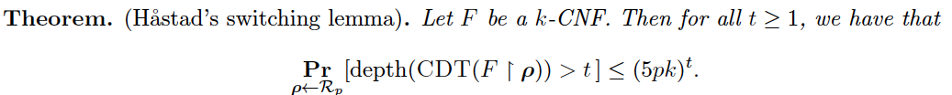
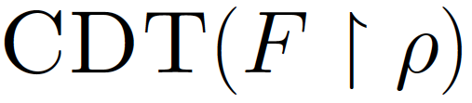
Setup for how [TX13] “fools the proof” of [H86] to get a pseudorandom switching lemma
Let CDT(F) = canonical decision tree for CNF F.
CDT(F): If the CNF is is constant, stop. Otherwise, pick first remaining clause, query all variables, simplify, and recurse. Resulting DT is CDT(F).)
[H86] switching lemma actually proves:
[TX13] pseudorandom switching lemma: exploits “computational simplicity” of how is constructed.
Notes:
Explicit function that requires any circuit size n^{\omega(1)}.
We don’t know how to prove 10n lower bound.
So, we look at restricted circuits.
Bound depth
Monotone circuits (for monotone functions)

Slide 25
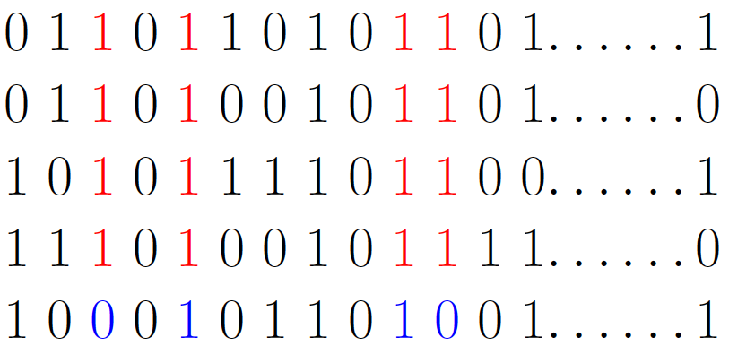

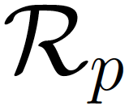
[TX13]: encoding restrictions with bit-strings
Restriction is an element of {0,1,*}^{n}:
[TX13] encode restriction as
element of {0,1}^{Y},
Y=[n] x [q], q=log(1/p) + 1:
log(1/p)
Uniform random element of {0,1}^{Y}: restriction from .
Pseudorandom element of of {0,1} ^{Y}: pseudorandom restriction.
Notes:
Explicit function that requires any circuit size n^{\omega(1)}.
We don’t know how to prove 10n lower bound.
So, we look at restricted circuits.
Bound depth
Monotone circuits (for monotone functions)

Slide 26
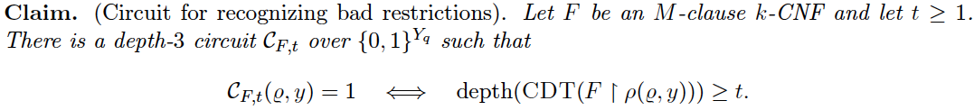

Key ingredient for [TX13]’s PRSL:
Recognizing bad restrictions for [H86] SL in AC⁰
By analyzing the construction of CDT(F), [TX13] show the following:
OR over depth-2 circuits: each one corresponds to possible deep path
in CDT
1 iff restriction is “bad”:
Depth-3
:
Encoding of restriction
This means: suffices to use pseudorandom distribution over {0,1}^{Y} that fools depth-3 circuits.
Notes:
Explicit function that requires any circuit size n^{\omega(1)}.
We don’t know how to prove 10n lower bound.
So, we look at restricted circuits.
Bound depth
Monotone circuits (for monotone functions)

Slide 27
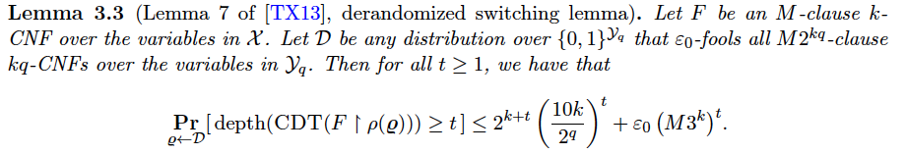
The [TX13] pseudorandom switching lemma
These depth-2 circuits corresponds to possible deep path in CDT
Iterating d times, this yields pseudorandom switching lemma for AC⁰_{d} which is plugged into [AW85] framework.
Notes:
Explicit function that requires any circuit size n^{\omega(1)}.
We don’t know how to prove 10n lower bound.
So, we look at restricted circuits.
Bound depth
Monotone circuits (for monotone functions)

Slide 28
Quick overview of our pseudorandom multi-switching lemma
We proceed analogously…but now using
[H14] multi-switching lemma
in place of
[H86] switching lemma.
Notes:
Explicit function that requires any circuit size n^{\omega(1)}.
We don’t know how to prove 10n lower bound.
So, we look at restricted circuits.
Bound depth
Monotone circuits (for monotone functions)

Slide 29
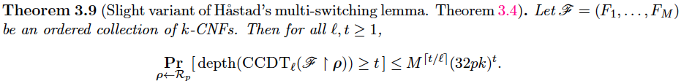


A helpful analogy
[H86], simplified:
[H14], simplified:
[H86], for real:
[H14], real:
: canonical common -partial DT for
Notes:
Explicit function that requires any circuit size n^{\omega(1)}.
We don’t know how to prove 10n lower bound.
So, we look at restricted circuits.
Bound depth
Monotone circuits (for monotone functions)

Slide 30

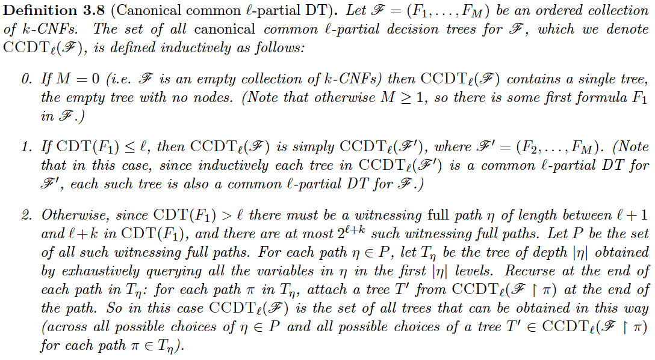

What is the canonical common -partial DT for ?
Analogous to CDT(F), but now for a collection of k-CNFs.
Notes:
Explicit function that requires any circuit size n^{\omega(1)}.
We don’t know how to prove 10n lower bound.
So, we look at restricted circuits.
Bound depth
Monotone circuits (for monotone functions)

Slide 31
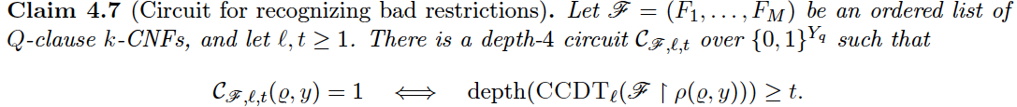

Key ingredient for our PRSL:
Recognizing bad restrictions for [H14] SL in AC⁰
Like [TX13], we encode restrictions as bit-strings in {0,1}^{Y}.
Careful analysis of CCDT construction yields the following:
OR over depth-3 circuits: each one corresponds to possible deep path
in CCDT
1 iff restriction is “bad”:
Depth-4
:
Encoding of restriction
So similar to before, suffices to use pseudorandom distribution over {0,1}^{Y} that fools depth-4 circuits.
Notes:
Explicit function that requires any circuit size n^{\omega(1)}.
We don’t know how to prove 10n lower bound.
So, we look at restricted circuits.
Bound depth
Monotone circuits (for monotone functions)

Slide 32
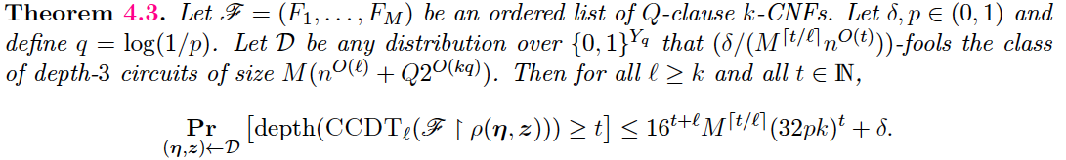
Our pseudorandom multi-switching lemma
Thanks to [HS16], suffices to take to be a bounded-independence distribution, and costs only one factor of log(1/eps) in seed length!
Notes:
Explicit function that requires any circuit size n^{\omega(1)}.
We don’t know how to prove 10n lower bound.
So, we look at restricted circuits.
Bound depth
Monotone circuits (for monotone functions)

Slide 33
Take-away
Gave a
pseudorandom variant of [IMP12,H14] multi-switching lemma
and used it (with some other ingredients) to achieve
PRGs for AC⁰, S-sparse F₂ polynomials
that are best possible
without proving new correlation bounds / circuit lower bounds.
Notes:
Explicit function that requires any circuit size n^{\omega(1)}.
We don’t know how to prove 10n lower bound.
So, we look at restricted circuits.
Bound depth
Monotone circuits (for monotone functions)

Slide 34
Thank you!

