Slide 1
Unifying logic and probability The BLOG language
Stuart Russell Computer Science Division, UC Berkeley Joint work with Brian Milch, David Sontag, Andrey Kolobov, Bhaskara Marthi, Lei Li, Siddharth Srivastava, Nimar Arora, Erik Sudderth, Paul Kidwell, David Moore, Kevin Mayeda, Steve Myers, Christopher Lin, Tony Dear, Ron Sun, Min Joon Seo

Slide 2
AI: intelligent systems in the real world

Slide 3
AI: intelligent systems in the real world
The world has things in it!!

Slide 4
AI: intelligent systems in the real world
The world has things in it!!
Good Old-Fashioned AI: first-order logic

Slide 5
Why did AI choose first-order logic?
Provides a declarative substrate
Learn facts, rules from observation and communication
Combine and reuse in arbitrary ways

Slide 6
Why did AI choose first-order logic?
Provides a declarative substrate
Learn facts, rules from observation and communication
Combine and reuse in arbitrary ways
Expressive enough for general-purpose intelligence
It provides concise models, essential for learning

Slide 7
Why did AI choose first-order logic?
Provides a declarative substrate
Learn facts, rules from observation and communication
Combine and reuse in arbitrary ways
Expressive enough for general-purpose intelligence
It provides concise models, essential for learning
E.g., rules of chess (32 pieces, 64 squares, ~100 moves)

Slide 8
Why did AI choose first-order logic?
Provides a declarative substrate
Learn facts, rules from observation and communication
Combine and reuse in arbitrary ways
Expressive enough for general-purpose intelligence
It provides concise models, essential for learning
E.g., rules of chess (32 pieces, 64 squares, ~100 moves)
~100 000 000 000 000 000 000 000 000 000 000 000 000 pages as a state-to-state transition matrix (cf HMMs, automata)
R.B.KB.RPPP..PPP..N..N…..PP….q.pp..Q..n..n..ppp..pppr.b.kb.r

Slide 9
Why did AI choose first-order logic?
Provides a declarative substrate
Learn facts, rules from observation and communication
Combine and reuse in arbitrary ways
Expressive enough for general-purpose intelligence
It provides concise models, essential for learning
E.g., rules of chess (32 pieces, 64 squares, ~100 moves)
~100 000 000 000 000 000 000 000 000 000 000 000 000 pages as a state-to-state transition matrix (cf HMMs, automata)
R.B.KB.RPPP..PPP..N..N…..PP….q.pp..Q..n..n..ppp..pppr.b.kb.r
~100 000 pages in propositional logic (cf circuits, graphical models)
WhiteKingOnC4@Move12

Slide 10
Why did AI choose first-order logic?
Provides a declarative substrate
Learn facts, rules from observation and communication
Combine and reuse in arbitrary ways
Expressive enough for general-purpose intelligence
It provides concise models, essential for learning
E.g., rules of chess (32 pieces, 64 squares, ~100 moves)
~100 000 000 000 000 000 000 000 000 000 000 000 000 pages as a state-to-state transition matrix (cf HMMs, automata)
R.B.KB.RPPP..PPP..N..N…..PP….q.pp..Q..n..n..ppp..pppr.b.kb.r
~100 000 pages in propositional logic (cf circuits, graphical models)
WhiteKingOnC4@Move12
1 page in first-order logic
∀x,y,t,color,piece On(color,piece,x,y,t) ⇔ …

Slide 11
AI: intelligent systems in the real world
The world has things in it!!
Good Old-Fashioned AI: first-order logic

Slide 12
AI: intelligent systems in the real world
The world has things in it!!
The world is uncertain!!
Good Old-Fashioned AI: first-order logic

Slide 13
AI: intelligent systems in the real world
The world has things in it!!
The world is uncertain!!
Good Old-Fashioned AI: first-order logic
Modern AI: probabilistic graphical models

Slide 14
Bayesian networks
Define distributions on all possible propositional worlds
Burglary
Earthquake
Alarm

Slide 15
Bayesian networks
Define distributions on all possible propositional worlds
Burglary
Earthquake
Alarm
P(B,E,A) = P(B) P(E) P(A | B, E)

Slide 16
Bayesian networks
Define distributions on all possible propositional worlds
0.003
0.002
Burglary
Earthquake
B | E | P(A|B,E)
F | F | 0.01
F | T | 0.4
T | F | 0.8
T | T | 0.9
Alarm
P(B,E,A) = P(B) P(E) P(A | B, E)

Slide 17
Bayesian networks
Define distributions on all possible propositional worlds
0.003
0.002
Burglary
Earthquake
B | E | P(A|B,E)
F | F | 0.01
F | T | 0.4
T | F | 0.8
T | T | 0.9
B | E | A | P(B,E,A)
F | F | F | 0.985
F | F | T | 0.00995
F | T | F | 0.0012
F | T | T | 0.0008
T | F | F | 0.0006
T | F | T | 0.0024
T | T | F | 0.0000006
T | T | T | 0.0000054
Alarm
P(B,E,A) = P(B) P(E) P(A | B, E)

Slide 18
Bayesian networks
Define distributions on all possible propositional worlds
0.003
0.002
Burglary
Earthquake
B | E | P(A|B,E)
F | F | 0.01
F | T | 0.4
T | F | 0.8
T | T | 0.9
B | E | A | P(B,E,A)
F | F | F | 0.985
F | F | T | 0.00995
F | T | F | 0.0012
F | T | T | 0.0008
T | F | F | 0.0006
T | F | T | 0.0024
T | T | F | 0.0000006
T | T | T | 0.0000054
Alarm
P(B,E,A) = P(B) P(E) P(A | B, E)

Slide 19
AI: intelligent systems in the real world
The world has things in it!!
The world is uncertain!!
Good Old-Fashioned AI: first-order logic
Modern AI: probabilistic graphical models

Slide 20
AI: intelligent systems in the real world
The world has things in it!!
The world is uncertain!!
Good Old-Fashioned AI: first-order logic
Modern AI: probabilistic graphical models
The world is uncertain!!

Slide 21
AI: intelligent systems in the real world
The world has things in it!!
The world is uncertain!!
Good Old-Fashioned AI: first-order logic
Modern AI: probabilistic graphical models
The world is uncertain!!
The world has things in it!!

Slide 22
AI: intelligent systems in the real world
The world has things in it!!
The world is uncertain!!
Good Old-Fashioned AI: first-order logic
Modern AI: probabilistic graphical models
The world is uncertain!!
The world has things in it!!
A New Dawn for AITM: first-order probabilistic languages

Slide 23
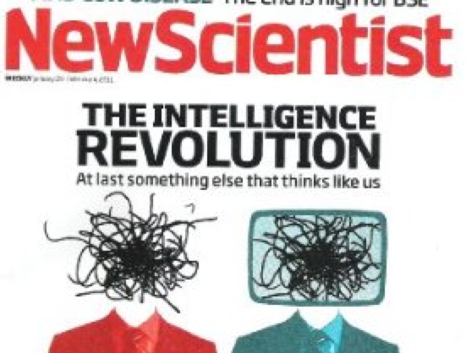
Anil Ananthaswamy, “I, Algorithm: A new dawn for AI,”
New Scientist, Jan 29, 2011
Notes:
Prompted by an overexcited press release from an east coast university whose initials are M.I.T.

Slide 24
First-order probabilistic languages
Simple idea (1990s): combine logical notation for random variables with Bayes net factorization idea

Slide 25
First-order probabilistic languages
Simple idea (1990s): combine logical notation for random variables with Bayes net factorization idea
Burglary(house)
Earthquake(Region(house))
Alarm(house)

Slide 26
First-order probabilistic languages
Simple idea (1990s): combine logical notation for random variables with Bayes net factorization idea
a
Burglary(house)
Earthquake(Region(house))
1
2
Alarm(house)
3
5
b
4

Slide 27
First-order probabilistic languages
Simple idea (1990s): combine logical notation for random variables with Bayes net factorization idea
Earthquake(R_{a})
Earthquake(R_{b})
B(H₁)
B(H₂)
B(H₃)
B(H₄)
B(H₅)
A(H₁)
A(H₂)
A(H₃)
A(H₄)
A(H₅)

Slide 28
First-order probabilistic languages
Simple idea (1990s): combine logical notation for random variables with Bayes net factorization idea
Earthquake(R_{a})
Earthquake(R_{b})
B(H₁)
B(H₂)
B(H₃)
B(H₄)
B(H₅)
A(H₁)
A(H₂)
A(H₃)
A(H₄)
A(H₅)

Slide 29
AI: intelligent systems in the real world
The world is uncertain and has things in it!!
A New Dawn for AITM: first-order probabilistic languages

Slide 30
AI: intelligent systems in the real world
The world has things in it and we don’t know what they are!!
A Newer Dawn for AITM: first-order open-universe probabilistic languages

Slide 31
An important distinction in logic
Closed-universe languages assume unique names and domain closure, i.e., known objects
Like Prolog, databases (Herbrand semantics)
Poole 93, Sato 97, Koller & Pfeffer 98, De Raedt 00, etc.
Open-universe languages allow uncertainty over the existence and identity of objects
Like full first-order logic
BLOG (Milch & Russell 05): declarative OUPM language
Probabilistic programming (Koller, McAllester, Pfeffer 97, Pfeffer 01, Goodman et al 08): distribution on execution traces of stochastic programs

Slide 32
A little test
Given
Bill = Father(William) and Bill = Father(Junior)
How many children does Bill have?
Closed-universe (Herbrand) semantics:
2
Open-universe (full first-order) semantics:
Between 1 and ∞

Slide 33
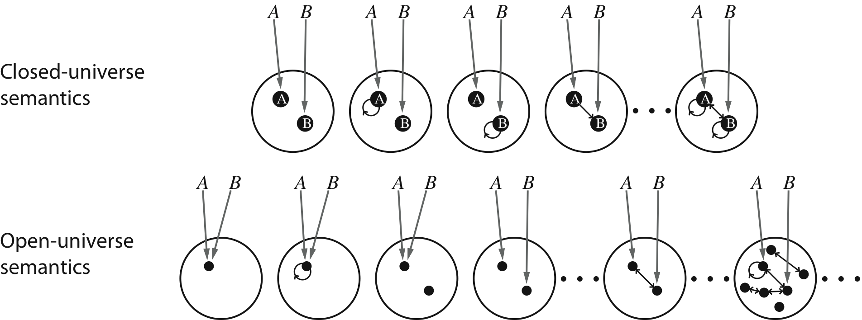
Open-universe semantics
Possible worlds for a language with two constant
symbols A and B and one relation symbol
but how can we define P on Ω ??

Slide 34
Bayes nets build propositional worlds
Burglary
Earthquake
Alarm

Slide 35
Bayes nets build propositional worlds
Burglary
Earthquake
Alarm
Burglary

Slide 36
Bayes nets build propositional worlds
Burglary
Earthquake
Alarm
Burglary
not Earthquake

Slide 37
Bayes nets build propositional worlds
Burglary
Earthquake
Alarm
Burglary
not Earthquake
Alarm

Slide 38
Open-universe models in BLOG
Construct worlds using two kinds of steps, proceeding in topological order:
Dependency statements: Set the value of a function or relation on its arguments, conditioned on parent values
Alarm(h) ~ CPT[..](Burglary(h), Earthquake(Region(h)))
Number statements: Add some objects to the world, conditioned on what objects and relations exist so far
#GeologicalFaultRegion ~ Uniform{1…10}
#House(Region=r) ~ Poisson(50)
Origin function

Slide 39
Semantics
Objects are defined by type, origin, number:
<GeologicalFaultRegion, ,3>
<House,<Region, <GeologicalFaultRegion, ,3>>, 97>
Each basic random variable is a function or predicate symbol indexed by a tuple of objects:
Earthquake_{<<GeologicalFaultRegion, ,3>>}(ω)
Each possible world ω specifies values for all number variables and basic random variables
Probability of ω is given by the product of conditional probabilities specified in the model
Notes:
The last point holds because objects contain their generation history, so there is a unique generation path to any world.

Slide 40
Semantics contd.
Probability of ω is given by the product of conditional probabilities specified in the model
This holds because the generation path for any world is unique
Which holds because objects contain their generation history
(Which would not be true if we used the standard objects of model theory, o₁, o₂, o₃, o₄,…)

Slide 41
Semantics contd.
Every well-formed* BLOG model specifies a unique proper probability distribution over all possible worlds definable given its vocabulary
* No infinite receding ancestor chains; no conditioned cycles; all expressions finitely evaluable; functions of countable sets

Slide 42
Citation information extraction
Given: a set of text strings from reference lists:
[Lashkari et al 94] Collaborative Interface Agents, Yezdi Lashkari, Max Metral, and Pattie Maes, Proceedings of the Twelfth National Conference on Articial Intelligence, MIT Press, Cambridge, MA, 1994.
Metral M. Lashkari, Y. and P. Maes. Collaborative interface agents. In Conference of the American Association for Artificial Intelligence, Seattle, WA, August 1994
Decide:
What papers and researchers exist
For each paper
The real title
The real authors
The papers it cites

Slide 43
BLOG model (single-author)
#Researcher ~ LogNormal[6.9,2.3]();
Name(r) ~ CensusDB_NamePrior();
#Paper(Author=r) ~
if Prof(r) then LogNormal[3.5,1.2]()
else LogNormal[2.3,1.2]()
Title(p) ~ CSPaperDB_TitlePrior();
PubCited(c) ~ Uniform({Paper p});
Text(c) ~ NoisyCitationGrammar (Name(Author(PubCited(c))),
Title(PubCited(c)));

Slide 44
BLOG model (single-author)
#Researcher ~ LogNormal[6.9,2.3]();
Name(r) ~ CensusDB_NamePrior();
#Paper(Author=r) ~
if Prof(r) then LogNormal[3.5,1.2]()
else LogNormal[2.3,1.2]()
Title(p) ~ CSPaperDB_TitlePrior();
PubCited(c) ~ Uniform({Paper p});
Text(c) ~ NoisyCitationGrammar (Name(Author(PubCited(c))),
Title(PubCited(c)));

Slide 45
BLOG model (single-author)
#Researcher ~ LogNormal[6.9,2.3]();
Name(r) ~ CensusDB_NamePrior();
#Paper(Author=r) ~
if Prof(r) then LogNormal[3.5,1.2]()
else LogNormal[2.3,1.2]()
Title(p) ~ CSPaperDB_TitlePrior();
PubCited(c) ~ Uniform({Paper p});
Text(c) ~ NoisyCitationGrammar (Name(Author(PubCited(c))),
Title(PubCited(c)));

Slide 46
BLOG model (single-author)
#Researcher ~ LogNormal[6.9,2.3]();
Name(r) ~ CensusDB_NamePrior();
#Paper(Author=r) ~
if Prof(r) then LogNormal[3.5,1.2]()
else LogNormal[2.3,1.2]()
Title(p) ~ CSPaperDB_TitlePrior();
PubCited(c) ~ Uniform({Paper p});
Text(c) ~ NoisyCitationGrammar (Name(Author(PubCited(c))),
Title(PubCited(c)));

Slide 47
How to use BLOG
Write model
Supply data (e.g., citation strings)
Ask query (e.g., what papers exist, who wrote them, what is the citation graph?)
(wait a long time)

Slide 48
Fraction of citation clusters imperfectly recovered
0.25
CiteSeer
0.20
0.15
0.10
0.05
0.00
Reinforce
Face
Reason
Constraint
Four data sets of ~300-500 citations, referring to ~150-300 papers

Slide 49
Fraction of citation clusters imperfectly recovered
0.25
CiteSeer
BLOG model
0.20
0.15
0.10
0.05
0.00
Reinforce
Face
Reason
Constraint
Four data sets of ~300-500 citations, referring to ~150-300 papers

Slide 50
BLOG Example Library
PCFG for simple English
Simplified 3D vision
Hurricane prediction
Burglary
Balls and urns (counting)
Sybil attack (cybersecurity)
Students and grades
Topic models (LDA)
Citation information extraction
Competing workshops
Galaxy model
Infinite mixture of Gaussians
Monopoly (invisible opponent)
Blackjack
Multi-target tracking
HMM for genetic sequences
Weather forecasting
Video background subtraction
Financial volatility
Autoregression time series
Kalman filter
Infinite-state HMM
Notes:
A wide variety of models, no significant representational obstacles

Slide 51
BLOG Example Library
PCFG for simple English
Simplified 3D vision
Hurricane prediction
Burglary
Balls and urns (counting)
Sybil attack (cybersecurity)
Students and grades
Topic models (LDA)
Citation information extraction
Competing workshops
Galaxy model
Infinite mixture of Gaussians
Monopoly (invisible opponent)
Blackjack
Multi-target tracking
HMM for genetic sequences
Weather forecasting
Video background subtraction
Financial volatility
Autoregression time series
Kalman filter
Infinite-state HMM
Notes:
Several known statistical models including the counting model for population estimation

Slide 52
BLOG Example Library
PCFG for simple English
Simplified 3D vision
Hurricane prediction
Burglary
Balls and urns (counting)
Sybil attack (cybersecurity)
Students and grades
Topic models (LDA)
Citation information extraction
Competing workshops
Galaxy model
Infinite mixture of Gaussians
Monopoly (invisible opponent)
Blackjack
Multi-target tracking
HMM for genetic sequences
Weather forecasting
Video background subtraction
Financial volatility
Autoregression time series
Kalman filter
Infinite-state HMM
Notes:
More substantial models, including citation information extraction, 3x more accurate than CiteSeer (2002)

Slide 53
Multi-target tracking + data association
#Aircraft(EntryTime = t) ~ Poisson(λ_{a});
Exits(a,t) if InFlight(a,t) then ~ Boolean(α_{e});
InFlight(a,t) = (t == EntryTime(a)) |(InFlight(a,t-1) & !Exits(a,t-1));
X(a,t) if t = EntryTime(a) then ~ InitState() elseif InFlight(a,t) then ~ Normal(F*X(a,t-1),Σ_{x});
#Blip(Source=a, Time=t) if InFlight(a,t) then
~ Bernoulli(DetectionProbability(X(a,t)));
#Blip(Time=t) ~ Poisson(λ_{f});
Z(b) if Source(b)=null then ~ Uniform(R) else ~ Normal(H*X(Source(b),Time(b)),Σ_{z});

Slide 54
BLOG Example Library
PCFG for simple English
Simplified 3D vision
Hurricane prediction
Burglary
Balls and urns (counting)
Sybil attack (cybersecurity)
Students and grades
Topic models (LDA)
Citation information extraction
Competing workshops
Galaxy model
Infinite mixture of Gaussians
Monopoly (invisible opponent)
Blackjack
Multi-target tracking
HMM for genetic sequences
Weather forecasting
Video background subtraction
Financial volatility
Autoregression time series
Kalman filter
Infinite-state HMM
Notes:
Some vision models

Slide 55
BLOG Example Library
PCFG for simple English
Simplified 3D vision
Hurricane prediction
Burglary
Balls and urns (counting)
Sybil attack (cybersecurity)
Students and grades
Topic models (LDA)
Citation information extraction
Competing workshops
Galaxy model
Infinite mixture of Gaussians
Monopoly (invisible opponent)
Blackjack
Multi-target tracking
HMM for genetic sequences
Weather forecasting
Video background subtraction
Financial volatility
Autoregression time series
Kalman filter
Infinite-state HMM
Notes:
Some decision models including partially observable Monopoly where you don’t know where your opponent is or what properties he owns

Slide 56
Inference
Theorem: BLOG inference algorithms (rejection sampling, importance sampling, MCMC) converge* to correct posteriors for any well-formed model, for any finitely evaluable first-order query
Algorithms dynamically construct finite partial worlds with ground-atom variables directly relevant to query and evidence

Slide 57
Why MCMC?
Works for any* model
No model-specific mathematical work required
Small space requirement
Metropolis-Hastings step involves computing the acceptance ratio π(x’)q(x|x’) / π(x)q(x’|x); everything cancels except local changes
Query evaluation on states is also incrementalizable (cf DB systems)
Notes:
Microsoft’s infer.net is a closed-universe first-order language serving hundreds of millions of users every day with recommendations, TrueSkill, etc.

Slide 58
Digression: Probabilistic programming
A probabilistic program is an ordinary stochastic program that defines a probability over each possible execution trace given its inputs
Since programs can construct objects, different executions may generate different numbers of objects; hence PPLs are “open-universe”
Most PPLs require the user program to build data structures for possible worlds

Slide 59
Digression: Probabilistic programming
(define num-regions (mem (lambda () (uniform 1 3))))
(define-record-type region (fields index))
(define regions (map (lambda (i) (make-region i))
(iota (num-regions)))
(define num-houses (mem (lambda (r) (uniform 0 4))))
(define-record-type house (fields fault-region index))
(define houses (map (lambda (r)
(map (lambda (i) (make-house r i))
(iota (num-houses r)))) regions)))
(define earthquake (mem (lambda (r) (flip 0.002))))
(define burglary (mem (lambda (h) (flip 0.003))))
(define alarm (mem (lambda (h)
(if (burglary h)
(if (earthquake (house-fault-region h))
(flip 0.9) (flip 0.8))
(if (earthquake (house-fault-region h))
(flip 0.4) (flip 0.01))))

Slide 60
Digression: Probabilistic programming
(define num-regions (mem (lambda () (uniform 1 3))))
(define-record-type region (fields index))
(define regions (map (lambda (i) (make-region i))
(iota (num-regions)))
(define num-houses (mem (lambda (r) (uniform 0 4))))
(define-record-type house (fields fault-region index))
(define houses (map (lambda (r)
(map (lambda (i) (make-house r i))
(iota (num-houses r)))) regions)))
(define earthquake (mem (lambda (r) (flip 0.002))))
(define burglary (mem (lambda (h) (flip 0.003))))
(define alarm (mem (lambda (h)
(if (burglary h)
(if (earthquake (house-fault-region h))
(flip 0.9) (flip 0.8))
(if (earthquake (house-fault-region h))
(flip 0.4) (flip 0.01))))

Slide 61
MCMC on values
Earthquake(R_{a})
Earthquake(R_{b})
B(H₁)
B(H₂)
B(H₃)
B(H₄)
B(H₅)
A(H₁)
A(H₂)
A(H₃)
A(H₄)
A(H₅)
Earthquake(R_{a})
Earthquake(R_{b})
B(H₁)
B(H₂)
B(H₃)
B(H₄)
B(H₅)
A(H₁)
A(H₂)
A(H₃)
A(H₄)
A(H₅)
Earthquake(R_{a})
Earthquake(R_{b})
B(H₁)
B(H₂)
B(H₃)
B(H₄)
B(H₅)
A(H₁)
A(H₂)
A(H₃)
A(H₄)
A(H₅)
Earthquake(R_{a})
Earthquake(R_{b})
B(H₁)
B(H₂)
B(H₃)
B(H₄)
B(H₅)
A(H₁)
A(H₂)
A(H₃)
A(H₄)
A(H₅)
Notes:
“Ordinary” MCMC, for inferring values of variables. Each big oval is a possible world with values for all variables.

Slide 62
MCMC on values
Earthquake(R_{a})
Earthquake(R_{b})
B(H₁)
B(H₂)
B(H₃)
B(H₄)
B(H₅)
A(H₁)
A(H₂)
A(H₃)
A(H₄)
A(H₅)
Earthquake(R_{a})
Earthquake(R_{b})
B(H₁)
B(H₂)
B(H₃)
B(H₄)
B(H₅)
A(H₁)
A(H₂)
A(H₃)
A(H₄)
A(H₅)
Earthquake(R_{a})
Earthquake(R_{b})
B(H₁)
B(H₂)
B(H₃)
B(H₄)
B(H₅)
A(H₁)
A(H₂)
A(H₃)
A(H₄)
A(H₅)
Earthquake(R_{a})
Earthquake(R_{b})
B(H₁)
B(H₂)
B(H₃)
B(H₄)
B(H₅)
A(H₁)
A(H₂)
A(H₃)
A(H₄)
A(H₅)
Notes:
In the current world we select a variable, resample its value, and move to a new world

Slide 63
MCMC on values
Earthquake(R_{a})
Earthquake(R_{b})
B(H₁)
B(H₂)
B(H₃)
B(H₄)
B(H₅)
A(H₁)
A(H₂)
A(H₃)
A(H₄)
A(H₅)
Earthquake(R_{a})
Earthquake(R_{b})
B(H₁)
B(H₂)
B(H₃)
B(H₄)
B(H₅)
A(H₁)
A(H₂)
A(H₃)
A(H₄)
A(H₅)
Earthquake(R_{a})
Earthquake(R_{b})
B(H₁)
B(H₂)
B(H₃)
B(H₄)
B(H₅)
A(H₁)
A(H₂)
A(H₃)
A(H₄)
A(H₅)
Earthquake(R_{a})
Earthquake(R_{b})
B(H₁)
B(H₂)
B(H₃)
B(H₄)
B(H₅)
A(H₁)
A(H₂)
A(H₃)
A(H₄)
A(H₅)
Notes:
The process repeats indefinitely, and the query is answered according to the statistics of the answers in the worlds visited

Slide 64
MCMC on values
Earthquake(R_{a})
Earthquake(R_{b})
B(H₁)
B(H₂)
B(H₃)
B(H₄)
B(H₅)
A(H₁)
A(H₂)
A(H₃)
A(H₄)
A(H₅)
Earthquake(R_{a})
Earthquake(R_{b})
B(H₁)
B(H₂)
B(H₃)
B(H₄)
B(H₅)
A(H₁)
A(H₂)
A(H₃)
A(H₄)
A(H₅)
Earthquake(R_{a})
Earthquake(R_{b})
B(H₁)
B(H₂)
B(H₃)
B(H₄)
B(H₅)
A(H₁)
A(H₂)
A(H₃)
A(H₄)
A(H₅)
Earthquake(R_{a})
Earthquake(R_{b})
B(H₁)
B(H₂)
B(H₃)
B(H₄)
B(H₅)
A(H₁)
A(H₂)
A(H₃)
A(H₄)
A(H₅)

Slide 65
MCMC on values
Earthquake(R_{a})
Earthquake(R_{b})
B(H₁)
B(H₂)
B(H₃)
B(H₄)
B(H₅)
A(H₁)
A(H₂)
A(H₃)
A(H₄)
A(H₅)
Earthquake(R_{a})
Earthquake(R_{b})
B(H₁)
B(H₂)
B(H₃)
B(H₄)
B(H₅)
A(H₁)
A(H₂)
A(H₃)
A(H₄)
A(H₅)
Earthquake(R_{a})
Earthquake(R_{b})
B(H₁)
B(H₂)
B(H₃)
B(H₄)
B(H₅)
A(H₁)
A(H₂)
A(H₃)
A(H₄)
A(H₅)
Earthquake(R_{a})
Earthquake(R_{b})
B(H₁)
B(H₂)
B(H₃)
B(H₄)
B(H₅)
A(H₁)
A(H₂)
A(H₃)
A(H₄)
A(H₅)

Slide 66
Earthquake(R_{a})
Earthquake(R_{b})
B(H₁)
B(H₂)
B(H₃)
B(H₄)
B(H₅)
A(H₁)
A(H₂)
A(H₃)
A(H₄)
A(H₅)
Earthquake(R_{a})
Earthquake(R_{b})
B(H₁)
B(H₂)
B(H₃)
B(H₄)
B(H₅)
A(H₁)
A(H₂)
A(H₃)
A(H₄)
A(H₅)
Earthquake(R_{a})
Earthquake(R_{b})
B(H₁)
B(H₂)
B(H₃)
B(H₄)
B(H₅)
Earthquake(R_{a})
Earthquake(R_{b})
A(H₁)
A(H₂)
A(H₃)
A(H₄)
A(H₅)
B(H₁)
B(H₂)
B(H₃)
B(H₄)
B(H₅)
Earthquake(R_{a})
Earthquake(R_{b})
A(H₁)
A(H₂)
A(H₃)
A(H₄)
A(H₅)
B(H₁)
B(H₂)
B(H₃)
B(H₄)
B(H₅)
Earthquake(R_{a})
Earthquake(R_{b})
A(H₁)
A(H₂)
A(H₃)
A(H₄)
A(H₅)
B(H₁)
B(H₂)
B(H₃)
B(H₄)
B(H₅)
A(H₁)
A(H₂)
A(H₃)
A(H₄)
A(H₅)
Earthquake(R_{a})
Earthquake(R_{b})
B(H₁)
B(H₂)
B(H₃)
B(H₄)
B(H₅)
A(H₁)
A(H₂)
A(H₃)
A(H₄)
A(H₅)
Earthquake(R_{a})
Earthquake(R_{b})
B(H₁)
B(H₂)
B(H₃)
B(H₄)
B(H₅)
A(H₁)
A(H₂)
A(H₃)
A(H₄)
A(H₅)
Earthquake(R_{a})
Earthquake(R_{b})
B(H₁)
B(H₂)
B(H₃)
B(H₄)
B(H₅)
A(H₁)
A(H₂)
A(H₃)
A(H₄)
A(H₅)
Earthquake(R_{a})
Earthquake(R_{b})
B(H₁)
B(H₂)
B(H₃)
B(H₄)
B(H₅)
A(H₁)
A(H₂)
A(H₃)
A(H₄)
A(H₅)
Earthquake(R_{a})
Earthquake(R_{b})
B(H₁)
B(H₂)
B(H₃)
B(H₄)
B(H₅)
A(H₁)
A(H₂)
A(H₃)
A(H₄)
A(H₅)
Earthquake(R_{a})
Earthquake(R_{b})
B(H₁)
B(H₂)
B(H₃)
B(H₄)
B(H₅)
A(H₁)
A(H₂)
A(H₃)
A(H₄)
A(H₅)
Notes:
In BLOG, we can also be uncertain about relations, e.g., which earthquake fault is close to each house. Each large rectangle represents one setting for this relation.

Slide 67
Earthquake(R_{a})
Earthquake(R_{b})
B(H₁)
B(H₂)
B(H₃)
B(H₄)
B(H₅)
A(H₁)
A(H₂)
A(H₃)
A(H₄)
A(H₅)
Earthquake(R_{a})
Earthquake(R_{b})
B(H₁)
B(H₂)
B(H₃)
B(H₄)
B(H₅)
A(H₁)
A(H₂)
A(H₃)
A(H₄)
A(H₅)
Earthquake(R_{a})
Earthquake(R_{b})
B(H₁)
B(H₂)
B(H₃)
B(H₄)
B(H₅)
Earthquake(R_{a})
Earthquake(R_{b})
A(H₁)
A(H₂)
A(H₃)
A(H₄)
A(H₅)
B(H₁)
B(H₂)
B(H₃)
B(H₄)
B(H₅)
Earthquake(R_{a})
Earthquake(R_{b})
A(H₁)
A(H₂)
A(H₃)
A(H₄)
A(H₅)
B(H₁)
B(H₂)
B(H₃)
B(H₄)
B(H₅)
Earthquake(R_{a})
Earthquake(R_{b})
A(H₁)
A(H₂)
A(H₃)
A(H₄)
A(H₅)
B(H₁)
B(H₂)
B(H₃)
B(H₄)
B(H₅)
A(H₁)
A(H₂)
A(H₃)
A(H₄)
A(H₅)
Earthquake(R_{a})
Earthquake(R_{b})
B(H₁)
B(H₂)
B(H₃)
B(H₄)
B(H₅)
A(H₁)
A(H₂)
A(H₃)
A(H₄)
A(H₅)
Earthquake(R_{a})
Earthquake(R_{b})
B(H₁)
B(H₂)
B(H₃)
B(H₄)
B(H₅)
A(H₁)
A(H₂)
A(H₃)
A(H₄)
A(H₅)
Earthquake(R_{a})
Earthquake(R_{b})
B(H₁)
B(H₂)
B(H₃)
B(H₄)
B(H₅)
A(H₁)
A(H₂)
A(H₃)
A(H₄)
A(H₅)
Earthquake(R_{a})
Earthquake(R_{b})
B(H₁)
B(H₂)
B(H₃)
B(H₄)
B(H₅)
A(H₁)
A(H₂)
A(H₃)
A(H₄)
A(H₅)
Earthquake(R_{a})
Earthquake(R_{b})
B(H₁)
B(H₂)
B(H₃)
B(H₄)
B(H₅)
A(H₁)
A(H₂)
A(H₃)
A(H₄)
A(H₅)
Earthquake(R_{a})
Earthquake(R_{b})
B(H₁)
B(H₂)
B(H₃)
B(H₄)
B(H₅)
A(H₁)
A(H₂)
A(H₃)
A(H₄)
A(H₅)
Notes:
We can flip the relation, causing a change in dependency structure among the variables; wander around a bit there, then flip again

Slide 68
Earthquake(R_{a})
Earthquake(R_{b})
B(H₁)
B(H₂)
B(H₃)
B(H₄)
B(H₅)
A(H₁)
A(H₂)
A(H₃)
A(H₄)
A(H₅)
Earthquake(R_{a})
Earthquake(R_{b})
B(H₁)
B(H₂)
B(H₃)
B(H₄)
B(H₅)
A(H₁)
A(H₂)
A(H₃)
A(H₄)
A(H₅)
Earthquake(R_{a})
Earthquake(R_{b})
B(H₁)
B(H₂)
B(H₃)
B(H₄)
B(H₅)
Earthquake(R_{a})
Earthquake(R_{b})
A(H₁)
A(H₂)
A(H₃)
A(H₄)
A(H₅)
B(H₁)
B(H₂)
B(H₃)
B(H₄)
B(H₅)
Earthquake(R_{a})
Earthquake(R_{b})
A(H₁)
A(H₂)
A(H₃)
A(H₄)
A(H₅)
B(H₁)
B(H₂)
B(H₃)
B(H₄)
B(H₅)
Earthquake(R_{a})
Earthquake(R_{b})
A(H₁)
A(H₂)
A(H₃)
A(H₄)
A(H₅)
B(H₁)
B(H₂)
B(H₃)
B(H₄)
B(H₅)
A(H₁)
A(H₂)
A(H₃)
A(H₄)
A(H₅)
Earthquake(R_{a})
Earthquake(R_{b})
B(H₁)
B(H₂)
B(H₃)
B(H₄)
B(H₅)
A(H₁)
A(H₂)
A(H₃)
A(H₄)
A(H₅)
Earthquake(R_{a})
Earthquake(R_{b})
B(H₁)
B(H₂)
B(H₃)
B(H₄)
B(H₅)
A(H₁)
A(H₂)
A(H₃)
A(H₄)
A(H₅)
Earthquake(R_{a})
Earthquake(R_{b})
B(H₁)
B(H₂)
B(H₃)
B(H₄)
B(H₅)
A(H₁)
A(H₂)
A(H₃)
A(H₄)
A(H₅)
Earthquake(R_{a})
Earthquake(R_{b})
B(H₁)
B(H₂)
B(H₃)
B(H₄)
B(H₅)
A(H₁)
A(H₂)
A(H₃)
A(H₄)
A(H₅)
Earthquake(R_{a})
Earthquake(R_{b})
B(H₁)
B(H₂)
B(H₃)
B(H₄)
B(H₅)
A(H₁)
A(H₂)
A(H₃)
A(H₄)
A(H₅)
Earthquake(R_{a})
Earthquake(R_{b})
B(H₁)
B(H₂)
B(H₃)
B(H₄)
B(H₅)
A(H₁)
A(H₂)
A(H₃)
A(H₄)
A(H₅)

Slide 69
B(H₁)
A(H₁)
B(H₂)
A(H₂)
B(H₃)
A(H₃)
B(H₄)
A(H₄)
B(H₅)
A(H₅)
B(H₁)
A(H₁)
B(H₂)
A(H₂)
B(H₃)
A(H₃)
B(H₄)
A(H₄)
B(H₅)
A(H₅)
B(H₁)
A(H₁)
B(H₂)
A(H₂)
B(H₃)
A(H₃)
B(H₄)
A(H₄)
B(H₅)
A(H₅)
B(H₁)
A(H₁)
B(H₂)
A(H₂)
B(H₃)
A(H₃)
B(H₄)
A(H₄)
B(H₅)
A(H₅)
B(H₁)
A(H₁)
B(H₂)
A(H₂)
B(H₃)
A(H₃)
B(H₄)
A(H₄)
B(H₅)
A(H₅)
B(H₁)
A(H₁)
B(H₂)
A(H₂)
B(H₃)
A(H₃)
B(H₄)
A(H₄)
B(H₅)
A(H₅)
B(H₁)
A(H₁)
B(H₂)
A(H₂)
B(H₃)
A(H₃)
B(H₄)
A(H₄)
B(H₅)
A(H₅)
B(H₁)
B(H₂)
B(H₃)
B(H₄)
B(H₅)
A(H₅)
B(H₁)
B(H₂)
B(H₃)
B(H₄)
B(H₅)
A(H₅)
A(H₁)
A(H₂)
A(H₃)
A(H₄)
A(H₁)
A(H₂)
A(H₃)
A(H₄)
B(H₁)
A(H₁)
B(H₂)
A(H₂)
B(H₃)
A(H₃)
B(H₄)
A(H₄)
B(H₅)
A(H₅)
B(H₁)
A(H₁)
B(H₂)
A(H₂)
B(H₃)
A(H₃)
B(H₄)
A(H₄)
B(H₅)
A(H₅)
B(H₁)
A(H₁)
B(H₂)
A(H₂)
B(H₃)
A(H₃)
B(H₄)
A(H₄)
B(H₅)
A(H₅)
B(H₁)
A(H₁)
B(H₂)
A(H₂)
B(H₃)
A(H₃)
B(H₄)
A(H₄)
B(H₅)
A(H₅)
B(H₁)
B(H₂)
B(H₃)
B(H₄)
A(H₄)
B(H₅)
A(H₅)
B(H₁)
B(H₂)
B(H₃)
B(H₄)
B(H₅)
A(H₅)
A(H₁)
A(H₂)
A(H₃)
B(H₁)
B(H₂)
B(H₃)
B(H₄)
B(H₅)
B(H₄)
B(H₅)
A(H₁)
A(H₂)
A(H₃)
A(H₄)
B(H₃)
B(H₄)
B(H₅)
A(H₁)
A(H₂)
A(H₃)
A(H₄)
A(H₅)
B(H₁)
A(H₁)
B(H₂)
A(H₂)
B(H₃)
A(H₃)
A(H₄)
A(H₅)
B(H₁)
A(H₁)
B(H₂)
A(H₂)
A(H₃)
A(H₄)
A(H₅)
B(H₁)
A(H₁)
B(H₂)
A(H₂)
B(H₃)
A(H₃)
B(H₄)
A(H₄)
B(H₅)
A(H₅)
B(H₁)
A(H₁)
B(H₂)
A(H₂)
B(H₃)
A(H₃)
B(H₄)
A(H₄)
B(H₅)
A(H₅)
B(H₁)
A(H₁)
B(H₂)
A(H₂)
B(H₃)
A(H₃)
B(H₄)
A(H₄)
B(H₅)
A(H₅)
B(H₁)
A(H₁)
B(H₂)
A(H₂)
B(H₃)
A(H₃)
B(H₄)
A(H₄)
B(H₅)
A(H₅)
B(H₁)
A(H₁)
B(H₂)
A(H₂)
B(H₃)
A(H₃)
B(H₄)
A(H₄)
B(H₅)
A(H₅)
B(H₁)
A(H₁)
B(H₂)
A(H₂)
B(H₃)
A(H₃)
B(H₄)
A(H₄)
B(H₅)
A(H₅)
B(H₁)
A(H₁)
B(H₂)
A(H₂)
B(H₃)
A(H₃)
B(H₄)
A(H₄)
B(H₅)
A(H₅)
B(H₁)
A(H₁)
B(H₂)
A(H₂)
B(H₃)
A(H₃)
B(H₄)
A(H₄)
B(H₅)
A(H₅)
B(H₁)
A(H₁)
B(H₂)
A(H₂)
B(H₃)
A(H₃)
B(H₄)
A(H₄)
B(H₅)
A(H₅)
B(H₁)
A(H₁)
B(H₂)
A(H₂)
B(H₃)
A(H₃)
B(H₄)
A(H₄)
B(H₅)
A(H₅)
B(H₁)
A(H₁)
B(H₂)
A(H₂)
B(H₃)
A(H₃)
B(H₄)
A(H₄)
B(H₅)
A(H₅)
B(H₁)
A(H₁)
B(H₂)
A(H₂)
B(H₃)
A(H₃)
B(H₄)
A(H₄)
B(H₅)
A(H₅)
B(H₁)
A(H₁)
B(H₂)
A(H₂)
B(H₃)
A(H₃)
B(H₄)
A(H₄)
B(H₅)
A(H₅)
B(H₁)
A(H₁)
B(H₂)
A(H₂)
B(H₃)
A(H₃)
B(H₄)
A(H₄)
B(H₅)
A(H₅)
B(H₁)
A(H₁)
B(H₂)
A(H₂)
B(H₃)
A(H₃)
B(H₄)
A(H₄)
B(H₅)
A(H₅)
B(H₁)
A(H₁)
B(H₂)
A(H₂)
B(H₃)
A(H₃)
B(H₄)
A(H₄)
B(H₅)
A(H₅)
B(H₁)
A(H₁)
B(H₂)
A(H₂)
B(H₃)
A(H₃)
B(H₄)
A(H₄)
B(H₅)
A(H₅)
B(H₁)
A(H₁)
B(H₂)
A(H₂)
B(H₃)
A(H₃)
B(H₄)
A(H₄)
B(H₅)
A(H₅)
B(H₁)
A(H₁)
B(H₂)
A(H₂)
B(H₃)
A(H₃)
B(H₄)
A(H₄)
B(H₅)
A(H₅)
B(H₁)
A(H₁)
B(H₂)
A(H₂)
B(H₃)
A(H₃)
B(H₄)
A(H₄)
B(H₅)
A(H₅)
B(H₁)
A(H₁)
B(H₂)
A(H₂)
B(H₃)
A(H₃)
B(H₄)
A(H₄)
B(H₅)
A(H₅)
B(H₁)
A(H₁)
B(H₂)
A(H₂)
B(H₃)
A(H₃)
B(H₄)
A(H₄)
B(H₅)
A(H₅)
B(H₁)
B(H₂)
B(H₃)
A(H₃)
B(H₄)
A(H₄)
B(H₅)
A(H₅)
B(H₁)
B(H₂)
B(H₃)
B(H₄)
B(H₅)
A(H₁)
A(H₂)
B(H₁)
B(H₂)
B(H₃)
B(H₄)
B(H₅)
A(H₅)
A(H₁)
A(H₂)
A(H₃)
A(H₄)
A(H₅)
B(H₁)
B(H₂)
B(H₃)
A(H₃)
B(H₄)
A(H₄)
B(H₅)
A(H₅)
A(H₁)
A(H₂)
A(H₃)
A(H₄)
B(H₁)
B(H₂)
B(H₃)
B(H₄)
B(H₅)
A(H₁)
A(H₂)
B(H₁)
B(H₂)
B(H₃)
B(H₄)
B(H₅)
A(H₅)
A(H₁)
A(H₂)
A(H₃)
A(H₄)
A(H₅)
B(H₁)
B(H₂)
B(H₃)
B(H₄)
B(H₅)
A(H₁)
A(H₂)
A(H₃)
A(H₄)
A(H₁)
A(H₂)
A(H₃)
A(H₄)
A(H₅)
B(H₁)
B(H₂)
B(H₃)
B(H₄)
B(H₅)
A(H₁)
A(H₂)
A(H₃)
A(H₄)
A(H₅)
B(H₁)
A(H₁)
B(H₂)
A(H₂)
B(H₃)
A(H₃)
B(H₄)
A(H₄)
B(H₅)
A(H₅)
B(H₁)
A(H₁)
B(H₂)
A(H₂)
B(H₃)
A(H₃)
B(H₄)
A(H₄)
B(H₅)
A(H₅)
B(H₁)
A(H₁)
B(H₂)
A(H₂)
B(H₃)
A(H₃)
B(H₄)
A(H₄)
B(H₅)
A(H₅)
B(H₁)
A(H₁)
B(H₂)
A(H₂)
B(H₃)
A(H₃)
B(H₄)
A(H₄)
B(H₅)
A(H₅)
Notes:
At this point powerpoint runs out of gas – fortunately! we can’t draw more complex diagrams than this!

Slide 70
Efficient inference
Real applications use special-purpose inference
DARPA PPAML program is trying several solutions
Model-specific code generation reduces overhead
BLOG compiler gives 100x-300x speedup
700x compared to widely used Bayes net packages
Partial evaluator independent of inference algorithm
Modular design with “plug-in” expert samplers
E.g., sample a parse tree given sentence + PCFG
E.g., sample X₁,…,X_{k} given their sum
Data and process parallelism, special-purpose chips
Lifted inference: an analogue of unification/resolution?
Adaptive MCMC proposals
Notes:
Microsoft’s infer.net is a closed-universe first-order language serving hundreds of millions of users every day with recommendations, TrueSkill, etc.

Slide 71
Markov Chain Monte Carlo
Notes:
BUGS and Infer.net cannot handle Urn Ball and Hurricane. Figaro times out on Hurricane?

Slide 72
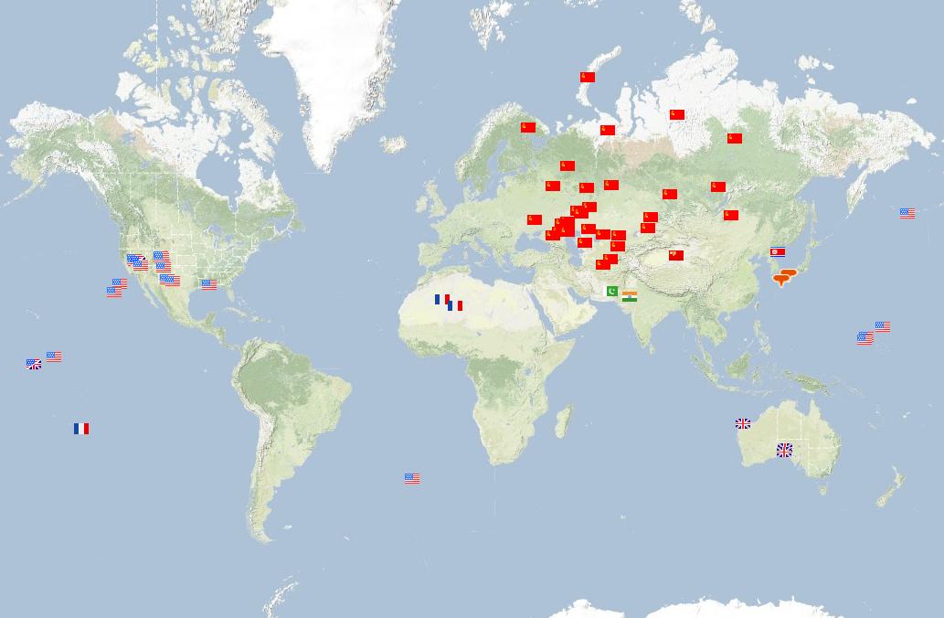
2055 nuclear explosions, 300K deaths

Slide 73
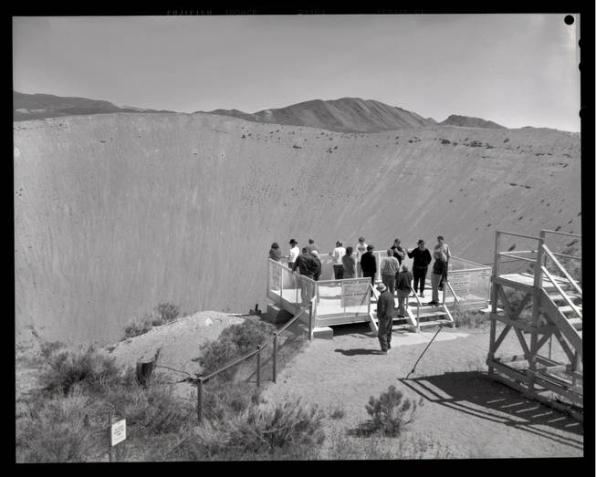
Notes:
12 million tons of earth

Slide 74
CTBT
First formal treaty proposal in 1958 (Eisenhower’s letter to Khrushchev)
“Failure to achieve a ban on nuclear testing, would have to be classed as the greatest disappointment of any administration -- of any decade -- of any time and of any party.”
Treaty signed in 1996 (eventually 183 nations)
Allows for outside inspection of 1000km²

Slide 75
CTBT
First formal treaty proposal in 1958 (Eisenhower’s letter to Khrushchev)
“Failure to achieve a ban on nuclear testing, would have to be classed as the greatest disappointment of any administration -- of any decade -- of any time and of any party.”
Treaty signed in 1996 (eventually 183 nations)
Allows for outside inspection of 1000km²
US Senate refused to ratify in 1998
“too hard to monitor”

Slide 76
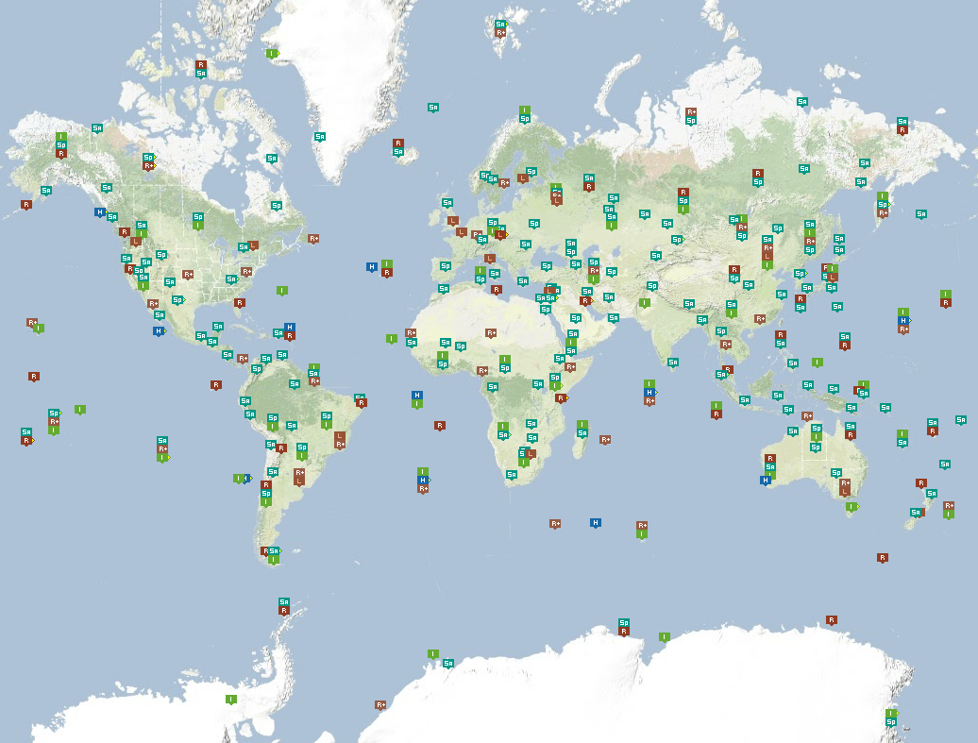
278 monitoring stations (147 seismic)

Slide 77
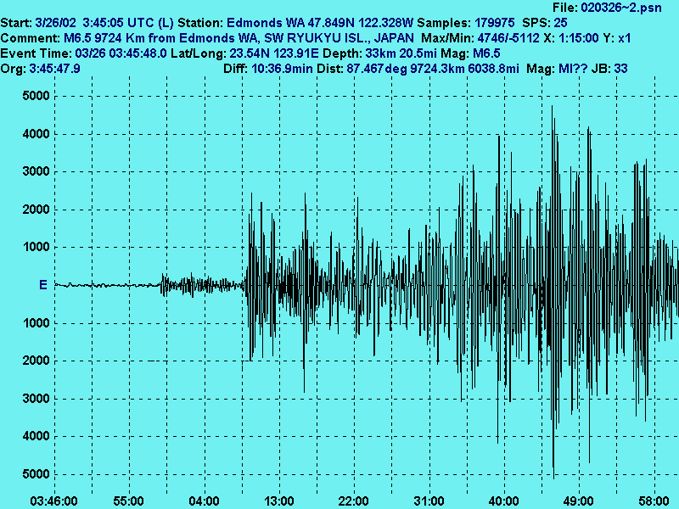
Notes:
This is what the stations record – waveform signals. This is a 6.5 earthquake measured at 9700 km.

Slide 78
Notes:
This is the size of a small decoupled nuclear test

Slide 79
Global seismic monitoring
Given: continuous waveform measurements from a global network of seismometer stations
Output: a bulletin listing seismic events, with
Time
Location (latitude, longitude)
Depth
Magnitude
Notes:
Real-time (every 24 hours)

Slide 80
Is this a hard problem?
CTBTO system (GA➔SEL3) developed over 10 years, $100M software plus $1B network
Recall 69%, precision 47%
16 human analysts correct or discard SEL3 events, create new events, generate LEB (“ground truth”)
Unreliable below magnitude 4 (1kT)
Notes:
50% of US geophysics funding aimed at this problem

Slide 81
Why is this a hard problem?
~10 000 “detections” per day, 90% false
Lots of background noise
Events generate dozens of wave types (“phases”) with different velocities, paths
Signals take 15 minutes to several hours to traverse the earth, so they are all mixed up

Slide 82
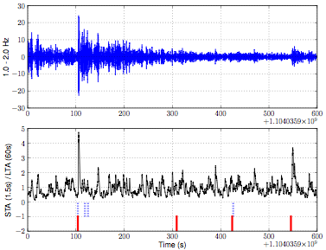
Detections
Local spike in signal value; attributes are:
Onset time
Amplitude
Azimuth and slowness (= direction it arrives from)
Phase type (= one of 14 distinct wave types)

Slide 83
Very short course in seismology

Slide 84
Notes:
Given a global network of stations.

Slide 86
Notes:
Seismic energy from these events propagates outwards

Slide 89
Notes:
But other noise detections are also noted, due to small local events.

Slide 91
Notes:
Wave types vary from 12 minutes to 40 minutes to traverse the earth

Slide 92
Notes:
What we see though are just a bunch of detections at each stations which we need to associate together.

Slide 93
BLOG model for seismology
Model describes
Event occurrence (frequency, location, magnitude)
Signal detection probability
Signal properties (time, amplitude, direction)
Measurement uncertainty
Noise processes producing false detections
Advantages:
Prior knowledge, historical data => better results, happy geophysicists
Top-down inference disambiguates local signals
Notes:
About 600 predictive models in the traditional sense

Slide 94
#SeismicEvents ~ Poisson[T*λ_{e}];
Time(e) ~ Uniform(0,T)
IsEarthQuake(e) ~ Bernoulli(.999);
Location(e) ~ if IsEarthQuake(e) then SpatialPrior() else UniformEarthDistribution();
Depth(e) ~ if IsEarthQuake(e) then Uniform[0,700] else 0;
Magnitude(e) ~ Exponential(log(10));
IsDetected(e,p,s) ~ Logistic[weights(s,p)](Magnitude(e), Depth(e), Distance(e,s));
#Detections(site = s) ~ Poisson[T*λ_{f}(s)];
#Detections(event=e, phase=p, station=s) = if IsDetected(e,p,s) then 1 else 0;
OnsetTime(a,s) ~ if (event(a) = null) then Uniform[0,T] else
Time(event(a)) + GeoTravelTime(Distance(event(a),s),Depth(event(a)),phase(a)) + Laplace(μ_{t}(s), σ_{t}(s))
Amplitude(a,s) ~ If (event(a) = null) then NoiseAmplitudeDistribution(s)
else AmplitudeModel(Magnitude(event(a)), Distance(event(a),s),Depth(event(a)),phase(a))
Azimuth(a,s) ~ If (event(a) = null) then Uniform(0, 360)
else GeoAzimuth(Location(event(a)),Depth(event(a)),phase(a),Site(s)) + Laplace(0,σ_{a}(s))
Slowness(a,s) ~ If (event(a) = null) then Uniform(0,20)
else GeoSlowness(Location(event(a)),Depth(event(a)),phase(a),Site(s)) + Laplace(0,σ_{a}(s))
ObservedPhase(a,s) ~ CategoricalPhaseModel(phase(a))
Notes:
Here’s the whole thing, will look at pieces of it

Slide 95
#SeismicEvents ~ Poisson[T*λ_{e}];
Time(e) ~ Uniform(0,T)
IsEarthQuake(e) ~ Bernoulli(.999);
Location(e) ~ if IsEarthQuake(e) then SpatialPrior() else UniformEarthDistribution();
Depth(e) ~ if IsEarthQuake(e) then Uniform[0,700] else 0;
Magnitude(e) ~ Exponential(log(10));
IsDetected(e,p,s) ~ Logistic[weights(s,p)](Magnitude(e), Depth(e), Distance(e,s));
#Detections(site = s) ~ Poisson[T*λ_{f}(s)];
#Detections(event=e, phase=p, station=s) = if IsDetected(e,p,s) then 1 else 0;
OnsetTime(a,s) ~ if (event(a) = null) then Uniform[0,T] else
Time(event(a)) + GeoTravelTime(Distance(event(a),s),Depth(event(a)),phase(a)) + Laplace(μ_{t}(s), σ_{t}(s))
Amplitude(a,s) ~ If (event(a) = null) then NoiseAmplitudeDistribution(s)
else AmplitudeModel(Magnitude(event(a)), Distance(event(a),s),Depth(event(a)),phase(a))
Azimuth(a,s) ~ If (event(a) = null) then Uniform(0, 360)
else GeoAzimuth(Location(event(a)),Depth(event(a)),phase(a),Site(s)) + Laplace(0,σ_{a}(s))
Slowness(a,s) ~ If (event(a) = null) then Uniform(0,20)
else GeoSlowness(Location(event(a)),Depth(event(a)),phase(a),Site(s)) + Laplace(0,σ_{a}(s))
ObservedPhase(a,s) ~ CategoricalPhaseModel(phase(a))
Notes:
Number statements describe unknown entities: events and detections

Slide 96
#SeismicEvents ~ Poisson[T*λ_{e}];
Time(e) ~ Uniform(0,T)
IsEarthQuake(e) ~ Bernoulli(.999);
Location(e) ~ if IsEarthQuake(e) then SpatialPrior() else UniformEarthDistribution();
Depth(e) ~ if IsEarthQuake(e) then Uniform[0,700] else 0;
Magnitude(e) ~ Exponential(log(10));
IsDetected(e,p,s) ~ Logistic[weights(s,p)](Magnitude(e), Depth(e), Distance(e,s));
#Detections(site = s) ~ Poisson[T*λ_{f}(s)];
#Detections(event=e, phase=p, station=s) = if IsDetected(e,p,s) then 1 else 0;
OnsetTime(a,s) ~ if (event(a) = null) then Uniform[0,T] else
Time(event(a)) + GeoTravelTime(Distance(event(a),s),Depth(event(a)),phase(a)) + Laplace(μ_{t}(s), σ_{t}(s))
Amplitude(a,s) ~ If (event(a) = null) then NoiseAmplitudeDistribution(s)
else AmplitudeModel(Magnitude(event(a)), Distance(event(a),s),Depth(event(a)),phase(a))
Azimuth(a,s) ~ If (event(a) = null) then Uniform(0, 360)
else GeoAzimuth(Location(event(a)),Depth(event(a)),phase(a),Site(s)) + Laplace(0,σ_{a}(s))
Slowness(a,s) ~ If (event(a) = null) then Uniform(0,20)
else GeoSlowness(Location(event(a)),Depth(event(a)),phase(a),Site(s)) + Laplace(0,σ_{a}(s))
ObservedPhase(a,s) ~ CategoricalPhaseModel(phase(a))

Slide 97
Event location prior

Slide 98
#SeismicEvents ~ Poisson[T*λ_{e}];
Time(e) ~ Uniform(0,T)
IsEarthQuake(e) ~ Bernoulli(.999);
Location(e) ~ if IsEarthQuake(e) then SpatialPrior() else UniformEarthDistribution();
Depth(e) ~ if IsEarthQuake(e) then Uniform[0,700] else 0;
Magnitude(e) ~ Exponential(log(10));
IsDetected(e,p,s) ~ Logistic[weights(s,p)](Magnitude(e), Depth(e), Distance(e,s));
#Detections(site = s) ~ Poisson[T*λ_{f}(s)];
#Detections(event=e, phase=p, station=s) = if IsDetected(e,p,s) then 1 else 0;
OnsetTime(a,s) ~ if (event(a) = null) then Uniform[0,T] else
Time(event(a)) + GeoTravelTime(Distance(event(a),s),Depth(event(a)),phase(a)) + Laplace(μ_{t}(s), σ_{t}(s))
Amplitude(a,s) ~ If (event(a) = null) then NoiseAmplitudeDistribution(s)
else AmplitudeModel(Magnitude(event(a)), Distance(event(a),s),Depth(event(a)),phase(a))
Azimuth(a,s) ~ If (event(a) = null) then Uniform(0, 360)
else GeoAzimuth(Location(event(a)),Depth(event(a)),phase(a),Site(s)) + Laplace(0,σ_{a}(s))
Slowness(a,s) ~ If (event(a) = null) then Uniform(0,20)
else GeoSlowness(Location(event(a)),Depth(event(a)),phase(a),Site(s)) + Laplace(0,σ_{a}(s))
ObservedPhase(a,s) ~ CategoricalPhaseModel(phase(a))

Slide 99
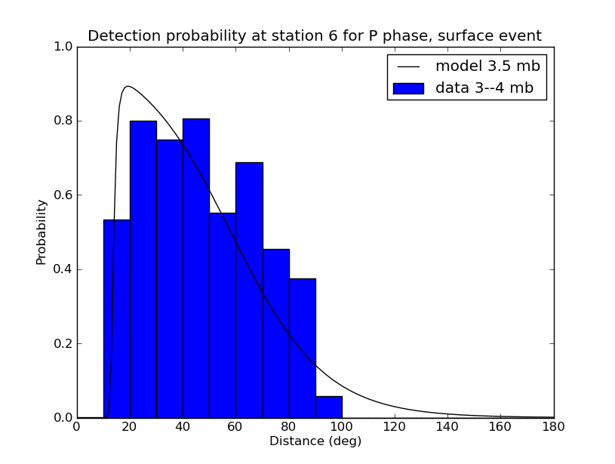
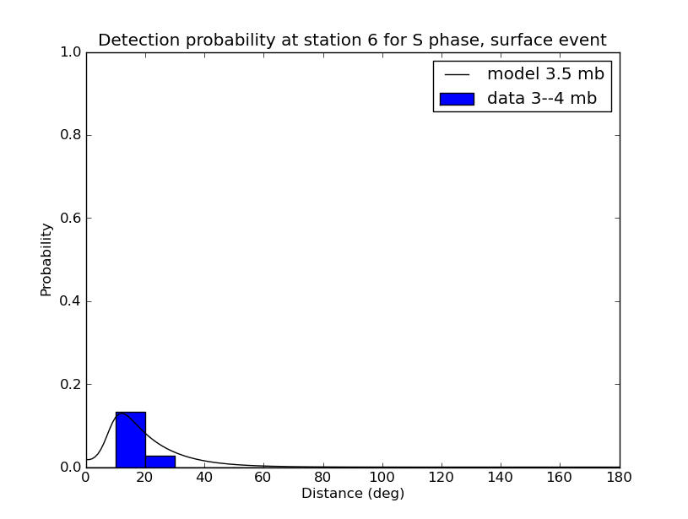
Detection probability as a function of distance (station 6, m_{b} 3.5)
P phase
S phase
Notes:
Hierarchical Bayesian model to allow sharing across stations with little data

Slide 100
#SeismicEvents ~ Poisson[T*λ_{e}];
Time(e) ~ Uniform(0,T)
IsEarthQuake(e) ~ Bernoulli(.999);
Location(e) ~ if IsEarthQuake(e) then SpatialPrior() else UniformEarthDistribution();
Depth(e) ~ if IsEarthQuake(e) then Uniform[0,700] else 0;
Magnitude(e) ~ Exponential(log(10));
IsDetected(e,p,s) ~ Logistic[weights(s,p)](Magnitude(e), Depth(e), Distance(e,s));
#Detections(site = s) ~ Poisson[T*λ_{f}(s)];
#Detections(event=e, phase=p, station=s) = if IsDetected(e,p,s) then 1 else 0;
OnsetTime(a,s) ~ if (event(a) = null) then Uniform[0,T] else
Time(event(a)) + GeoTravelTime(Distance(event(a),s),Depth(event(a)),phase(a)) + Laplace(μ_{t}(s), σ_{t}(s))
Amplitude(a,s) ~ If (event(a) = null) then NoiseAmplitudeDistribution(s)
else AmplitudeModel(Magnitude(event(a)), Distance(event(a),s),Depth(event(a)),phase(a))
Azimuth(a,s) ~ If (event(a) = null) then Uniform(0, 360)
else GeoAzimuth(Location(event(a)),Depth(event(a)),phase(a),Site(s)) + Laplace(0,σ_{a}(s))
Slowness(a,s) ~ If (event(a) = null) then Uniform(0,20)
else GeoSlowness(Location(event(a)),Depth(event(a)),phase(a),Site(s)) + Laplace(0,σ_{a}(s))
ObservedPhase(a,s) ~ CategoricalPhaseModel(phase(a))
Notes:
This is the core: GeoTravelTime is a physics-based standard model based on a radially symmetric velocity model

Slide 101
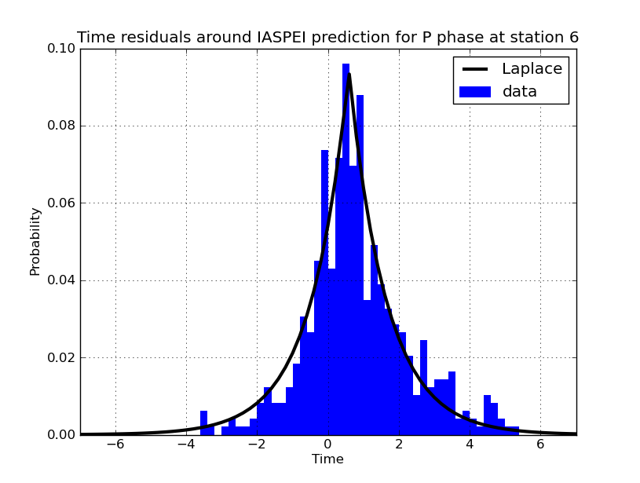
Travel-time residual (station 6)
Notes:
The residuals are fit better by a Laplacian, not Gaussian. 2 seconds on 15 minutes is pretty good. MASSIVE investment in improving it.

Slide 102
#SeismicEvents ~ Poisson[T*λ_{e}];
Time(e) ~ Uniform(0,T)
IsEarthQuake(e) ~ Bernoulli(.999);
Location(e) ~ if IsEarthQuake(e) then SpatialPrior() else UniformEarthDistribution();
Depth(e) ~ if IsEarthQuake(e) then Uniform[0,700] else 0;
Magnitude(e) ~ Exponential(log(10));
IsDetected(e,p,s) ~ Logistic[weights(s,p)](Magnitude(e), Depth(e), Distance(e,s));
#Detections(site = s) ~ Poisson[T*λ_{f}(s)];
#Detections(event=e, phase=p, station=s) = if IsDetected(e,p,s) then 1 else 0;
OnsetTime(a,s) ~ if (event(a) = null) then Uniform[0,T] else
Time(event(a)) + GeoTravelTime(Distance(event(a),s),Depth(event(a)),phase(a)) + Laplace(μ_{t}(s), σ_{t}(s))
Amplitude(a,s) ~ If (event(a) = null) then NoiseAmplitudeDistribution(s)
else AmplitudeModel(Magnitude(event(a)), Distance(event(a),s),Depth(event(a)),phase(a))
Azimuth(a,s) ~ If (event(a) = null) then Uniform(0, 360)
else GeoAzimuth(Location(event(a)),Depth(event(a)),phase(a),Site(s)) + Laplace(0,σ_{a}(s))
Slowness(a,s) ~ If (event(a) = null) then Uniform(0,20)
else GeoSlowness(Location(event(a)),Depth(event(a)),phase(a),Site(s)) + Laplace(0,σ_{a}(s))
ObservedPhase(a,s) ~ CategoricalPhaseModel(phase(a))
Notes:
Azimuth is the direction of the incoming wave at the station

Slide 103
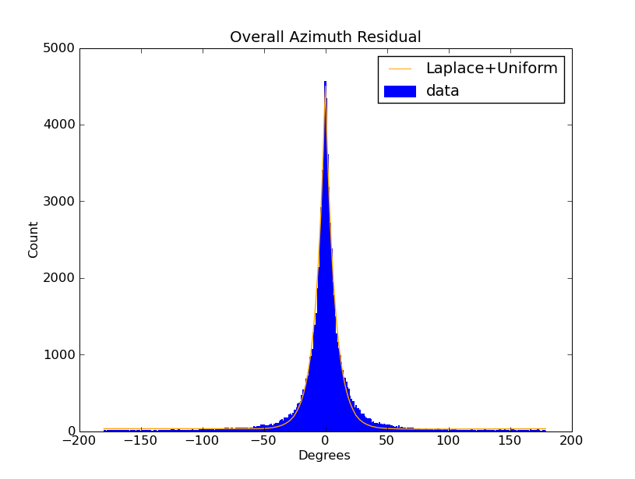
Overall Azimuth Error
Notes:
Again, Laplacian errors, quite large!!

Slide 104
Inference
NET-VISA aims for most likely explanation (MAP)
Probability-driven local optimization search with 4 moves:
Birth move suggests new events to account for new arrivals
Improve-arrival move selects a better event for a given arrival
Improve-event optimizes event location, time given its arrivals
Death move kills events with no arrivals or negative likelihood
Runs faster than real time
Huge events (Sumatra, Tohoku) handled using ~100 nodes
Key point for “client”: computing posterior probabilities takes the algorithm off the table; to get better answers,
Improve the model, or
Add more sensors

Slide 105
Evaluation
11 weeks / 1 week train/test split
Evaluated using human-expert LEB as “ground truth”
Notes:
More recent tests run over 3 years of data, similar results

Slide 106
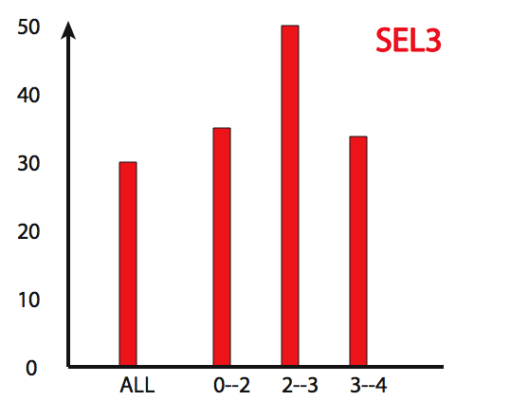
Fraction of events missed
Existing UN system
magnitude

Slide 107
Fraction of events missed
Existing UN system
NET-VISA
NET-VISA
magnitude
Notes:
in 2009 the UN’s SEL3 automated bulletin missed 27.4% of the 27294 events in the magnitude range 3–4 while NET-VISA missed 11.1%

Slide 108
Detecting Events Found by Regional Networks
NET-VISA recall 20-100% better than human experts

Slide 109
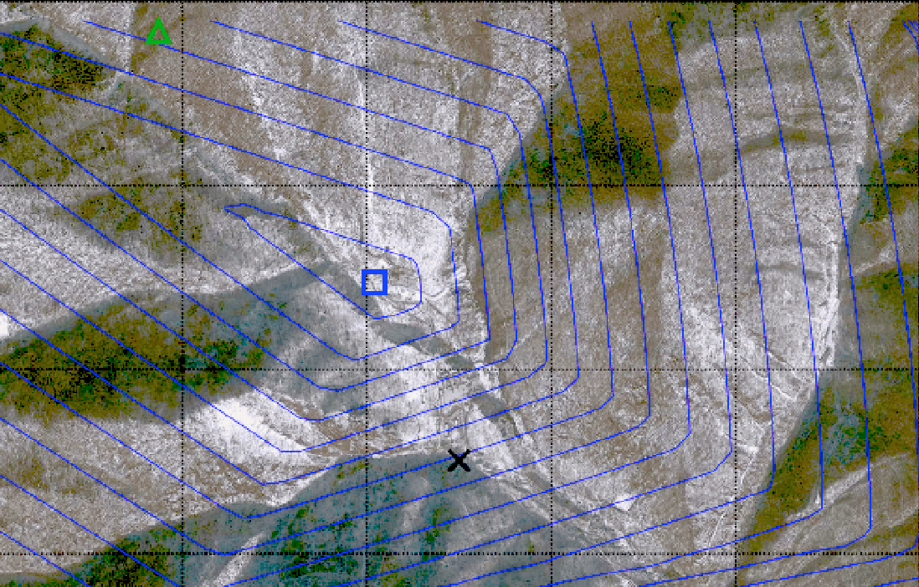
February 12, 2013 DPRK test
CTBTO LEB location
NET-VISA location
Tunnel entrance

Slide 110
NET-VISA status
CTBTO has announced that NET-VISA will be the new global monitoring system

Slide 111
Lots more to do
Question answering
Structural learning
Semantics and inference with functions of continuous arguments
Experiment with many applications
Tackle some harder problems: vision, real NLP

Slide 112
Thank you! Research funded by DARPA, CTBTO, DTRA, ANR, and Région d’Île de France Questions?

