Slide 1



Transcriptional Enhancers
Looking out for the genes and each other
Sridhar Hannenhalli
Department of Cell Biology and Molecular Genetics
Center for Bioinformatics and Computational Biology
UM Institute for Advance Computer Studies
University of Maryland

Slide 2
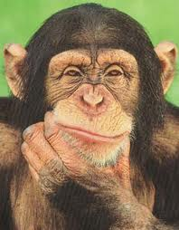
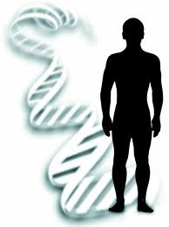

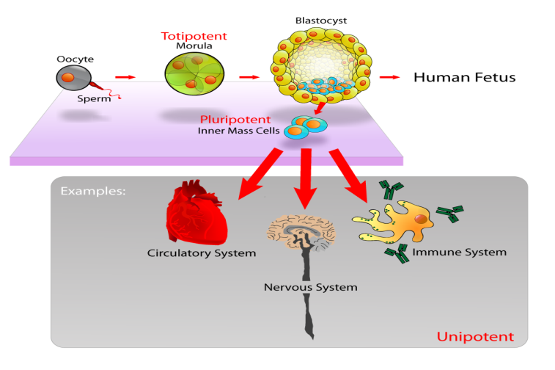
Transcriptome – a key mediator of diversity
“their macromolecules are so alike that regulatory mutations may account for their biological differences.” King and Wilson, Science, 1975
Genotype
Transcriptome
Phenotype

Slide 3
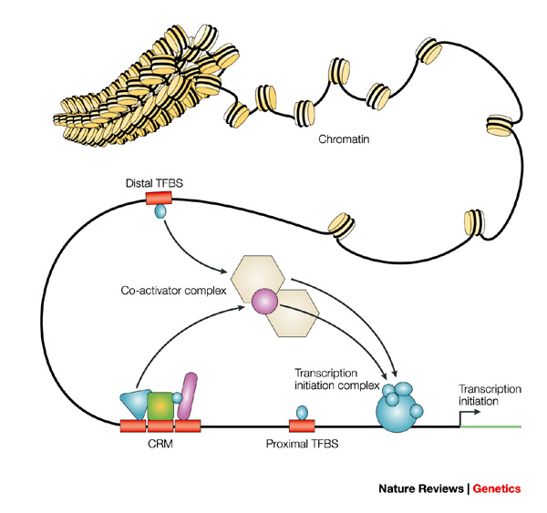
Transcriptional Regulation
Chromatin structure
TF interactions
Promoter
Posttranslational modification
TF-DNA binding

Slide 4


Enhancers – key mediators of context-specific gene regulation
Lmbr1
Enhancer
1 Mb
Shh
A long-range Shh enhancer regulates expression in the developing limb and fin and is associated with preaxial polydactyly, Lettice et al. HMG 2003

Slide 5
Enhancer
Gene
I.
SNP
Gene Expression
II.
Enhancer
Enhancer
Transcription Factor
Enhancer
III.
(In a 3D chromatin context)

Slide 6

Enhancer
Gene
I.
SNP
Gene Expression
Avinash

Slide 7
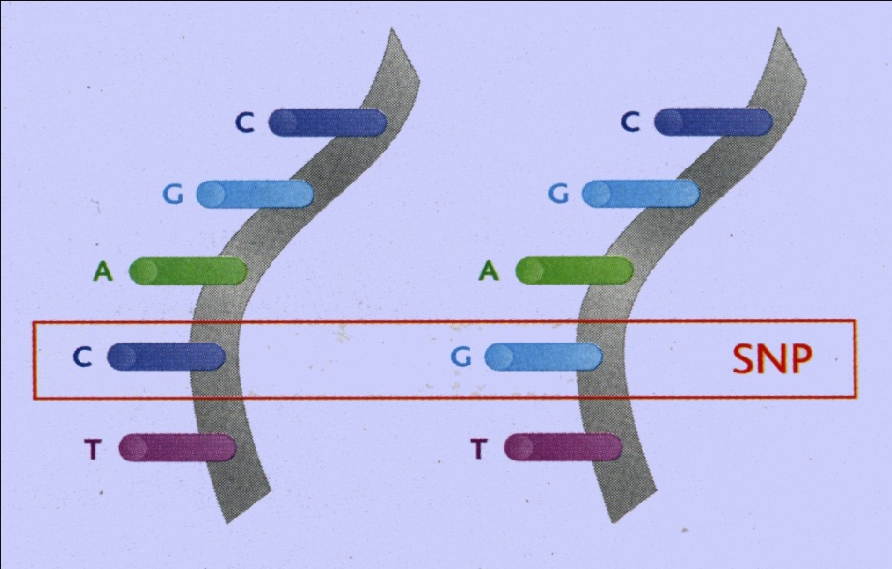
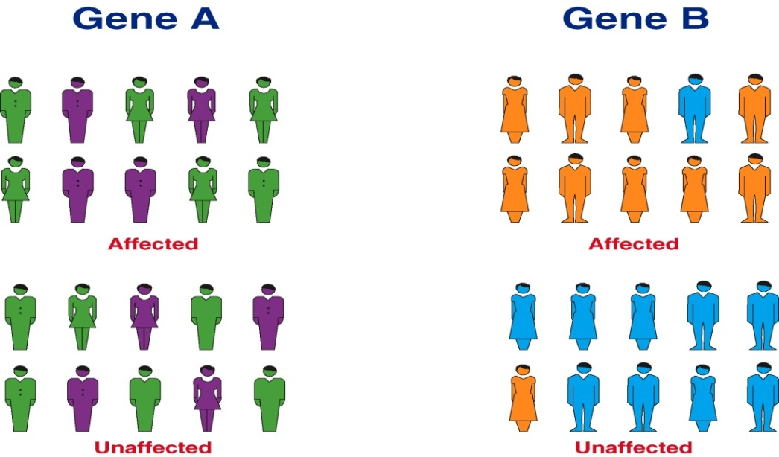
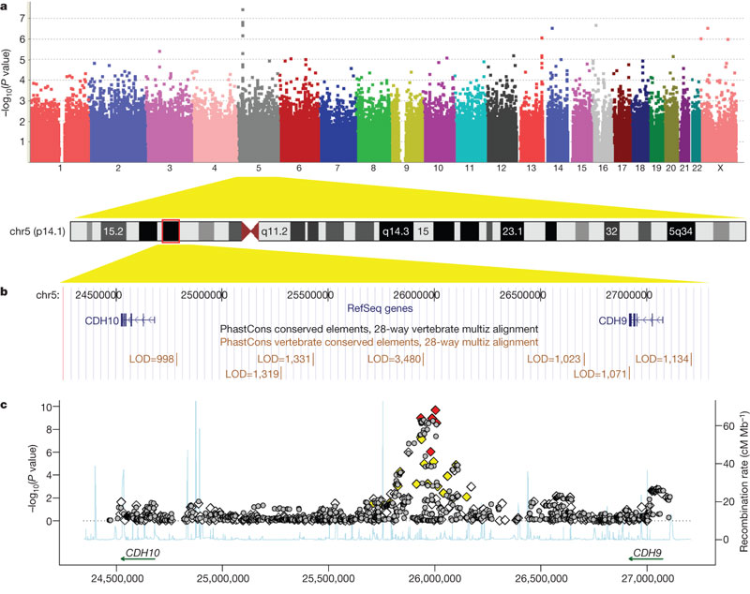
Genome-wide association studies
Collins 2007
Collins 2007
Wang et al. Nature 2009

Slide 8
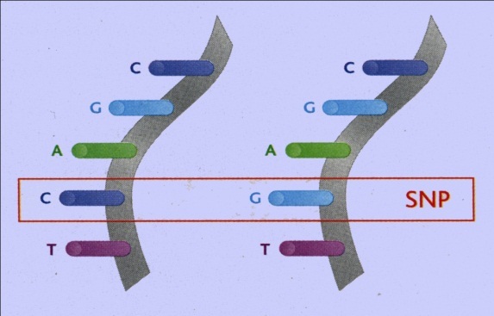
Expression Quantitative Trait Loci (eQTL)
CC
CG
GG
Linkage disequilibrium – Association versus causality
Functional interpretation of detected SNPs
GWAS :: Trait = Phenotype
Trait
eQTL :: Trait = Expression

Slide 9
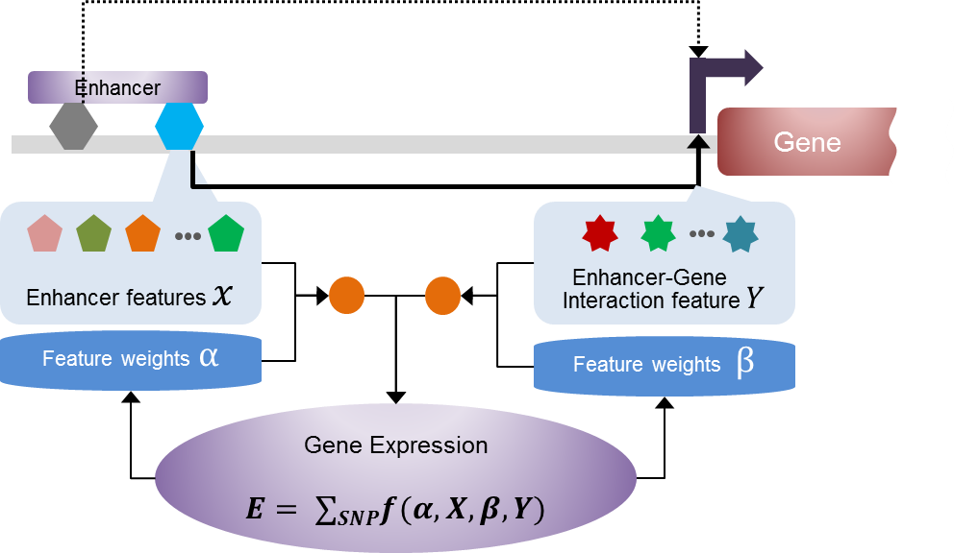
Enhancer-mediated eQTL (eQTeL)
Nat Comm, 2015

Slide 10
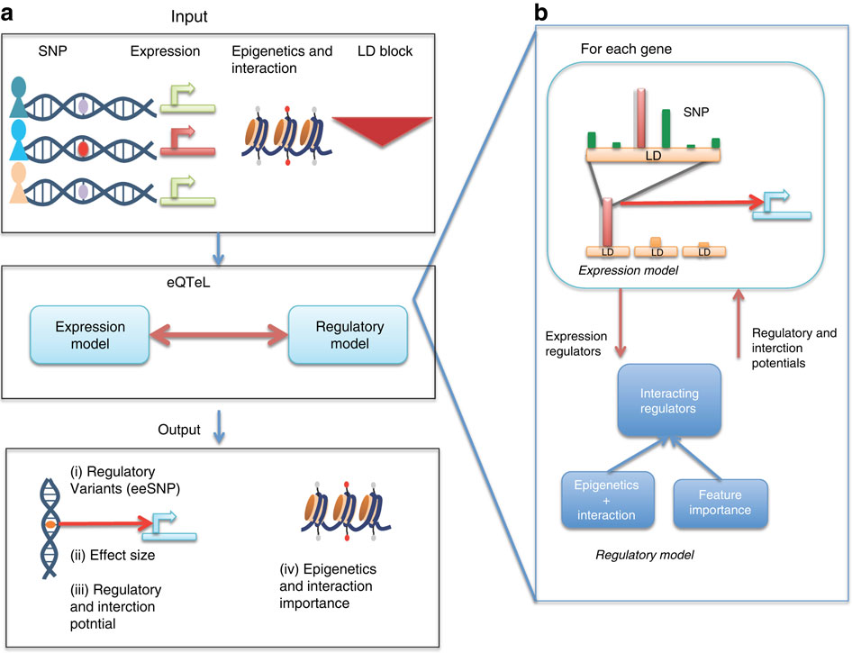

Slide 11
eQTeL application
MAGNet
>300 human hearts
Gene expression
Genotype
ENCODE & Epigenome roadmap
Histone modifications
Transcription factors
Chromatin accessibility….
Notes:
Gene expression and genotype data for heart failure cases and healthy heart were collected from magnet consortium.. This heart failure were not due love but had genetic basis. We generated simulated data such that it is similar to magnet data. For 500 individual we generated 50,000 SNPs with similar MAF as Magnet. We dulicated the SNP to simulate LD. 10 of SNPs were selected to lie in a regulator. 5-10 snps for each gene were selected to be expression regulators. Finaly expression of 100 genes were generated such that explain variance match magnet data. We collected heart specific epigentics data from encode and road map epigenome project. Using, human heart enhancers, which were validated in-vivo in mouse, we generated epigentics features for regulators and other SNP.

Slide 12
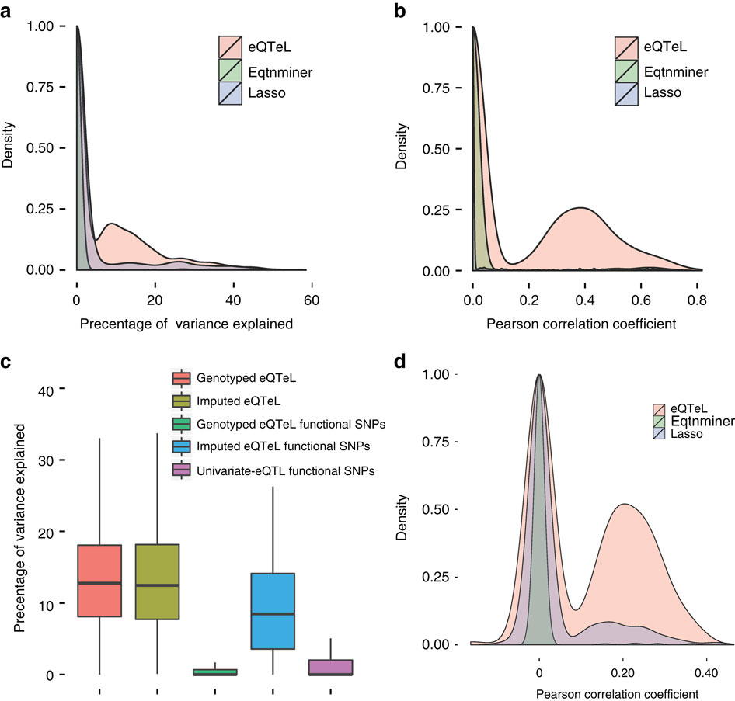

Slide 13
Biology: Protein binding

Slide 14
Motif disruption
Biological evidence II:

Slide 15
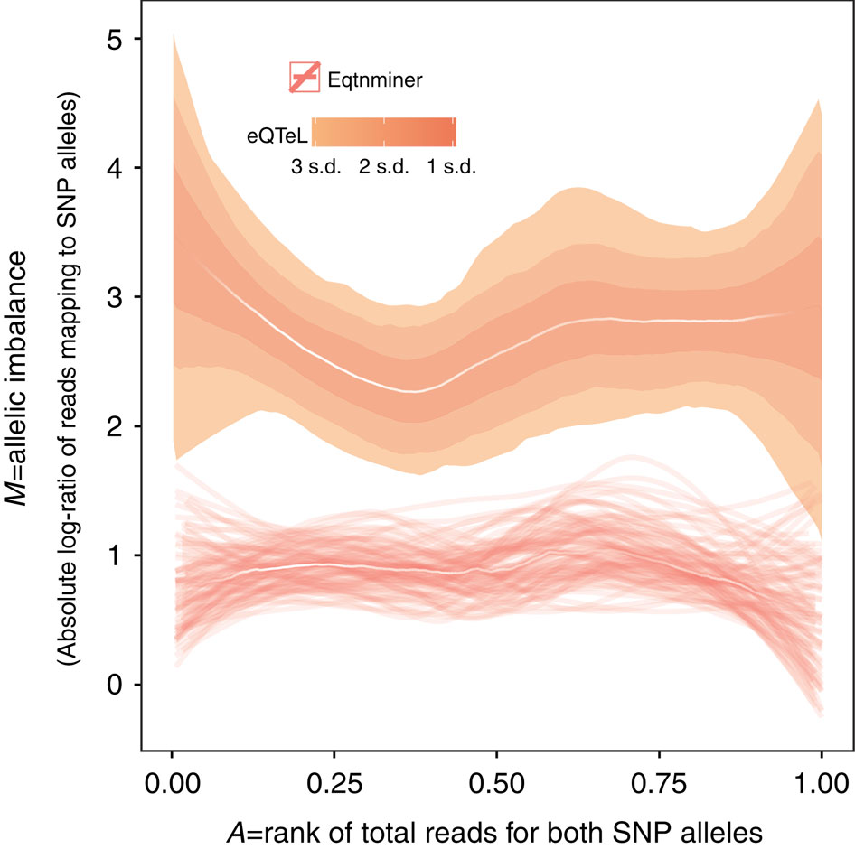
Allelic imbalance

Slide 16
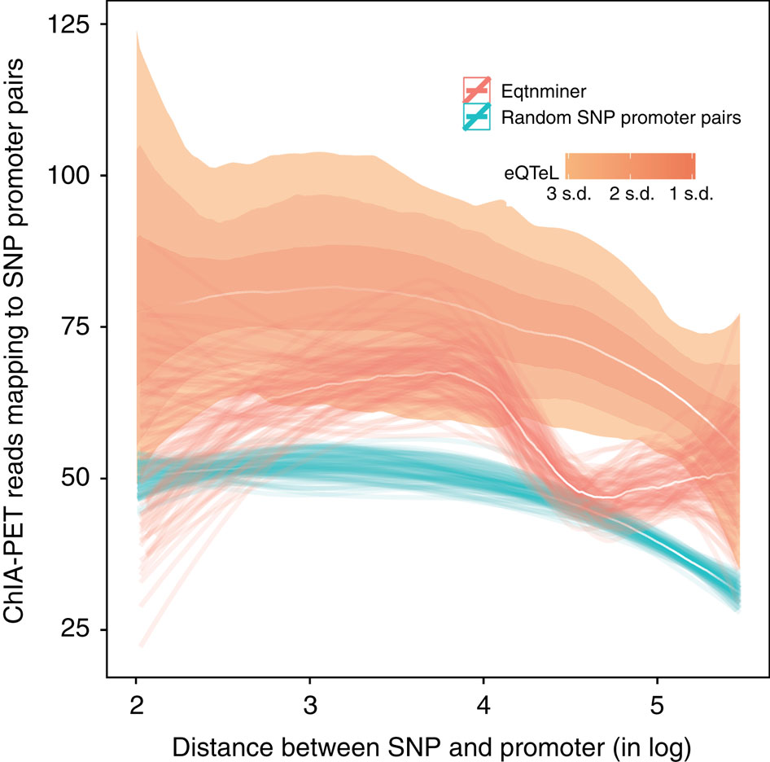
Spatial proximity to target

Slide 17
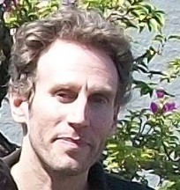
II.
Enhancer
Enhancer
Justin Malin

Slide 18
Tissues
Tissues
Correlated “expression”
Correlated “activity”
Gene Network
Enhancer Network
Malin et al. NAR 2013

Slide 19
Notes:
Clusters of correlated enhancers tend to span large portions of their respective chromosome.

Slide 20
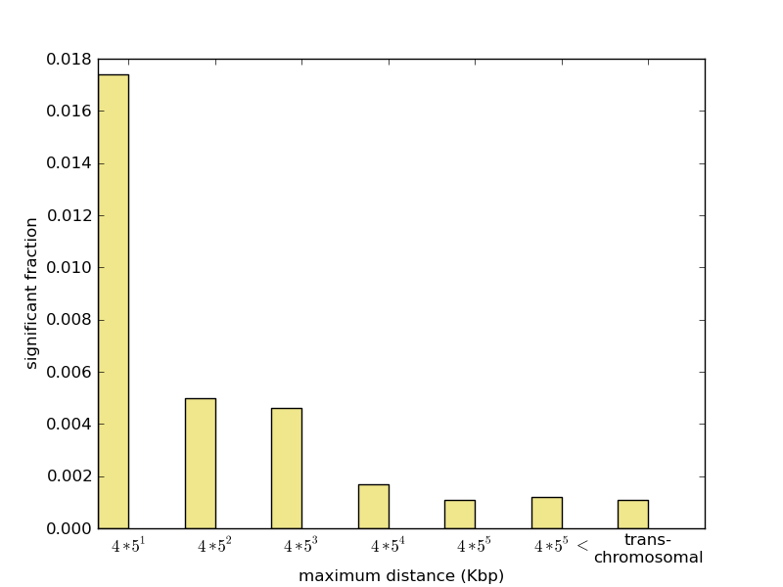
~100K candidate enhancers
DNAse HS as a proxy for enhancer “activity”
Genome-wide DHS profiles for 72 tissue types
Notes:
HepG2 Liver hepatocellular carcinoma
GM12878 lymphoblastoid
H1-HESC
SK-N-SH_RA Neuroblastoma

Slide 21
Properties of correlated enhancers
Shared TF binding sites
  Correlated enhancers tend to share common transcription factor binding motifs.
  This trend is stronger for enhancer pairs at greater distances.
  Presence of shared motifs can predict correlated activity with 73% accuracy.
Chromatin modification enzymes preferentially interact with the TF with enriched motifs in correlated enhancers
Correlated enhancers tend to be spatially proximal in multiple cell lines
Motif Sharing
Notes:
52 TFs (Sp1 AP1 ZF5 REST, Nkx)
28 CMEs (Lots of histone deacytelase)
44 out of ~500 enhancer clusters are enriched for a motif.

Slide 22
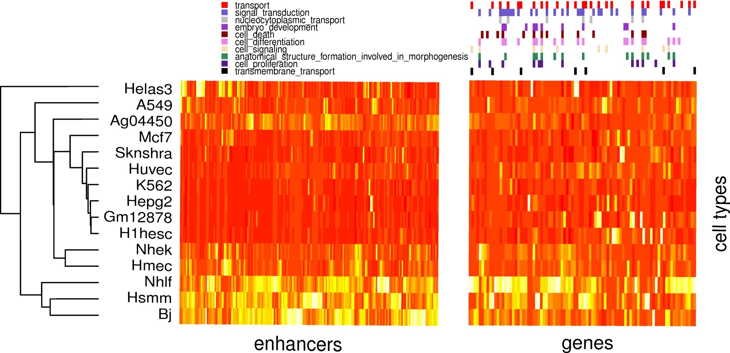
Putative targets (nearest gene) of correlated enhancers
Have correlated expression consistent with enhancer activity
Enriched for specific molecular functions
Notes:
What can we do with the additional clusters we have found?
Did we completely ignore negative correlations? How many significant ones are there?

Slide 23
Putting it together ….
?
Motif Sharing
3D Proximity
0.9
0
0.1
0.8
0.7
Correlated gene
expression
1
0.1
0
0.9
0.8
1
0
0
1
1
Correlated enhancer activity
1
0
0
1
1

Slide 24
Transcription Factor
Enhancer
III.
(In a 3D chromatin context)
a.k.a. Crowdsourcing of transcription factor binding by a spatially clustered collective of binding sites
Justin Malin

Slide 25
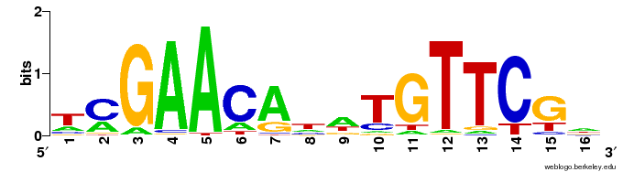
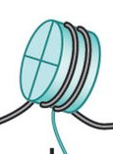
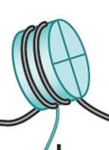
Determinants of TF-DNA interaction
In vitro determinant: motif
In vivo determinants
DNA motif (~20 bases)
Cooperative binding (~100 bases)
GC content of flanking region (~200 bases)
Local chromatin state (~500 bases)
Homotypic clusters of BS (~500 bases)
Notes:
To give context for the second aim, I have to step back for a moment and talk about
determinants of TF-DNA binding…
Why important?
TFs in mammals convey a large portion of the state information of the cell. A gene interprets that state information
through selective binding of TF with DNA -- either its promoter or one of its enhancers. This governs
Recruitment of the basal transcriptional machinery and polymerase II.
…
Homotypic clusters are genomic clusters of typically low information motifs that therefore occur naturally
With high frequency through the genome, anyway. Interestingly, homotypic clusters are much more prevalent than
expected by chance, alone, in enhancers and promoters, and show high evolutionary conservation.
Likely unrelatedly, they have been shown to result in higher rates of occupancy to the region than a single
Instance of the same motif, solo.
Note that these are all genomically proximal features. But this begs the question,
what is the effect of spatially proximal features, such as binding sites for the same TF?

Slide 26
Spatial homotypic clusters of TF BS
Low spatial proximity
HCT
High spatial proximity
Specific TF
Degenerate TF
Notes:
The combination of spatial proximity and genomic homotypic clusters of TFBS produce high homotypic TF BS concentration. As illustrated in this cartoon, low-RE (degenerate) motif BS have a higher expected frequency in the genome than high-RE motif BS, including more frequent HCTs. In a spatially proximal chromatin context, effective homotypic BS concentrations are substantially elevated – for low-RE motif BS, in particular. This effect is further accentuated in archipelagos of enhancers, which have been shown to be enriched for HCTs for shared TFs. High effective homotypic BS concentration is likely a pre-requisite for the crowdsourcing effect. Large ovals denote archipelagos of functionally related enhancers and target genes. Depth of background color approximates the maximum expected homotypic BS concentration. Not drawn to scale. Green: DNA. Black: BS. BS=binding site; RE=relative entropy; HCT = homotypic cluster of TFBS.

Slide 27
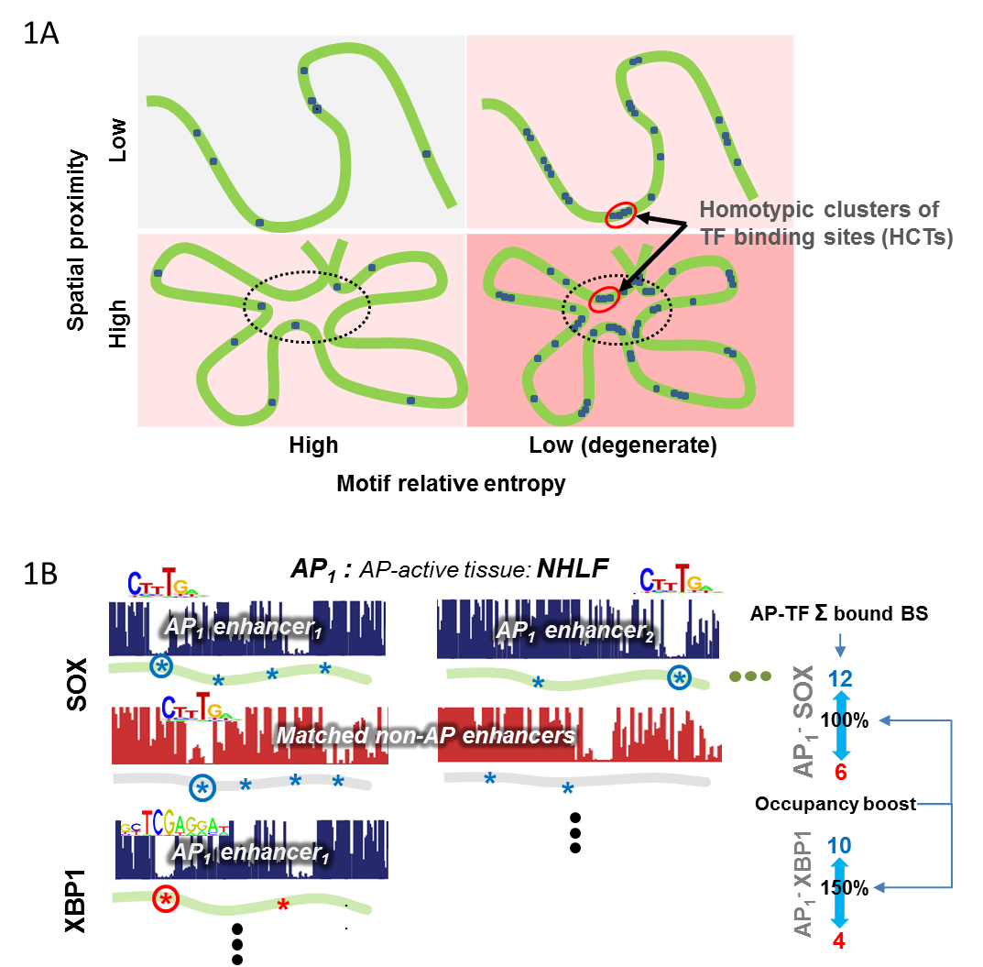
Computing occupancy ‘boost’ in archipelagos (APs) with digital footprint data
(Neph et al 2012)
Notes:
Compare AP to non-archipelago matched for motif composition and accessibility.
DGF based on high resolution DNAse sensitivity data
Crosslinked. A sharp footprint suggests protection against digestion, likely by a TF
Match with motif instances to identify transcription factor binding sites

Slide 28
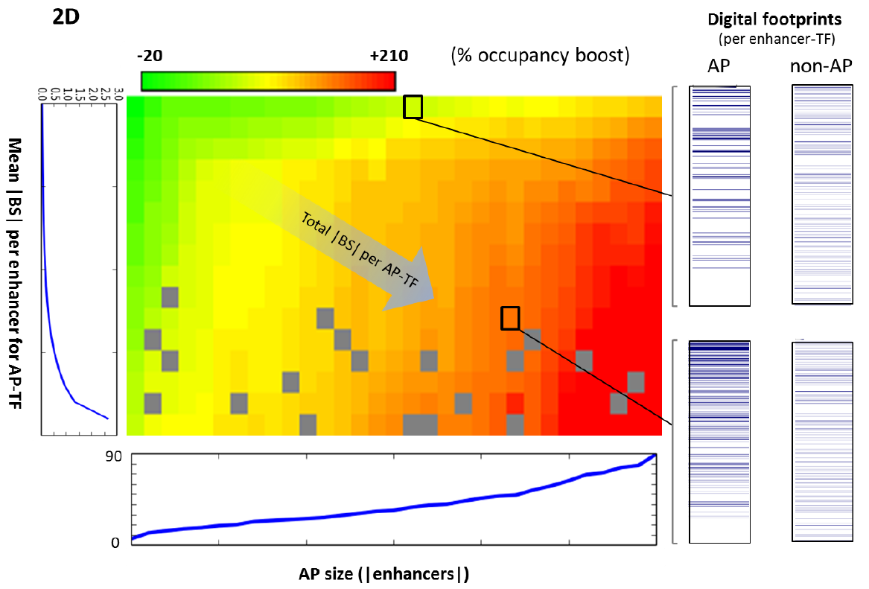
Occupancy boost scales with |BS|
Notes:
Lowess smoothed

Slide 29
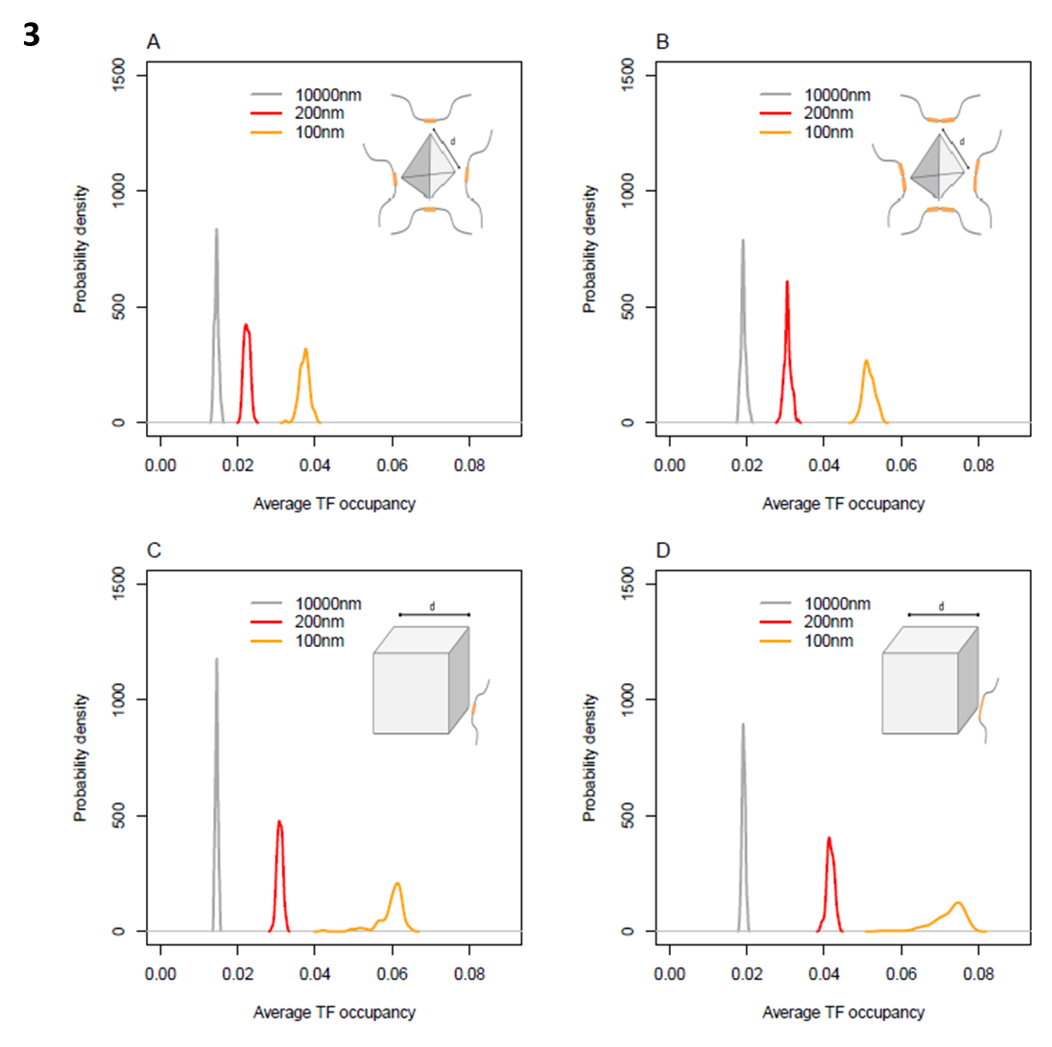
AP occupancy simulated (Facilitated TF Diffusion)
Number of enhancer per archipelago
8 4
1 2
Number of homotypic sites per enhancer
Boris Adryan, Daphne Ezer, Xiaoyan Ma, Cambridge
Notes:
READ x-axis out loud.. Point out PROB DISTRIBUTION Colors refer to distance…

Slide 30
Downstream impact of crowdsourcing occupancy boost
 | AP enhancers enriched for degenerate motifs | AP enhancers depleted for degenerate motifs
Evolutionary conservation* | 120% higher | 20% higher
Target (neighbor) gene expression* | ~3-fold higher | ~3-fold lower
Enhancer activity/ accessibility | 9-fold higher DHS 3.5-fold higher H3K27Ac in enriched than depleted enhancers^
*Relative to matched non-AP enhancers
^ FG, BG controlled relative to matched non-AP enhancers
Notes:
Scaled up to look for downstream effects (indiv BS hard!!)
Compared enriched to depleted enhancers
Also did acetylation

Slide 31
TF occupancy
Chromatin
accessibility
Notes:
Accessibility = activity!!

Slide 32
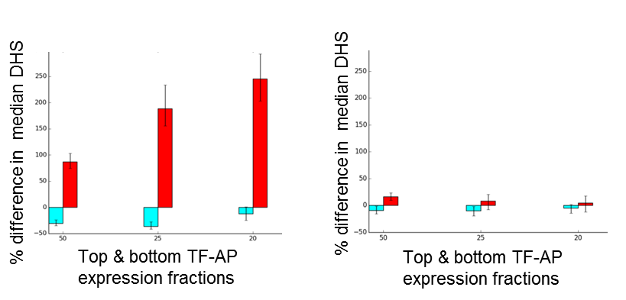
As expression of degenerate TFs ↑ (across 11 tissues)
  mean AP activity level (DHS) ↑
  No change for non-degenerate TFs, non-AP
Degenerate TFs
Non-degenerate TFs
AP
Non-AP
Notes:
(TF, AP, tissue) triplets subdivided into non-degenerate (cyan) and degenerate TFs (red)
Suggests causality: As degenerate TF

Slide 33
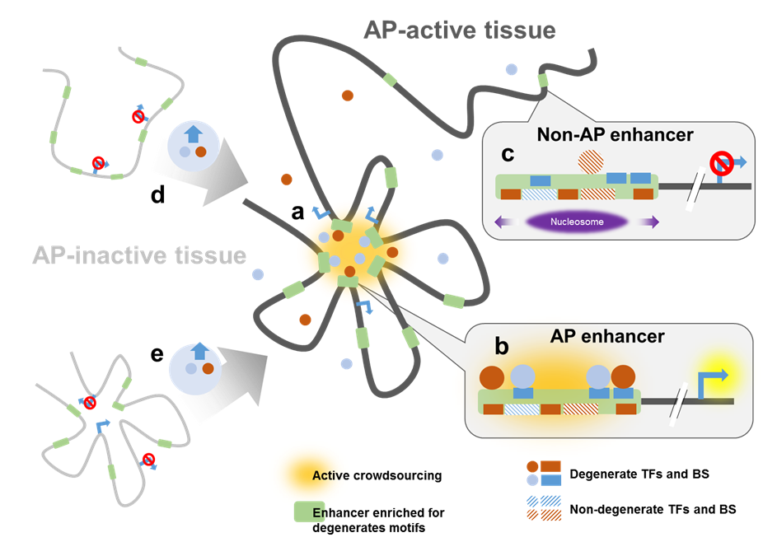
Crowdsourcing emergent in gene complexes

Slide 34
I.
Enhancer
Gene
SNP
Gene Expression
Incorporating enhancer-mediated regulatory mechanisms in the eQTL model is critical to identify causal SNPs
II.
Enhancer
Enhancer
Much like genes, enhancers form functionally cohesive co-active clusters
III.
Transcription Factor
Enhancer
(In a 3D chromatin context)
Spatial enhancer clusters have a group-level effect on in vivo occupancy

Slide 35
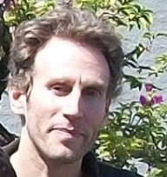


Cambridge
Daphne Ezer
Xiaoyan Ma
Boris Adryan
Avinash Das
Justin Malin
NIH

