Slide 1
Selecting genomics assays
William Stafford Noble
Department of Genome Sciences
Department of Computer Science and Engineering
University of Washington

Slide 2
ENCODE didn’t study my favorite cell type!

Slide 3

We can’t do all possible genomics assays
Heart
Liver
Leukemia
…
As of March, 2016, The ENCODE and Roadmap Epigenomics Consortia have generated 3373 human data sets.
Cell types
DNase1
H3K4me3
CTCF
Assay types
Notes:
- Cell type: any combination of cell line, tissue type, disease state, individual, drug perturbation, etc

Slide 4
Which assays should we perform on a new cell type?
A high-quality panel should
measure all types of activity
at minimal total cost.
Cell types
New cell type
Assay types

Slide 5
We are interested in choosing representative subsets
Choosing which genomics assays to perform on a new cell type.
Selecting a representative set of existing genomics data sets.
Selecting a representative set of protein sequences.

Slide 6
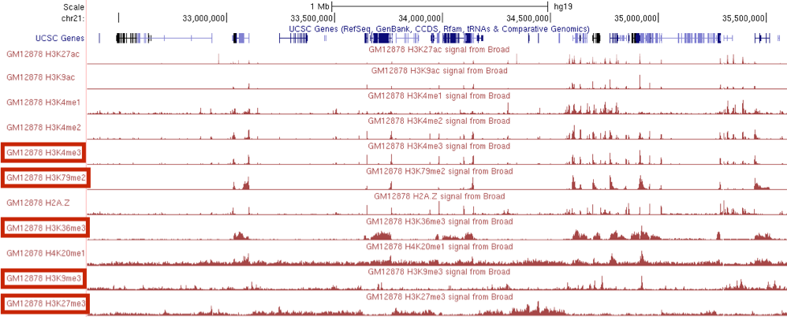
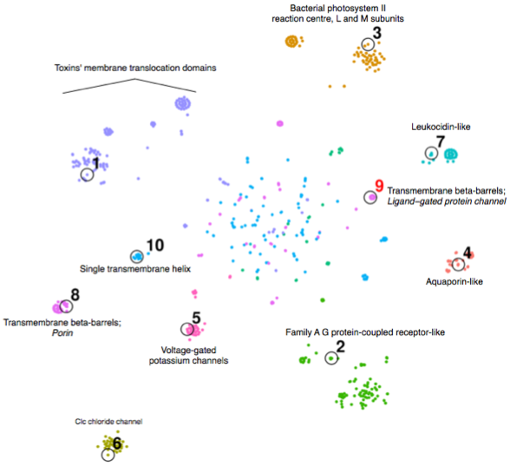

Removing redundancy in
protein sequence data sets
An optimization framework for representative set selection
Choosing diverse panels
of genomics assays

Slide 7


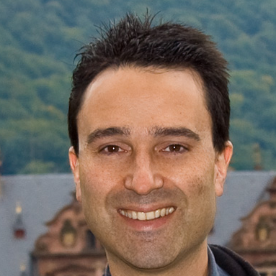
The team
Kai Wei
Jeff Bilmes
Max Libbrecht

Slide 8
Submodular optimization provides a formal framework for selecting representative subsets
Continuous optimization : Convexity :: Discrete optimization : ?
Semidefiniteness
Submodularity
Differentiability
Perspicacity
Notes:
they are neither convex nor concave, they have properties that are like both, but also properties that are like neither.
2) they are ideal for measuring "information" in data. The entropy function is submodular, but submodular functions span a much wider range of functions. We can craft a submodular function to a particular task (e.g., that of genomic assays, as we've done here), but this is only the beginning
(the reason for the second point is that we still haven't done much to learn the submodular function, I think we can do a much better job once we start doing that).

Slide 9
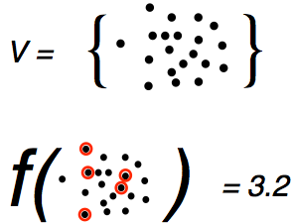
A set function assigns a real number to every subset of a given set
Ground set
Quality of the subset
Set function
Notes:
“Quality” is not part of the definition of “set function.”
in case anyone asks why it is called a 'ground' set, it comes from lattice theory, and the way lattices are drawn typically.

Slide 10
How long will it take to find the highest quality subset?
O(2^{n})

Slide 11



Submodular set functions satisfy the property of diminishing returns
$$f\left(A∪\left\{v\right\}\right)−f\left(A\right)≥f\left(A∪B∪\left\{v\right\}\right)−f\left(A∪B\right)$$
Gain from adding v to A
Gain from adding v to A ⋃ B
f( ) - f( ) ≤ f( ) -f( )

Slide 12
A greedy algorithm maximizes a submodular function within a constant factor of optimal
Key result!
Initialize empty representative set A
For 1…k:
  Add the item v that most improves the quality of A
Guaranteed to produce a solution within a factor of 1-1/e ≈ 0.63 (Nemhauser Mathematical Programming 1978).
Best possible approximation ratio unless P=NP (Feige SIAM 1998).
Can run in practically O(k log n) time (Minoux Optimization Techniques 1978).
Notes:
Returns an order, so you can just run it once for all subset sizes

Slide 13
Removing redundancy in
protein sequence data sets
A submodular optimization framework for representative set selection
Choosing diverse panels
of genomics assays

Slide 14

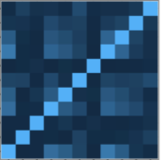
Problem: What panel of genomics assays should we perform on a new cell type?
Genomic position
Budget = 3
Assay type
Assay similarities
Cell type
Selection procedure
Panel:
H3K4me3
H3K79me2
H3K9me3
New cell type

Slide 15

Estimate the similarity between pairs of assay types via correlation
Cell types where both
have been performed
Notes:
Need to motivate choice of facility location function.
Intuitively, the facility location objective function takes a high value when every assay type has at least one similar representative in the panel

Slide 16
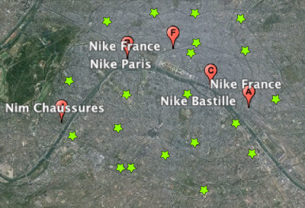
The facility location problem has a submodular objective
Notes:
Need a better example. Can’t see the customers.

Slide 17
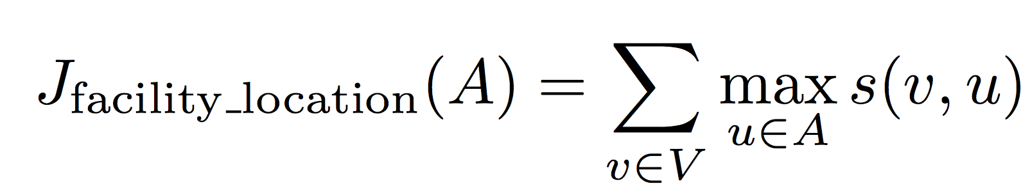
Facility location function
= sum of similarities to most-similar representative
Notes:
Need a better title. Connect better to Nike example.

Slide 18
The quality of a panel of genomics assays is estimated via facility location.
Similarity of two assay types:
Facility location objective function:
Set of all assay types
Cell types where both
have been performed
Notes:
Need to motivate choice of facility location function.
Intuitively, the facility location objective function takes a high value when every assay type has at least one similar representative in the panel
Replace right-hand side with correlation heat map.

Slide 19
Submodular selection of assays (SSA) selects diverse panels
1 MB
Genes
H3K27ac
H3K9ac
H3K4me1
H3K4me2
► H3K4me3
►H3K79me2
H2A.Z
► H3K36me3
H4K20me1
► H3K9me3
► H3K27me3
Notes:
H3K79me2 and H3k36me3 mark different parts of genes and are regulated differently relative the gene’s level of transcription.

Slide 20
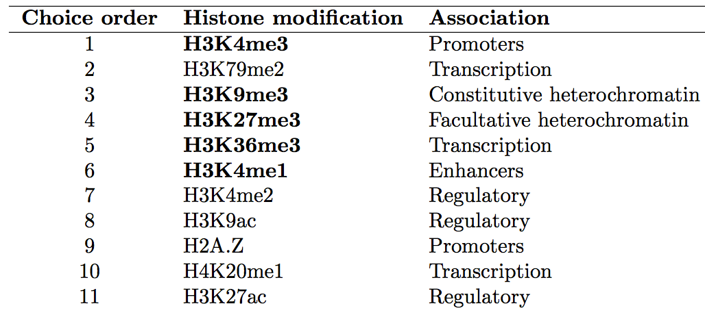
SSA recapitulates the panel manually selected by the Roadmap Epigenomics consortium
Chosen by Roadmap
Notes:
Roadmap’s panel ranks 16/2772 according to the facility location objective function

Slide 21
The submodular function measures the quality of each panel
rank | assay | conditional gain | modular value | function value | rank | assay | conditional gain | modular value | function value
1 | H3K4me3 | 3.183 | 3.183 | 3.183 | 0 | H3K27ac | 2.615 | 2.615 | 2.615
2 | H3K79me2 | 0.971 | 2.403 | 4.154 | 1 | H3K79me2 | 0.836 | 2.403 | 3.451
3 | H3K9me3 | 0.34 | 0.703 | 4.494 | 2 | H3K4me3 | 0.788 | 3.183 | 4.239
4 | H3K27me3 | 0.246 | 0.862 | 4.739 | 3 | H3K9me3 | 0.34 | 0.703 | 4.579
5 | H3K36me3 | 0.227 | 1.214 | 4.966 | 4 | H3K27me3 | 0.246 | 0.862 | 4.824
6 | H3K4me1 | 0.179 | 1.864 | 5.145 | 5 | H3K36me3 | 0.227 | 1.214 | 5.051
7 | H3K4me2 | 0.083 | 3.122 | 5.227 | 6 | H3K4me1 | 0.153 | 1.864 | 5.203
8 | H3K9ac | 0.074 | 3.128 | 5.301 | 7 | H3K4me2 | 0.083 | 3.122 | 5.286
9 | H2A.Z | 0.05 | 2.472 | 5.352 | 8 | H2A.Z | 0.05 | 2.472 | 5.336
10 | H4K20me1 | 0.006 | 1.412 | 5.357 | 9 | H3K9ac | 0.015 | 3.128 | 5.352
11 | H3K27ac | 0 | 2.615 | 5.357 | 10 | H4K20me1 | 0.006 | 1.412 | 5.357
H3K27Ac is redundant

Slide 22
What happens if we start with H3K27Ac?
rank | assay | conditional gain | modular value | function value | rank | assay | conditional gain | modular value | function value
1 | H3K4me3 | 3.183 | 3.183 | 3.183 | 0 | H3K27ac | 2.615 | 2.615 | 2.615
2 | H3K79me2 | 0.971 | 2.403 | 4.154 | 1 | H3K79me2 | 0.836 | 2.403 | 3.451
3 | H3K9me3 | 0.34 | 0.703 | 4.494 | 2 | H3K4me3 | 0.788 | 3.183 | 4.239
4 | H3K27me3 | 0.246 | 0.862 | 4.739 | 3 | H3K9me3 | 0.34 | 0.703 | 4.579
5 | H3K36me3 | 0.227 | 1.214 | 4.966 | 4 | H3K27me3 | 0.246 | 0.862 | 4.824
6 | H3K4me1 | 0.179 | 1.864 | 5.145 | 5 | H3K36me3 | 0.227 | 1.214 | 5.051
7 | H3K4me2 | 0.083 | 3.122 | 5.227 | 6 | H3K4me1 | 0.153 | 1.864 | 5.203
8 | H3K9ac | 0.074 | 3.128 | 5.301 | 7 | H3K4me2 | 0.083 | 3.122 | 5.286
9 | H2A.Z | 0.05 | 2.472 | 5.352 | 8 | H2A.Z | 0.05 | 2.472 | 5.336
10 | H4K20me1 | 0.006 | 1.412 | 5.357 | 9 | H3K9ac | 0.015 | 3.128 | 5.352
11 | H3K27ac | 0 | 2.615 | 5.357 | 10 | H4K20me1 | 0.006 | 1.412 | 5.357
The resulting panels are lower quality.

Slide 23
Selecting TFs in diverse regulatory pathways
Notes:
The vast majority of transcription factors in our data set bind to promoters and enhancers and regulate the transcription of RNA Pol II-transcribed genes.
The top five transcription factors chosen by SSA includes three of these factors, each of which regulate very different regulatory pathways: SMARCB1, an ATP-dependent chromatin remodeler; PML, a tumor suppression factor; and STAT5A, a factor involved in developmental signal transduction (UniProt Consortium, 2014).
CTCF, part of the cohesin complex, regulates chromatin conformation and enhancer- promoter insulation and only about half of its binding sites occur in promoters or enhancers.
BRF2 is part of the RNA Polymerase III complex, which transcribes rRNA, tRNA and other small RNAs.

Slide 24
How can we objectively evaluate the quality of a panel of genomics assays?
Solution: Evaluate the panel’s performance on the most common downstream applications of a panel.
Impute the results of assays outside the panel.
Identify functional elements (e.g. promoters, enhancers).
Use the panel for semi-automated genome annotation.

Slide 25
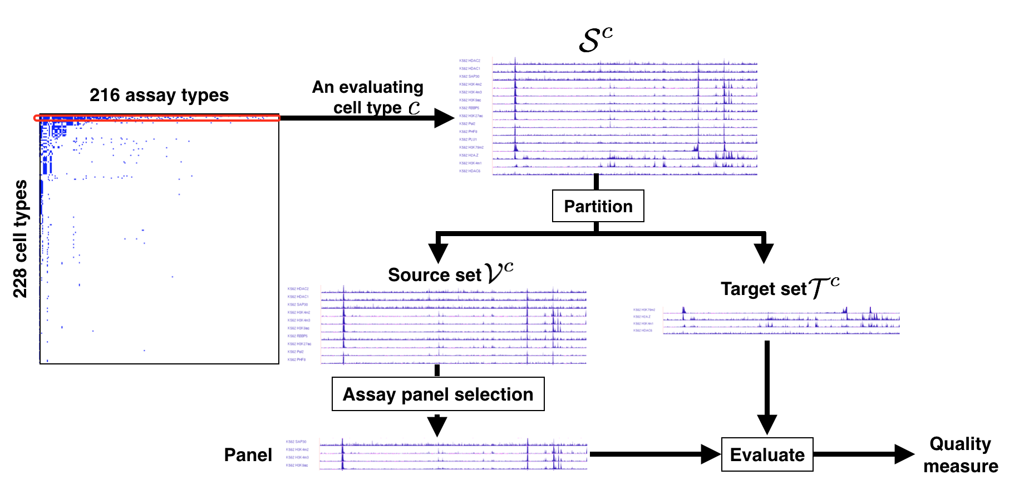
Evaluation involves holding out some data and comparing to the representative set.

Slide 26
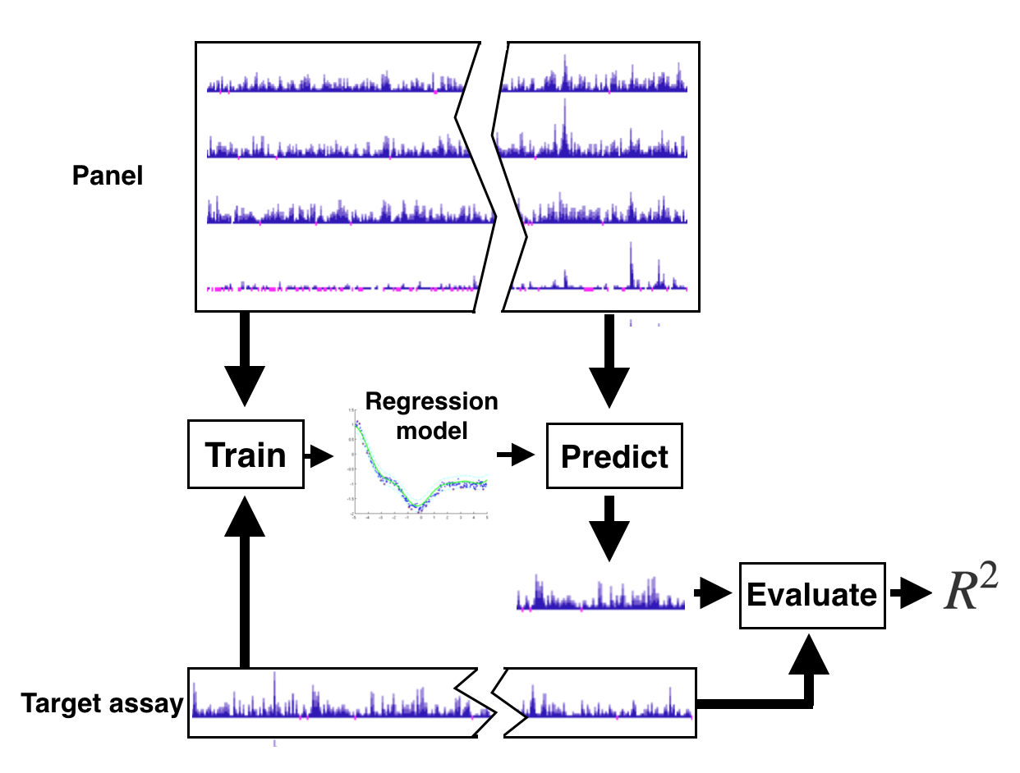
Imputing missing data

Slide 27
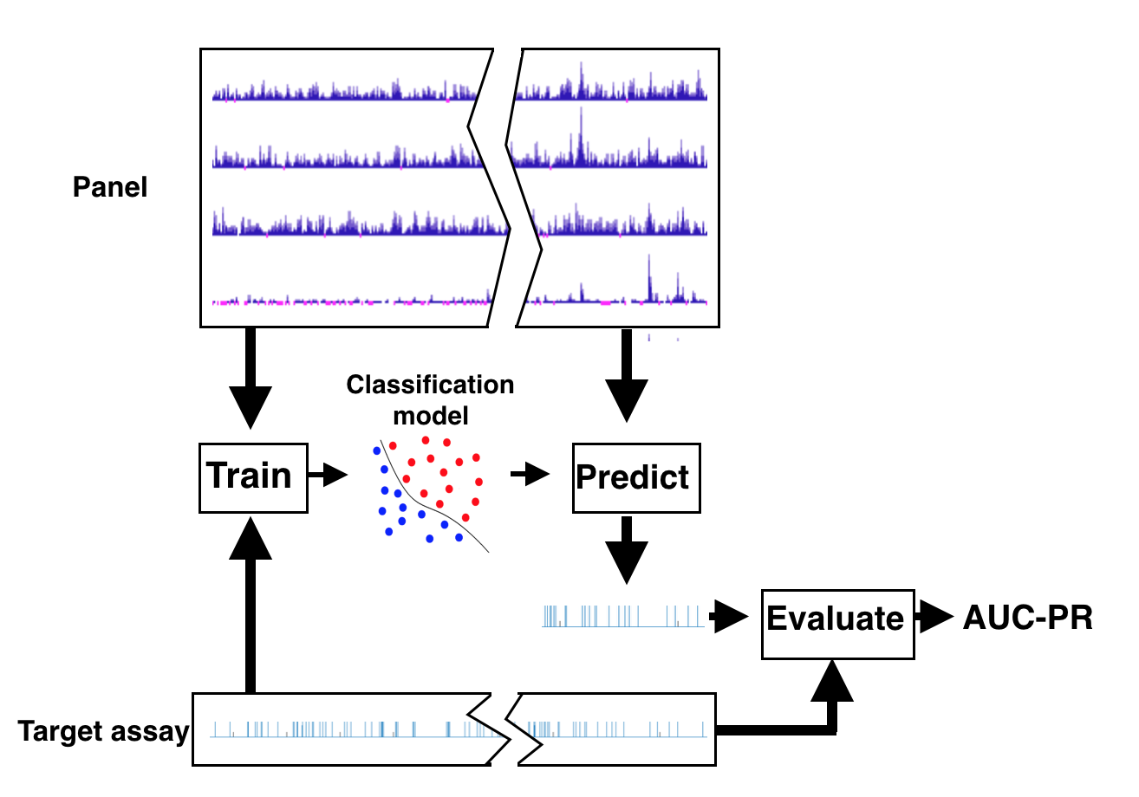
Functional element prediction

Slide 28
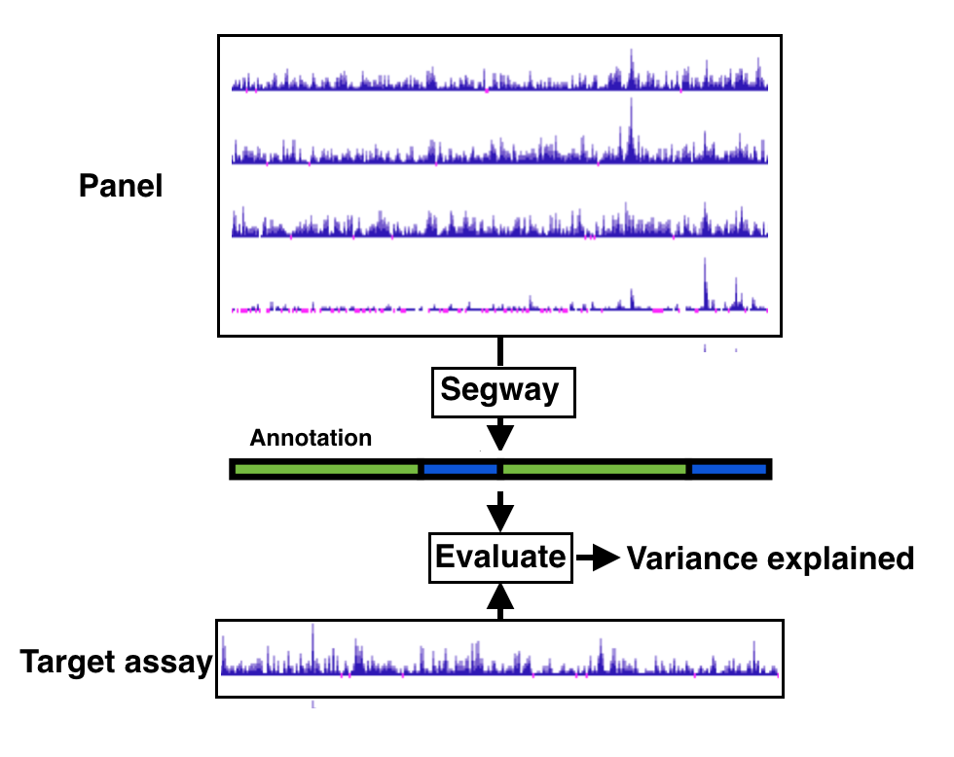
Semi-automated genome annotation

Slide 29
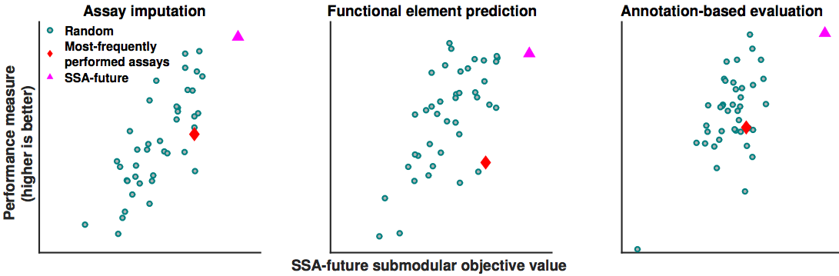
The facility location objective function is correlated with the evaluation metrics
Panels of size 5.
Notes:
Most-frequently performed is a panel, a surrogate for the assays one might choose manually.

Slide 30
SSA selects panels that are high quality according to all three evaluation metrics
Assay imputation
Functional element prediction
Annotation-based evaluation
Normalized performance
Cell type GM12878
Panel size

Slide 31
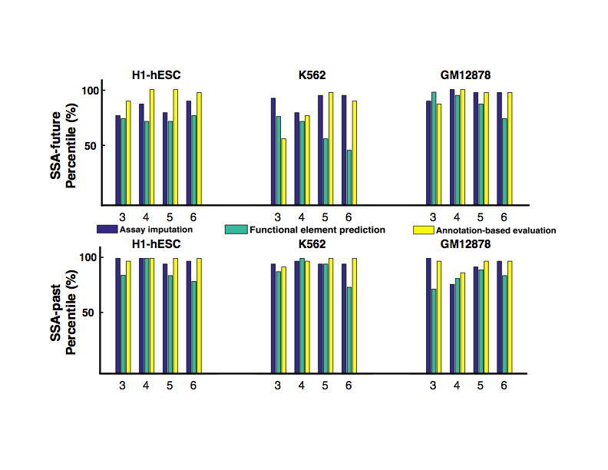
SSA performs well on various cell types
Vertical axis is percentile over 40 random choices.

Slide 32
Problem variant: Which existing assays should you use for a computationally expensive analysis?
Other variants:
“Given these assays, which experiment should I do next?”
“Which cell types should I use?”
“What panel should I use for multiple cell types?”
Existing data
Missing data
Notes:
1) You have already done a few assays in a particular cell type and you want to decide which to do next; (2) You want to choose which cell types to use, rather than which assay types; (3) You want to do SSA-past on multiple cell types, with the restriction that you get the same panel for all cell types.

Slide 33
Using information about the target cell type (SSA-past) usually increases performance
Notes:
FIXME: Make a version of this figure with shared axes.

Slide 34
Removing redundancy in
protein sequence data sets
A submodular optimization framework for representative set selection
Choosing diverse panels
of genomics assays

Slide 35
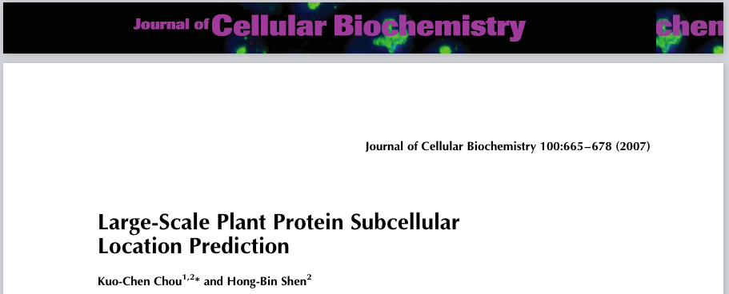
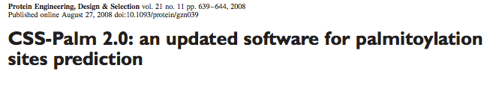
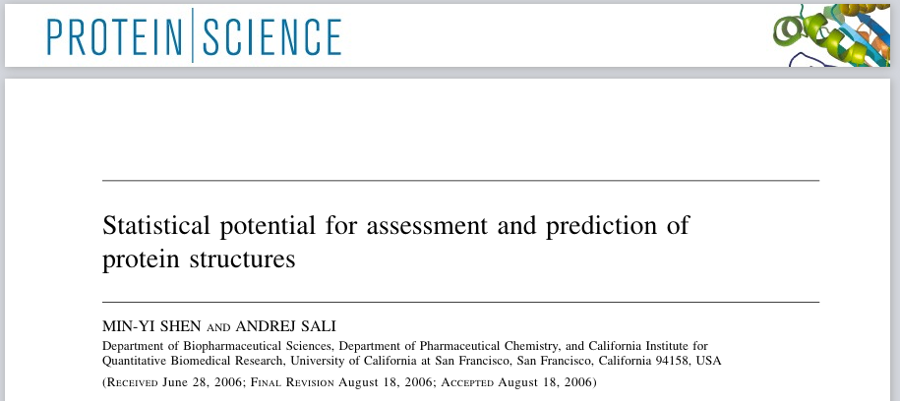
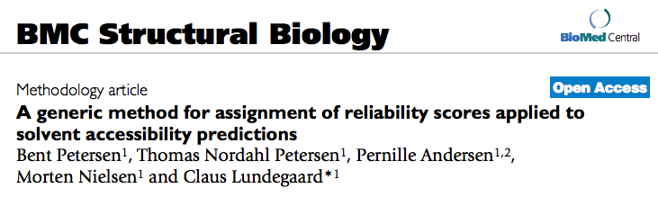
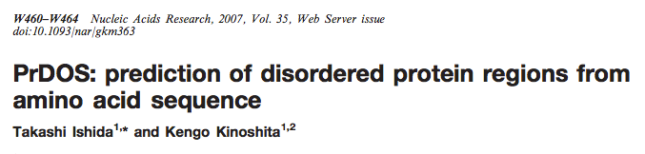
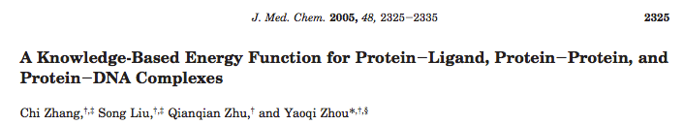
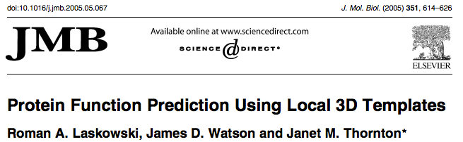
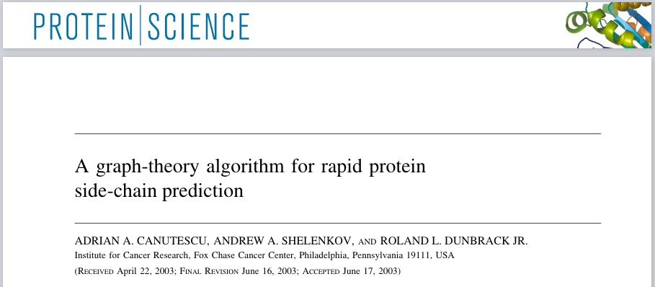
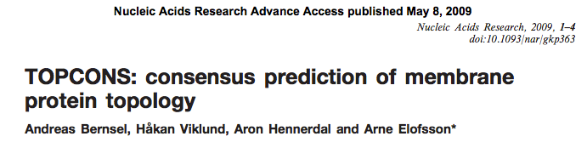
Many people want to find representative sets of protein sequences
>4,000 citations (Google Scholar)

Slide 36
A slightly smaller team
Jeff Bilmes
Max Libbrecht

Slide 37
Existing solutions use a heuristic algorithm
Sort sequences in decreasing order of length.
Initialize representative set A as empty
For each sequence s:
  If the most similar sequence to s in A has similarity <T (e.g. 40% identity), add s to A.
CD-HIT (Li Bioinformatics 2006) and Pisces (Wang Bioinformatics 2003).

Slide 38

We need a submodular estimate of the quality of a subset of protein sequences
Sum-redundancy objective function:
Approaches zero when no sequences are similar to each other.
We tested 29 other objective functions on a development set (21% of the data).

Slide 39
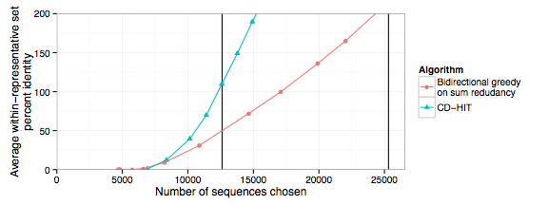
Optimizing sum-redundancy effectively removes redundancy in the representative set
CD-HIT 40%
CD-HIT 90%
Notes:
FIXME: What is the data set, and how large is it?

Slide 40
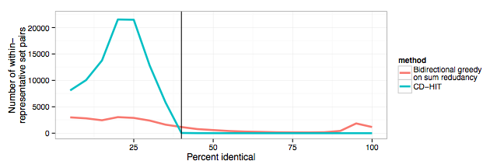
Optimizing sum-redundancy chooses very few sequences with detectable similarity at the cost of choosing a small number of closely-related pairs
40%
Notes:
- This is for a set of size 12,614, the size reported by CD-HIT with 40% identity threshold

Slide 41
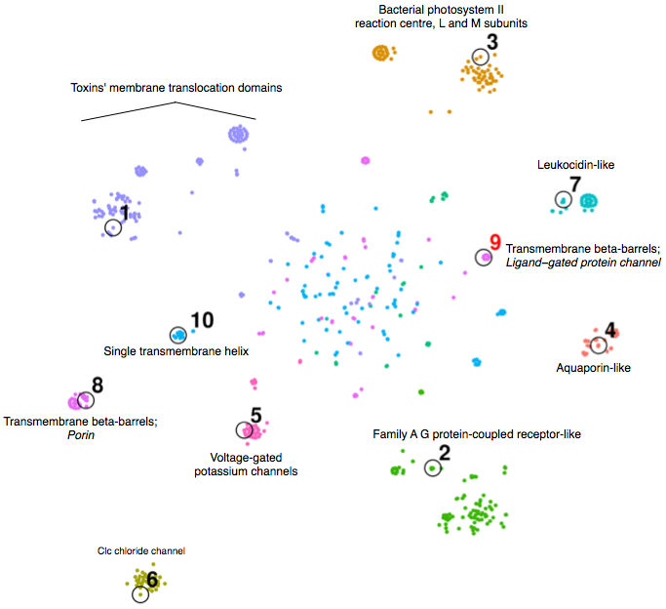
Selection using submodular optimization chooses proteins with diverse structures
Bacterial photosystem II reaction center
Toxin’s membrane translocation domains
Leukocidin-like
SCOPe: “Structural Classification of Proteins—extended”
SCOPe assigns protein domain sequences to protein structure families.
Quality of a subset = Number of families it covers
Transmembrane beta barrels;
Ligand-gated protein channel
Single transmembrane helix
Aquaporin-like
Transmembrane beta-barrels;
Porin
Family A G protein-coupled receptor-like
Voltage-gated potassium channels
Clc choride channel
Projection via t-SNE (Van der Maaten JMLR 2008)
Notes:
The diffuse points in the middle are a common feature of tSNE plots that are a result of the algorithm recapitulating the N-D space imperfectly

Slide 42
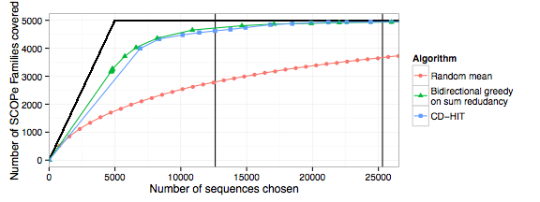
Optimizing sum-redundancy results in representative sets with high structural diversity
Notes:
- This plot is hard to see — let’s subtract random and divide by maximum possible

Slide 43
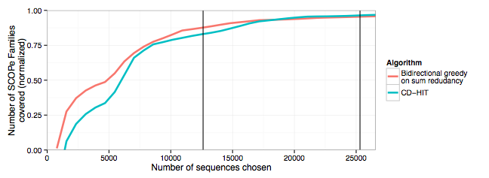
Optimizing sum-redundancy results in representative sets with high structural diversity
Compared to CD-HIT with 40% threshold, we leave 27% fewer families uncovered.

Slide 44
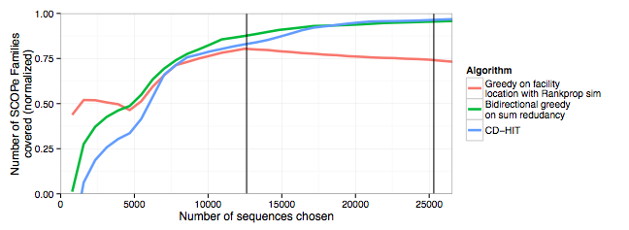
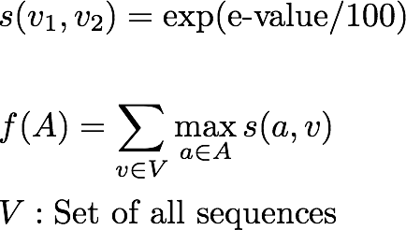
Using a different objective and similarity measure results in better performance for small subsets
Rankprop similarity function:
Facility-location objective function:

Slide 45
Using a different objective and similarity measure results in better performance for small subsets
Rankprop similarity function:
Facility-location objective function:
(Weston PNAS 2004)
Notes:
Intuitively, facility-location takes a high value when every sequence in V has at least one similar representative in A
Facility-location makes up for the weakness of redundancy-minimizing objectives that they cannot differentiate between any representative set with no detectable similarity between any representatives
Conclusion: the two objectives have orthogonal information

Slide 46
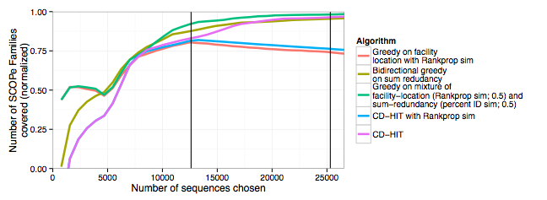
A mixture of objective functions performs better than any single function

Slide 47
What data sets do you want to summarize?

