Slide 1
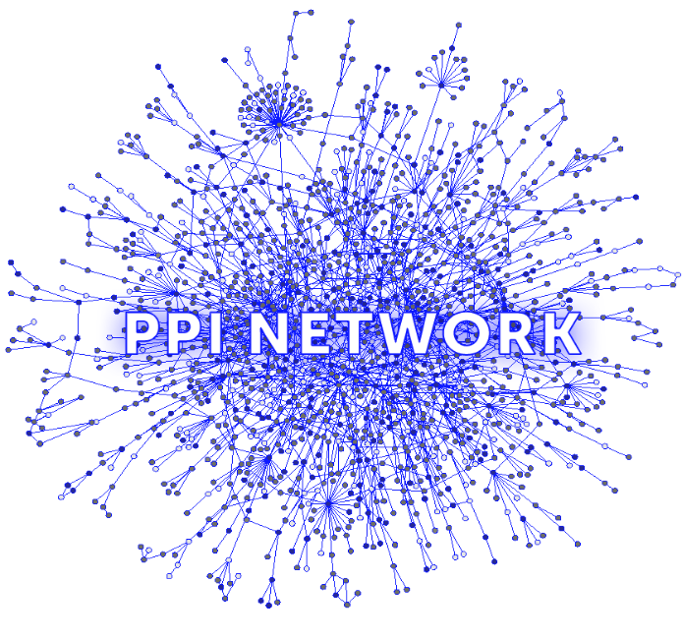
INFERENCE OF PERSONALIZED DRUG TARGETS VIA NETWORK PROPAGATION
Ortal Shnaps, Eyal Perry, Dana Silverbush and Roded Sharan
PSB 2016

Slide 2
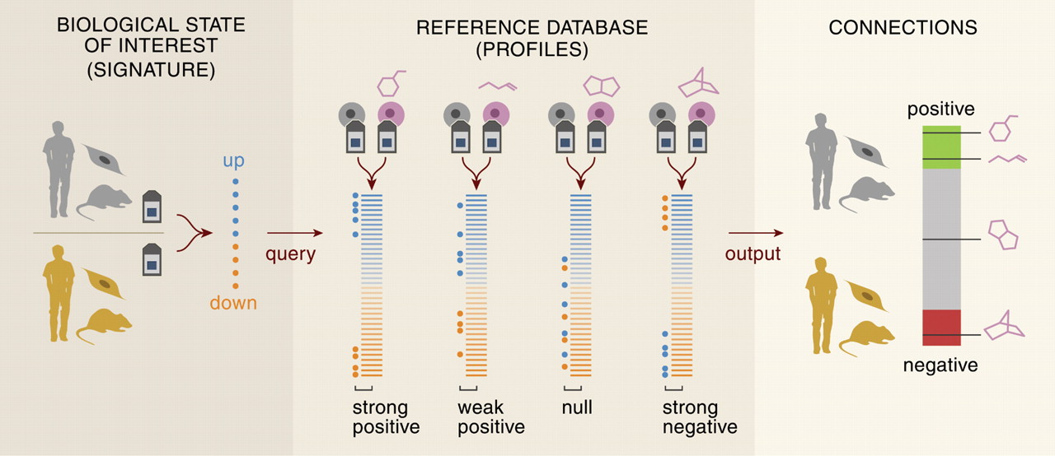
Promising Drug Targets Reverse Expression Signature
Gene Expression query
Connectivity Score
Lamb et. al. “The Connectivity Map: using gene-expression signatures to connect small molecules, genes, and disease,” Science, 2006.

Slide 3
Looking For Drug Targets Using In-Silico Knockouts in a PPI Network
Disease State
Disease State + Drug
Mutation
signal from mutations
inhibition

Slide 4
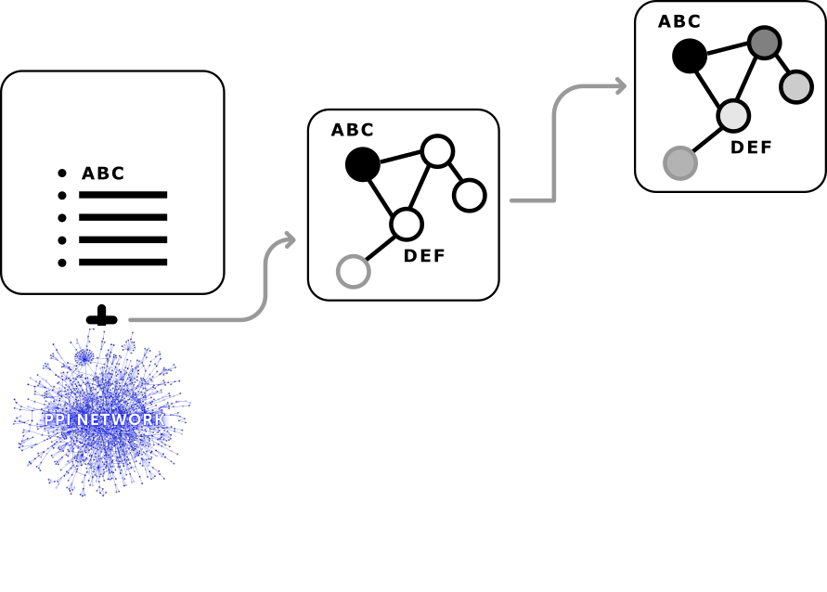
Knockout of Good Drug Target Will Reverse the Disease-Related Effects
Differentially expressed genes
propagation
g1
g2
g3
g4
g5
g6
g7
g8
g9
g10
Patient’s mutation data

Slide 5
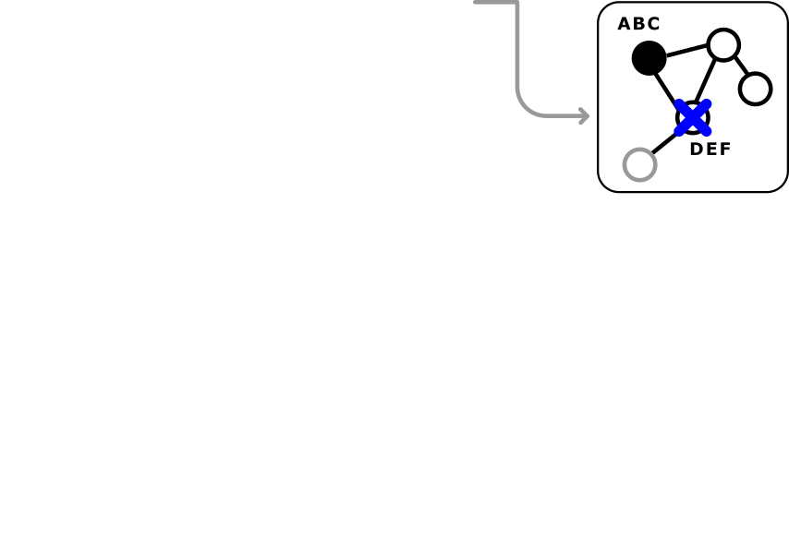
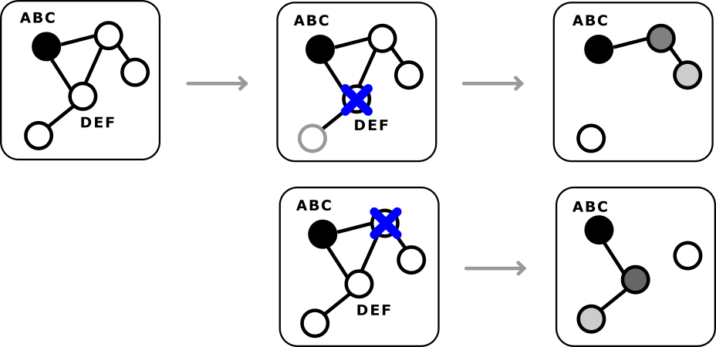
Knockout of Good Drug Target Will Reverse the Disease-Related Effects
Differentially expressed genes
propagation
g1
g2
g3
g4
g5
g6
g7
g8
g9
g10
Patient’s mutation data
propagation
knockout
propagation
g1
g2
g3
g4
g5
g6
g7
g8
g9
g10

Slide 6
Knockout of Good Drug Target Will Reverse the Disease-Related Effects
Differentially expressed genes
propagation
g1
g2
g3
g4
g5
g6
g7
g8
g9
g10
Patient’s mutation data
g1
g2
g3
g4
g5
g6
g7
g8
g9
g10
knockouts
propagation
g1
g2
g3
g4
g5
g6
g7
g8
g9
g10

Slide 7
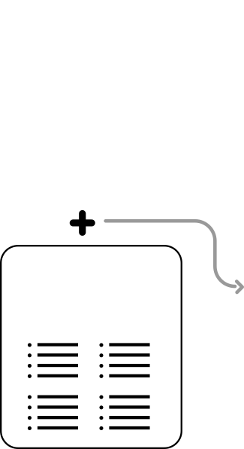
Knockout of Good Drug Target Will Reverse the Disease-Related Effects
Differentially expressed genes
propagation
g1
g2
g3
g4
g5
g6
g7
g8
g9
g10
Patient’s mutation data
g1
g2
g3
g4
g5
g6
g7
g8
g9
g10
knockouts
propagation
g1
g2
g3
g4
g5
g6
g7
g8
g9
g10
Simulated “healthy” state

Slide 8
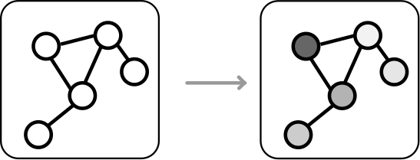
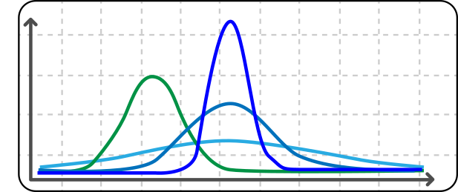
Knockout of Good Drug Target Will Reverse the Disease-Related Effects
Differentially expressed genes
propagation
g1
g2
g3
g4
g5
g6
g7
g8
g9
g10
Patient’s mutation data
g1
g2
g3
g4
g5
g6
g7
g8
g9
g10
knockouts
propagation
g1
g2
g3
g4
g5
g6
g7
g8
g9
g10
Simulated “healthy” state

Slide 9
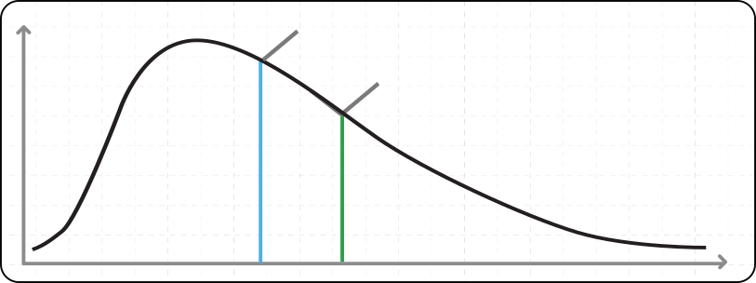
Score Drug Target for Single Differentially Expressed Gene
For a single gene with a single knockout:
Post KO
Pre KO

Slide 10
Back2Health(drug) = count reversing events
Back2Health score =
Differentially expressed genes
Post KO
Pre KO
|Differentially expressed genes|

Slide 11
Evaluate With Known Drug Targets
Hippie PPI network
186,217 interactions among 15,029 proteins.
174 AML samples
on average 7.6 mutated and 340 differentially expressed genes per patient.
Patient specific ranked drug targets
Aggregate results for validation

Slide 12
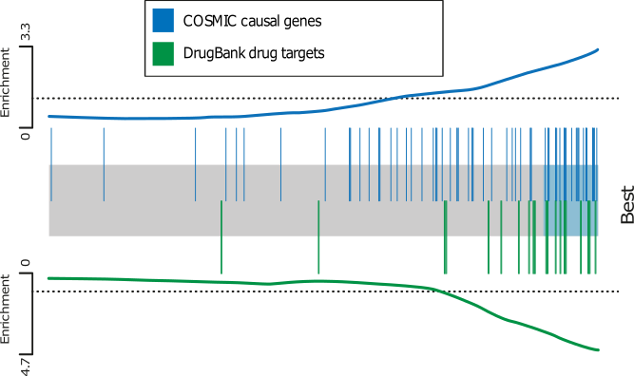
Top scoring targets (1%) were highly enriched with known drug targets
Cosmic obtained 72 causal genes
DrugBank version 4.3 obtaining 22 drug targets.

Slide 13
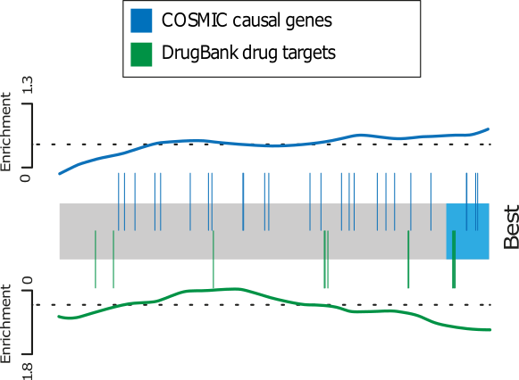
Patient-Specific Approach vs. Consensus Patient
Naïve approach focusing on common mutations

Slide 14
Predicting Sensitivity for FLT3-ITD Patients Replicates In-Vitro Results
In-Vitro Conclusions:
Poorly responsive to PI3K inhibitor
Decreased abnormal proliferation, yet showing unchanged abnormal levels of apoptosis for MEK inhibitor
Responded with high sensitivity to PIMs inhibitor, led to development of AZD1208
Back2Health Score
Drug Target Candidate
Notes:
Multiple knockouts

Slide 15
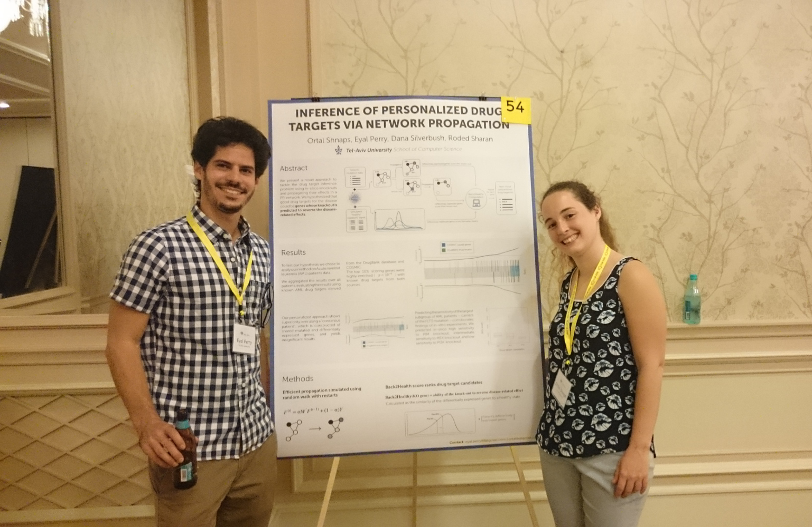
Thank you
Ortal Shnaps & Eyal Perry PSB 2016

