Slide 1
Joint Analysis of Multiple Cancer Types for Revealing Disease-Specific Genomic Events
David Amar and Ron Shamir
School of Computer Science
Tel Aviv University
Simons Inst. workshop on Computational Cancer Biology
UC Berkeley, Feb. 1 2016
1
Notes:
1
Contents: Adeptus + new Cosmic results
30 minutes

Slide 2
The Omics data deluge
1.7 million expression profiles in GEO
How can we exploit this richness?

Slide 3
The Omics data deluge (2)
1.2M cancer mutation profiles in COSMIC
How can we exploit this richness?
Notes:
218 databases listed – in reality there are probably at least 10 times as many

Slide 4
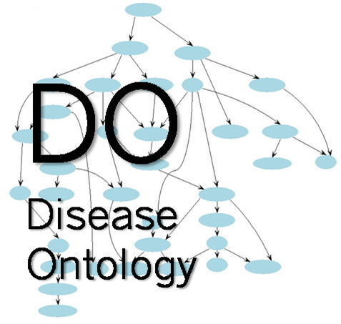
…and put it in disease context?
> 6500 DO terms

Slide 5
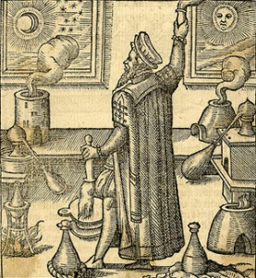
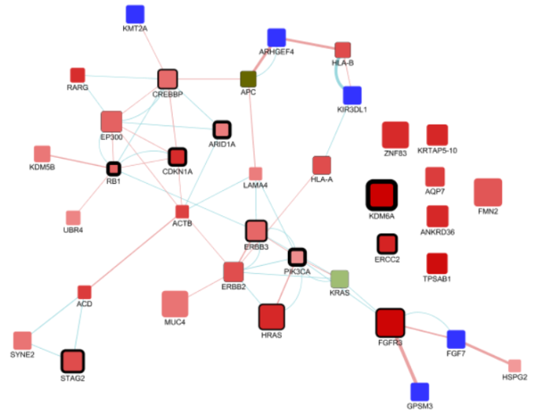
Outline
Expression-based classification
Mutation-based classification
Tom Hait
Shai Izraeli
Sheba Hospital
Notes:
5

Slide 6
I. Expression based classification
Amar et al., NAR 2015
6
6
Notes:
6

Slide 7
Goals
Single study disease biomarkers: predictive, but not reproducible and low on biomed context.
Want
Better biomarkers from numerous expression profiles of many diseases
More robust
More interpretable
Huang et al. PNAS 2010; Schmid et al. PNAS 2012; Lee et al. Bioinformatics 2013; Altschuler et al. Genome Med 2013

Slide 8
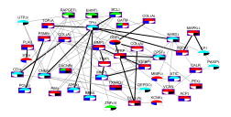
The analysis process
Sample features & labels
Well- classified diseases
Biomarker gene sets
Disease summaries
Manually annotated expression database
Classification
Disease specific differential genes
Integration of external data
GEO,TCGA
Multi-label classification, Disease-specific validation
Disease Ontology
Mutations,
Drugs,
Interactions
>13K profiles (GEO)
170 datasets
17 platforms

Slide 9
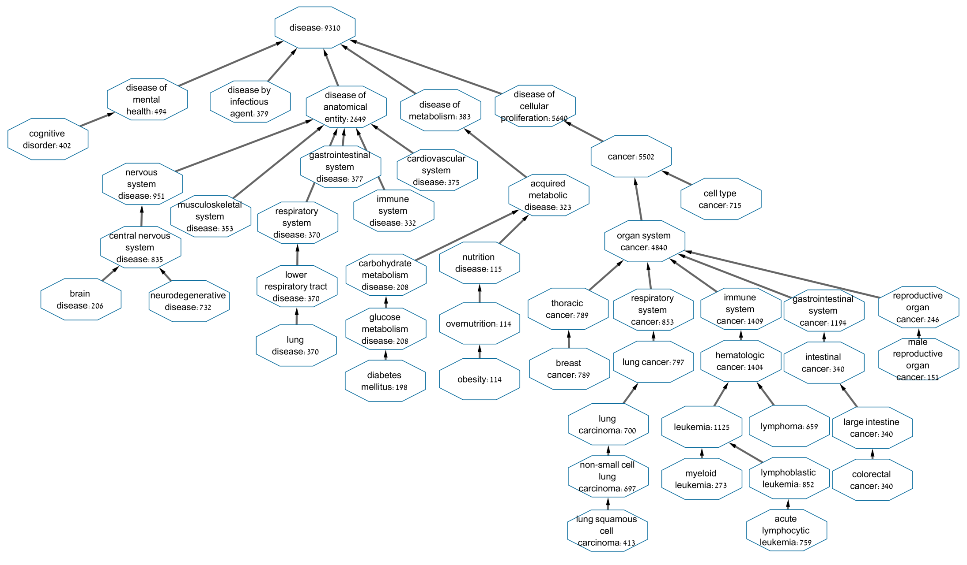
48 participating DO terms
Criteria: ≥ 5 datasets; ≥ 100 samples

Slide 10
Multi-label classification
Several correct labels possible per sample
Approaches:
Learn separately each single class for each disease
Adaptation: Bayesian Correction (Barutcuoglu et al. 2006)
Transformation: use label power-sets and learn a multiclass model (Tsoumakas 2009)
Notes:
Power set: Using RF: similar to multi-label trees
Power set was better than most approaches in an experimental study (Madjarov et al. 2012)

Slide 11
Evaluating the algorithms
Use leave-dataset-out cross-validation
Global AUC scores: sort all Pij and compare to Yij
Disease-based AUC: same for each column separately
Classifier output:
True labels:
Disease terms
Disease terms
P
Y
Test set
Samples
Samples
Probabilities [0,1]
{0,1}

Slide 12
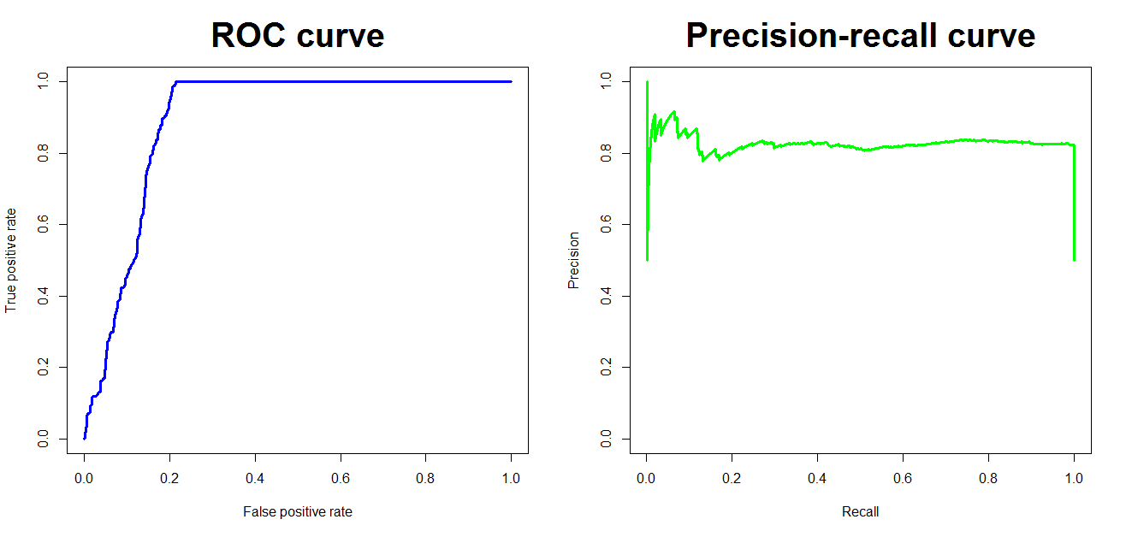
An embarrassment of riches
For a disease D define:
Positives: disease samples
Negatives: direct controls in the same study
Background controls (BGCs): all others
Scores can be high even if positives ≈ negatives and both differ from BGCs
Disease D studies
controls
cases
All other diseases
500 positives, 500 negatives, identically distributed, 10000 BGCs with lower mean

Slide 13
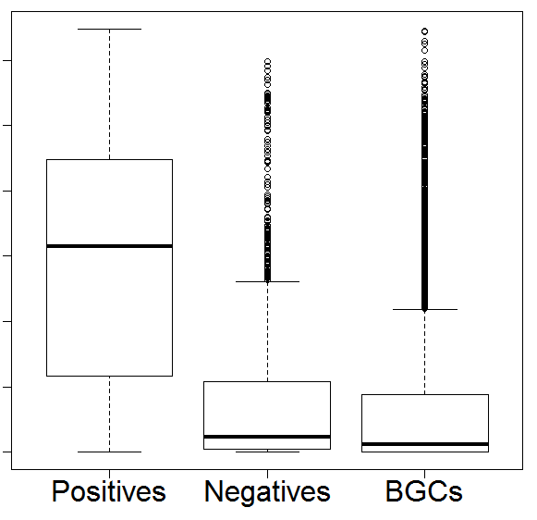
Solution: stricter evaluation, multiple criteria
(1) PN-ROC: AUC positives vs. negatives
(2) PB-ROC: AUC positives vs. BGCs
Probability
(3) SMQ: Study-based meta-analysis q-value for combined confidence on the disease datasets
per-dataset Z-score, summarize using Stouffer’s method, correct by FDR.

Slide 14
Comparing classifiers
*Multi-label classifiers
LP: label power-set* BC: Bayesian correction*
RF: random forest SVM: support vector machine

Slide 15
Comparing classifiers (2)
Well-classified disease terms:
SMQ < 0.05, PB-ROC > 0.7, PN-ROC > 0.7

Slide 16
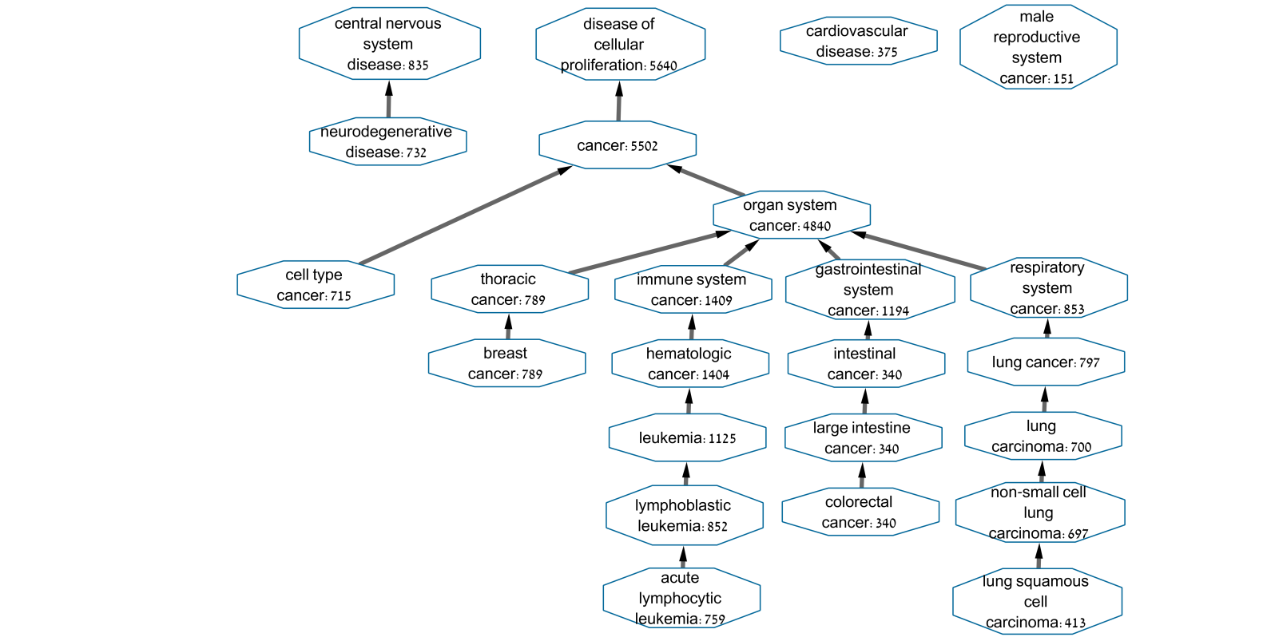
24 well-classified diseases

Slide 17
Independent validation: RNA-seq
Data: 1,699 samples (TCGA)
AUC > 0.96

Slide 18
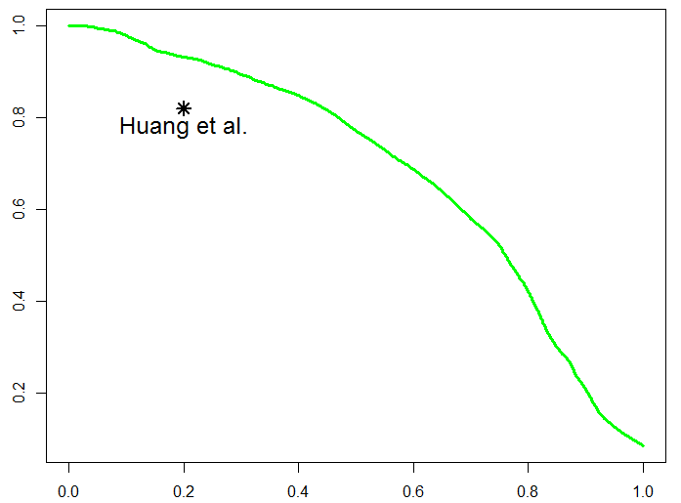
Validation 2: Global AUPR
PNAS 2010
precision
recall
Notes:
24% higher recall at the same precision
11% higher precision at the same recall

Slide 19
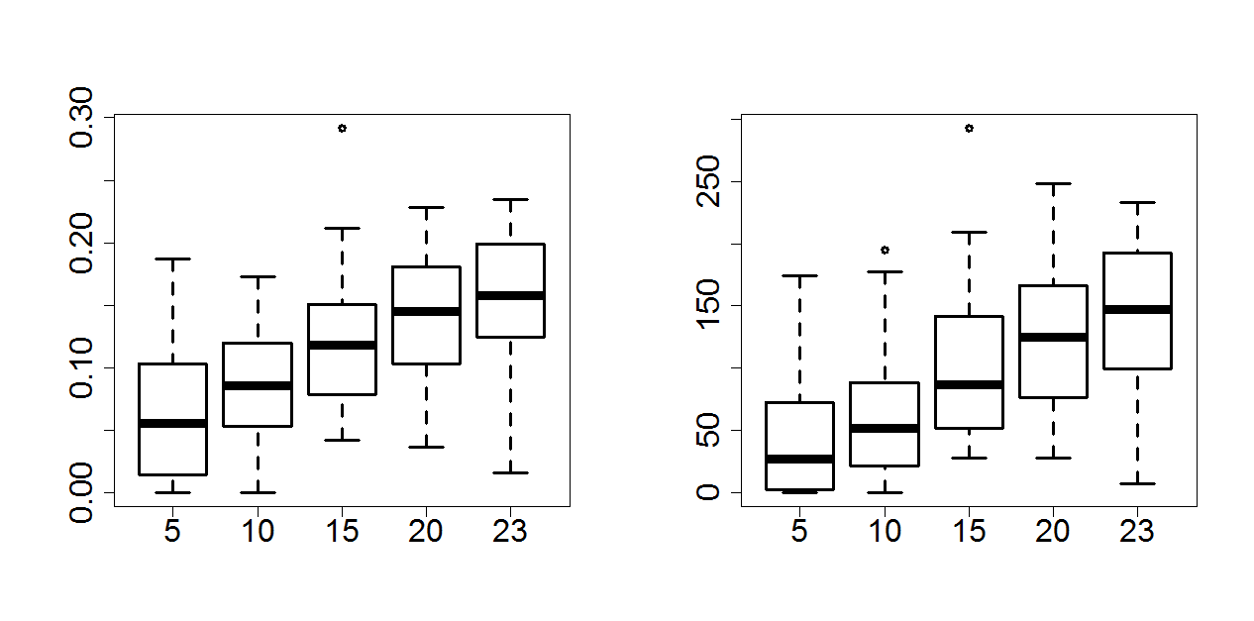
Robustness
Compute differential genes on disjoint groups of datasets, calculate their overlap, significance
Assuming linear trend continues:
At 46 datasets, 4,258 samples: Jaccard ~ 0.29 (p < 1E-270).
For 100 datasets, 10,000 samples: Jaccard ~ 0.6.
Cancer
Jaccard
-log p-value
Number of datasets
Number of datasets

Slide 20
Selecting biomarker genes
For disease D, ∀ gene G, rank samples by G’s expression
Call G differential for D if
PB-ROC, PN-ROC > 0.65, SMQ <0.05
G has SMQ < 0.05 on samples with label D but no child labels
Notes:
Differential: its PB-ROC, PN-ROC > 0.65, SMQ<0.05
To avoid inheriting genes from a child: require SMQ <0.05 on parent samples only

Slide 21
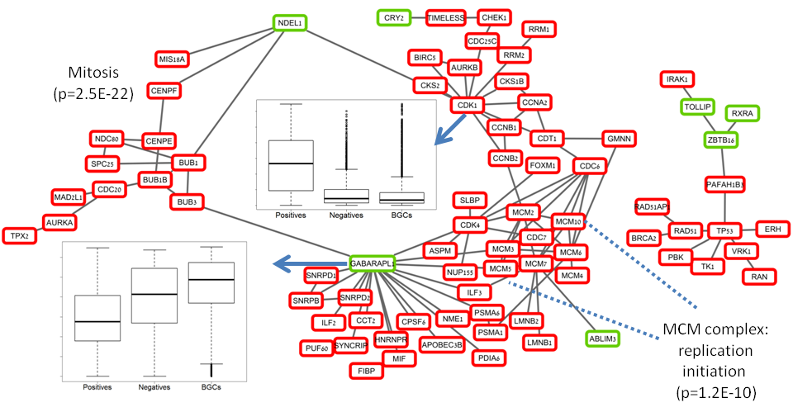
Projecting the cancer biomarker genes on the PPI network
258 cancer-specific genes
The two largest components in the PPI graph:
Down: cytoskeleton
Up:
TP53 network
Mitosis
Replication
Cell cycle
Impaired rewiring of replication pathway?
Notes:
Mitosis submodule is upregulated but its ability to form physical interactions with cytoskeleton related factors is impaired.

Slide 22
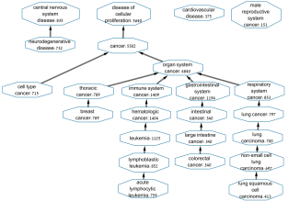
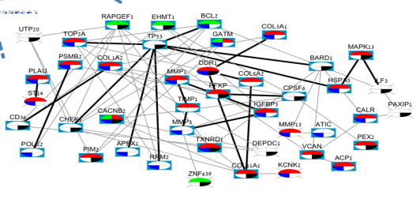
Summary (1)
A new GE compendium
Multi-label classification
Dataset-level CV, validation on RNA-Seq data
Simple approach wins
Improves over extant studies
Improving interpretability
Disease-specific differential genes
Not Shown: Integration with network, mutation, drug target data reveals therapeutic potential
Computational take home lessons:
Must separate controls and BGCs
Reproducible biomarkers: still a challenge
ADEPTUS*
*Annotated Disease Expression Profiles Transformed into a Unified Suite
http://acgt.cs.tau.ac.il/adeptus/

Slide 23
II. Mutation based classification
23
23
Notes:
23

Slide 24
Moving to other genomics
The flow can be used for other genomic data
Somatic mutations
Great, we have the TCGA
Not so great – no negatives

Slide 25
A large compendium of annotated somatic mutations
Easy to work with
>1,000,000 samples
Most samples are from small-scale experiments or are not curated
DO labels: much easier to map than GEO
COSMIC maintains a controlled vocabulary
~770,000 patients mapped to DO terms

Slide 26
Data selection
Filter
(labels) Only samples with mapped DOs terms
(curated) Only “confirmed somatic mutations”
(WG) Samples from whole exome studies
9,304 patients
4,636 are from the TCGA

Slide 27
Tested algorithms
52 terms with > 50 patients, 3 datasets
Multi-label algorithms
MLkNN, HOMER, RFPCT, Single (BR), BC
Most terms are tiny, require many trees
➔ RF*: revised Random Forest:
Let P,N,B be the pos, neg, and BGCs sets
F = an empty forest
Repeat K times
Sample B*, a set of |N|+|P| samples from B
Learn an RF using P,N ∪B*
Combine with F

Slide 28
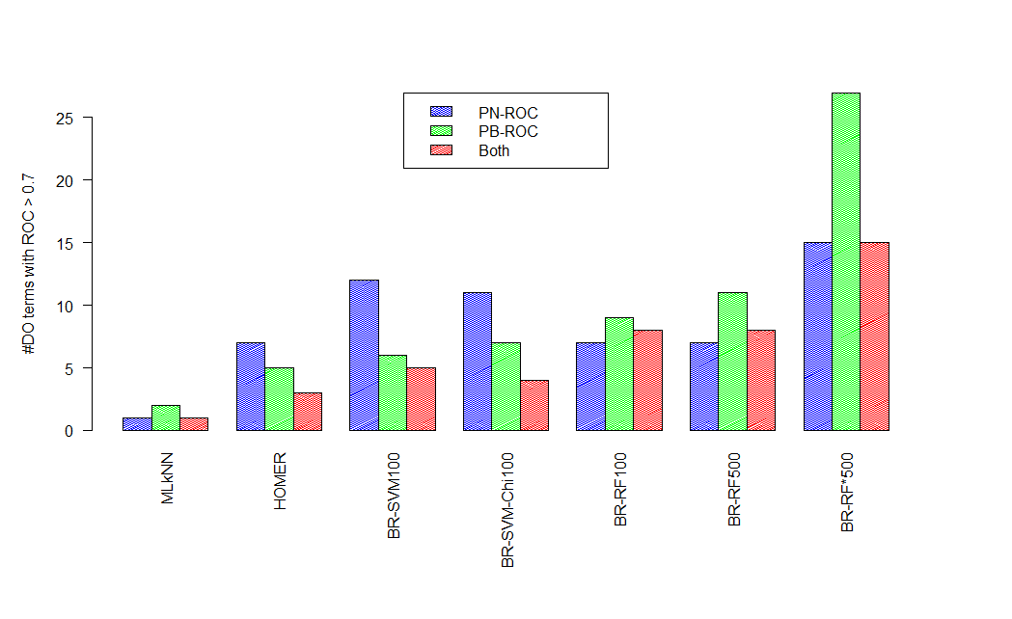
LDO Results
Benign neoplasm
Kidney cancer
Bladder cancer
Immune cancers
Pancreatic cancer
Liver cancer
Intestinal
…
colorectal has low PN-ROC
No terms when using the number of mutations as a single feature: large differences between TCGA and nonTCGA (details later)

Slide 29
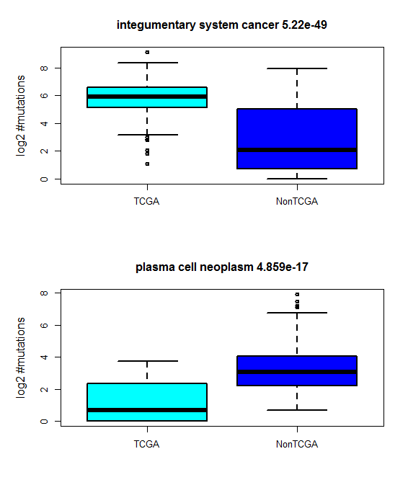
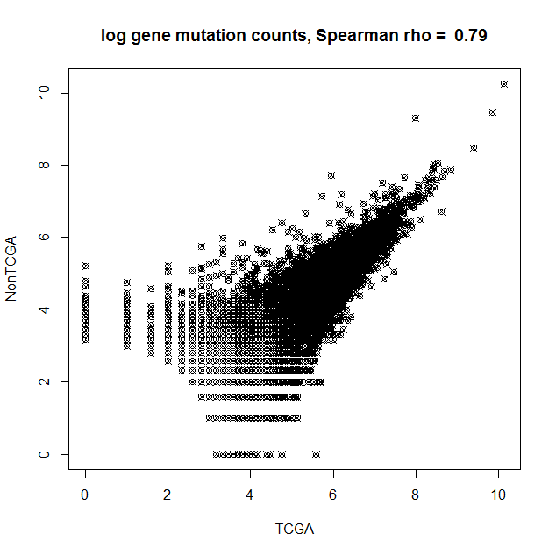
TCGA vs. non TCGA
#Mutations per gene
#Mutations per sample (examples)
Sig. diff (p<0.001 Bonf) in 22 out of 42 terms
TCGA>NonTCGA in 13 out the 22 cases

Slide 30
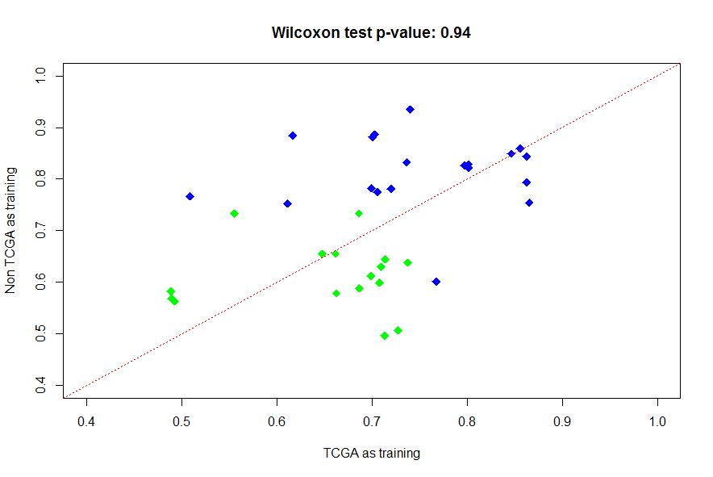
Training on one set, testing on the other
19 DO terms with ROC > 0.75 (in the union)
Caution! No negatives

Slide 31
Interpreting the classifiers
For each disease D
Take the top 50 genes in the RF
Their enrichment score:
P(mut in D)/P(mut not in D)
Add PPI and pathway networks, focus on the largest component

Slide 32
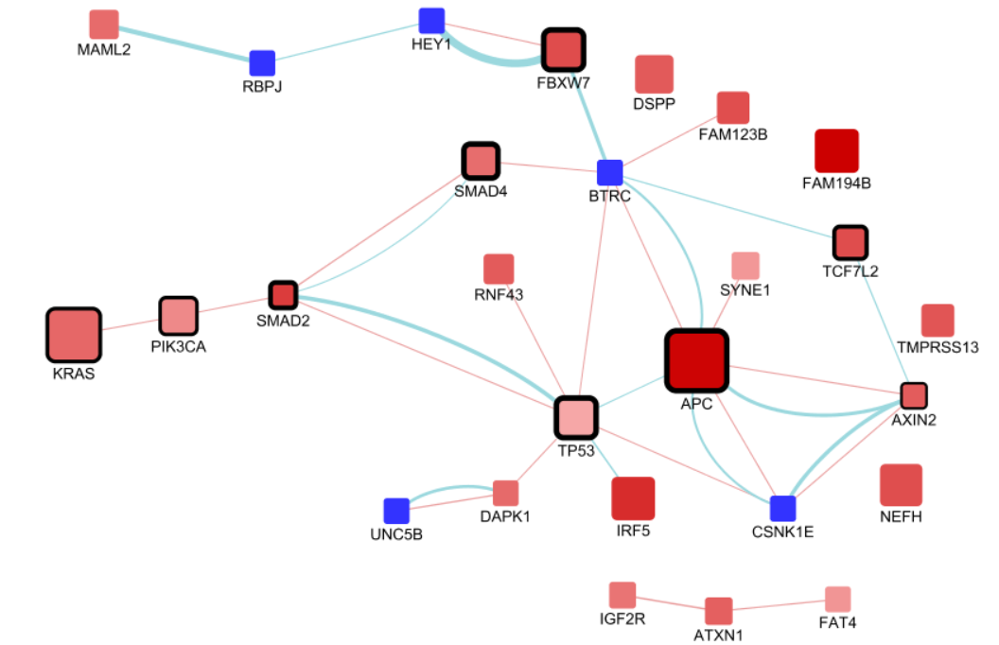
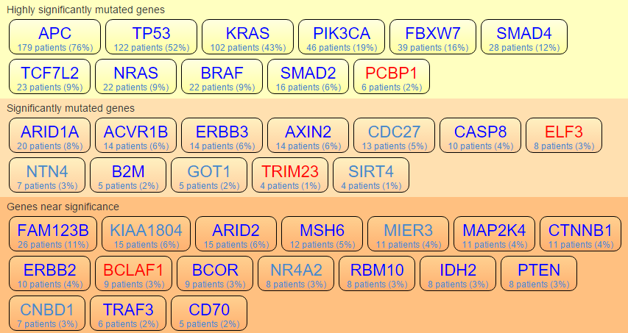
Intestinal cancer: nice agreement with colon
Gene enrichment factor log (P₁/ P₀)
-0.55
3.5
GeneMania Added gene
Tumorportal (Lawrence Nature 14) CRC:
√
√
√
√
√
√
√
√
√
√
P (overlap with highly sig. mut) < 1E-15

Slide 33
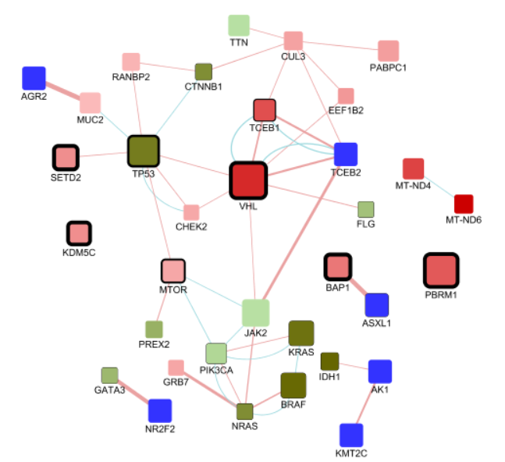
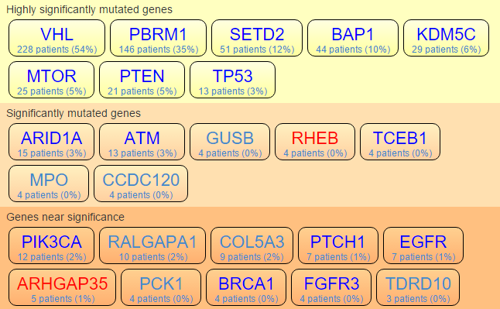
Kidney: nice agreement with corrections
Gene enrichment factor log (P₁/ P₀)
-2.72
5.1
GeneMania Added gene
Tumorportal
KIRC (Kidney):
√
√
√
√
√
√
√
√
genetic interactions?

Slide 34
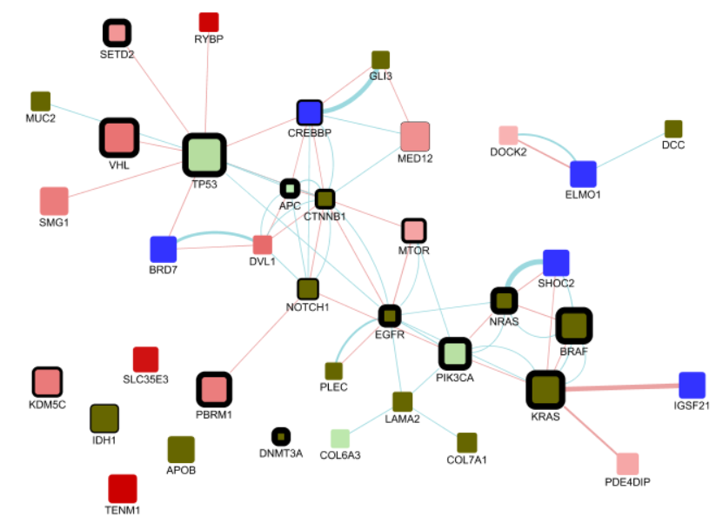
Benign: non TCGA example
Gene enrichment factor log (P₁/ P₀)
<-10
3.9
GeneMania Added gene
Node border width is proportional to the q-value reported in Lawrence et al. (Nature 14) for all PanCan. Only nodes with q<0.1 have border.

Slide 35
Summary (2)
TCGA is not enough – COSMIC adds value
Better, faster classification by treating negatives, BGC differently
Can classify 28% of terms
Can classify some additional non-TCGA terms
Classifier interpretation
Recapitulates the main cancer genes
Refines Tumorportal: removes and adds genes, new terms
Not shown: additional classification results
Example: Small-scale data
91 DO terms; 249 genes; 21,586 samples
33 DO terms with PB and PN ROC > 0.7

