Slide 1
Orthogonal Vectors is hard for first-order properties on sparse graphs
Computational Complexity of Low-Polynomial Time Problems Workshop
Dec. 3, 2015
Jiawei Gao, Russell Impagliazzo
UC San Diego

Slide 2
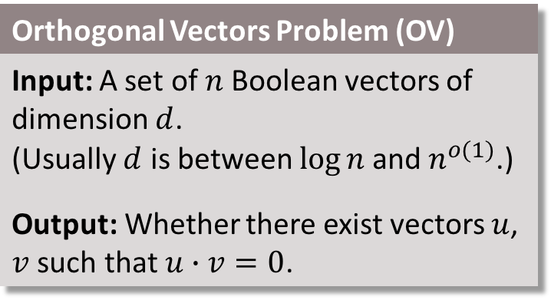


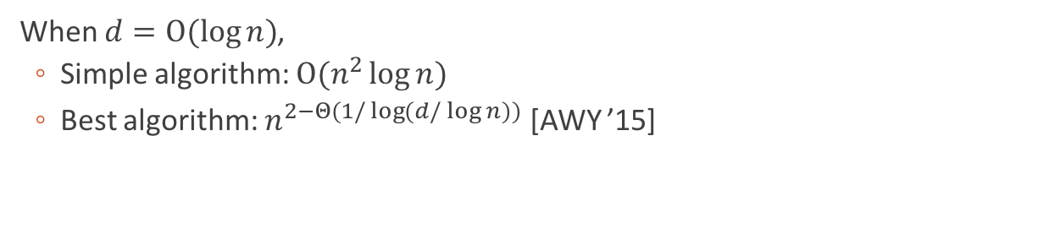



Introduction
$$d$$
Orthogonal Vectors Problem (OV)
Input: A set of $n$ Boolean vectors of dimension $d$. (Usually $d$ is between $\log{n}$ and $n^{o(1)}$.) Output: Whether there exist vectors $u$, $v$ such that $u∙v=0$.
1 | 1 | 0 | 1 | 1
$$u$$
0 | 1 | 0 | 0 | 1
1 | 0 | 0 | 1 | 1
$$n$$
$$v$$
1 | 0 | 1 | 0 | 0
When $d=O(\log{n})$,
  Simple algorithm: $O(n^{2}\log{n})$
  Best algorithm: $n^{2−Θ(1/\log{(d/\log{n})})}$ [AWY ’15]
0 | 1 | 0 | 1 | 0
Orthogonal Vectors Conjecture
OV with $d=O(\log{n})$ requires time $n^{2−o(1)}$.
Implied by SETH

Slide 3







Introduction
Sparse OV
$$m^{2−ε^{′′}}$$
Frechet Distance
$$n^{2−ε^{′′}}$$
Edit Distance
Longest Common Substring
Sparse Graph Diameter
Local Alignment
LCS
..
$$∈$$
FO graph properties
$$m^{2−ε^{′}}$$
OV
$$n^{2−ε^{′}}$$
Hitting set
k-clique
Polynomial
k-dominating set
…
$$m^{k−ε^{′′}}$$
NP-complete
k-CNF-SAT
$$2^{\left(1−ε\right)n}$$
Notes:
Motivations

Slide 4
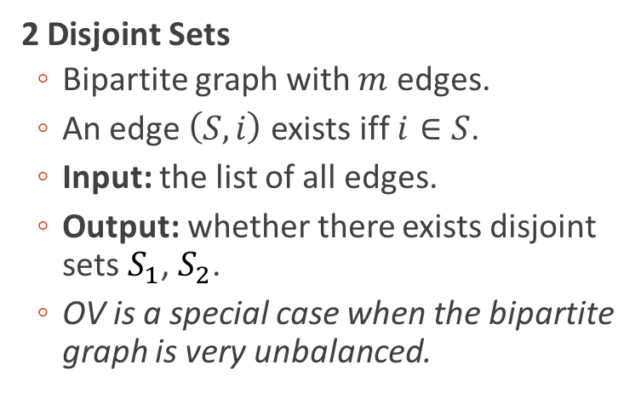




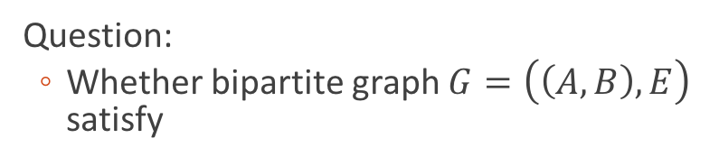
“Sparse” OV Problem
2 Disjoint Sets
  Bipartite graph with $m$ edges.
  An edge $\left(S,i\right)$ exists iff $i∈S$.
  Input: the list of all edges.
  Output: whether there exists disjoint sets $S_{1}$, $S_{2}$.
  OV is a special case when the bipartite graph is very unbalanced.
$$u$$
0 | 1 | 0 | 0 | 1
$$v$$
1 | 0 | 1 | 0 | 0
1
$$S_{u}$$
2
$$S_{v}$$
3
Question:
  Whether bipartite graph $G=\left(\left(A,B\right),E\right)$ satisfy
4
5
$$\left(∃S_{1}∈A\right)\left(∃S_{2}∈A\right)\left(∀i∈B\right) \left[¬((S_{1},i)∈E)∨¬((S_{2},i)∈E)\right]$$
Notes:
TODO

Slide 5

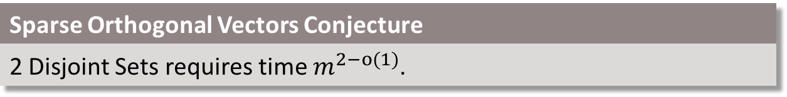
“Sparse” OV Conjecture
Orthogonal Vectors Conjecture
OV with $d=O(\log{n})$ requires time $n^{2−o(1)}$.
Sparse Orthogonal Vectors Conjecture
2 Disjoint Sets requires time $m^{2−o(1)}$.

Slide 6
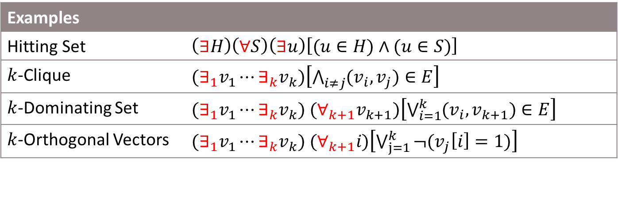
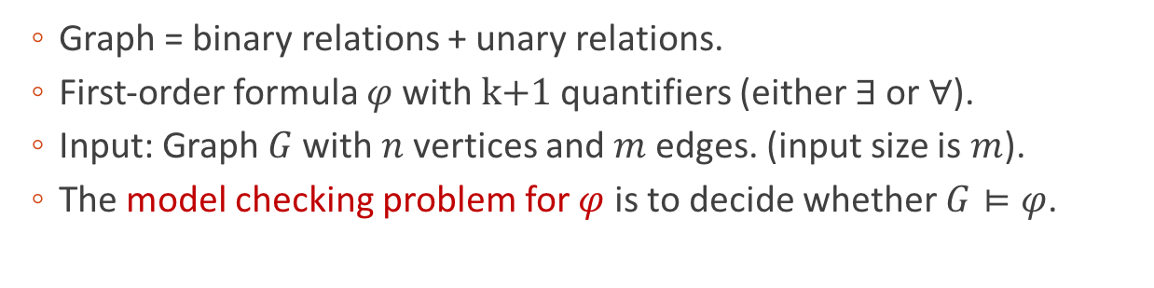
First-order graph property
  Graph = binary relations + unary relations.
  First-order formula $φ$ with k+1 quantifiers (either $∃$ or $∀$).
  Input: Graph $G$ with $n$ vertices and$m$ edges. (input size is $m$).
  The model checking problem for $φ$ is to decide whether $G⊨φ$.
Examples
Hitting Set | $\left(∃H\right)\left(∀S\right)\left(∃u\right)\left[(u∈H)∧(u∈S)\right]$
$k$-Clique | $(∃_{1}v_{1}⋯∃_{k}v_{k})\left[\bigwedge_{i≠j}{(v_{i},v_{j})∈E}\right]$
$k$-Dominating Set | $(∃_{1}v_{1}⋯∃_{k}v_{k}) (∀_{k+1}v_{k+1})\left[\bigvee_{i=1}^{k}{(v_{i},v_{k+1})∈E}\right]$
$k$-Orthogonal Vectors | $(∃_{1}v_{1}⋯∃_{k}v_{k}) (∀_{k+1}i)\left[\bigvee_{j=1}^{k}{¬(v_{j}\left[i\right]=1)}\right]$

Slide 7

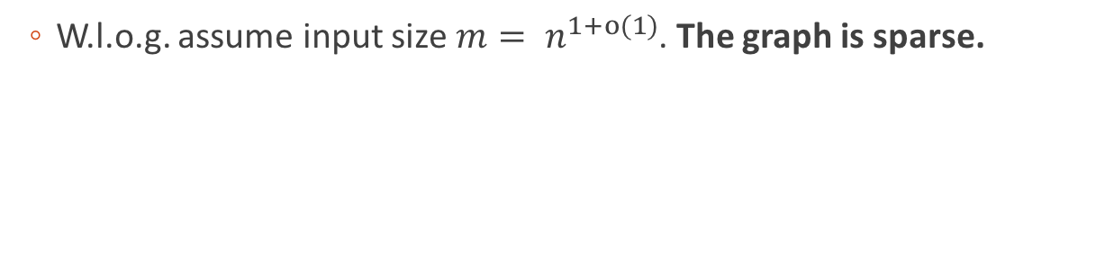
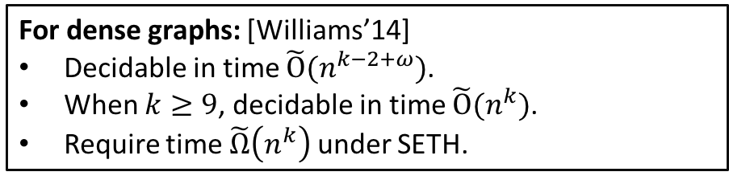
First-order model checking
Model checking for $\left(k+1\right)$-quantifier formula $φ$
is solvable in $O(n^{k−1}m)$ time.
We conjecture it requires $\tilde{Ω}(m^{k})$ time.
Implied by SETH and OVC
“Model Checking Conjecture”
  W.l.o.g. assume input size $m= n^{1+o(1)}$. The graph is sparse.
For dense graphs: [Williams’14]
Decidable in time $\tilde{O}(n^{k−2+ω})$.
When $k≥9$, decidable in time $\tilde{O}(n^{k})$.
Require time $\tilde{Ω}\left(n^{k}\right)$ under SETH.

Slide 8
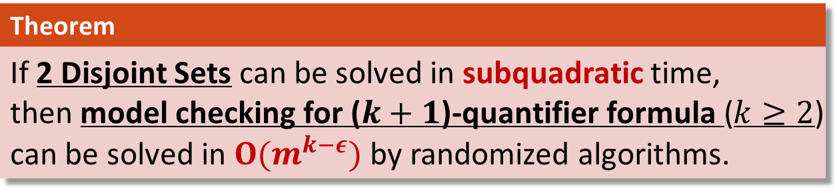
Main Result
  2 Disjoint Sets is hard for model checking on graphs, under randomized reductions.
  “Model Checking Conjecture” is another name for Sparse OV Conjecture.
Theorem
If 2 Disjoint Sets can be solved in subquadratic time, then model checking for ($k+1$)-quantifier formula ($k≥2$) can be solved in $O(m^{k−ε})$ by randomized algorithms.

Slide 9






Fine-grained reductions
Problem $Π_{1}$
Problem $Π_{2}$
  Preserves fine-grained time complexity of problems.
  If $Π_{2}$ can be solved substantially faster than $T_{2}\left(n\right)$,
    then $Π_{1}$ can be solved substantially faster than $T_{1}\left(n\right)$.
$$≤_{FGR}$$
Time $T_{1}(n)$
Time $T_{2}(n)$

Slide 10
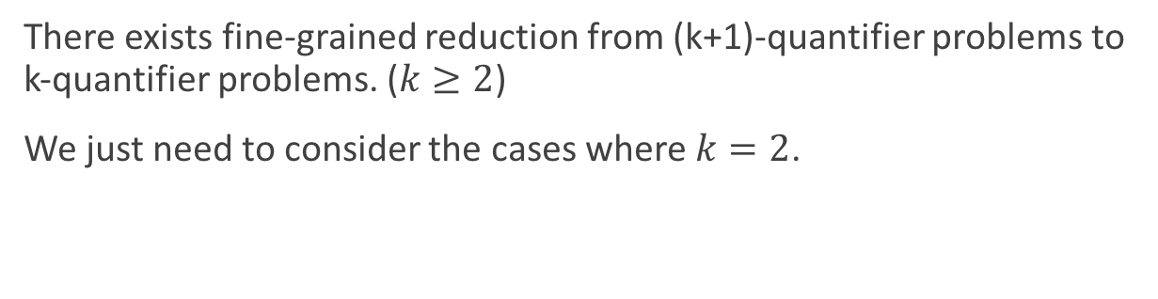





Hardness in 3-quantifier problems
There exists fine-grained reduction from (k+1)-quantifier problems to k-quantifier problems. ($k≥2$)
We just need to consider the cases where $k=2$.
(k+1)-quantifier problems
$$≤_{FGR}$$
k-quantifier problems
3-quantifier problems
2 Disjoint Sets
$$≤_{FGR}$$
. . .
$$≤_{FGR}$$
$$≤_{FGR}$$
Time $m^{k}$
Time $m^{k−1}$
Time $m^{2}$
Time $m^{2}$
By exhaustive search
Need to show
Theorem 1
2 Disjoint Sets is hard in 3-quantifier problems under randomized fine-grained reductions.

Slide 11



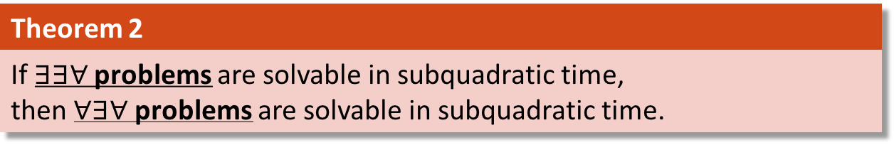
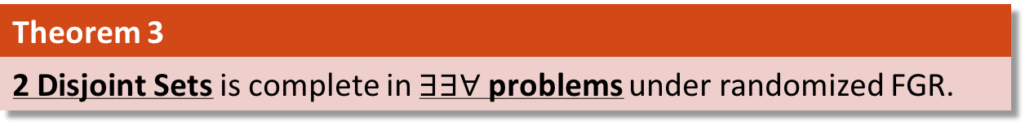






Hardness in 3-quantifier problems
Theorem 2
If $∃∃∀$ problems are solvable in subquadratic time, then $∀∃∀$ problems are solvable in subquadratic time.
Theorem 3
2 Disjoint Sets is complete in $∃∃∀$ problems under randomized FGR.
Hard problems
Easy problems
$$∀∃∀$$
Thm. 2
$$∃∃∀$$
Thm. 3
2 Disj.
Sets
$$∃∃∃$$
$$∀∃∃$$
$$O(m^{3/2})$$
$$∃∀∃$$
$$∀∀∃$$
$$∀∀∀$$
$$∃∀∀$$
Hitting Set
Graph Radius 2
Graph Diameter 2
3-Clique
3-Independent Set
Notes:
Remove sparseOV
Move to the other slide

Slide 12

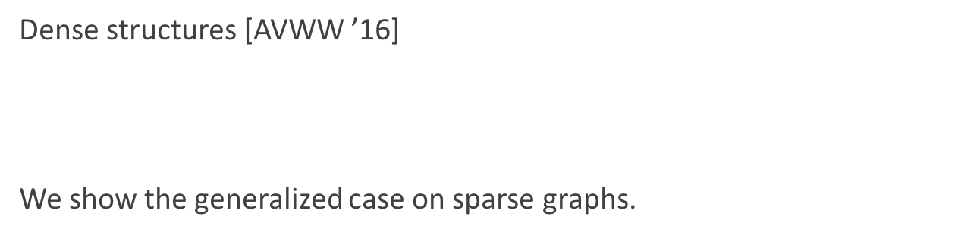
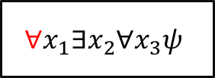
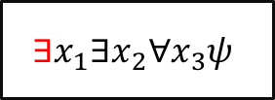
From $∀∃∀$ to $∃∃∀$
Theorem 2
If $∃∃∀$ problems are solvable in subquadratic time, then $∀∃∀$ problems are solvable in subquadratic time.
Dense structures [AVWW ’16]
We show the generalized case on sparse graphs.
Hitting Set
OV
$$∀x_{1}∃x_{2}∀x_{3}ψ$$
$$∃x_{1}∃x_{2}∀x_{3}ψ$$

Slide 13

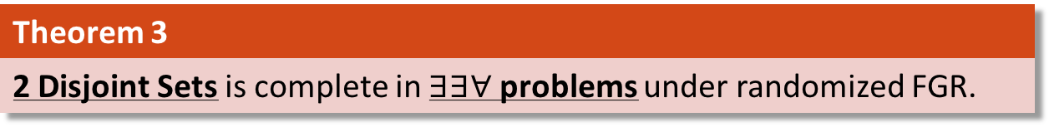
Completeness in $∃∃∀$
Theorem 3
2 Disjoint Sets is complete in $∃∃∀$ problems under randomized FGR.
Lemma
These three problems are equivalent under randomized FGR: 2 Disjoint Sets Set Containment 2 Set Covering
The only randomized reduction.
Other parts of the proof are deterministic.

Slide 14

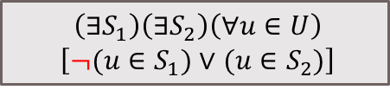
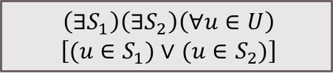

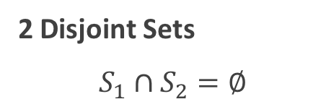
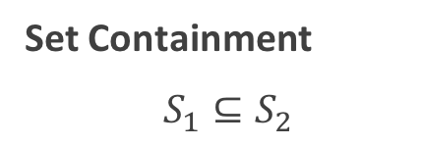
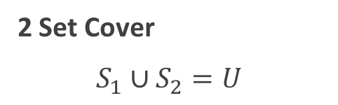
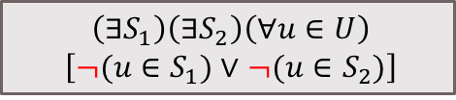



Basic Problems
2 Disjoint Sets
$S_{1}∩S_{2}=∅$
Set Containment
$S_{1}⊆S_{2}$
2 Set Cover
$S_{1}∪S_{2}=U$
$\left(∃S_{1}\right)\left(∃S_{2}\right)\left(∀u∈U\right)$
$\left[¬(u∈S_{1})∨¬(u∈S_{2})\right]$
$\left(∃S_{1}\right)\left(∃S_{2}\right)\left(∀u∈U\right)$
$\left[¬(u∈S_{1})∨(u∈S_{2})\right]$
$\left(∃S_{1}\right)\left(∃S_{2}\right)\left(∀u∈U\right)$
$\left[(u∈S_{1})∨(u∈S_{2})\right]$
$$U$$
$$U$$
$$U$$
$$S_{1}$$
$$S_{1}$$
$$S_{1}$$
$$S_{2}$$
$$S_{2}$$
$$S_{2}$$
To preserve the sparsity of input graph,
we are not allowed to complement the sets directly.

Slide 15








Equivalence of Basic Problems
We do Universe-Shrinking Self-Reductions on Basic Problems.
$$U$$
$$S_{1}$$
$$S_{1}^{′}$$
$$U′$$
$$S_{1}^{′}$$
$$U′$$
$$S_{2}$$
randomized
self
reduction
$$S_{2}^{′}$$
complementsets
$$\overline{S_{2}^{′}}$$
Problem 1
Problem 1
Problem 2
  Preserves fine-grained complexity on sparse graphs.
Notes:
Omit computations
just preserves fine grain complexity

Slide 16
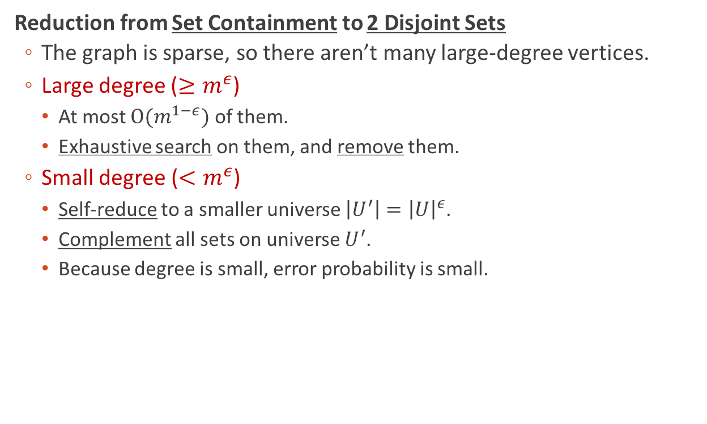
Equivalence of Basic Problems
Reduction from Set Containment to 2 Disjoint Sets
  The graph is sparse, so there aren’t many large-degree vertices.
  Large degree ($≥m^{ε}$)
    At most $O(m^{1−ε})$ of them.
    Exhaustive search on them, and remove them.
  Small degree ($<m^{ε}$)
    Self-reduce to a smaller universe $\left|U^{′}\right|={\left|U\right|}^{ε}$.
    Complement all sets on universe $U^{′}$.
    Because degree is small, error probability is small.

Slide 17
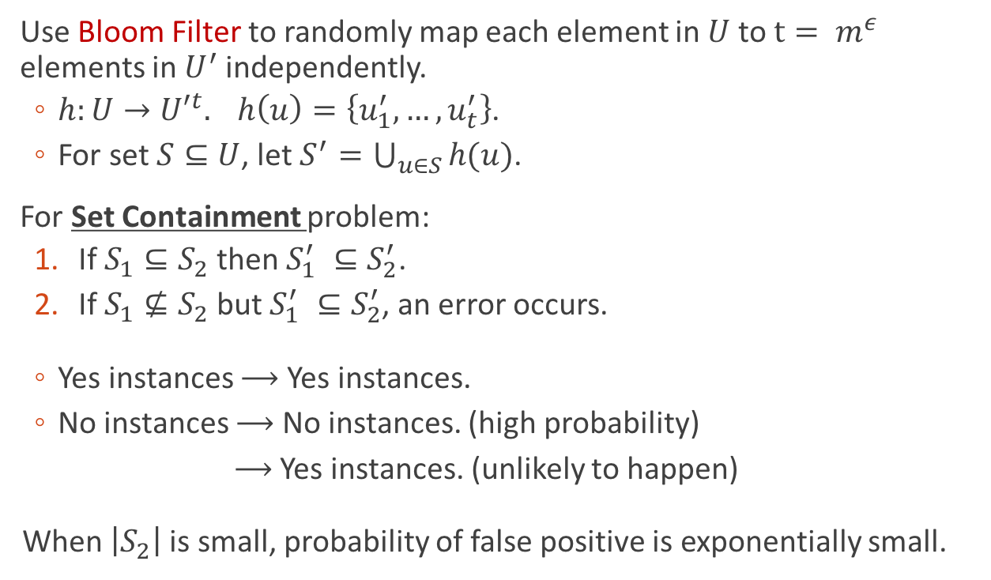




Universe-shrinking technique
Use Bloom Filter to randomly map each element in $U$ to $t= m^{ε}$ elements in $U^{′}$ independently.
  $h:U→{U′}^{t}. h\left(u\right)=\left\{u_{1}^{′}, …,u_{t}^{′}\right\}$.
  For set $S⊆U$, let $S^{′}=\bigcup_{u∈S}{h(u)}$.
For Set Containment problem:
  If $S_{1}⊆S_{2}$ then $S_{1}^{′} ⊆S_{2}^{′}$.
  If $S_{1}⊈S_{2}$ but $S_{1}^{′} ⊆S_{2}^{′}$, an error occurs.
  Yes instances $⟶$ Yes instances.
  No instances $⟶$ No instances. (high probability)
  $⟶$ Yes instances. (unlikely to happen)
  When $\left|S_{2}\right|$ is small, probability of false positive is exponentially small.
$$U$$
$$U^{′}$$
$$S_{1}$$
$$S_{2}$$

Slide 18
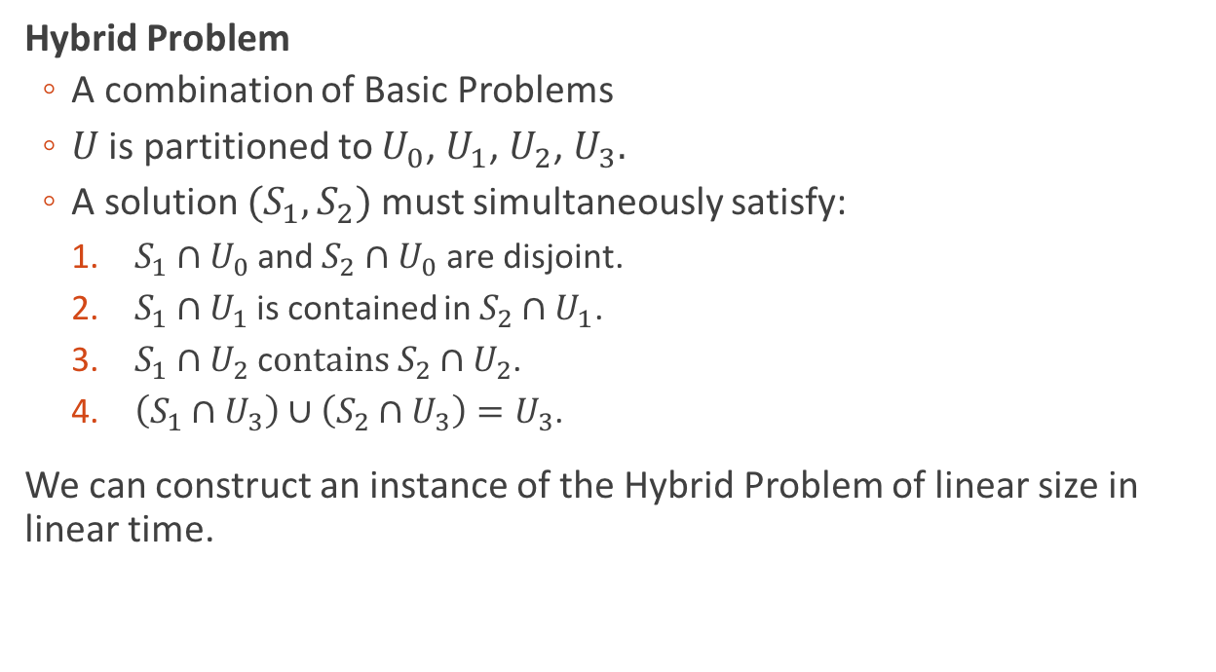

Hybrid Problem
$∃∃∀$ Problems
Hybrid Problem
Basic Problems
Hybrid Problem
  A combination of Basic Problems
  $U$ is partitioned to $U_{0}$, $U_{1}$, $U_{2}$, $U_{3}.$
  A solution ${(S}_{1},S_{2})$ must simultaneously satisfy:
    $S_{1}∩U_{0}$ and $S_{2}{∩U}_{0}$ are disjoint.
    $S_{1}{∩U}_{1}$ is contained in $S_{2}{∩U}_{1}$.
    $S_{1}{∩U}_{2}$ c$ontains S_{2}{∩U}_{2}$.
    $\left(S_{1}{∩U}_{3}\right)∪\left(S_{2}{∩U}_{3}\right)=U_{3}$.
We can construct an instance of the Hybrid Problem of linear size in linear time.

Slide 19
Conclusion
Frechet Distance
$$n^{2−ε^{′′}}$$
Edit Distance
Longest Common Substring
Sparse Graph Diameter
Local Alignment
LCS
..
FO graph properties
Sparse OV
$$m^{2−ε^{′}}$$
Hitting set
k-OV
Polynomial
k-dominating set
…
$$m^{k−ε^{′′}}$$
NP-complete
If SETH is false
k-CNF-SAT
$$2^{\left(1−ε\right)n}$$

Slide 20

Conclusion
Frechet Distance
$$n^{2−ε^{′′}}$$
Edit Distance
Longest Common Substring
Sparse Graph Diameter
Local Alignment
LCS
Sparse OV
$$m^{2−ε^{′}}$$
FO graph properties
$$m^{k−ε^{′′}}$$
Polynomial
Notes:
world tidier

Slide 21
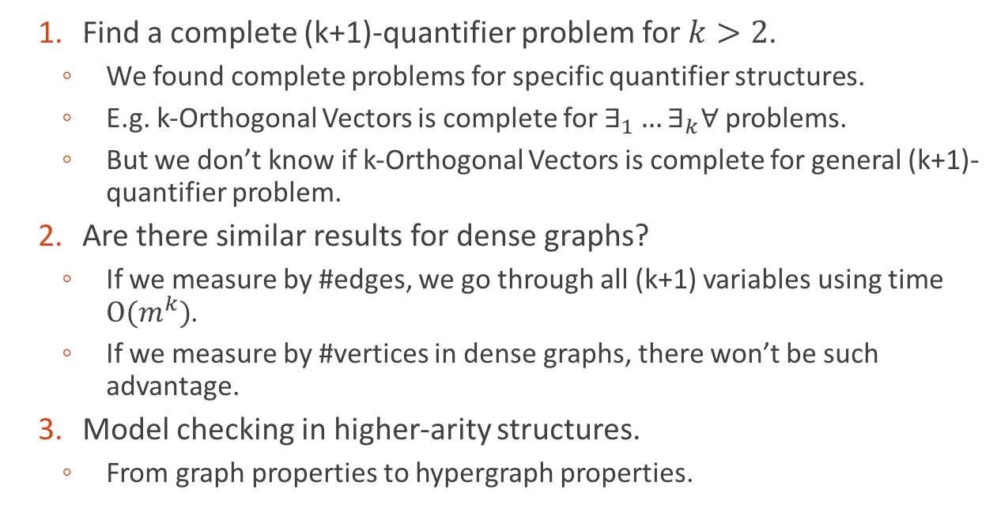
Open Problems
  Find a complete (k+1)-quantifier problem for $k>2$.
    We found complete problems for specific quantifier structures.
    E.g. k-Orthogonal Vectors is complete for $∃_{1}…∃_{k}∀$ problems.
    But we don’t know if k-Orthogonal Vectors is complete for general (k+1)-quantifier problem.
  Are there similar results for dense graphs?
    If we measure by #edges, we go through all (k+1) variables using time $O(m^{k})$.
    If we measure by #vertices in dense graphs, there won’t be such advantage.
  Model checking in higher-arity structures.
    From graph properties to hypergraph properties.

Slide 22
Open Problems
  Completeness results for dynamic programming.
    Can we clean up more mess in the graph?
    Many SETH-hard problems have dynamic programming algorithms.
    When can’t we do better than dynamic programming?
Thank you.

