Slide 1
The State of Techniques for Solving Large Imperfect-Information Games
Tuomas Sandholm
Professor
Carnegie Mellon University
Computer Science Department
Also:
Machine Learning Department
Ph.D. Program in Algorithms, Combinatorics, and Optimization
CMU/UPitt Joint Ph.D. Program in Computational Biology
Notes:
ABSTRACT: Incomplete-information games - such as most auctions, negotiations, and future (cyber)security settings - cannot be solved using minimax search even in principle. Completely different algorithms are needed. A dramatic scalability leap has occurred in our ability to solve such games over the last eight years, fueled in large part by the Annual Computer Poker Competition. I will discuss the key domain-independent techniques that enabled this leap, including automated abstraction techniques and approaches for mitigating the issues that they raise, new equilibrium-finding algorithms, safe opponent exploitation methods, techniques that use qualitative knowledge as an extra input, and endgame solving techniques. I will include brand new results on 1) developing Tartanian7, the world’s leading no-limit Texas Hold’em program, 2) theory that enables abstraction that gives solution quality guarantees, 3) techniques for hot starting the equilibrium finding, 4) simultaneous abstraction and equilibrium finding, 5) theory that improves gradient-based equilibrium finding. The talk covers joint work with many co-authors, mostly Sam Ganzfried, Noam Brown, and Christian Kroer.

Slide 2
Incomplete-information game tree
0.2
0.3
0.5
Information set
0.5
0.5
Strategy,
beliefs

Slide 3
Tackling such games
Domain-independent techniques
Techniques for complete-info games don’t apply
Challenges
  Unknown state
  Uncertainty about what other agents and nature will do
  Interpreting signals and avoiding signaling too much
Definition. A Nash equilibrium is a strategy and beliefs for each agent such that no agent benefits from using a different strategy
  Beliefs derived from strategies using Bayes’ rule
Notes:
(Speculation, counter-speculation, … ad infinitum -> Nash)

Slide 4
Most real-world games are like this
Negotiation
Multi-stage auctions (FCC ascending, combinatorial)
Sequential auctions of multiple items
Political campaigns (TV spending)
Military (allocating troops; spending on space vs ocean)
Next-generation (cyber)security (jamming [DeBruhl et al.]; OS)
Medical treatment [Sandholm 2012, AAAI-15 SMT Blue Skies]
…
Notes:
(e.g., China owns US reserves)
Has bluffs: Pas de Calais, Israel’s war with Lebanon, Qin’s army, forts
Combat
Currency attacks
International (over-)fishing
In cybersecurity, active security: identify opponent’s objectives and defend based on that.
Attacks against memory vulnerabilities depend crucially on the memory layout of the program
being targeted. On the other hand, legitimate programs are agnostic to details of memory layout
because of mechanisms such as dynamic linking. Our adaptive defense strategies will make use of
artificial diversity mechanisms such as Address-Space Layout Randomization, or ASLR—a mitigation
technique based on this observation. ASLR changes the layout of memory segments in
a process’ address space, making it difficult for the attacker to calculate the addresses he needs
to mount his attack. ASLR is implemented in most modern operating systems. ASLR introduces
artificial diversity to running systems, making them more resistant to attack [52]. The deployed versions
of ASLR have low runtime overhead but are vulnerable to attack by determined adversaries,
for example after searching the space of possible randomizations by brute force (see Shacham et
al. [125]). Researchers have demonstrated the feasibility of randomizing substantially more features
of a running system [15], but their proposals have not yet seen adoption.”

Slide 5
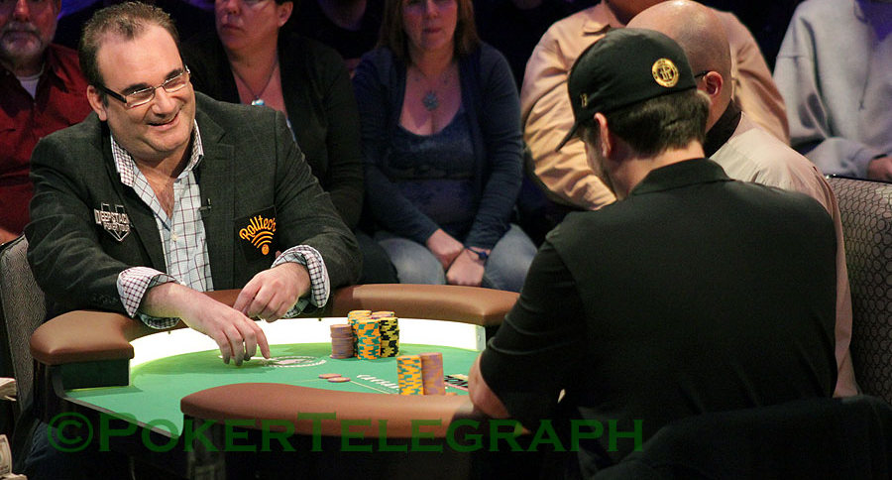
Poker
Recognized challenge problem in AI since 1992 [Billings, Schaeffer, …]
  Hidden information (other players’ cards)
  Uncertainty about future events
  Deceptive strategies needed in a good player
  Very large game trees
NBC National Heads-Up Poker Championship 2013
Notes:
2-player is highly complex & difficult to play well.
Mano a mano
No others to muddle up the game.
(Luck plays a smaller role.)
(Picture is a Heads-Up competition televised by NBC.)

Slide 6
Our approach [Gilpin & Sandholm EC-06, J. of the ACM 2007…]
Now used basically by all competitive Texas Hold’em programs
Original game
Abstracted game
Automated abstraction
10¹⁶¹
Custom
equilibrium-finding
algorithm
Nash equilibrium
Reverse model
Nash equilibrium
Foreshadowed by Shi & Littman 01, Billings et al. IJCAI-03
Notes:
MENTION AS OUTLINE:
- Opponent exploitation
- Bots vs pros
- Learning from bots
(Reverse model is straightforward if only signals are abstracted, but an interesting problem if also actions are abstracted, as in No-Limit Texas Hold’em.)

Slide 7
Lossless abstraction
[Gilpin & Sandholm EC-06, J. of the ACM 2007]
Notes:
JACM reviewer: This is to incomplete-information games like what alpha-beta search is to complete-information games.

Slide 8
Information filters
Observation: We can make games smaller by filtering the information a player receives
Instead of observing a specific signal exactly, a player instead observes a filtered set of signals
  E.g. receiving signal {A♠,A♣,A♥,A♦} instead of A♥
Notes:
Information filters isolate signal history from action history

Slide 9
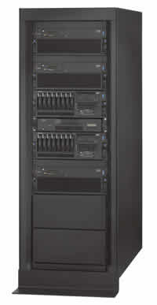
Solved Rhode Island Hold’em poker
AI challenge problem [Shi & Littman 01]
  3.1 billion nodes in game tree
Without abstraction, LP has 91,224,226 rows and columns => unsolvable
GameShrink ran in one second
After that, LP had 1,237,238 rows and columns (50,428,638 non-zeros)
Solved the LP
  CPLEX barrier method took 8 days & 25 GB RAM
Exact Nash equilibrium
Largest incomplete-info game solved
by then by over 4 orders of magnitude
Notes:
Most of the game was redundant.

Slide 10
Lossy abstraction

Slide 11
Texas Hold’em poker
2-player Limit has ~10¹⁴ info sets
2-player No-Limit has ~10¹⁶¹ info sets
Losslessly abstracted game too big to solve => abstract more => lossy
Nature deals 2 cards to each player
Round of betting
Nature deals 3 shared cards
Round of betting
Nature deals 1 shared card
Round of betting
Nature deals 1 shared card
Round of betting
Notes:
Most popular poker variant.

Slide 12
Important ideas for practical game abstraction 2007-13
Integer programming [Gilpin & Sandholm AAMAS-07]
Potential-aware [Gilpin, Sandholm & Sørensen AAAI-07, Gilpin & Sandholm AAAI-08]
Imperfect recall [Waugh et al. SARA-09, Johanson et al. AAMAS-13]
Notes:
DAG
(Waugh, Zinkevich, Johanson, Kan, Schnizlein & Bowling)

Slide 13
Leading practical abstraction algorithm:
Potential-aware imperfect-recall abstraction with earth-mover’s distance
[Ganzfried & Sandholm AAAI-14]
Bottom-up pass of the tree, clustering using histograms over next-round clusters
  EMD is now in multi-dimensional space
    Ground distance assumed to be the (next-round) EMD between the corresponding cluster means
Notes:
No need to perform multiple bottom up passes like in potential-aware abstraction before, due to imperfect recall.
No need for IP, due to imperfect recall.
Using our algorithm to compute the abstraction (for the flop round), we beat best prior abstraction algorithm

Slide 14
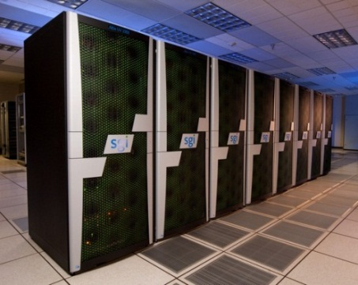
Techniques used to develop Tartanian7, program that won the heads-up no-limit Texas Hold’em ACPC-14
[Brown, Ganzfried, Sandholm AAMAS-15]
Enables massive distribution or leveraging ccNUMA
Abstraction:
  Top of game abstracted with any algorithm
  Rest of game split into equal-sized disjoint pieces based on public signals
    This (5-card) abstraction determined based on transitions to a base abstraction
  At each later stage, abstraction done within each piece separately
Equilibrium finding (see also [Jackson, 2013; Johanson, 2007])
  “Head” blade handles top in each iteration of External-Sampling MCCFR
  Whenever the rest is reached, sample (a flop) from each public cluster
  Continue the iteration on a separate blade for each public cluster. Return results to head node
  Details:
    Must weigh each cluster by probability it would’ve been sampled randomly
    Can sample multiple flops from a cluster to reduce communication overhead

Slide 15
Lossy Game Abstraction with Bounds

Slide 16
Lossy game abstraction with bounds
Tricky due to abstraction pathology [Waugh et al. AAMAS-09]
Prior lossy abstraction algorithms had no bounds
  First exception was for stochastic games only [S. & Singh EC-12]
We do this for general extensive-form games
[Kroer & S. EC-14]
  Many new techniques required
  For both action and state abstraction
  More general abstraction operations by also allowing one-to-many mapping of nodes
Notes:
(Explain relationship to abstraction pathology.)
Abstraction performed in game tree (doesn’t assume game of ordered signals)

Slide 17
Bounding abstraction quality
Main theorem:
where ε=max _{i∈Players} ε_{i}
Nature distribution
error at height j
Set of heights
for player i
Set of heights
for nature
Reward error
Nature distribution
error at height j
Maximum utility
in abstract game
Notes:
We define the reward error recursively:
at leaf nodes to be the maximum difference between values of the real leaf and the abstract leaves that it maps to,
at player nodes to be the maximum error of the child nodes, and
at nature nodes to be the weighted sum.
(The reward error for Player i of an information set I is the maximum error over the nodes in I, and the total
reward error is the maximum of this quantity over all information sets.)

Slide 18
Hardness results
Determining whether two subtrees are “extensive-form game-tree isomorphic” is graph isomorphism complete
Computing the minimum-size abstraction given a bound is NP-complete
  Holds also for minimizing a bound given a maximum size
Doesn’t mean abstraction with bounds is undoable or not worth it computationally
Notes:
Q: Why is this relevant if the level-by-level abstraction is impossible anyway? And I thought “extensive-form game-tree isomorphism” was ill-defined?
A: That's a good question. One answer could be that it simply shows another facet of the hardness of abstraction: Even just determining if the tree shape is correct for merging two subgames is graph isomorphism complete. Also, since that applies even for two subgames, it shows hardness in a setting where the impossibility result doesn't even apply.
(I would probably take out the "Needed to reason about level-by-level" since I think it's an interesting hardness aspect in its own right, and that would avoid the confusion about whether it even matters due to the impossibility.)

Slide 19
Extension to imperfect recall
Merge information sets
Allows payoff error
Allows chance error
Going to imperfect-recall setting costs an error increase that is linear in game-tree height
Exponentially stronger bounds and broader class (abstraction can introduce nature error) than [Lanctot et al. ICML-12], which was also just for CFR
[Kroer and Sandholm IJCAI-15 workshop]
Notes:
No branch removal
But can be supported by removing branches to a perfect-recall abstraction first using our theory for that step
Sum of errors at levels where player is active
Similar to perfect-recall bound, for a single level

Slide 20
Role in modeling
All modeling is abstraction
These are the first results that tie game modeling choices to solution quality in the actual world!

Slide 21
Original game
Abstracted game
Automated abstraction
Custom
equilibrium-finding
algorithm
Nash equilibrium
Reverse model
Nash equilibrium

Slide 22
Scalability of (near-)equilibrium finding in 2-player 0-sum games
AAAI poker competition announced
Gilpin, Sandholm
& Sørensen
Scalable EGT
Zinkevich et al.
Counterfactual regret
Gilpin, Hoda,
Peña & Sandholm
Scalable EGT
Koller & Pfeffer
Using sequence form
& LP (simplex)
Billings et al.
LP (CPLEX interior point method)
Gilpin & Sandholm
LP (CPLEX interior point method)

Slide 23
Scalability of (near-)equilibrium finding in 2-player 0-sum games…
Regret-based pruning [Brown & Sandholm NIPS-15]
Information sets
Cepheus [Bowling et al.]
Tartanian7 [Brown, Ganzfried & Sandholm]
5.5 * 10¹⁵ nodes
Slumbot [Jackson]
Hyperborean [Bowling et al.]
Hyperborean [Bowling et al.]
Hyperborean [Bowling et al.]
Hyperborean [Bowling et al.]
GS3 [Gilpin, Sandholm & Sørensen]
Losslessly abstracted
Rhode Island Hold’em
[Gilpin & Sandholm]

Slide 24
Leading equilibrium-finding algorithms for 2-player 0-sum games
Counterfactual regret (CFR)
Scalable EGT
Based on no-regret learning
Most powerful innovations:
  Each information set has a separate no-regret learner [Zinkevich et al. NIPS-07]
  Sampling
  [Lanctot et al. NIPS-09, …]
O(1/ε²) iterations
  Each iteration is fast
Parallelizes
Selective superiority
Can be run on imperfect-recall games and with >2 players (without guarantee of converging to equilibrium)
Based on Nesterov’s Excessive Gap Technique
Most powerful innovations:
[Hoda, Gilpin, Peña & Sandholm WINE-07, Mathematics of Operations Research 2011]
  Smoothing fns for sequential games
  Aggressive decrease of smoothing
  Balanced smoothing
  Available actions don’t depend on chance => memory scalability
O(1/ε) iterations
  Each iteration is slow
Parallelizes
New O(log(1/ε)) algorithm
[Gilpin, Peña & Sandholm AAAI-08, Mathematical Programming 2012]

Slide 25
Better first-order methods
[Kroer, Waugh, Kılınç-Karzan & Sandholm EC-15]
New prox function for first-order methods such as EGT and Mirror Prox
  Gives first explicit convergence-rate bounds for general zero-sum extensive-form games (prior explicit bounds were for very restricted class)
  In addition to generalizing, bound improvement leads to a linear (in the worst case, quadratic for most games) improvement in the dependence on game specific constants
Introduces gradient sampling scheme
  Enables the first stochastic first-order approach with convergence guarantees for extensive-form games
  As in CFR, can now represent game as tree that can be sampled
Introduces first first-order method for imperfect-recall abstractions
  As with other imperfect-recall approaches, not guaranteed to converge

Slide 26
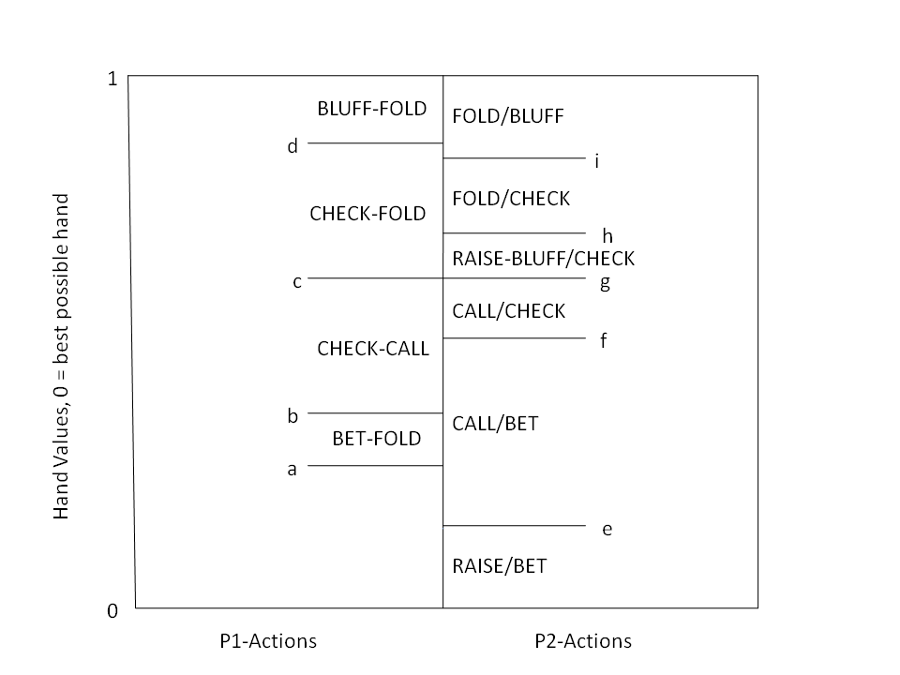
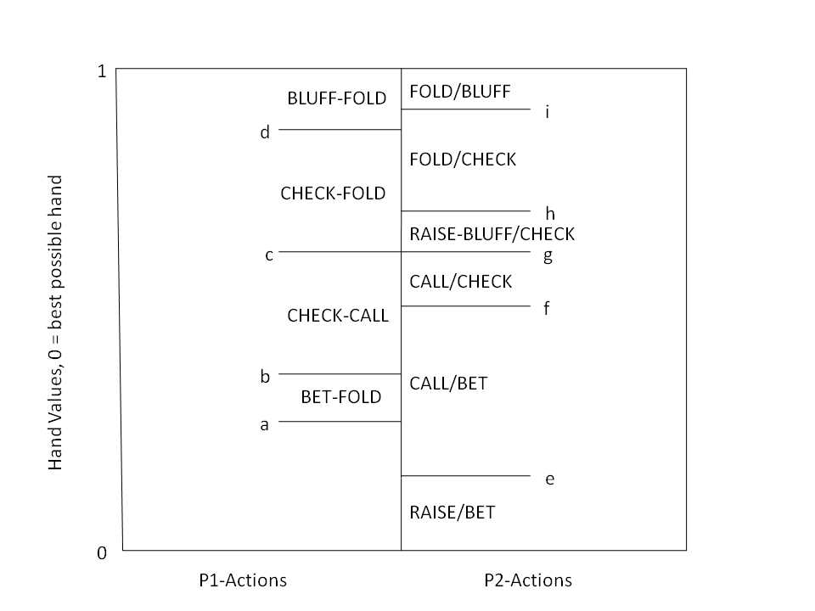
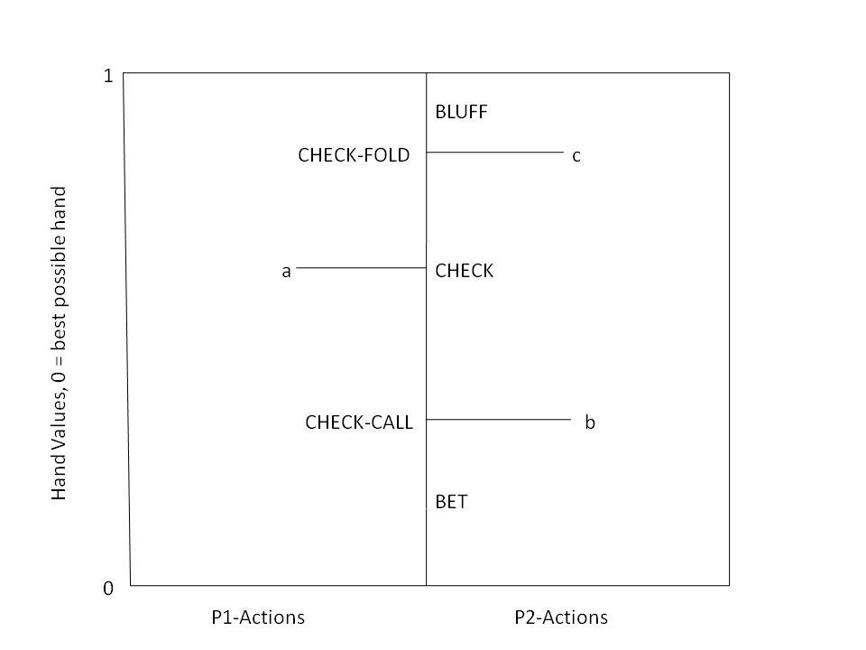
Computing equilibria by leveraging qualitative models
Player 1’s
strategy
Player 2’s
strategy
Weaker
hand
BLUFF/CHECK
BLUFF/CHECK
Stronger
hand
Theorem. Given F₁, F₂, and a qualitative model, we have a complete mixed-integer linear feasibility program for finding an equilibrium
Qualitative models can enable proving existence of equilibrium & solve games for which algorithms didn’t exist
[Ganzfried & Sandholm AAMAS-10 & newer draft]
Notes:
Limit.
River with 1 raise allowed.
It is ok if the models are wrong!
(Sam iterated to come up with these 3 models. He got the first one from Chen & Ankeman book.)
Which of these 3 models is right depends on the private signal distributions at the beginning of the endgame (fourth round).
Experiments found an eq with one of these for each F1, F2 reached in practice. Sam says there is a 4th one, that was never reached between these players.
Use qualitative models to learn about poker by testing different ones (manually or automatically generated).
(Analogy to air combat)

Slide 27
Simultaneous Abstraction and Equilibrium Finding in Games
[Brown & Sandholm IJCAI-15 & new manuscript]

Slide 28
Problems solved
Cannot solve without abstracting, and cannot principally abstract without solving
  SAEF abstracts and solves simultaneously
Must restart equilibrium finding when abstraction changes
  SAEF does not need to restart (uses discounting)
Abstraction size must be tuned to available runtime
  In SAEF, abstraction increases in size over time
Larger abstractions may not lead to better strategies
  SAEF guarantees convergence to a full-game equilibrium
Notes:
Cannot calculate a full-game best response in large games
In special cases, possible in the size of the abstraction

Slide 29
Opponent exploitation

Slide 30
Traditionally two approaches
Game theory approach (abstraction+equilibrium finding)
  Safe in 2-person 0-sum games
  Doesn’t maximally exploit weaknesses in opponent(s)
Opponent modeling
  Needs prohibitively many repetitions to learn in large games (loses too much during learning)
    Crushed by game theory approach in Texas Hold’em
    Same would be true of no-regret learning algorithms
  Get-taught-and-exploited problem [Sandholm AIJ-07]
Notes:
Crushed by game theory approach in Texas Hold’em, even with just 2 players and limit betting

Slide 31
Let’s hybridize the two approaches
Start playing based on pre-computed (near-)equilibrium
As we learn opponent(s) deviate from equilibrium, adjust our strategy to exploit their weaknesses
  Adjust more in points of game where more data now available
  Requires no prior knowledge about opponent
Significantly outperforms game-theory-based base strategy in 2-player limit Texas Hold’em against
  trivial opponents
  weak opponents from AAAI computer poker competitions
Don’t have to turn this on against strong opponents
[Ganzfried & Sandholm AAMAS-11]

Slide 32
Other modern approaches to opponent exploitation
ε-safe best response
[Johanson, Zinkevich & Bowling NIPS-07, Johanson & Bowling AISTATS-09]
Precompute a small number of strong strategies. Use no-regret learning to choose among them
[Bard, Johanson, Burch & Bowling AAMAS-13]

Slide 33
Safe opponent exploitation
Definition. Safe strategy achieves at least the value of the (repeated) game in expectation
Is safe exploitation possible (beyond selecting among equilibrium strategies)?
[Ganzfried & Sandholm EC-12, TEAC 2015]
Notes:
i.e., cannot be exploited due to the get-taught-and-exploited problem

Slide 34

Exploitation algorithms
Risk what you’ve won so far
Risk what you’ve won so far in expectation (over nature’s & own randomization), i.e., risk the gifts received
  Assuming the opponent plays a nemesis in states where we don’t know
…
Theorem. A strategy for a 2-player 0-sum game is safe iff it never risks more than the gifts received according to #2
Can be used to make any opponent model / exploitation algorithm safe
No prior (non-eq) opponent exploitation algorithms are safe
#2 experimentally better than more conservative safe exploitation algs
Suffices to lower bound opponent’s mistakes
Notes:
#1 Doesn’t differentiate whether winnings are due to opponent’s mistakes (gifts) or our luck

Slide 35
State of TOP poker programs

Slide 36
Rhode Island Hold’em
Bots play optimally
[Gilpin & Sandholm EC-06, J. of the ACM 2007]

Slide 37
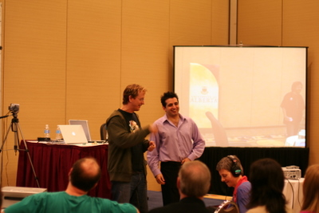
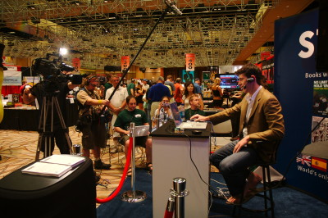
Heads-Up Limit Texas Hold’em
Bots surpassed pros in 2008
[U. Alberta Poker Research Group]
“Essentially solved” in 2015 [Bowling et al.]
AAAI-07
2008
Notes:
On 6/25/2013 in a live stream, Phil Galfond said he thought that hyperborean could beat mid-stakes online (1-2 and 2-4), but not higher currently. But he thinks within several years it will beat top humans.
(2008: They had 5 strong human opponents: Grudzien, Hawrilenko, Palansky, Paradis, and Hendon. The player in the picture is Matt “Hoss_TBF” Hawrilenko, the strongest heads-up limit player at the time according to Michael Bowling.)

Slide 38

Heads-Up No-Limit Texas Hold’em
Annual Computer Poker Competition
Tartanian7
--> Claudico
Statistical significance win against every bot
Smallest margin in IRO: 19.76 ± 15.78
Average in Bankroll: 342.49
(next highest: 308.92)

Slide 39
“Brains vs AI” event

Slide 40
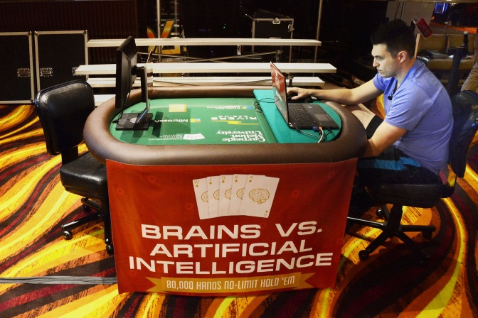
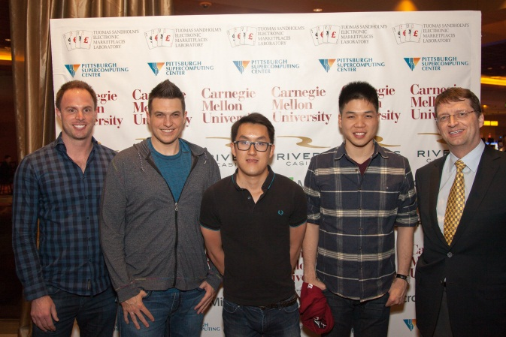
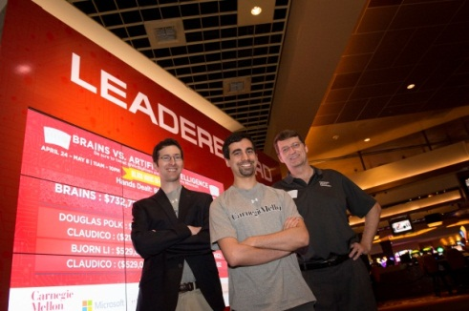
Claudico against each of 4 of the top-10 pros in this game
4 * 20,000 hands over 2 weeks
Strategy was precomputed, but we used endgame solving [Ganzfried & Sandholm AAMAS-15] in some sessions

Slide 41


Slide 42
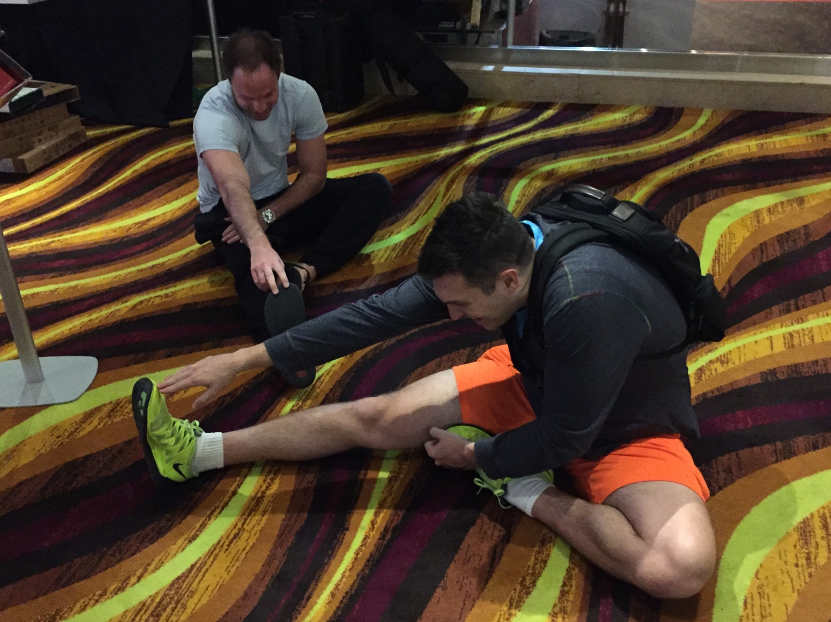
Humans’ $100,000 participation fee distributed based on performance

Slide 43
Overall performance
Pros won by 91 mbb/hand
  Not statistically significant (at 95% confidence)
  Perspective:
    Dong Kim won a challenge against Nick Frame by 139 mbb/hand
    Doug Polk won a challenge against Ben Sulsky 247 mbb/hand
3 pros beat Claudico, one lost to it
Pro team won 9 days, Claudico won 4

Slide 44
Observations about Claudico’s play
Strengths (beyond what pros typically do):
  Small bets & huge all-ins
  Perfect balance
  Randomization: not “range-based”
  “Limping” & “donk betting”
Weaknesses:
  Coarse handling of “card removal” in endgame solver
    Because endgame solver only had 20 seconds
  Action mapping approach
  No opponent exploitation

Slide 45
Multiplayer poker
Bots aren’t very strong (at least not yet)
  Exception: programs are very close to optimal in jam/fold games [Ganzfried & Sandholm AAMAS-08, IJCAI-09]

Slide 46
Conclusions
Domain-independent techniques
Abstraction
  Automated lossless abstraction—exactly solves games with billions of nodes
  Best practical lossy abstraction: potential-aware, imperfect recall, EMD
  Lossy abstraction with bounds
    For action and state abstraction
    Also for modeling
  Simultaneous abstraction and equilibrium finding
  (Reverse mapping [Ganzfried & S. IJCAI-13])
  (Endgame solving [Ganzfried & S. AAMAS-15])
Equilibrium-finding
  Can solve 2-person 0-sum games with 10¹⁴ information sets to small ε
    O(1/ε²) -> O(1/ε) -> O(log(1/ε))
  New framework for fast gradient-based algorithms
    Works with gradient sampling and can be run on imperfect-recall abstractions
  Regret-based pruning for CFR
  Using qualitative knowledge/guesswork
Pseudoharmonic reverse mapping
Opponent exploitation
  Practical opponent exploitation that starts from equilibrium
  Safe opponent exploitation

Slide 47
Current & future research
Lossy abstraction with bounds
  Scalable algorithms
  With structure
  With generated abstract states and actions
Equilibrium-finding algorithms for 2-person 0-sum games
  Even better gradient-based algorithms
  Parallel implementations of our O(log(1/ε)) algorithm and understanding how #iterations depends on matrix condition number
  Making interior-point methods usable in terms of memory
  Additional improvements to CFR
Endgame and “midgame” solving with guarantees
Equilibrium-finding algorithms for >2 players
Theory of thresholding, purification [Ganzfried, S. & Waugh AAMAS-12], and other strategy restrictions
Other solution concepts: sequential equilibrium, coalitional deviations, …
Understanding exploration vs exploitation vs safety
Application to other games (medicine, cybersecurity, etc.)
Notes:
(Ex ante & ex post)

Slide 48
Thank you!
Students & collaborators:
  Noam Brown
  Christian Kroer
  Sam Ganzfried
  Andrew Gilpin
  Javier Peña
  Fatma Kılınç-Karzan
  Sam Hoda
  Troels Bjerre Sørensen
  Satinder Singh
  Kevin Waugh
  Kevin Su
  Benjamin Clayman
Sponsors:
  NSF
  Pittsburgh Supercomputing Center
  San Diego Supercomputing Center
  Microsoft
  IBM
  Intel

