Slide 1
Kidney exchange 2000-2015:
Algorithms and Incentives
Al Roth
Stanford
Simons Institute for Theoretical Computer Science
Berkeley
Nov 17, 2015

Slide 2
Some mile posts of kidney exchange in the U.S.
2000: First U.S. exchange, in Rhode Island Hospital
2004: formation of New England Program for Kidney Exchange, Ohio consortium
2005: implemented algorithm for pairwise exchange
Began to do short chains, and longer (3-way) cycles
Other kidney exchange networks formed (including federally sponsored pilot program in 2010)
2007: Norwood Act makes kidney exchange legal
2007: first long (non-simultaneous) chain.
2009: non-simultaneous chains become standard
2015--?

Slide 3
Kidney exchange clearinghouse design
Roth, Alvin E., Tayfun Sönmez, and M. Utku Ünver, “Kidney Exchange,” Quarterly Journal of Economics, 119, 2, May, 2004, 457-488.
________started talking to docs________
____ “Pairwise Kidney Exchange,” Journal of Economic Theory, 125, 2, 2005, 151-188.
___ “A Kidney Exchange Clearinghouse in New England,” American Economic Review, Papers and Proceedings, 95,2, May, 2005, 376-380.
_____ “Efficient Kidney Exchange: Coincidence of Wants in Markets with Compatibility-Based Preferences,” American Economic Review, June 2007, 97, 3, June 2007, 828-851
___multi-hospital exchanges become common—hospitals become players in a new “kidney game”________
Ashlagi, Itai, David Gamarnik and Alvin E. Roth, The Need for (long) Chains in Kidney Exchange, May 2012
Ashlagi, Itai and Alvin E. Roth, “New challenges in multi-hospital kidney exchange,” American Economic Review Papers and Proceedings, 102,3, May 2012, 354-59.
Ashlagi, Itai and Alvin E. Roth "Free Riding and Participation in Large Scale, Multi-hospital Kidney Exchange,”Theoretical Economics 9(2014),817–63.
Anderson, Ross, Itai Ashlagi, David Gamarnik and Alvin E. Roth, “Finding long chains in kidney exchange using the traveling salesmen problem,” Proceedings of the National Academy of Sciences of the United States of America (PNAS), January 20, 2015 | vol. 112 | no. 3 | 663–668.

Slide 4
And in the medical literature
Saidman, Susan L., Alvin E. Roth, Tayfun Sönmez, M. Utku Ünver, and Francis L. Delmonico, “Increasing the Opportunity of Live Kidney Donation By Matching for Two and Three Way Exchanges,” Transplantation, 81, 5, March 15, 2006, 773-782.
Roth, Alvin E., Tayfun Sönmez, M. Utku Ünver, Francis L. Delmonico, and Susan L. Saidman, “Utilizing List Exchange and Undirected Donation through “Chain” Paired Kidney Donations,” American Journal of Transplantation, 6, 11, November 2006, 2694-2705.
Rees, Michael A., Jonathan E. Kopke, Ronald P. Pelletier, Dorry L. Segev, Matthew E. Rutter, Alfredo J. Fabrega, Jeffrey Rogers, Oleh G. Pankewycz, Janet Hiller, Alvin E. Roth, Tuomas Sandholm, Utku Ünver, and Robert A. Montgomery, “A Non-Simultaneous Extended Altruistic Donor Chain,” New England Journal of Medicine , 360;11, March 12, 2009, 1096-1101.
Ashlagi, Itai, Duncan S. Gilchrist, Alvin E. Roth, and Michael A. Rees, “Nonsimultaneous Chains and Dominos in Kidney Paired Donation – Revisited,” American Journal of Transplantation, 11, 5, May 2011, 984-994
Ashlagi, Itai, Duncan S. Gilchrist, Alvin E. Roth, and Michael A. Rees, “NEAD Chains in Transplantation,” American Journal of Transplantation, December 2011; 11: 2780–2781.
Rees, Michael A., Mark A. Schnitzler, Edward Zavala, James A. Cutler, Alvin E. Roth, F. Dennis Irwin, Stephen W. Crawford,and Alan B. Leichtman, “Call to Develop a Standard Acquisition Charge Model for Kidney Paired Donation,” American Journal of Transplantation, 2012, 12, 6 (June), 1392-1397.
Roth, Alvin E., “Transplantation: One Economist’s Perspective,” Transplantation, February 2015, Volume 99 - Issue 2 - p 261–264.

Slide 5
Today: New Developments and Frontiers
Fumo, D.E., V. Kapoor, L.J. Reece, S.M. Stepkowski,J.E. Kopke, S.E. Rees, C. Smith, A.E. Roth, A.B. Leichtman, M.A. Rees, “Improving matching strategies in kidney paired donation: the 7-year evolution of a web based virtual matching system,” American Journal of Transplantation, October 2015, 15(10), 2646-2654 .
Afshin Nikzad, Mohammad Akbarpour,, Alvin E. Roth and Michael A. Rees, “Financing Transplant Costs of the Poor: Global Kidney Exchange,” in preparation
Notes:
Today, I’ll try to fulfil the promise of my title, to tell you about recent developments, and further frontiers.
After giving you some background, the first paper I’ll tell you about talks about some of the non-mathematical, ongoing features of design—interacting with the market participants. The second paper will speak about possibilities for expanding kidney exchange internationally.

Slide 6
Pre-kidney history: some abstract theory
Shapley, Lloyd and Herbert Scarf (1974), “On Cores and Indivisibility,” Journal of Mathematical Economics, 1, 23-37.
Roth, Alvin E. and Andrew Postlewaite (1977), “Weak Versus Strong Domination in a Market with Indivisible Goods,” Journal of Mathematical Economics, 4, 131-137.
Roth, Alvin E. (1982), “Incentive Compatibility in a Market with Indivisible Goods,” Economics Letters, 9, 127-132.

Slide 7
House allocation
Shapley & Scarf [1974] housing market model: n agents each endowed with an indivisible good, a “house”.
Each agent has preferences over all the houses and there is no money, trade is feasible only in houses.
Gale’s top trading cycles (TTC) algorithm: Each agent points to her most preferred house (and each house points to its owner). There is at least one cycle in the resulting directed graph (a cycle may consist of an agent pointing to her own house.) In each such cycle, the corresponding trades are carried out and these agents are removed from the market together with their assignments.
The process continues (with each agent pointing to her most preferred house that remains on the market) until no agents and houses remain.

Slide 8
Theorem (Shapley and Scarf 74): the allocation x produced by the top trading cycle algorithm is in the core (no set of agents can all do better than to participate)
Proof : Let the cycles, in order of removal, be C1, C2,…Ck. (In case two cycles are removed at the same period, the order is arbitrary.)
Suppose agent a is in C1. Then x_{a} is a’s first choice, so a can’t do better at any other allocation y, so no y dominates x via a coalition containing a.
Induction: suppose we have shown that no agent from cycles C1,…Cj can be in a dominating coalition. Then if a is in cycle Cj+1, the only way that agent a can be better off at some y than at x is if, at y, a receives one of the houses that originally belonged to an agent b in one of C1,…Cj . But, by the inductive hypothesis, y cannot dominate x via a coalition that contains b…

Slide 9
Theorem (Shapley and Scarf 74): the allocation x produced by the top trading cycle algorithm is in the core (no set of agents can all do better than to participate)
When preferences are strict, Gale’s TTC algorithm yields the unique allocation in the core (Roth and Postlewaite 1977).

Slide 10
Theorem (Roth 1982): if the top trading cycle procedure is used, it is a dominant strategy for every agent to state his true preferences.

Slide 11
Sketch of proof: Cycles and chains
Theorem (Roth 1982): if the top trading cycle procedure is used, it is a dominant strategy for every agent to state his true preferences.
i

Slide 12
The cycles leave the system (regardless of where i points), but i’s choice set (the chains pointing to i) remains, and can only grow
i

Slide 13
Allocating dormitory rooms
Abdulkadiroğlu & Sönmez [1999] studied the housing allocation problems on college campuses, which are in some respects similar:
A set of houses (rooms) must be allocated to a set of students. Some of the students are existing tenants each of whom already occupies a room and the rest of the students are newcomers. In addition to occupied rooms, there are vacant rooms. Existing tenants are not only entitled to keep their current houses but also apply for other houses.
Notes:
Skip for NOM talk

Slide 14
Transplants—some background
Transplantation is the best treatment for a number of diseases
For kidneys both deceased and live donation is possible
For most organs, deceased donation is the only possibility
But there’s a big shortage of organs compared to the need

Slide 15
Kidneys
More than 100,000 people on the waiting list for deceased-donor kidneys in the U.S.
  The wait can be many years, and many die while waiting.
  (In 2012, 4,543 died, and 2,668 became too sick to transplant…)
Transplantable organs can come from both deceased donors and living donors.
  In 2013 there were 5,732 transplants from living donors
  Now including more than 10% from kidney exchange
Sometimes donors are incompatible with their intended recipient.
This opens the possibility of exchange.

Slide 16
Simple two-pair kidney exchange
Donor 1
Blood type A
Recipient 1
Blood type B
Donor 2
Blood type B
Recipient 2
Blood type A

Slide 17
Modeling kidney exchange, when it was new
Players: patients, donors, surgeons
Incentives: Need to make it safe for them to reveal relevant medical information
Blood type is the big determinant of compatibility between donors and patients
The pool of incompatible patient-donor pairs looks like the general pool of patients with incompatible donors
Efficient exchange can be achieved in large enough markets (but not infinitely large) with exchanges and chains of small sizes

Slide 18
Roth, Alvin E., Tayfun Sönmez, and M. Utku Ünver, “Kidney Exchange,” Quarterly Journal of Economics, 119, 2, May, 2004, 457-488.
Top trading cycles and chains…

Slide 19
Top Trading Cycles and Chains
The mechanism we propose relies on an algorithm consisting of several rounds. In each round
  each patient ti points either towards a kidney in Ki ∪ {ki} or towards w, and
  each kidney ki points to its paired recipient ti.
A cycle is an ordered list of kidneys and patients (k1, t1, k2 , t2, . . . , km, tm) such that
  kidney k1 points to patient t1,
  patient t1 points to kidney k2…
  kidney km points to patient tm, and
  patient tm points to kidney k1..
Note that no two cycles can intersect.

Slide 20
There can be w-chains as well as cycles
A w-chain is an ordered list of kidneys and patients (k1,t1, k2,t2, …km,tm) such that
  kidney k1 points to patient t1,
  patient t1 points to kidney k2…
  kidney km points to patient tm, and
  patient tm points to w.
Unlike cycles, w-chains can intersect, so a kidney or patient can be part of several w-chains, so an algorithm will have choices to make.
w

Slide 21
Lemma
Consider a graph in which both the patient and the kidney of each pair are distinct nodes, as is the waitlist option w.
Suppose each patient points either towards a kidney or w, and each kidney points to its paired recipient.
Then either there exists a cycle or each pair is at the end of a w-chain.

Slide 22
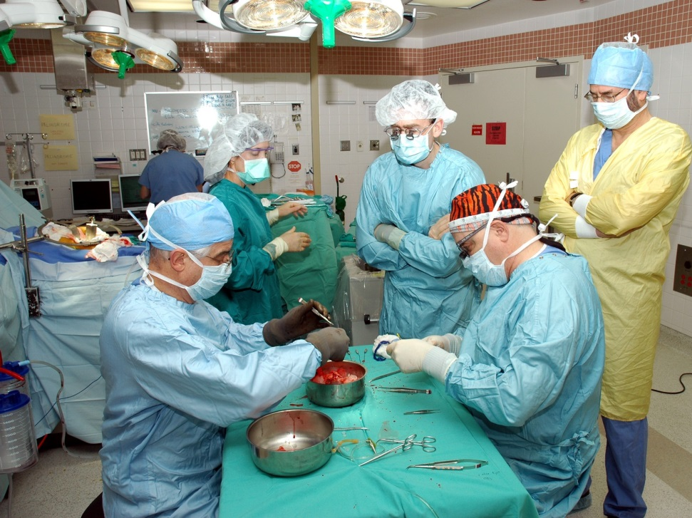
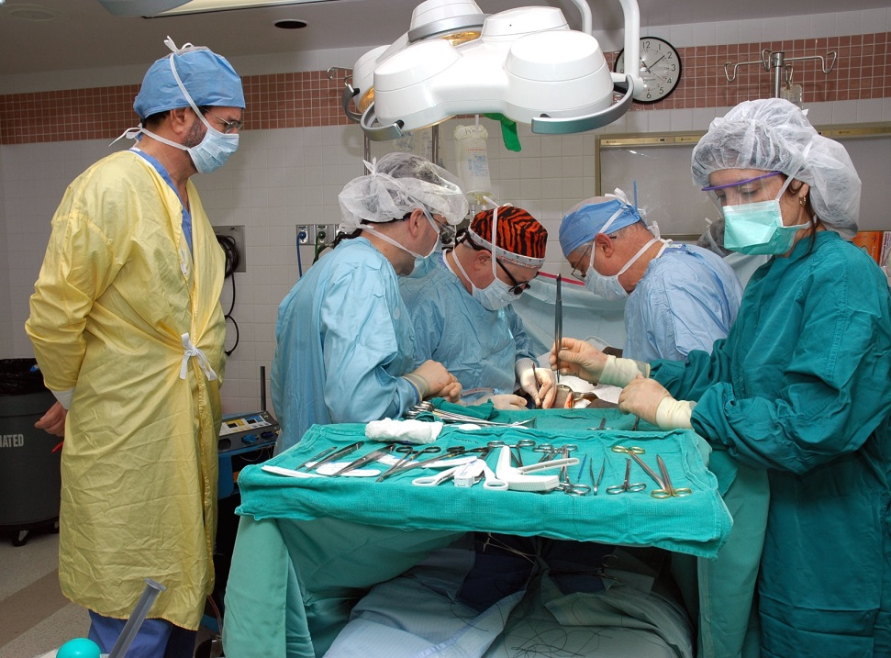
Kidney Exchange
For incentive reasons, all surgeries in an exchange are conducted simultaneously, so a 2-way exchange involves 4 simultaneous surgeries

Slide 23
Suppose exchanges involving more than two pairs are impractical?
Roth, Alvin E., Tayfun Sonmez , and M. Utku Unver, "Pairwise Kidney Exchange," Journal of Economic Theory, 125, 2, December 2005, 151-188.
Our New England surgical colleagues had (as a first approximation) 0-1 (feasible/infeasible) preferences over kidneys.
Initially, exchanges were restricted to pairs.
  This involves a substantial welfare loss compared to the unconstrained case
  But it allows us to tap into some elegant graph theory for constrained efficient and incentive compatible mechanisms.

Slide 24
Pairwise matchings and matroids
Let (V,E) be the graph whose vertices are incompatible patient-donor pairs, with mutually compatible pairs connected by (undirected) edges.
A matching M is a collection of edges such that no vertex is covered more than once.
Let S ={S} be the collection of subsets of V such that, for any S in S, there is a matching M that covers the vertices in S
Then (V, S) is a matroid:
  If S is in S, so is any subset of S.
  If S and S’ are in S, and |S’|>|S|, then there is a point in S’ that can be added to S to get a set in S.

Slide 25
Pairwise matching with 0-1 preferences
Theorems:
All maximal matchings match the same number of couples.
If patients have priorities, then a “greedy” priority algorithm produces the efficient (maximal) matching with highest priorities.
Any priority matching mechanism makes it a dominant strategy for all couples to
  accept all feasible kidneys
  reveal all available donors
So, there are efficient, incentive compatible mechanisms
Hatfield 2005: these results extend to a wide variety of possible constraints (not just pairwise)

Slide 26
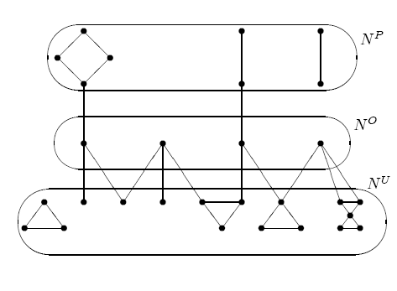
Gallai-Edmonds Decomposition

Slide 27
Who are the over-demanded and under-demanded pairs?
We can ask this even for the more general problem of efficient exchange (i.e. once we surmounted the constraint of just 2-way exchanges).
By 2006 we had successfully made the case for at least 3 way exchanges
  Saidman, Roth, Sönmez, Ünver, and Delmonico, “Increasing the Opportunity of Live Kidney Donation By Matching for Two and Three Way Exchanges,” Transplantation, 81, 5, March 15, 2006, 773-782.
  Roth, Sonmez, Unver “Efficient Kidney Exchange: Coincidence of Wants in Markets with Compatibility-Based Preferences,” American Economic Review, June 2007, 97, 3, June 2007, 828-851

Slide 28
Factors determining transplant opportunity
O
Blood compatibility
So type O patients are at a disadvantage in finding compatible kidneys—they can only receive O kidneys.
And type O donors will be in short supply.
Tissue type compatibility. Percentage reactive antibodies (PRA)
    Low sensitivity patients (PRA < 79): vast majority of patients
    High sensitivity patients (80 < PRA < 100): about 10% of general population, somewhat higher for those incompatible with a donor
    The presence of antibodies to donor HLAs--a positive crossmatch-- significantly increases the likelihood of graft rejection by the recipient
A
B
AB

Slide 29
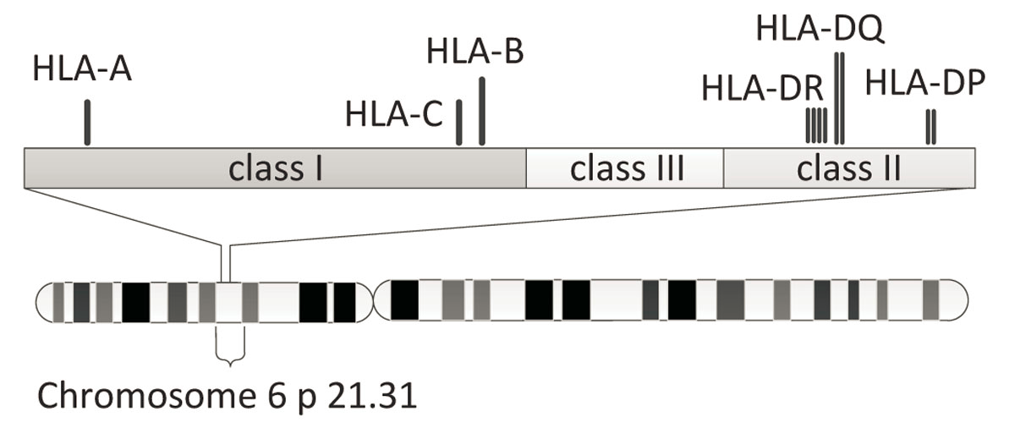
HLA (class I and II)
http://www.biomedcentral.com/1471-2105/11/S11/S10/figure/F1?highres=y

Slide 30
Compatibility graphs: An arrow points from pair i to pair j if the kidney from donor i is compatible with the patient in pair j.
Pair 1
Pair 3
Pair 4
Pair 5
Pair 2
Pair 6

Slide 31
Random Compatibility Graphs
n hospitals, each of a size c>0
D(n) - random compatibility graph:
n pairs/nodes are randomized –compatible pairs are disregarded
Edges (crossmatches) are randomized
Random graphs will allow us to ask :
What would efficient matches look like in an “ideal” large world?

Slide 32
(Large) Random Graphs
G(n,p) – n nodes and each two nodes have a non directed edge with probability p
Closely related model: G(n,M): n nodes and M edges—the M edges are distributed randomly between the nodes
Erdos-Renyi: For any p(n)≥(1+ε)(ln n)/n almost every large graph G(n,p(n)) has a perfect matching, i.e. as n goes to ∞ the probability that a perfect matching exists converges to 1.
A natural case for kidneys is p(n) = p, a constant (maybe different for different kinds of patients), hence always above the threshold.
“Giant connected component”
Similar lemma for a random bipartite graph G(n,n,p).
Can extend also for r-partite graphs, directed graphs…

Slide 33
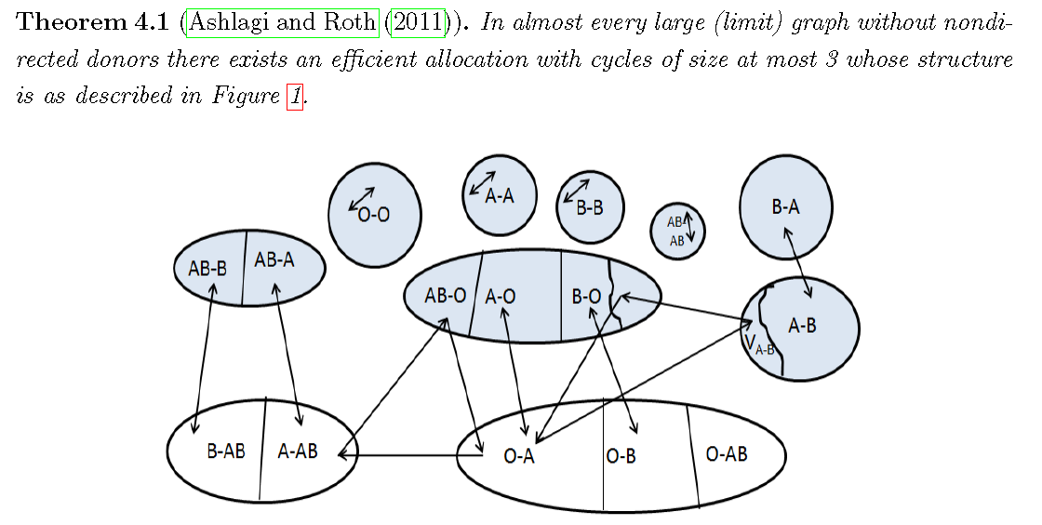
“Ideally” Efficient Allocations: if we were seeing all the patients in sufficiently large markets
2014
Patient-donor pairs by blood type.
Over-demanded (shaded) patient-donor pairs are all matched.

Slide 34
Compatibility graph: cycles and chains
Pair 1
Pair 3
Pair 4
Pair 5
Non-directed donor
Pair 2
Pair 6
Waiting list patient
Pair 7

Slide 35
Chains initiated by non-directed (altruistic) donors
Non-directed donation before kidney exchange was introduced
Non-directed donor
Wait list

Slide 36
Chains initiated by non-directed (altruistic) donors
Non-directed donation before kidney exchange was introduced
Non-directed donation after kidney exchange was introduced
Non-directed donor
Non-directed donor
Wait list
R1
D1
R2
D2
Wait list

Slide 37

A chain in 2007…
3-way chain
March 22, 2007
BOSTON -- A rare six-way surgical transplant was a success in Boston.
There are only 6 people in this chain.
Simultaneity congestion: 3 transplants + 3 nephrectomies = 6 operating rooms, 6 surgical teams…

Slide 38
Chains in an efficient large dense pool
O-O
A-A
B-A
B-B
AB-AB
AB-B
AB-A
A-O B-O
AB-O
A-B
  V_{A-B}
B-AB A-AB
O-B
O-A
O-AB
Waiting list patient
Non-directed donor—
blood type O
It looks like a non-directed donor can increase the match size by at most 3 ☹

Slide 39
How about when hospitals become players?
We are seeing some hospitals withhold internal matches, and contribute only hard-to-match pairs to a centralized clearinghouse.
Mike Rees (APD director) writes us: “As you predicted, competing matches at home centers is becoming a real problem. Unless it is mandated, I'm not sure we will be able to create a national system. I think we need to model this concept to convince people of the value of playing together”.

Slide 40
Individual rationality and efficiency: an impossibility theorem with a (discouraging) worst-case bound
For every k> 3, there exists a compatibility graph such that no k-maximum allocation which is also individually rational matches more than 1/(k-1) of the number of nodes matched by a k-efficient allocation.

Slide 41
Proof (for k=3)
a₃
a₁
a₂
e
c
b
d

Slide 42
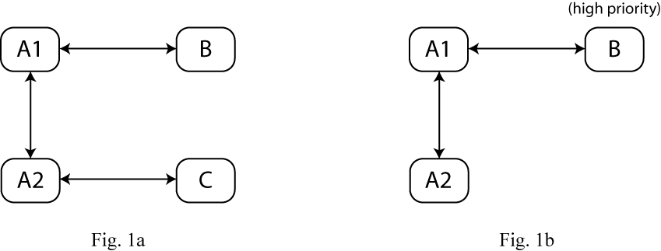
There are incentives for Transplant Centers not to fully participate even when there are only 2-way exchanges
The exchange A1-A2 results in two transplantations, but the exchanges A1-B and A2-C results in four.
(And you can see why, if Pairs A1 and A2 are at the same transplant center, it might be good for them to nevertheless be submitted to a regional match…)

Slide 43
PRA distribution in historical data
PRA – probability for a patient to fail a “tissue-type” test with a random donor

Slide 44
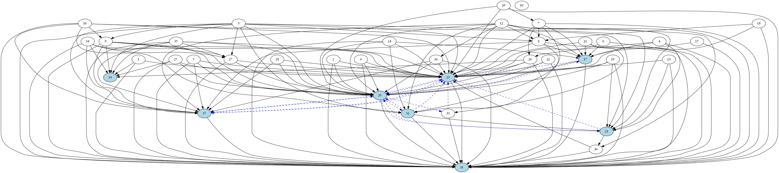
Graph induced by pairs with A patients and A donors. 38 pairs (30 high PRA). Dashed edges are parts of cycles.
No cycle contains only high PRA patients.
Only one cycle includes a high PRA patient

Slide 45
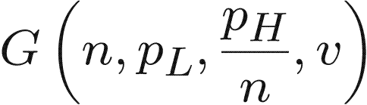


Cycles and paths in random dense-sparse graphs
n nodes. Each node is L w.p. v and H w.p. v
incoming edges to L are drawn w.p.
incoming edges to H are drawn w.p. c/n:
L
L nodes have many incoming arrows
H

Slide 46
Case v>0 (some low sensitized, easy to match patients. Why increasing cycle size helps
Theorem. Let C_{k} be the largest number of transplants achievable with
cycles · k. Let D_{k} be the largest number of transplants achievable with
cycles · k plus one non-directed donor. Then for every constant k there exists ρ>0
Furthermore, C_{k} and D_{k} cover almost all L nodes.
L
H

Slide 47
Can simultaneity be relaxed in Non-directed donor chains?
Cost-benefit analysis:
“If something goes wrong in subsequent transplants and the whole ND-chain cannot be completed, the worst outcome will be no donated kidney being sent to the waitlist and the ND donation would entirely benefit the KPD [kidney exchange] pool.” (Roth, Sonmez, Unver, Delmonico, and Saidman) AJT 2006, p 2704).

Slide 48
Simultaneous cycles and Non-simultaneous extended altruistic donor (NEAD) chains
D1
D2
R1
R2
Conventional cycle: why always simultaneous?
On day 1 donor D2 gives a kidney to recipient R1, and on day 2 donor D1 is supposed to give a kidney to recipient R2…

Slide 49
Simultaneous cycles and Non-simultaneous extended altruistic donor (NEAD) chains
D1
D2
NDD
D1
D2
R1
R2
R1
R2
Conventional cycle
Non-simultaneous chain
Since NEAD chains can be non-simultaneous, they can be long
Roth, Alvin E., Tayfun Sönmez, M. Utku Ünver, Francis L. Delmonico, and Susan L. Saidman, “Utilizing List Exchange and Undirected Donation through “Chain” Paired Kidney Donations,” American Journal of Transplantation, 2006

Slide 51
The First NEAD Chain (Rees, APD)
July
July
Sept
Sept
Feb
Feb
Feb
Feb
March
March
2007
2007
2007
2007
2008
2008
2008
2008
2008
2008
MI
AZ
OH
OH
OH
MD
MD
MD
NC
MD
OH
1
2
3
4
5
6
7
8
9
10
O
O
A
A
B
A
A
A
AB
A
AB
O
O
A
A
B
A
#
A
A
A
*
A
Recipient PRA
62
0
23
0
100
78
64
3
100
46
Recipient Ethnicity
Cauc
Cauc
Cauc
Cauc
Cauc
Hisp
Cauc
Cauc
Cauc
AA
Relationship
Husband
Wife
Mother
Daughter
Daughter
Mother
Sister
Brother
Wife
Husband
Father
Daughter
Husband
Wife
Friend
Friend
Brother
Brother
Daughter
Mother
* This recipient required desensitization to Blood Group (AHG Titer of 1/8).
# This recipient required desensitization to HLA DSA by T and B cell flow cytometry.

Slide 52
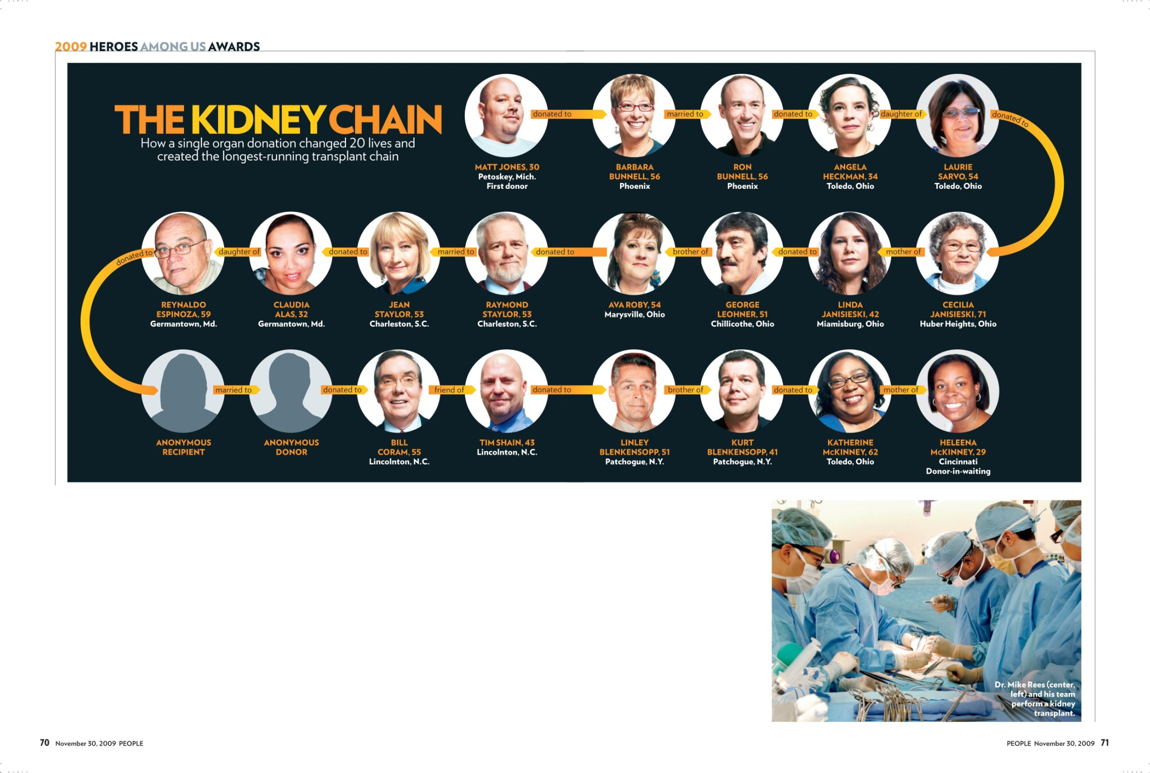

Slide 53
Chains are important for hard to match pairs
Why are chains essential? As kidney exchange became common and transplant centers gained experience they began withholding their easy to match pairs and transplanting them internally.
This means that the flow of new patients to kidney exchange networks contain many who are hard to match
So chains become important: many pairs with few compatible kidneys can only be reached through chains.

Slide 54

Feb 2012, NKR: a NDD chain of length 60 (30 transplants)

Slide 55
Computational notes
Finding maximal 2-way exchanges is a computationally easy problem.
Finding maximal 2- and 3-way exchanges is computationally complex.
There are many more chains than cycles
  But so far there hadn’t been a problem solving the necessary integer programs.

Slide 56
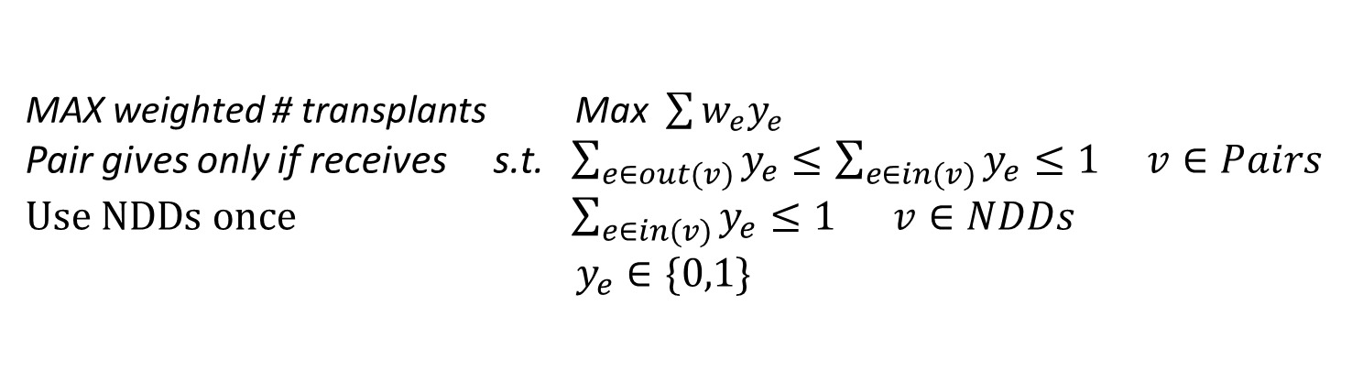
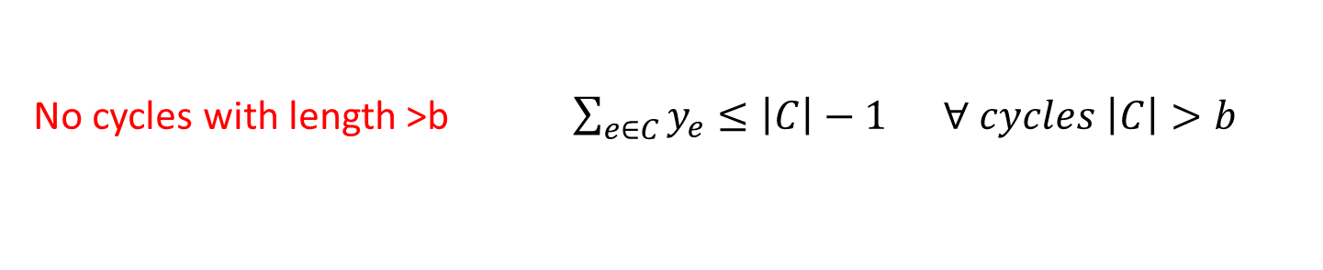
Matching algorithms have had to get more powerful to find optimal matchings involving cycles and chains in sparse graphs
Integer Programming based algorithm for finding optimal cycle and chain based exchanges.
Formulation I:
MAX weighted # transplants Max $\sum{w_{e}y_{e}}$
Pair gives only if receives s.t. $\sum_{e∈out(v)}{y_{e}≤\sum_{e∈in(v)}{y_{e}≤1 v∈Pairs }}$
$Use NDDs once$ $\sum_{e∈in(v)}{y_{e}≤1}$ $v∈NDDs$
$y_{e}∈\{0,1\}$
No cycles with length >b $\sum_{e∈C}{y_{e}}≤\left|C\right|−1 ∀ cycles \left|C\right|>b$
Cycle bound constraint is added only iteratively to speed up the computation
The running time of the algorithm is below 20 min for most instances (most are solved within seconds)
Anderson, Ross, Itai Ashlagi, David Gamarnik and Alvin E. Roth, “Finding long chains in kidney exchange using the traveling salesmen problem,” Proceedings of the National Academy of Sciences of the United States of America (PNAS), January 20, 2015 | 663–668.

Slide 57
Market design isn’t just analytical
I’ve briefly mentioned some of the analytical models that have played a big role:
  Game theory
    Top trading cycles and chains—the core
    Strategic behavior—dominant strategy incentive compatibility
  Deterministic graph theory
  Random graph theory
  Integer programming
But market design is also economic engineering at an operational level

Slide 58
Changes in kidney exchange over time
Operational level:
  How to manage long (non-simultaneous) chains
  How to increase acceptance rates of offers?
  Why do transplant centers withhold easy to match pairs?
  What makes kidney exchange among multiple hospitals hard?
  Why (else) are chains of such practical usefulness?
  What are (some of) the obstacles that remain?

Slide 59
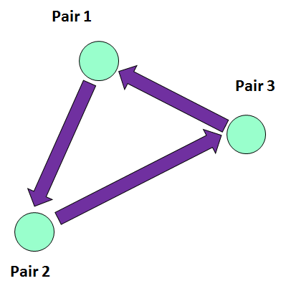
Most ‘offers’ are rejected
An ‘offer’ is a particular cycle or chain segment—an edge in the compatibility graph
In 2007, only about 15% of offers resulted in transplants
Today it’s closer to 50%
What’s going on?
X

Slide 60
Transplant centers declined donors for medical reasons
Transplant centers were consistently rejecting potential donors for reasons that could have been stated in advance
  But surgeons didn’t/couldn’t accept/reject kidneys in advance
A threshold language was introduced for pre-rejection
  But it’s hard to specify in advance which kidneys are unacceptable, when the language is limited to thresholds in each dimension—e.g. age, BMI, blood pressure…

Slide 61
Reducing “predictable” rejections
Now show transplant centers multiple combinations of donor-recipient offers prior to making formal offers.
  It’s easier to accept or reject from a relatively small set of possible kidneys

Slide 62
Remaining problems
Center incentives
  Frequent flier accounting
Finances
  Standard acquisition charge
Broader picture—enlarging the pool
  International?

Slide 63
Encouraging transplant centers to participate fully in kidney exchange
Make it safe for hospitals and their patients to enroll easy to match pairs in kidney exchange (and not just hard to match pairs)
  Guarantees to hospitals that they and their patients won’t lose if they enroll all pairs in exchange
  Frequent flier programs?

Slide 64
Frequent flier accounting: over and under-demanded patient-donor pairs
Over-demanded
Under-demanded—blood type O patients

Slide 65
Growth of kidney exchange in the US
Kidney exchange transplants per year
5-fold increase since 2007, majority in chains

Slide 66
Kidney exchange outside the U.S.
Friday, July 24, 2015 Kidney exchange in Turkey (1st exchanges there)
April 10, 2015 A first non-directed donor kidney exchange chain in Italy
March 30, 2015 A first kidney exchange in Argentina
March 5, 2015 First kidney exchange in Poland
Friday, November 7, 2014 Kidney exchange in Spain: now more than 100 transplants
June 7, 2014 Kidney exchange in France
December 19, 2013 Kidney exchange in Vienna
August 19, 2013 Ten kidney exchange transplants on World Kidney Day in Ahmedabad, India
July 28, 2013 First Kidney Exchange in Portugal:
July 23, 2013 Kidney exchange chain in India
June 6, 2013 Kidney exchange between Jewish and Arab families in Israel
December 26, 2012 Kidney exchange in Canada
December 1, 2012 Kidney exchange in India
June 1, 2012 Mike Rees and Greece: an intercontinental kidney exchange
March 27, 2012 Kidney exchange in Britain
February 5, 2012 Kidney exchange in Australia, 2011
April 29, 2011 First kidney exchange in Spain
December 8, 2010 National kidney exchange in Canada
August 3, 2010 Kidney Exchange in South Korea
Tuesday, August 3, 2010 Kidney Exchange in South Korea
Friday, July 30, 2010 Kidney transplantation advice from the Netherlands
March 9, 2010 Kidney exchange news from Britain (1st 3-way there)
January 27, 2010 The Australian paired Kidney eXchange (AKX) goes live
June 25, 2009 Kidney exchange in Canada (1st exchange there)
February 27, 2009 Kidney Exchange in Australia (in Western Australia)

Slide 67
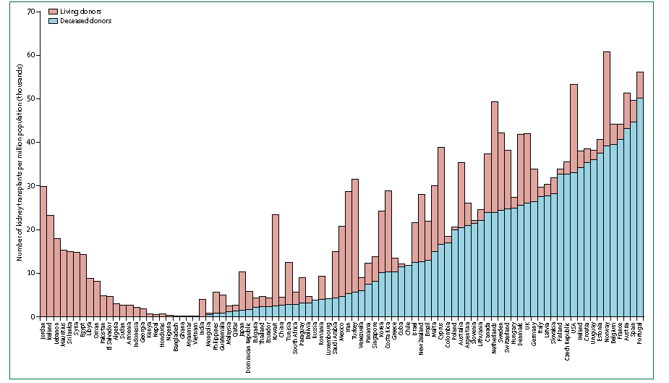
Kidneys Transplanted per million population
U.S.A.
Nigeria, Bangladesh, Vietnam…
(Global Observatory on Donation & Transplantation)
Notes:
Each transplant to an American saves about $250,000 compared to dialysis (over first 5 years)

Slide 69
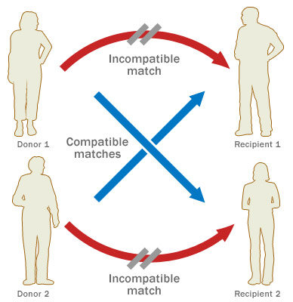
Global kidney exchange: a possibility of mutual aid
United States
Two-way exchange
Developing World
Transplants unavailable

Slide 70
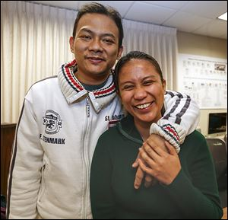
First global kidney exchange, with a pair from the Philippines—January 2015, Alliance for Paired Donation (Rees et al.)
Non-directed donor
Jose
Kristine
R2
D2
Jose Mamaril received a kidney from a non-directed American donor in Georgia. His wife, Kristine, donated one of her kidneys to an American recipient in Minnesota, whose donor continued the chain by donating to a patient in Seattle.
THE BLADE/JETTA FRASER
Wait list

Slide 71
Kidney Disease costs Medicare $35 Billion per year
Dialysis costs Medicare approx $90,000/year
Kidney transplantation costs approx $33,000/year
In 5 years U.S. taxpayers save >$275,000
per kidney transplant—
More than enough to pay for surgery
and post-operative care for a foreign pair.

Slide 72
Kidney Disease costs
Commercial Insurance Companies
> $14 Billion per year
Dialysis cost $800,000 / 33 months
Kidney transplantation costs $300,000 / 33 months
Insurance Companies can save up to $500,000
per kidney transplant
Notes:
72

Slide 73
Two Proposals and Three Planners
To exploit gains from trade, we introduce two proposals:
  Global kidney exchange
  Non-directed donors proposal
And analyze them from the perspectives of three planners:
  Medicare
  State department
  Private insurance

Slide 74
Planners’ Objectives
Medicare
  Maximize domestic transplants subject to budget constraint.
  Break ties in favor of policies with lower cost.
State department
  Maximizes domestic transplants subject to budget constraint.
  Break ties in favor of policies with more international transplants.
Profit-maximizing insurance corporation
  Minimize costs

Slide 75
Global Kidney Exchange
The GKE proposal is “self-financing”.
Back of the envelope calculation:
  cost of hemodialysis ≈ $90, 000 per year
  average time under dialysis ≈ 5 years
  cost of transplant ≈ $120, 000 per surgery (plus $20,000 in maintenance therapy costs per patient per year)
But in steady state, waiting time decreases. So dialysis costs will go down…how long will GKE remain self financing?

Slide 76
GKE: A (Stylized) Dynamic Model
Domestic pairs arrive with rate m.
International pairs arrive with rate λm
All pairs are ex ante biologically compatible with probability p
International pairs are financially incompatible
All pairs perish with (normalized) rate 1
GKE(λ): the above model with policy parameter λ

Slide 77
GKE: Greedy Matching Policy
Whenever a domestic pair arrives:
  If agent has any domestic matches, match her to one of them uniformly at random
  If agent has any international matches (but no domestic), match her to one of them uniformly at random
Whenever an international pair arrives:
  If agent has any matches, match her to one of them uniformly at random

Slide 78
GKE: Illustration (should become a dynamic animation)
International pairs
Domestic pairs

Slide 79
Large Market, Highly Sensitized Patients
we model a large market regime, with highly sensitized domestic patients: p (prob of compatibility) is “small” and “m” (domestic arrival rate) is large.
Formally:
  m . p = ω(1) (mp, the average degree of a node gets arbitrarily large as # nodes grows
  m . p = o(n) (mp grows slower than # nodes: the percentage of other nodes connected to each node goes to zero—the graph remains sparse)

Slide 80
Costs
C_{d} : cost of dialysis per patient per year
C_{s} : cost of surgery (and maintenance therapy) per patient
W(λ) : Average waiting time of all agents in GKE(λ)
  W(0) : Average waiting time under status quo
C(λ): Total cost = C_{d} W(λ) + C_{s} . (# of all matched patients)
Let θ(λ) = C_{d} . W(λ)/ C_{s} dialysis cost per patient / surgery cost

Slide 81
GKE Is Self-Financing
Theorem: If θ > ln(2), then there exists a constant λ>0 such that GKE(λ) is self-financing.
ln 2 = .693… < 1

Slide 82
Intuition
Some domestic pairs immediately find a match
Some other do not find a match upon arrival.
  They increase the average waiting cost
International pairs get matched to those the latter type of domestic pairs
So even if the average dialysis cost is less than the surgery costs, GKE can still be self-financing because it matches domestic patients with higher-than-average dialysis costs.

Slide 83
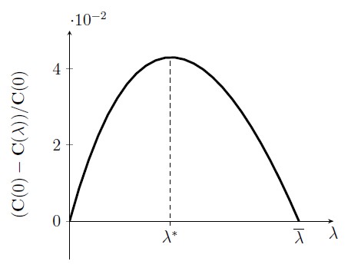
Planners’ Choices
Private insurer’s choice
Medicare and State Department’s
choice

Slide 84
The Non-Directed Donor Proposal
limitation of the GKE proposal:
The number of international transplants is bounded by the size of the domestic exchange pool (presently on the order of 1,000 pairs…)
The NDD proposal can increase the number of international transplants by more than an order of magnitude (100,000 patients on U.S. deceased-donor waiting list)

Slide 85
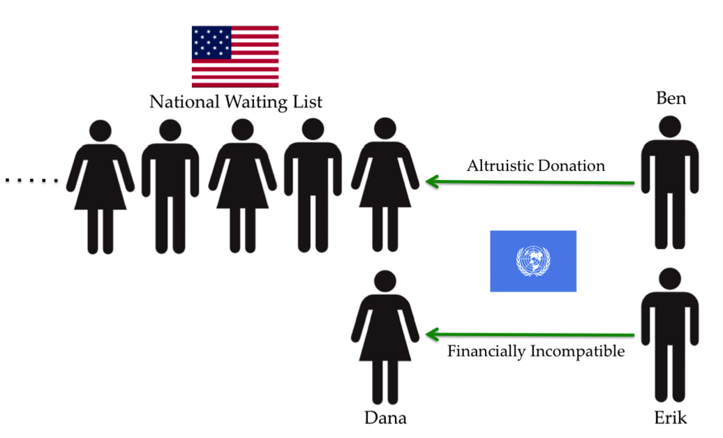
The Non-Directed Donor Proposal
Patient: Dana
Donor: Erik
NDD: Ben
Each international patient is accompanied
by a donor and a non-directed donor

Slide 86
NDD: A Dynamic Model
Domestic patients have arrival rate m.
Deceased kidneys become available with rate m_{d}
International patients (together with donors) arrive with rate m_{i}
Policy maker accepts international patients with rate λ (0≤ λ ≤ m_{i})
λ is the policy parameter (controlled by the policy maker)
When a deceased or international donation is accepted
  A match is found; number of domestic waiting patients decreases by one
All waiting patients perish with (normalized) rate 1
NDD(λ): the above policy with policy parameter λ

Slide 87
Matching Policy
Medicare and State department
  An arbitrary policy such as First-Come-First-Served
Insurance Corporation
  Last-Come-First-Served (U.S. private insurers only pay for first 33 months…)
  LCFS policy minimizes the waiting cost

Slide 88
Planner’s Decision
Theorem B. Average length of the domestic queue in NDD(λ) is m_{d} – (m + λ), unless the average queue length is “very small”.
When the queue becomes too short, (i.e. when m_{d} – (m + λ) becomes very small), m_{d} – (m + λ) is not a sharp estimate of the average queue length
But in this case, we have almost solved the problem
For our purpose, it is safe to assume m_{d} – (m + λ) is a sharp estimate for the average queue length—i.e. of average waiting time

Slide 89
The medical logistics may not be the hard part

Slide 90
Financial flows
Savings:
  Medicare—complex legislative/bureaucratic
  Private insurers (33 months)
Costs:
  Surgeries—transplant centers
  Post surgical treatment in home countries
  Infrastructure development in home countries
USAID?--Same Federal budget, but no change needed in Medicare
Allow insurance companies to nominate patients?

Slide 91

Jose and Kristine: Safely home…
$50,000 escrow fund for post-surgical care

Slide 92
Why do we have laws against simply buying and selling kidneys?
I sure don’t know the answer to this one, but I think it’s a subject that social scientists need to study…
It isn’t just about body parts…

