Slide 1
Algorithmic Game Theory Christos Papadimitriou Econ/TCS Boot Camp

Slide 2
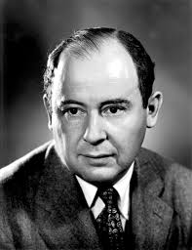
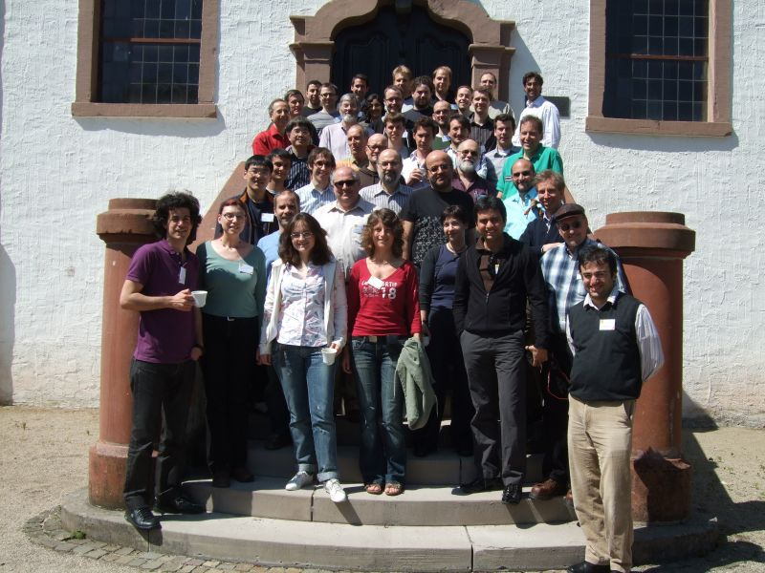
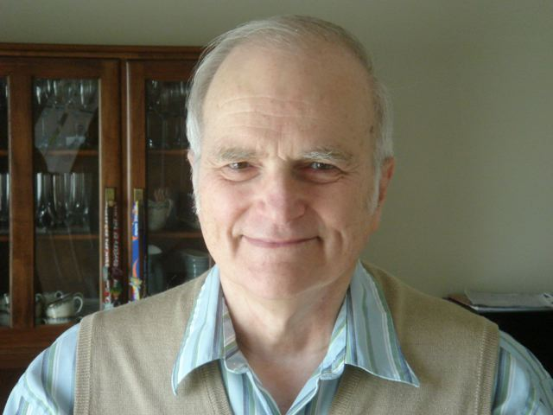
Before 1995…
A few researchers did both:
von Neumann N. Megiddo R. E. Stearns

Slide 3
Btw:
TCS =
Theoretical Computer Science =
“The mathematical study of computation
and in particular
of algorithms and their complexity”

Slide 4
Also before 1995: Computation as a game
Yao’s Lemma (1977)
Alternation formulation of space (ca. 1980)
Erenfeucht – Fraïssé games (ca. 1955)
Resource allocation in computer systems through market mechanisms (1980s-90s)

Slide 5
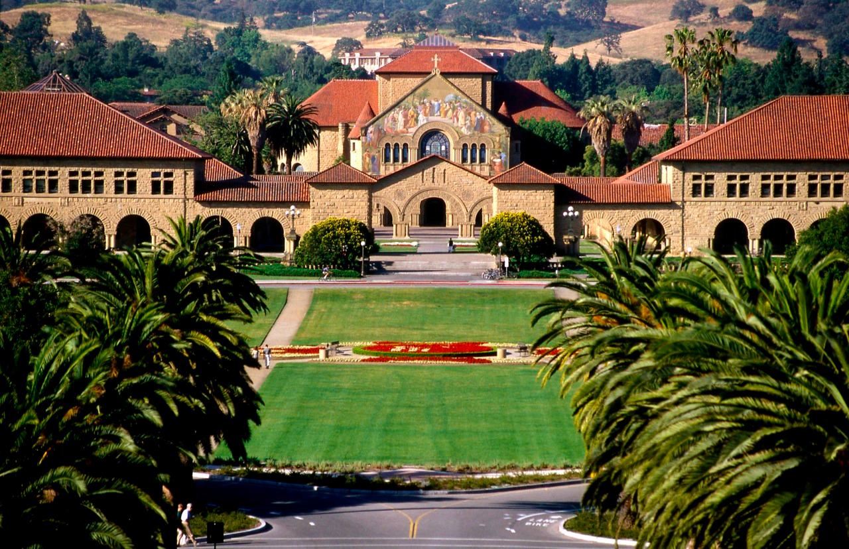
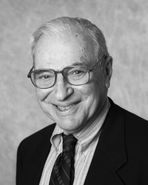
How I got into AGT

Slide 6
Bounded Rationality
Herbert A. Simon (1972):
Are undesired equilibria often the result of the common assumption that agents have unbounded resources for reasoning?
Megiddo and Wigderson (1986)
P. (GEB 1992)
P. and Yannakakis (1994 STOC)
Fortnow and Kimmel (1994 STOC)

Slide 7
Complexity in Cooperative Games
How hard is it to compute solution concepts such as the core, the Shapley value, the vN-M solution, the nucleolus, etc. in a particular cooperative game
Deng and P. (1990)

Slide 8
About the same time: complexity of Nash equilibrium?
Megiddo and P. 1991
Nonconstructive proofs and TFNP
Also, Koller, Megiddo, von Stengel (1994) algorithms for extensive-form zero-sum games

Slide 9
Then, all of a sudden…
…the Internet happened!

Slide 10
The Internet changed Computer Science (and TCS) it turned it into a physical science…

Slide 11
The Internet changed Computer Science (and TCS) it turned it into a physical science… …and a social science

Slide 12
Also, the methodological path to AGT: TCS as a Lens

Slide 13
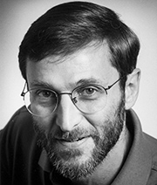
“The Internet is an
equilibrium; we
just need to identify
the game…”
Scott Shenker

Slide 14
Remember Max?
Max = a[1]
for i = 2,…,n do
if a[i] > Max, Max = a[i]
VCG is the new Max!

Slide 15
Algorithmic Mechanism Design?
Joel Sobel (ca 1990) “Mechanism designers get away with too many positive results. Aren’t there complexity obstacles?”

Slide 16
Algorithmic Mechanism Design!
Nisan and Ronen (1998): Combinatorial auctions!
Juggling:
fast computation vs
close approximation vs
incentive compatibility

Slide 17
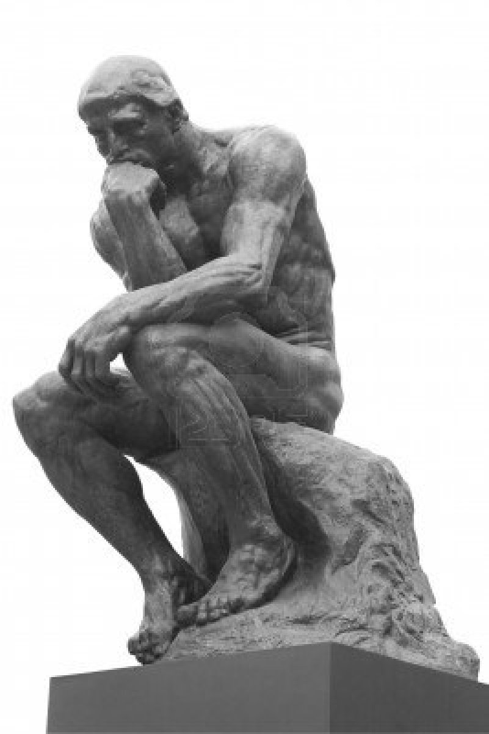
What makes a scientific idea go viral?

Slide 18
Much more on this in Jason’s and Costis’s talks

Slide 19
The new Complexity Theory
Let P^{IC} be the class of all oprimization problems that can be solved in polynomial time in an incentive compatible way
P^{IC} = P (reason: VCG)
NP-complete^{IC} = NP-complete
APX^{IC} ≠ APX (assuming P ≠ NP)
(Shapira, Singer, P. 2009)

Slide 20
Meanwhile: Equilibria can be inefficient!
delays
social optimum: 1.5
x
1
0
equilibrium: 2
x
1

Slide 21
Measuring the inefficiency: “The price of anarchy”
cost of worst Nash equilibrium
p. of A =
optimum social cost
(Koutsoupias and P. 1999)

Slide 22
Equilibria can be inefficient
delays
x
1
social optimum: 1.5
0
x
1
equilibrium: 2
(so, p. of A ≥ 4/3)

Slide 23
How much worse does it get?
= 4/3 !!!
[Roughgarden and Tardos, 2000;
Roughgarden 2002]
p. of A

Slide 24
But in the Internet flows don’t choose routes…
(P. and Greg Valiant, 2010): Suppose that each node routes the flow through it in such a way as to minimize expected travel time
Price of anarchy can be unbounded
But if routers charge a price per flow for routing (and compete for flows) then the price of anarchy vanishes
Notes:
+ SEARCH AUCTIONS, 10^9 LARGEST SCALE IN HISTORY

Slide 25
why wasn’t the price of anarchy studied before?

Slide 26
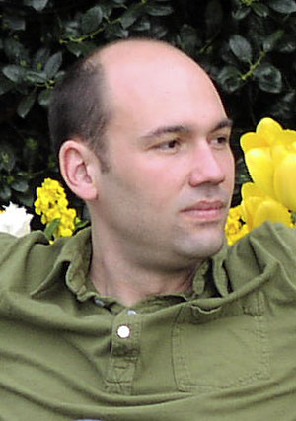
Much more on this in Tim’s talk

Slide 27
Complexity of Equilibria
The existence proofs for equilibria usually rely on topological theorems that are not constructive
Can we find the equilibria in reasonable time?
Or is this an intractable problem?

Slide 28
Nash is Intractable
Finding a Nash equilibrium is intractable
Specifically, PPAD-complete
(Daskalakis, Goldberg, P. 2006)
Even for 2 players (Chen, Deng 2006)

Slide 29
PPA… what?
unbalanced
node
Where is
the other
unbalanced
node??

Slide 30
Imagine now that…
…the graph is exponential, and the edges are given by an algorithm
Now how can you find the other unbalanced node?
It seems to take exponential time, huh?
That’s PPAD-complete
If it can be solved, cryptography is impossible

Slide 31
Much more on this in Costis’s talk

Slide 32
But why should we care about intractability?

Slide 33
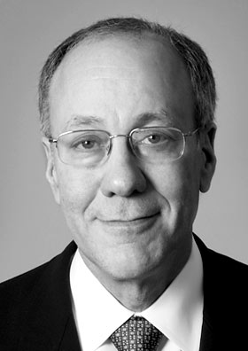
“The Nash equilibrium lies at the foundations of modern economic thought”
“Nobody would take seriously a solution concept that is not universal”
Roger Myerson

Slide 34
Price equilibria
Recall the Arrow-Debreu theory: producers, consumers, production functions, utilities
Convexity ⇒ prices
Prices ⇒ Pareto efficiency

Slide 35
Intractability
Finding price equilibria in exchange economies with consumer utilities that are “just outside” gross substitutablity is PPAD-complete
(Chen, Paparas, Yannakakis 2013)

Slide 36
More intractability (price adjustment mechanisms)
For any price adjustment mechanism there is an exchange market with three goods such that it takes the mechanism 2^{1/ε} steps to achieve excess demand ε
(P. Yannakakis 2013)

Slide 37
Price equilibria in economies with production
input
How do you get Pareto efficiency when you have economies of scale?
Convexity = no economies of scale
output

Slide 38
Complexity equilibria
With economies of scale, there are situations (a dense set thereof) where all agents can improve a lot, but they are all stuck at an inefficient place, and it is worse than NP-complete to get unstuck
(P. and Chris Wilkens, 2011)

Slide 39
Exact equilibria?
So far, we have been discussing approximate equilibria: excess demand, or incentive to deviate, is very small
These may not be close to true equilibria
Exact equilibria are much harder to find, possibly not in NP (the class FIXP)
(Etessami and Yannakakis 2010)

Slide 40
Three nice triess to deal with Nash equilibria
Lemke-Howson algorithm
The Homotopy Method
The Harsanyi – Selten equilibrium selection method

Slide 41
Much harder!
It is PSPACE-complete to find the Nash equilibrium arrived at by
(a) the Lemke-Howson algorithm;
(b) the homotopy method; and
(c) the Harsanyi-Selten equilibrium selection method
(Goldberg, Papadimitriou, Savani, 2010)

Slide 42
Soooooo…
The prehistory of AGT
AGT’s two decades
Algorithmic Mechanism Design
The Price of Anarchy
Equilibria and Complexity

Slide 43
And there is so much more…
Algorithmic Social Choice
Algorithmic market design
Prediction makets and matching markets
Cooperative games
Incentives in social networks
Security and privacy
Crowdsourcing
…

Slide 44
Next: some current stuff and some forward-looking stuff
Back to our roots: AGT and the Internet
Update on Approximate Nash
AGT and Social Networks
[ AGT and the Theory of Evolution ]
[ Dynamic mechanism design ]
AGT and Dynamical Systems
AGT and data

Slide 45
Update on Approximate Nash
LSS: For Nash only PTAS makes sense
Why? The curse of easy best response
Is there a PTAS?
…or PPAD-completeness for ε > 0?
[Rubinstein 2015]: The latter!!
(For n-player games…)

Slide 46
But how about 2 or 3 players?
Can we extend Aviad’s result?
[LMM 2003]: QPTAS
So, it is probably not PPAD-complete…

Slide 47
“Can almost everybody be almost happy?”
(δ, ε) – NASH: Given an n-player game, find a strategy profile such that a (1 – δ) fraction of the players are within ε of best response
Note: this is PPAD-complete for δ = 0 and some ε > 0.

Slide 48
“Can almost everybody be almost happy?”
Theorem: If for some δ, ε > 0 (δ, ε) – NASH requires 2^{n} time – or even 2 ^{ω(√n)} time – then [LMM 2003] is the best possible
(Babichenko, P, Rubinstein 2015)
“A PCP for PPAD”

Slide 49
Classification when the data are strategic
(Joint work with Hardt, Megiddo, Wootters)
Fact: The number of books in the household is an excellent predictor of success at school – actually, a bit better than grades
So, an admissions classifier should use this

Slide 50
Problem:
classifier
grades
books

Slide 51
The data are strategic!
Applicants will buy enough books to get in
(As long as their utility of admission covers this expense)

Slide 52
So, you have to…
grades
books

Slide 53
But of course…
…this way you may lose some good students who are poor…
Suppose you want to maximize the score = #correctly classified - # misclassified
Applicants: unit utility for being admitted
Each has a cost c_{i} (x, y) for moving from x to y (not necessarily a metric)

Slide 54
Stackelberg!
Given: Data distribution, cost function, ideal classifier H…
…come up with modified classifier H*…
…such that, when the data respond by moving to the closest admitted point (if cost of moving < 1)…
…the expected score is maximized

Slide 55
Good news, bad news
Theorem 1: Can be done arbitrarily close to the optimum in polynomial sample complexity and time as long as the original classification problem has low sample complexity and the cost function has “finite s-dimension”
Theorem 2: NP-hard to approximate within any ratio even if you know the data points

Slide 56
Finally: Strategic Data Sources
(Joint work with Cai and Daskalakis, in Arxiv)
Context: Statistical estimation
There is a ground truth function F(x)
You estimate it from data points (x_{i},y_{i})
You get the data points from workers
Each worker i has a convex function σ_{i}
With effort e >0 from x she comes up with y = F(x) in expectation, and variance σ_{i}²(e)

Slide 57
The agents
You (the Statistician) have a way, from data Z={x_{i},y_{i}}, to find an approximation G_{Z} of F
(Think linear regression, much more general)
Your loss is L = E_{x~D} [(F(x) – G_{Z}(x))²]
Assumption: L depends only on {x_{i}}, D, {σ_{i}}
(Not on F; estimation is unbiased)
Plus any payments to workers, Σ_{i} p_{i}
Each worker i wants to minimize e_{i} – p_{i}

Slide 58
Social Optimum
OPT = min _{W’, x, e} [ L({x_{i}}, D, {e_{i}}) + Σ_{i} e_{i} ]
Notice that OPT is your (the Statistician’s) wildest dream
It means that you have persuaded the workers to exert optimum effort at no surplus (can’t do better because of IR)

Slide 59
Surprise: It can be achieved!
Theorem: There is a mechanism which achieves “your wildest dream” utility OPT as dominant strategy equilibrium
Trick: Promise payments
p_{i} = A_{i} – B_{i} (y_{i} – G_{-i} (x_{i} ))²
zero
surplus
optimum
effort

Slide 60
Caveat
This means that the incentive problem can be solved, essentially by a surprisingsly powerful contract
What is less clear is how to solve the computational problem – how to compute OPT
Btw, if the x_{i}’s are given, even ridge regression can be managed the same way

Slide 61
Thank You!

Slide 62
Thank You!

