Slide 1
Practical
UC security
Black-box
protocols
Alessandra Scafuro
fellow talk

Slide 2
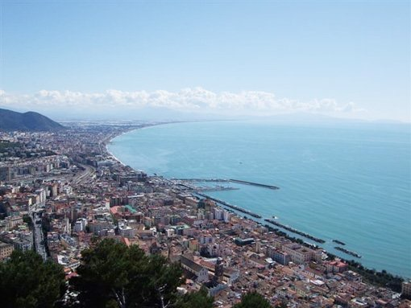
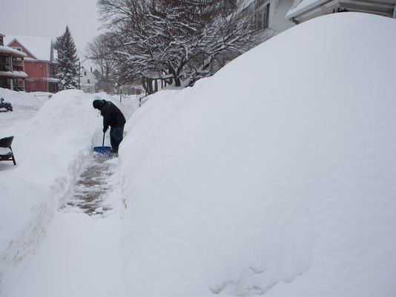
intro
PhD
2013-2014
Jan 2015
University of Salerno
UCLA
BU & NEU
Ivan Visconti
Rafail Ostrovsky
Canetti & Wichs
Practical
UC security
Practical
UC security
Black-box
protocols

Slide 3
Black-box
protocols

Slide 4
Black-box
protocols
semi-honest
P1
P2

Slide 5
Black-box
protocols
malicious
P1
P2

Slide 6
Black-box
protocols
Specific Assumption
malicious
P1
P2
proof
correctness
proof
correctness
proof
correctness
proof
correctness

Slide 7
Black-box
protocols
Specific Assumption
P1
P2
proof
correctness
proof
correctness
proof
correctness
proof
correctness

Slide 8
Black-box
protocols
Specific Assumption
General Assumption
P1
P2
proof
correctness
proof
correctness
proof
correctness
proof
correctness

Slide 9
General Assumptions
instantiate with several hardness assumptions
minimal assumptions?
minimal round complexity?
rounds
[Katz Ostrovsky 04]

Slide 10
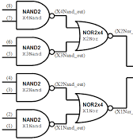
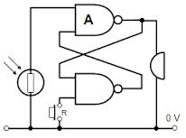
Black-box
protocols
Specific Assumption
General Assumption
NP-reduction
P1
P2
P1
P2
Theoretical insights
proof
correctness
proof
correctness
Inherently inefficient
proof
correctness
proof
correctness
proof
correctness

Slide 11
Black-box
protocols
Black-box
Specific Assumption
General Assumption
General Assumption
NP-reduction
f
P1
P2
P1
P2
proof
correctness
proof
correctness
proof
correctness
proof
correctness
proof
correctness

Slide 12
Black-box General Assumptions
instantiate with several hardness assumptions
no need of circuit, NP reduction
primitives can be instantiated with hardware/oracles
?
Black-box
more
General Assumption
General Assumption

Slide 13
Black-box
protocols
Black-box
Specific Assumption
General Assumption
General Assumption
NP-reduction
f
proof?
P1
P2
P1
P2
proof
correctness
proof
correctness
cut &
choose
proof
correctness
proof
correctness
[Ishai-Kushilevitz-Lindell-Petrank06,
IK Ostrovsky-Sahai07, IKOPS11
Haitner08, Pass-Wee09,
Choi-Dachman-Soled-Malkin-Wee09]
proof
correctness

Slide 14
Black-box
protocols
Black-box
Specific Assumption
General Assumption
General Assumption
f
P1
P2
P1
P2
P1
P2
π1
π2
π3
π4
π5
proof
correctness
proof
correctness
proof
correctness
check P1
proof
correctness
proof
correctness

Slide 15
Black-box
protocols
Black-box
Specific Assumption
General Assumption
General Assumption
f
P1
P2
P1
P2
P1
P2
π1
π2
π3
π4
π5
π5
proof
correctness
proof
correctness
proof
correctness
check P1
proof
correctness
check P2
proof
correctness
recombine
compute

Slide 16
cut & choose
techniques
Black-box
General Assumption
General Assumption
minimal assumptions
Yes
[Kil88, IPS08, IKLP11,IKOS07,
PW09,CDMW09,..]
(feasibility of MPC)
minimal rounds
4 rounds?
rounds
[Katz Ostrovsky 04]
succinctness

Slide 17
4 rounds??
Black-box
General Assumption
P1
P2
P1
P2
1.
Com P1
π1
π2
π3
π4
π5
2.
Com P2
3.
Checks
4.
recombine
5.
compute
check P1
check P2
recombine
compute

Slide 18
cut & choose
techniques
Black-box
General Assumption
General Assumption
minimal assumptions
Yes
[IKLP11,IKOS07,
PW09,CDMW09]
(feasibility of MPC)
minimal rounds
Yes
CRYPTO 2015
Ostrovsky, Scafuro, Richelson
STOC 2014
Goyal, Ostrovsky, Scafuro, Visconti
Succinctness

Slide 19
more
?
General Assumption
Black-box
General Assumption
WI Universal Arguments and
public coin ZK from
black-box Hash Function
STOC 2014
Goyal, Ostrovsky, Scafuro, Visconti
RO
Information theoretically
secure public coin ZK in NPRO

Slide 20
Black-box
protocols
Open problem
Closing the gap
?
Black-box
General Assumption
General Assumption
Application of developed techniques
Physical Zero-Knowledge
PUFs
Oracle
Oracle

Slide 21
Other topics
Practical UC-security
CCS 2014
Canetti, Jain, Scafuro
We introduce the Global Random Oracle Model
Garbled RAM
STOC 2015
Garg, Lu, Ostrovsky, Scafuro
Analog of garbled circuits for RAM programs
We show how to construct garbled RAM from OWFs
UC security with PUFs/ stateless tokens [OSVW13, SD13]
SOA-security [ORSV13]
Concurrency/ [SV12] Simultaneous Resettability [COSV12]

Slide 22
thanks.

