Slide 1


Verifiable Outsourcing of Computation
Ron Rothblum

Slide 2

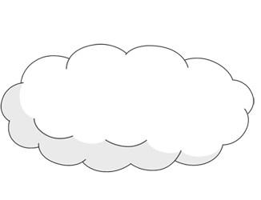


Outsourcing Computation
A new paradigm of computation.
Motivation: allow a computationally weak client to outsource its computation to the cloud.
$$x$$
$$y=f(x)$$
Notes:
Vast amount of data, huge computations – cannot afford to do these by ourselves. For example Siri

Slide 3

Outsourcing Computation
We do not want to blindly trust the cloud.
$$x$$
$$y=f(x)$$
Notes:
The cloud has no real incentive to give us the right answer (especially if there is an apriori expected answer). Furthermore, it does have an incentive to just give an arbitrary answer or even cleverly cheat.

Slide 4

Secure Outsourcing of Computation
Main security concerns:
Correctness: $y=f\left(x\right)?$
Privacy: cloud learns our secret data $x$.
Notes:
The cloud has no real incentive to give us the right answer (especially if there is an apriori expected answer). Furthermore, it does have an incentive to just give an arbitrary answer or even cleverly cheat.

Slide 5

Secure Outsourcing of Computation
Main security concerns:
Correctness: $y=f\left(x\right)?$
Privacy: cloud learns our secret data $x$.
Notes:
The cloud has no real incentive to give us the right answer (especially if there is an apriori expected answer). Furthermore, it does have an incentive to just give an arbitrary answer or even cleverly cheat.

Slide 6
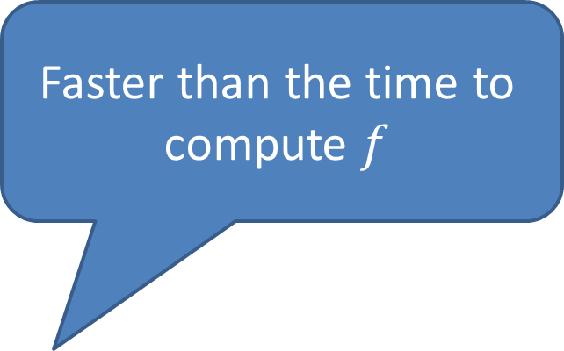
Verifiable Outsourcing of Computation
Faster than the time to compute $f$
Goal: allow the client to verify the correctness of the result.
Doubly efficiency requirement:
The client should be super efficient.
The cloud should be relatively efficient.
Also want to minimize the interaction.
Proving should not be much harder than computing

Slide 7
(Almost) Linear-time Verification
Prior Work
 | Statistical Soundness | Computational Soundness
Interactive
Non-interactive

Slide 8
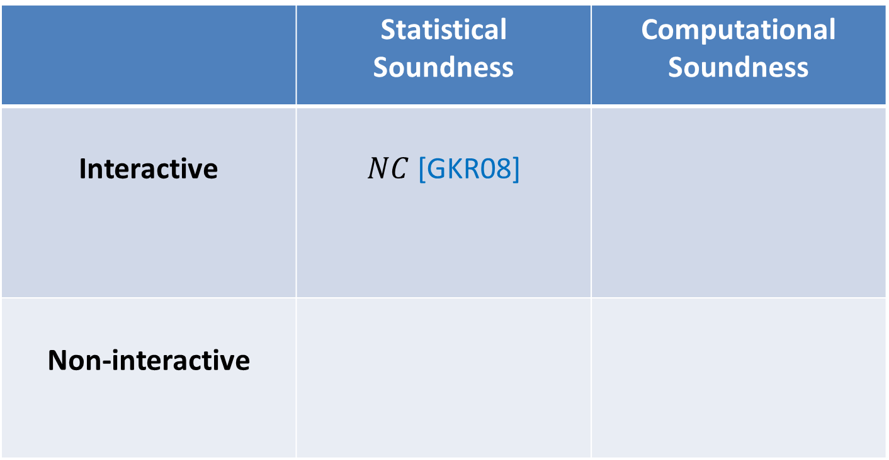
(Almost) Linear-time Verification
Prior Work
 | Statistical Soundness | Computational Soundness
Interactive | $NC$ [GKR08]
Non-interactive

Slide 9

(Almost) Linear-time Verification
Prior Work
 | Statistical Soundness | Computational Soundness
Interactive | $NC$ [GKR08]
Non-interactive | ?

Slide 10
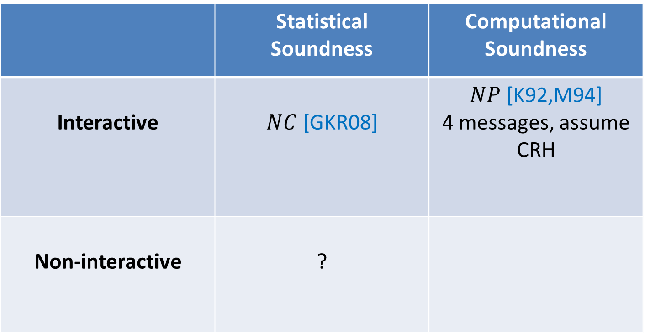
(Almost) Linear-time Verification
Prior Work
 | Statistical Soundness | Computational Soundness
Interactive | $NC$ [GKR08] | $NP$ [K92,M94] 4 messages, assume CRH
Non-interactive | ?

Slide 11
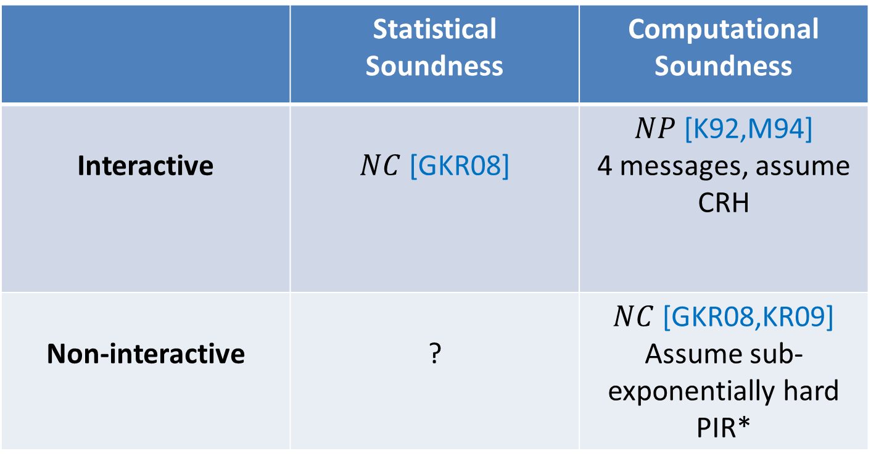
(Almost) Linear-time Verification
Prior Work
 | Statistical Soundness | Computational Soundness
Interactive | $NC$ [GKR08] | $NP$ [K92,M94] 4 messages, assume CRH
Non-interactive | ? | $NC$ [GKR08,KR09] Assume sub-exponentially hard PIR*
  * Lots of additional works in other models [M94,GGP10,CKV10, AIK10] or under strong assumptions [G10,GW11,GLR11,L12,BCCT12a,DFH12,BCCT12b,GGPR12,BGT14,PR14,…]

Slide 12
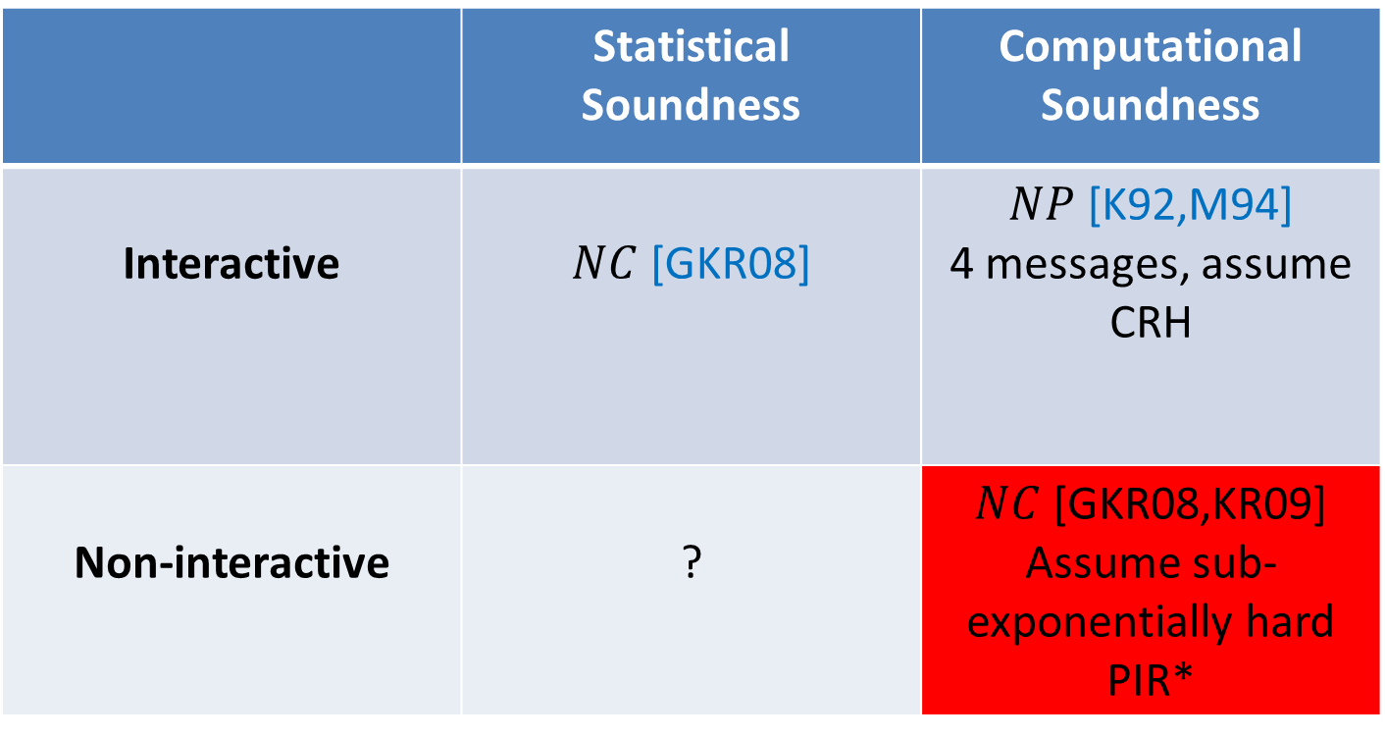
(Almost) Linear-time Verification
Prior Work
 | Statistical Soundness | Computational Soundness
Interactive | $NC$ [GKR08] | $NP$ [K92,M94] 4 messages, assume CRH
Non-interactive | ? | $NC$ [GKR08,KR09] Assume sub-exponentially hard PIR*
  * Lots of additional works in other models [M94,GGP10,CKV10, AIK10] or under strong assumptions [G10,GW11,GLR11,L12,BCCT12a,DFH12,BCCT12b,GGPR12,BGT14,PR14,…]

Slide 13
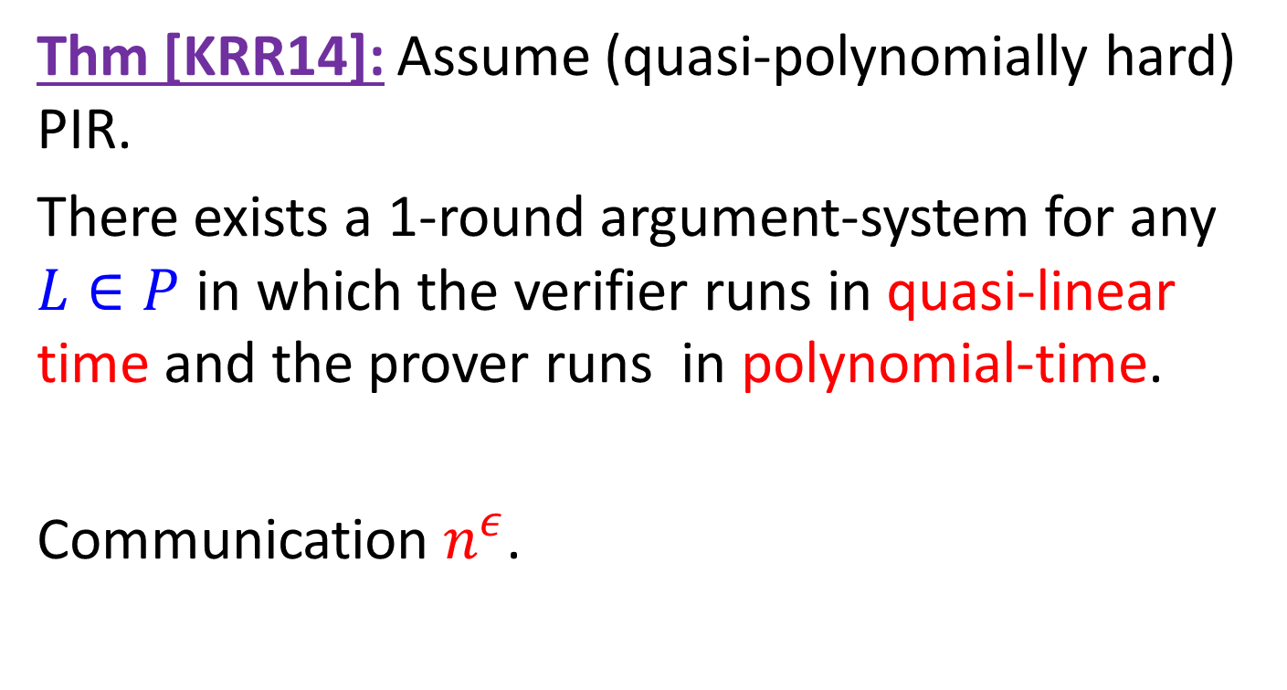
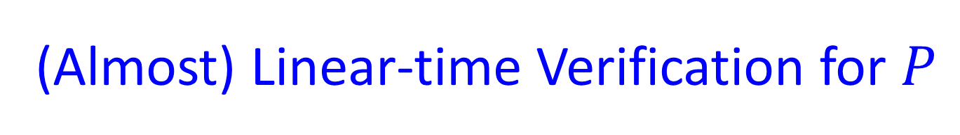
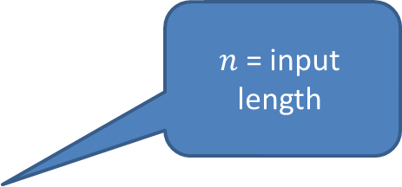
(Almost) Linear-time Verification for $P$
Thm [KRR14]: Assume (quasi-polynomially hard) PIR.
There exists a 1-round argument-system for any $L∈P$ in which the verifier runs in quasi-linear time and the prover runs in polynomial-time.
Communication $n^{ε}$.
$n$ = input length

Slide 14
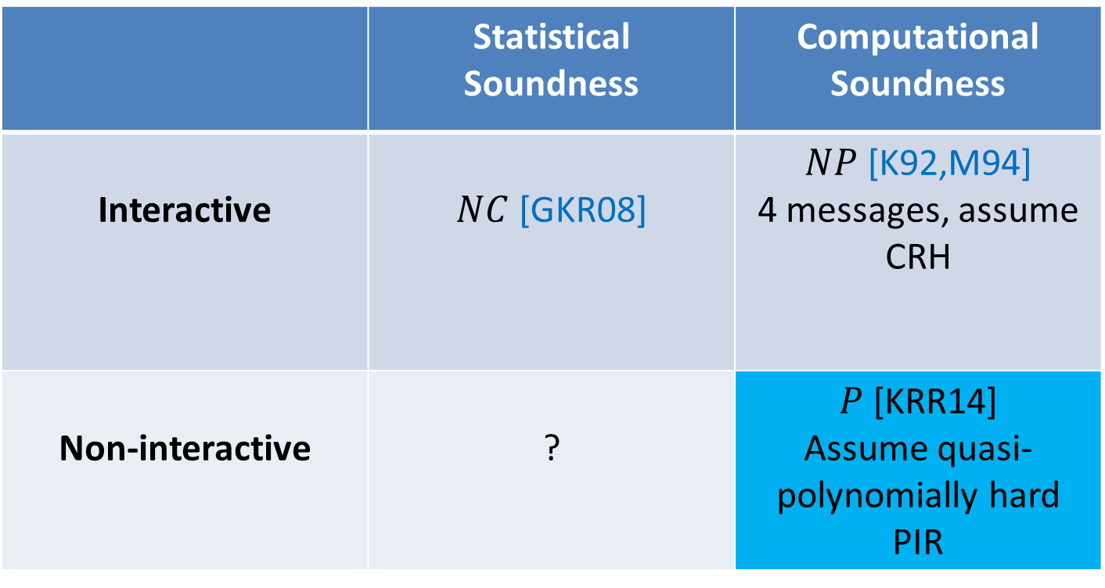
(Almost) Linear-time Verification
Prior Work
 | Statistical Soundness | Computational Soundness
Interactive | $NC$ [GKR08] | $NP$ [K92,M94] 4 messages, assume CRH
Non-interactive | ? | $P$ [KRR14] Assume quasi-polynomially hard PIR
  * Lots of additional works in other models [M94,GGP10,CKV10, AIK10] or under strong assumptions [G10,GW11,GLR11,L12,BCCT12a,DFH12,BCCT12b,GGPR12,BGT14,PR14,…]

Slide 15
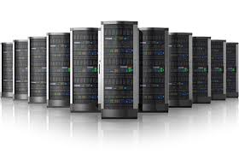

Sublinear-time Verification [EKR04,RVW13]
Motivation: statistical analysis of vast amounts of data.
Huge Database
Huge Database

Slide 16

Sublinear-time Verification [EKR04,RVW13]
Can we verify without even reading the input?
Yes! If we allow for an approximate answer.
Following property testing, only required to reject inputs that are far from the language.
YES instance
$$L$$
NO instance

Slide 17
Sublinear-time Verification
[EKR04,RVW13]
Can we verify without even reading the input?
Yes! If we allow for an approximate answer.
Following property testing, only required to reject inputs that are far from the language.
Proof of Proximity: New type of proof-system, verifier is convinced that input is close to an accepting input.

Slide 18
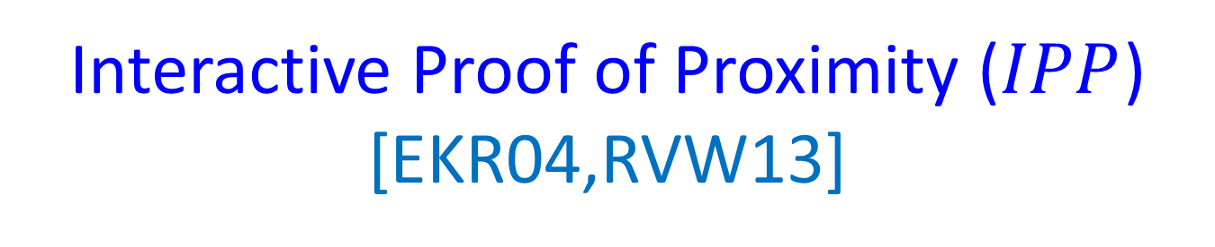
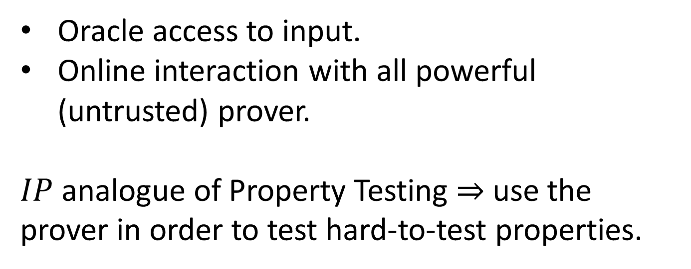
Interactive Proof of Proximity ($IPP$) [EKR04,RVW13]
Oracle access to input.
Online interaction with all powerful (untrusted) prover.
$IP$ analogue of Property Testing $⇒$ use the prover in order to test hard-to-test properties.

Slide 19
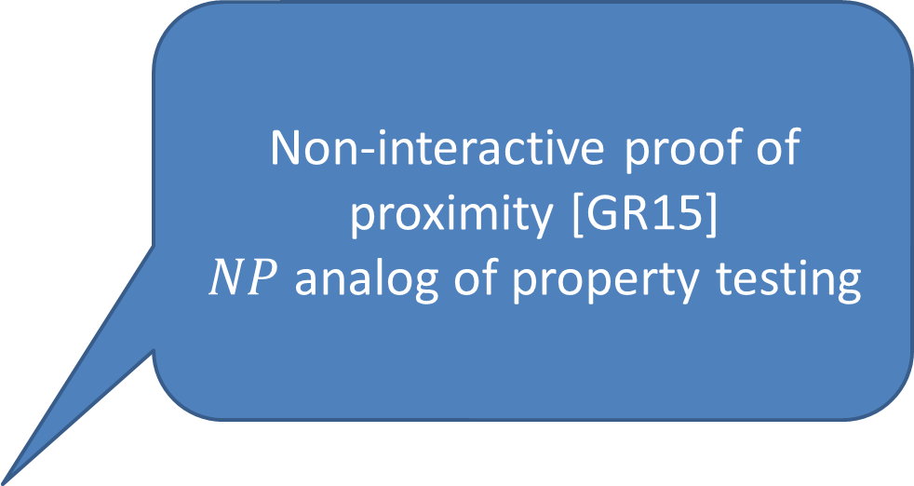

Example [FGL14]
Double palindromes:
$L=\{uu^{R}ww^{R}:u,w∈Σ^{∗}\}$.
[AKNS00]: requires $Ω(\sqrt{n})$ queries for a property tester (intuition: hard to find index that separates $uu^{R}$ from $ww^{R}$).
$IPP:$ provers sends the index. Constant number of queries suffice to check equality.
Non-interactive proof of proximity [GR15]
$NP$ analog of property testing

Slide 20
Sublinear-time Verification –
State of the Art
 | Statistical Soundness | Computational Soundness
Non-interactive
Interactive

Slide 21
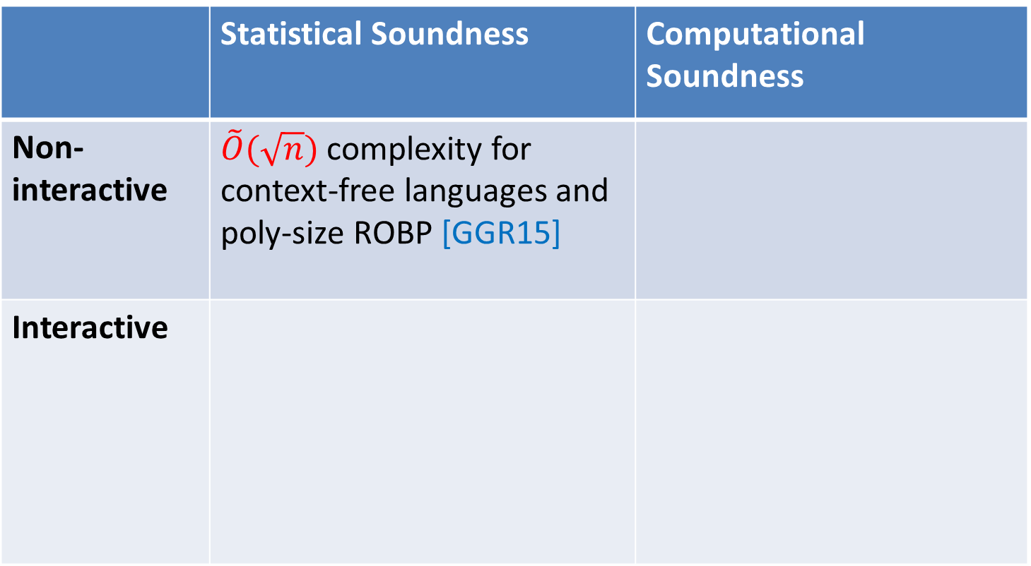
Sublinear-time Verification –
State of the Art
 | Statistical Soundness | Computational Soundness
Non-interactive | $\tilde{O}(\sqrt{n})$ complexity for context-free languages and poly-size ROBP [GGR15]
Interactive

Slide 22
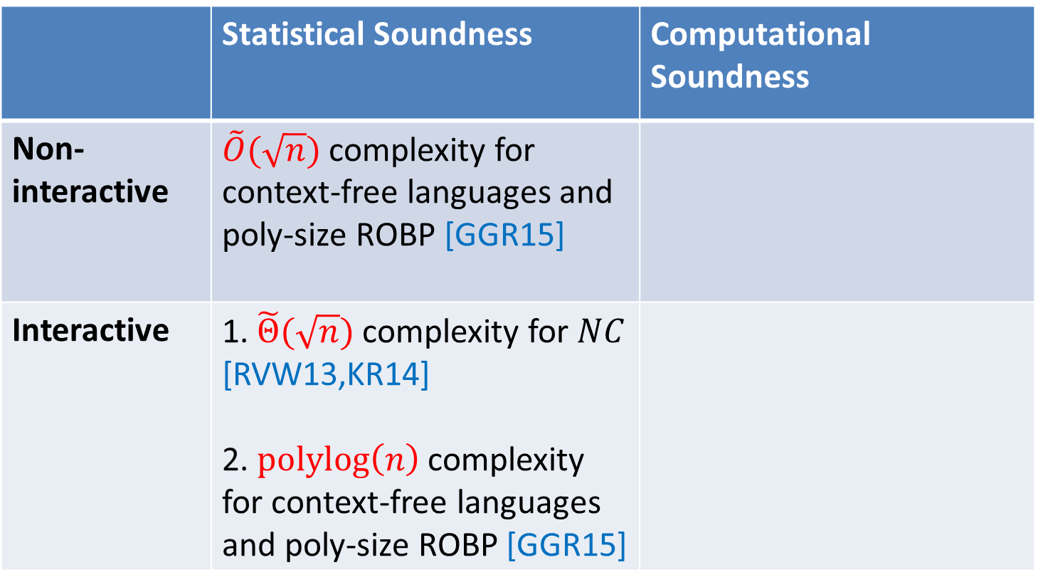
Sublinear-time Verification –
State of the Art
 | Statistical Soundness | Computational Soundness
Non-interactive | $\tilde{O}(\sqrt{n})$ complexity for context-free languages and poly-size ROBP [GGR15]
Interactive | 1. $\tilde{Θ}(\sqrt{n})$ complexity for $NC$ [RVW13,KR14] 2. $polylog\left(n\right)$ complexity for context-free languages and poly-size ROBP [GGR15]

Slide 23
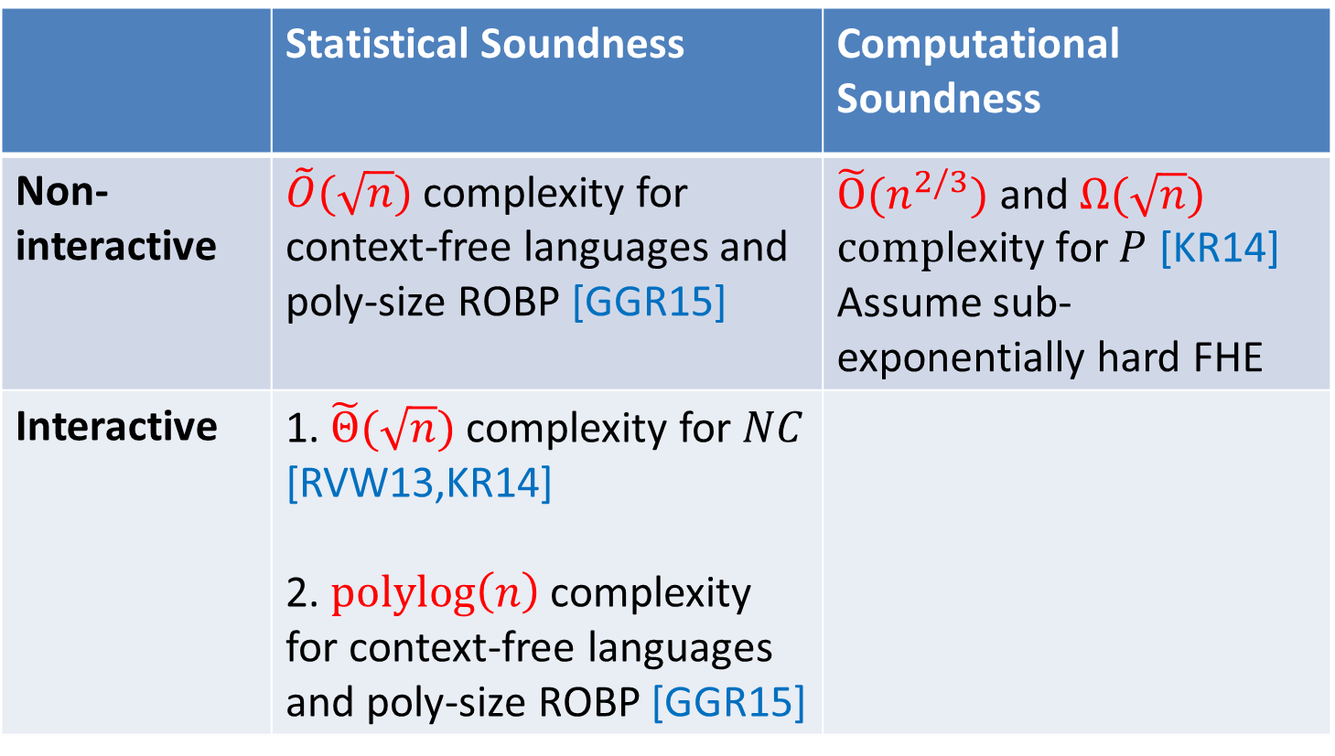
Sublinear-time Verification –
State of the Art
 | Statistical Soundness | Computational Soundness
Non-interactive | $\tilde{O}(\sqrt{n})$ complexity for context-free languages and poly-size ROBP [GGR15] | $\tilde{O}(n^{2/3}) \text{and} Ω(\sqrt{n}\text{) }\text{comp}\text{lexity} \text{for} P$ [KR14] Assume sub-exponentially hard FHE
Interactive | 1. $\tilde{Θ}(\sqrt{n})$ complexity for $NC$ [RVW13,KR14] 2. $polylog\left(n\right)$ complexity for context-free languages and poly-size ROBP [GGR15]

Slide 24
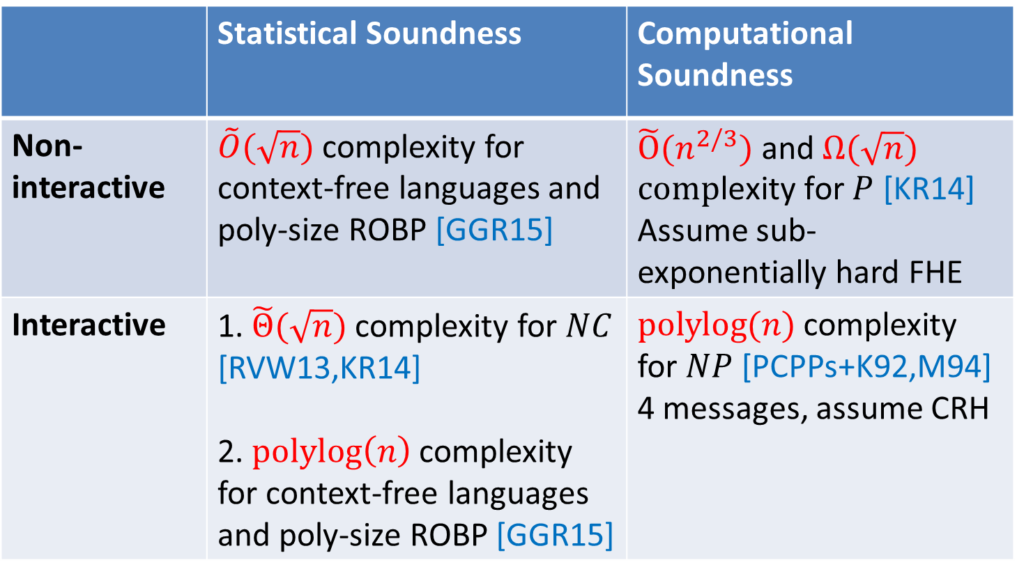
Sublinear-time Verification –
State of the Art
 | Statistical Soundness | Computational Soundness
Non-interactive | $\tilde{O}(\sqrt{n})$ complexity for context-free languages and poly-size ROBP [GGR15] | $\tilde{O}(n^{2/3}) \text{and} Ω(\sqrt{n}\text{) }\text{comp}\text{lexity} \text{for} P$ [KR14] Assume sub-exponentially hard FHE
Interactive | 1. $\tilde{Θ}(\sqrt{n})$ complexity for $NC$ [RVW13,KR14] 2. $polylog\left(n\right)$ complexity for context-free languages and poly-size ROBP [GGR15] | $polylog(n)$ complexity for $NP$ [PCPPs+K92,M94] 4 messages, assume CRH

Slide 25
Additional Interests
Cryptography:
  homomorphic encryption [R11].
  trapdoor permutations [GR13].
  MPC [CDIKMRR13].
  circular security [R13].
Psuedorandomness:
  explicit constructions [CDIKMRR13].
  connections to data structures [MRRR14,RRU14].

Slide 26
Thanks!

