Slide 1




OpenDP: A Pitch for a
Community Effort
Simons Workshop on Data Privacy:
From Foundations to Applications
March 8, 2019
Salil Vadhan
Harvard University
with support from:
Any opinions, findings, and conclusions or recommendations expressed in this material are those of the authors and do not necessarily reflect the views of our funders.

Slide 2
The Proposal
A community effort to build a trustworthy and open-source
suite of differential privacy tools that can be easily adopted by custodians of sensitive data to make it available for research.
Why?
High demand, compelling use cases.
Magnify impact of academic research on DP.

Slide 3
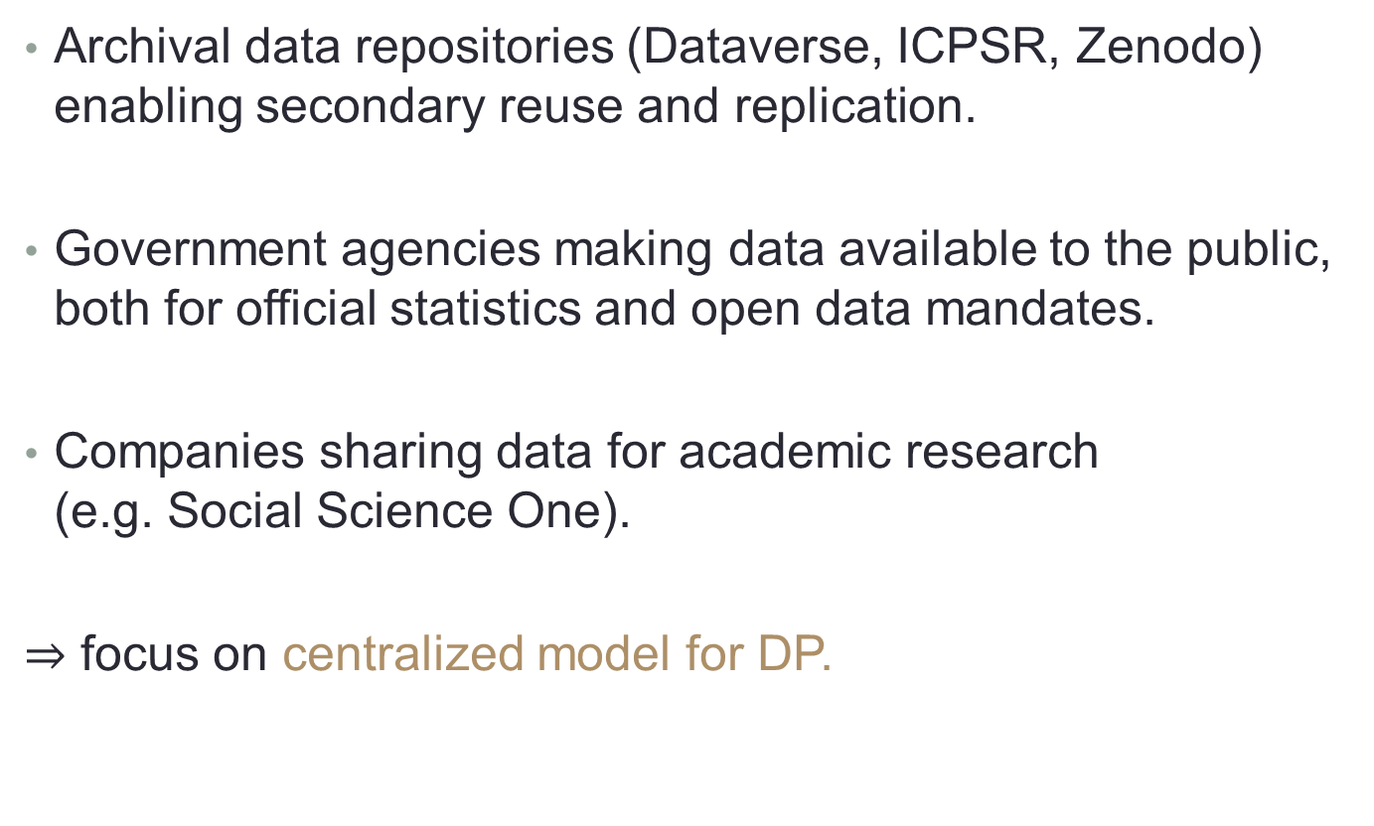
Motivating Use Cases
Archival data repositories (Dataverse, ICPSR, Zenodo) enabling secondary reuse and replication.
Government agencies making data available to the public, both for official statistics and open data mandates.
Companies sharing data for academic research
(e.g. Social Science One).
$⇒$ focus on centralized model for DP.

Slide 4
Current State of DP Tools
Heavily engineered systems for specific applications
(e.g. 2020 Decennial Census).
Aacademic research prototypes that don’t integrate with each other, have not been externally vetted, and/or are not easily adopted.
Closed commercial products (e.g. Leapyear).

Slide 5
Principles
Open Source
  worldwide open-source community
  processes and incentives for contribution.
Security & Privacy
  careful vetting of any security-critical or privacy-critical code
  can ship code to the sensitive data
Scalability
  handle petabyte-scale data
Extensibility
  can grow from the continuing research developments in the field

Slide 6
Components
Library of vetted DP algorithms
  Language(s)? R, Python, SQL, …?
  Formal vs. human verification?
Budgeting interfaces
  PSI-style GUI
  PinQ-style programming interface
Data formats
  Flat tables vs. multi-relational vs. …?
APIs
Containers (e.g. Docker)
Authentication & authorization (e.g. OAuth2)
Large-scale data engine (e.g. Spark/SparkR)

Slide 7
Using the Tools
Full System
  Web service
  Easily deployed & configured with no DP expertise
  Generates DP code to run on remote dataset in secure storage
  Tracks budgets
  Allows for analyst queries
Just the library
  For data custodians that understand DP
  Take advantage of vetted implementations of state-of-art algorithms
And other subsets…

Slide 8
Assembling a Team
Principal DP Scientist(s)
DP Researchers (e.g. postdocs, faculty sabbaticals)
Chief Technology Officer
Project Manager
Security Committee
Software Engineers
Open-Source Coordinator
Steering Committee
Domain experts/data scientists?

Slide 9
Next Steps
Planning workshop
  With data custodians, domain scientists, reps of other open-source projects,…
Raising funds
Assembling a team
Targeting the first uses (one year out?)

Slide 10
For Discussion
What will it take to get you all engaged?
Can generic DP methods be useful enough?
Are we focusing on the right use cases?
Can it be architected to evolve with the development of the field?
What kind of team & governance is needed for success?
Is manual vetting sufficiently scalable?
Is this realistic?

