Slide 1


Cryptography for Quantum Computers
Sanjam Garg
University of California, Berkeley

Slide 2
Outline
Quantum Crypto Complete?
(Strong Computational Assumptions)
Obfuscating Quantum Programs
  Randomized Encodings
  Attribute Based Encryption
  Non-Interactive Key Exchange (3 or more parties)
MPC with low-communication
(under different assumptions)
Quantum might have an advantage

Slide 3


Obfuscation
Obfuscation aims to make of computer programs ``unintelligible’’ without affecting their functionality.
P
O(P)
Alice Bob

Slide 4

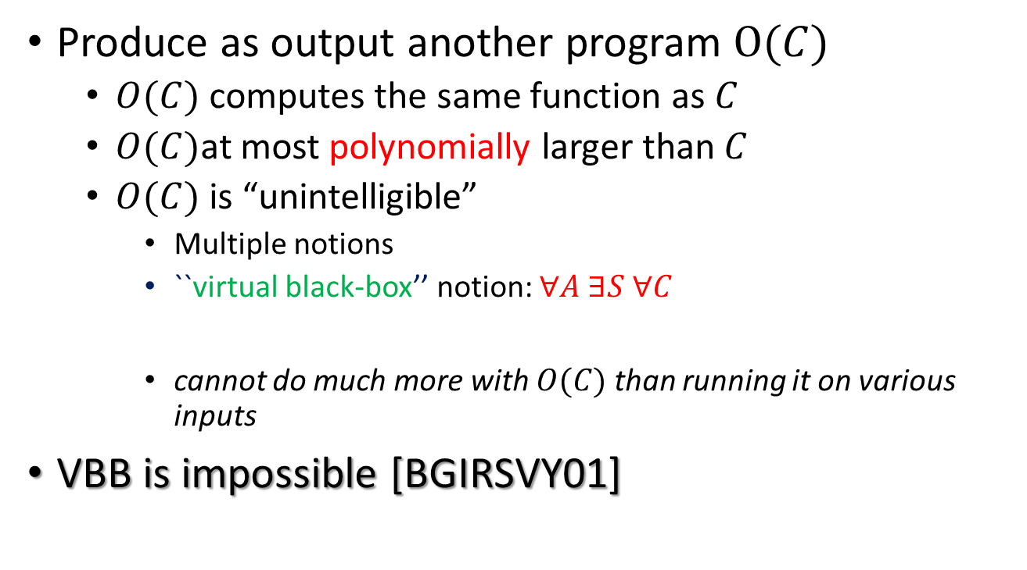
Attempt 1: Virtual-Black-Box Notion
Produce as output another program $O(C)$
  $O(C)$ computes the same function as $C$
  $O(C)$at most polynomially larger than $C$
  $O(C)$ is “unintelligible”
    Multiple notions
    ``virtual black-box’’ notion: $∀A ∃S ∀C$
    cannot do much more with $O(C)$ than running it on various inputs
VBB is impossible [BGIRSVY01]
$$A\left(O(C)\right)∼_{PPT}S^{C}(1^{\left|C\right|})$$

Slide 5
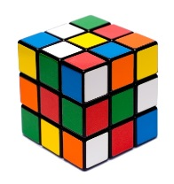
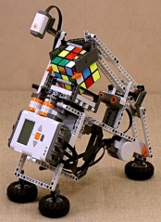
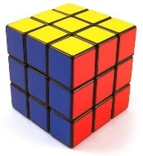
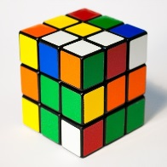
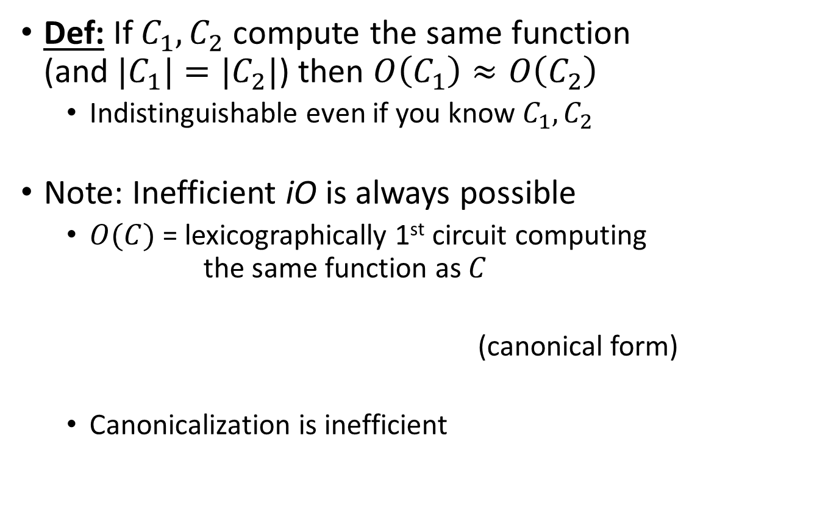
Attempt 2: Indistinguishability Obfuscation (IO)
Def: If $C_{1},C_{2}$ compute the same function
(and ${|C}_{1}|=|C_{2}|$) then $O\left(C_{1}\right)≈O\left(C_{2}\right)$
  Indistinguishable even if you know $C_{1},C_{2}$
Note: Inefficient iO is always possible
  $O(C)$ = lexicographically 1st circuit computing
  the same function as $C$
  (canonical form)
  Canonicalization is inefficient

Slide 6

The Power of IO
[GGHRW 13, Sahai-Waters 14, GGHR14…]
Functional encryption
Trapdoor permutations
MPC
Verifiable Delegation
Concurrent
Zero-Knowledge
IO*
Deniable encryption
PPAD-hardness?
* $NP ⊈RP$
Notes:
So if IO can replace ideal obfuscation in so many places, can we show that it implies PPAD-hardness?

Slide 7
Best Possible Obfuscation [GR07]
x
x
Indist. Obfuscation
Indist. Obfuscation
≈
Best Obfuscation
Padding
Some circuit C
Computationally Indistinguishable
Some circuit C
C(x)
C(x)

Slide 8
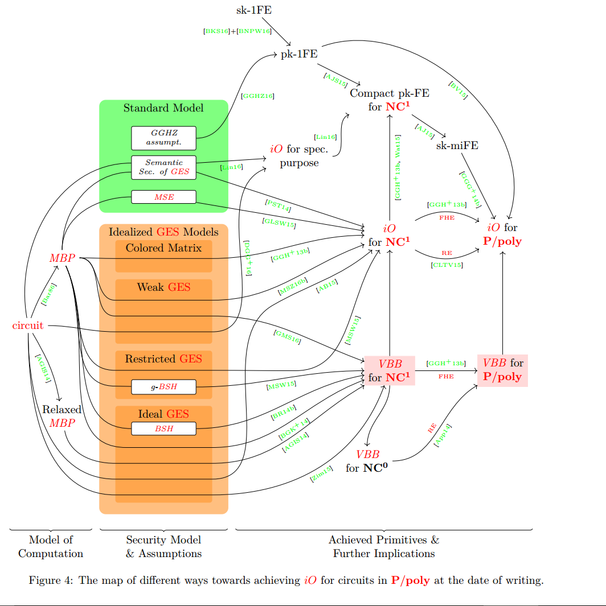

Indistinguishability Obfuscation
[BGIRSVY01]
Def: If $C_{1},C_{2}$ compute the same function
(and ${|C}_{1}|=|C_{2}|$) then $O\left(C_{1}\right)≈O\left(C_{2}\right)$
  Indistinguishable even if you know $C_{1},C_{2}$
Note: Inefficient iO is always possible
  $O(C)$ = lexicographically 1st circuit computing
  the same function as $C$
  (canonical form)
  Canonicalization is inefficient
Picture by [HB16]

Slide 9
Obfuscation: Open Questions
Question 1: Can quantum help obfuscate classical programs?
Question 2: Can we obfuscate quantum programs?
Simpler tasks?

Slide 10




Randomized Encodings [IK00,IK02,AIK04]
Question 3: Can Alice encode a quantum program classically?
Encode a “complex” computation into a “simple” one
E.g. Enc is low depth but larger parallel complexity
$$P,x$$
$$Enc(P,x)$$
$$P(x)$$
Alice Bob
Security:$Enc(P,x)≈Sim(1^{\left|P\right|},P\left(x\right))$
If $\left|Enc\left(P,x\right)\right|<|P(x)|$ then we can use $Enc$ to obtain obfuscation.

Slide 11



Attribute-Based Encryption
[SW05, GPSW06, … GVW13,…]
✗
✓
OR
MSK
✗
✓
PK
✗
AND
Board
Key Authority
✗
✓
✓
OR
PC
Crypto
Board
AND
PC
Crypto
SK
Question 4: Can an encryptor specify a quantum policy?
SK’
“PC”
“Crypto”
“PC”
“Eurocrypt”

Slide 12






Non-Interactive Key Exchange [DH76]
$$PK_{A}$$
$$PK_{B}$$
$$SK_{A}$$
$$K_{AB}$$
$$SK_{B}$$
Alice Bob

Slide 13
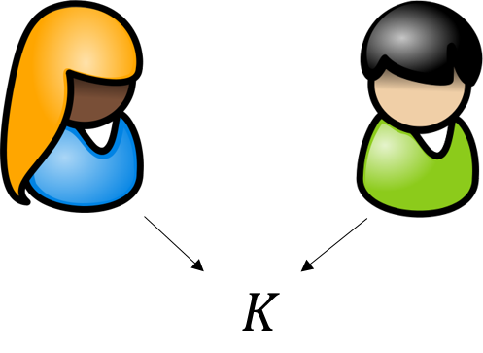
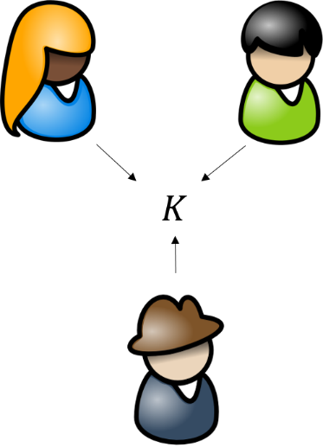
Non-Interactive Key Exchange
Two Parties [DH76]
1976
2000
Three Parties [Joux00]
No post-quantum NIKE is know for more than two parties.

Slide 14






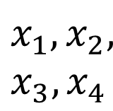

Starting Point NIKE from Obfuscation [BZ14]
Primitives
  One way function $G: s →x$
  Pseudorandom Function (PRF) F
Shared Key: $F_{K}\left(x_{1},x_{2},x_{3},x_{4}\right)$
$$s_{1}$$
$$s_{3}$$
$$x_{1}= G\left(s_{1}\right)$$
$$x_{1},x_{2},$$
$$x_{3},x_{4}$$
$$s_{2}$$
$$s_{4}$$
How?

Slide 15

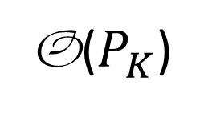
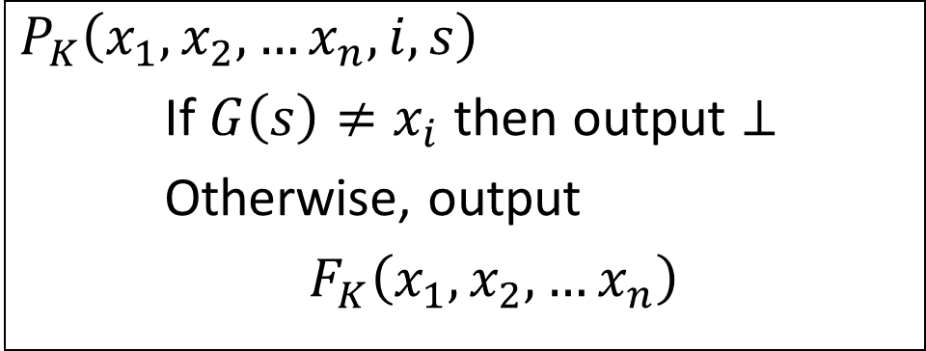


First party sends an obfuscation that does that
$$P_{K}$$
$$P_{K}\left(x_{1},x_{2},…x_{n}, i, s\right)$$
If $G\left(s\right)≠x_{i}$ then output $⊥$
Otherwise, output
$F_{K}\left(x_{1},x_{2}, …x_{n}\right)$
Skip: Security Proof (Uses Puncturable PRFs)
O($P_{K}$)
Now the parties can generate $F_{K}\left(x_{1},x_{2}, …x_{n}\right)$.

Slide 16




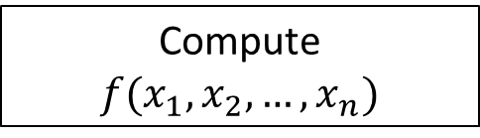




Secure Multiparty Computation
[Yao82, GMW87]
Compute $f(x_{1},x_{2},…,x_{n})$
$$x_{3}$$
$$x_{4}$$
$$x_{2}$$
$$x_{5}$$
$$x_{1}$$
$$x_{6}$$
…
$$x_{n}$$
$f$ is classical
Notes:
However, in this talk as the title suggests we are interested in the multiparty setting.
Here, there are n parties each with its own private input. They wish to compute a joint function f of their private inputs.

Slide 17
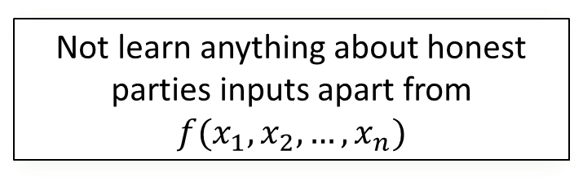
Secure Multiparty Computation
[Yao 86, GMW 87]
$$x_{3}$$
$$x_{4}$$
$$x_{2}$$
Not learn anything about honest parties inputs apart from $f(x_{1},x_{2},…,x_{n})$
$$x_{5}$$
$$x_{1}$$
$$x_{6}$$
…
$$x_{n}$$
Notes:
As before, the security notion is that even if a subset of parties get corrupted where the number of corrupted parties could be as large as n-1, they do not learn anything about the honest parties input apart from what is leaked from the function’s output.
Multiparty computation is a much more demanding setting and it is generally hard to design secure protocols that work in the multiparty case.

Slide 18
Efficiency
Have been good understanding.
Computational Complexity
Round Complexity
Communication Complexity
Several problems are open here.

Slide 19





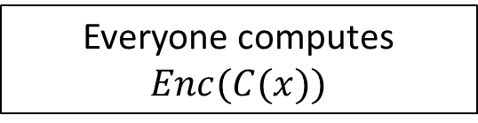



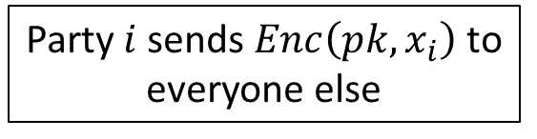


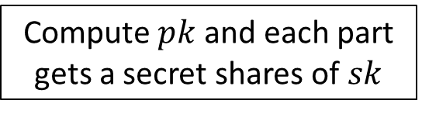




Known Results
FHE – Independent of s [Gentry09]
$$x_{3}$$
$$x_{4}$$
$$x_{2}$$
Phase 1:
Compute $pk$ and each part gets a secret shares of $sk$
$$x_{5}$$
$$x_{1}$$
$$x_{6}$$
…
$$x_{n}$$
Party $i$ sends $Enc\left(pk,x_{i}\right)$ to everyone else
Everyone computes $Enc(C(x))$
Phase 2:
$$x_{3}$$
$$x_{4}$$
$$x_{2}$$
Phase 3:
Parties decrypt Enc(C(x))
$$x_{5}$$
$$x_{1}$$
$$x_{6}$$
…
$$x_{n}$$

Slide 20
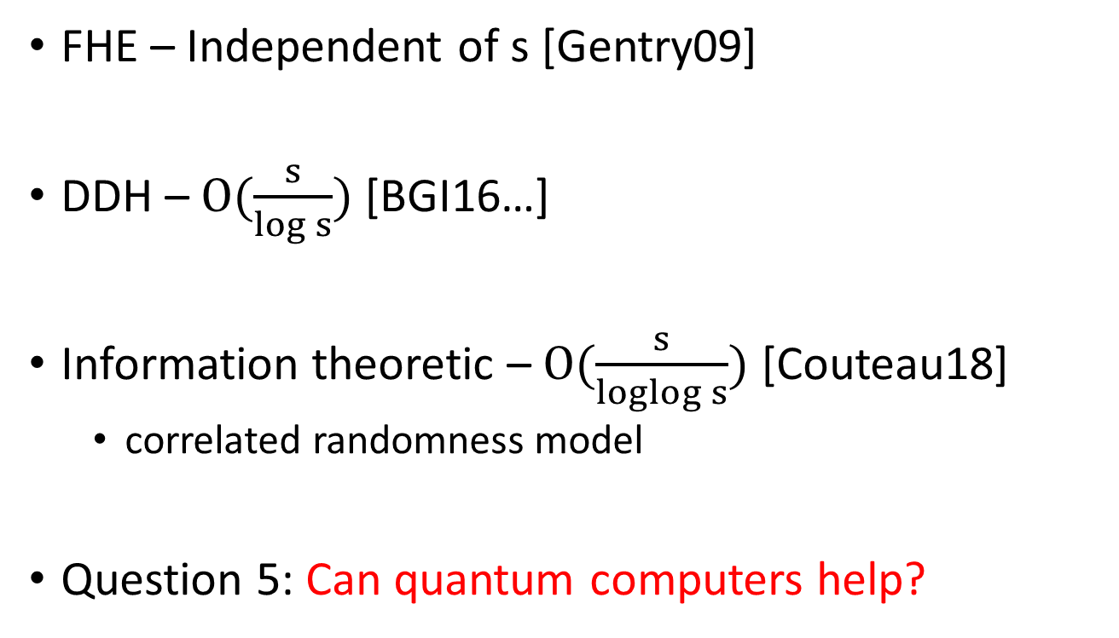
Known Results
FHE – Independent of s [Gentry09]
DDH – $O(\frac{s}{log s})$ [BGI16…]
Information theoretic – $O(\frac{s}{loglog s})$ [Couteau18]
  correlated randomness model
Question 5: Can quantum computers help?

Slide 21

Thank you!
Questions?

